Slide 1
Interactions for Seamlessly Coupled Exploration of High-Dimensional Images and Hierarchical Embeddings
Alexander Vieth¹, Boudewijn Lelieveldt^{1,2}, Elmar Eisemann¹,
Anna Vilanova³, Thomas Höllt¹
¹ Delft University of Technology
² Leiden University Medical Center
³ Eindhoven University of Technology

Slide 2
Image exploration

Slide 3
Pan

Slide 4
Zoom

Slide 5
Image exploration

Slide 6
Image exploration

Slide 7
Image exploration
Notes:
For photos: natural mapping to color, representation High-dim images: Missin relations between channels

Slide 8
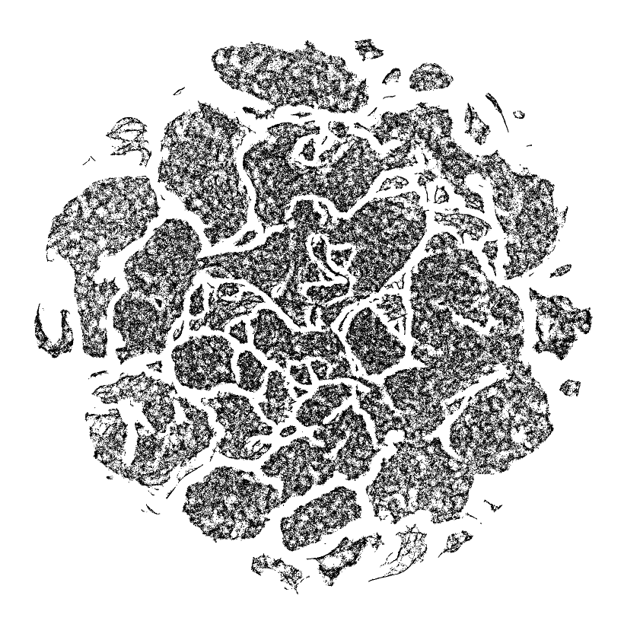
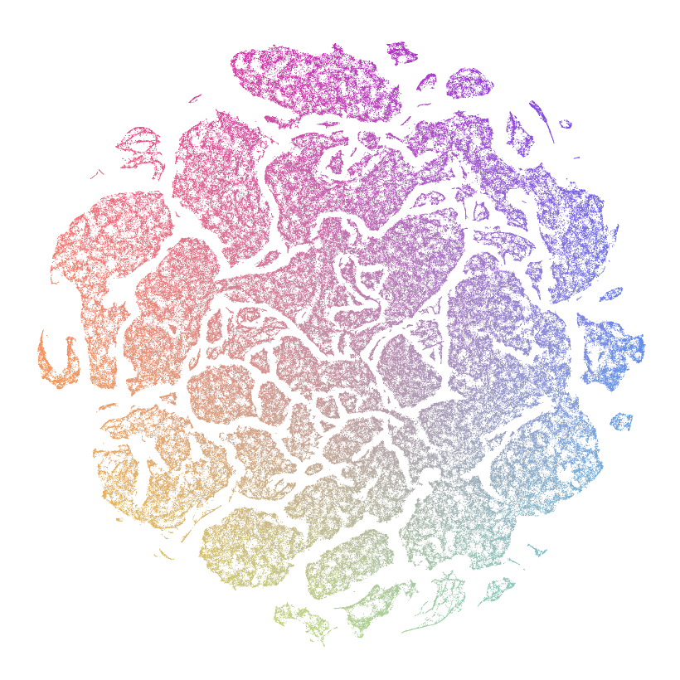
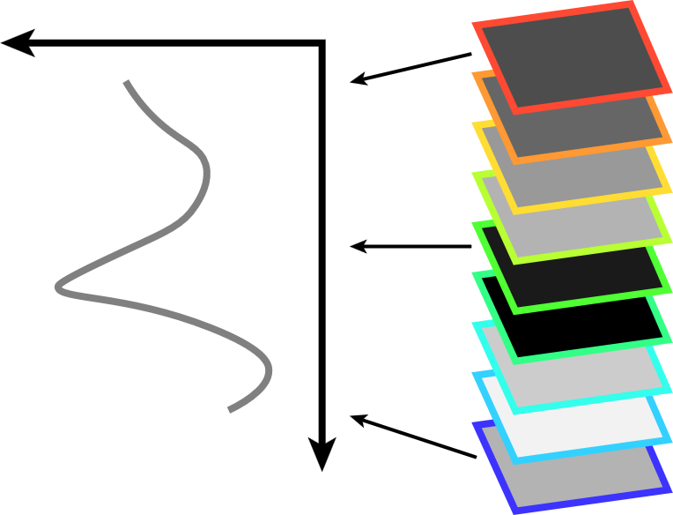
Image exploration
Attribute values
Abdelmoula (2016),
Evers & Huesmann (2021)
Pixel

Slide 9
Image exploration
Attribute values
Pixel

Slide 10
Image exploration

Slide 11
High-dimensional image exploration?
Attribute values
Pixel
Notes:
Several points: limitations of emb techniques for large data, structures not visible The recoloring/mapping only happens on a global scale
We need hierarchical embedding structure

Slide 12
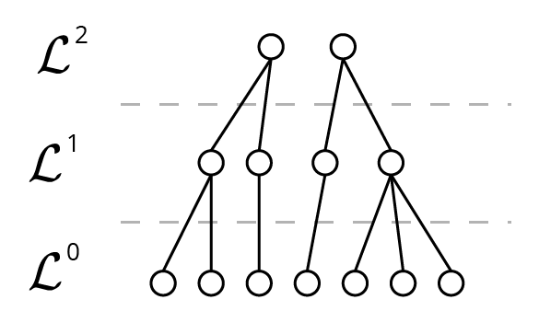
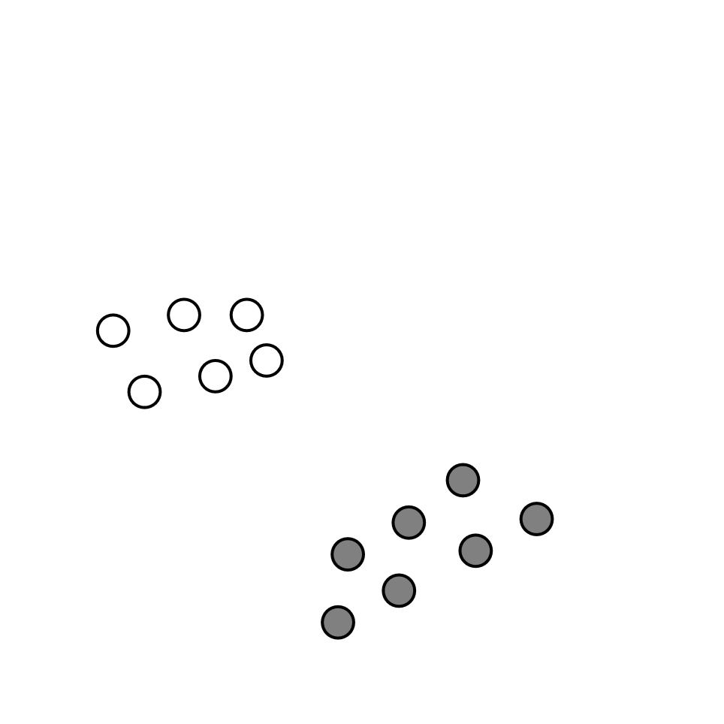
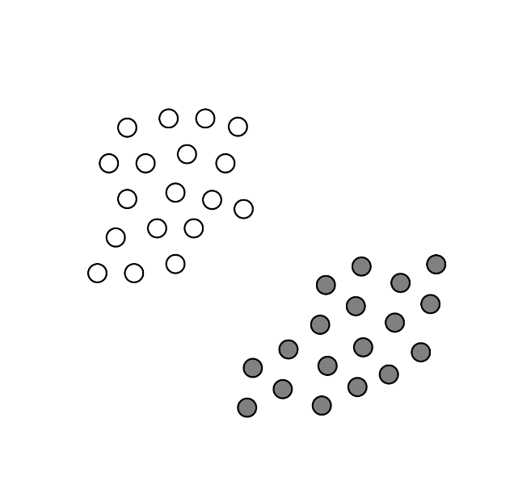
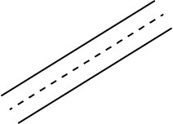
Hierarchical embeddings
Data Hierarchy
Top level
Standard embedding
Actual data points
Pezzotti (2016), Marcílio-Jr (2021)

Slide 13
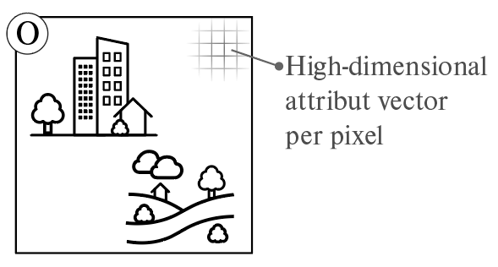
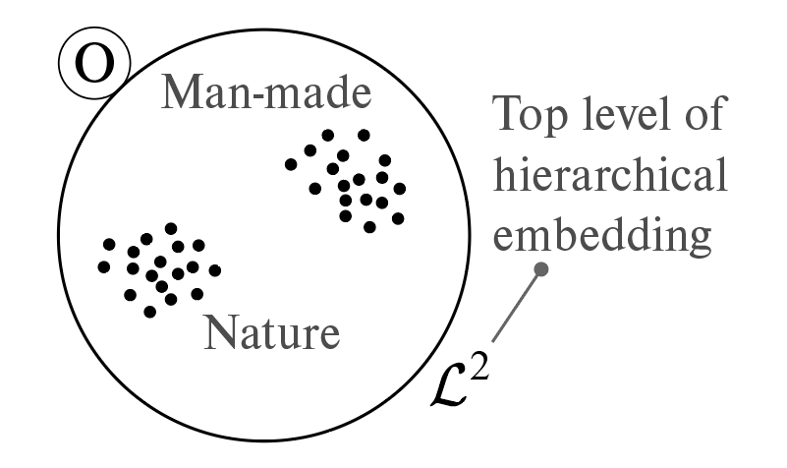
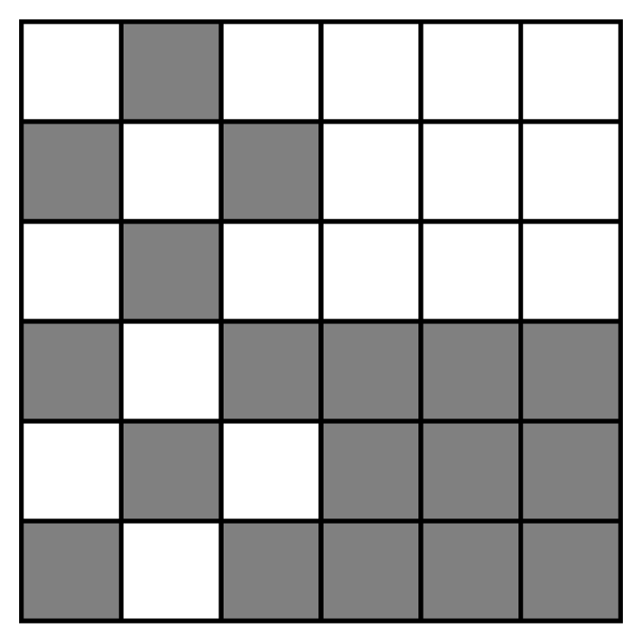
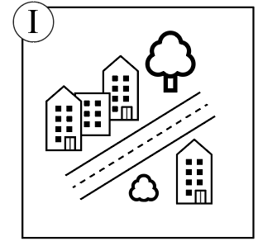
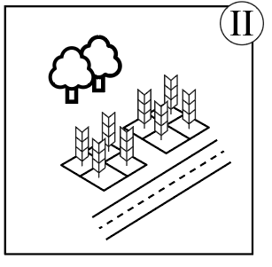
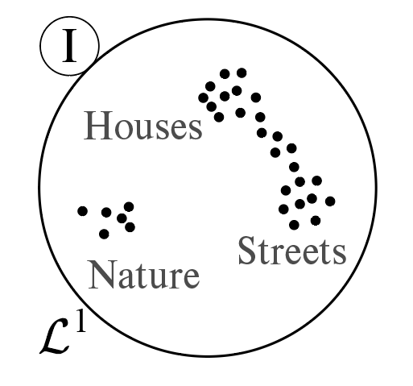
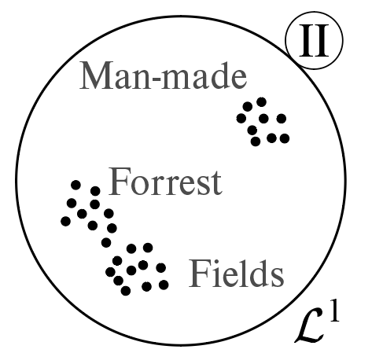
Goal: Coupled image-embedding exploration
High-dimensional
attribute vector
per pixel
Interaction with image should be reflected in embedding view
Top level of
hierarchical
embedding
I
II

Slide 14
Coupling image navigation & embedding hierarchy
Requirements
R1 Follow the “overview first, details-on-demand” approach
R2 Represent the ROI
R3 Provide stable transitions between embeddings
R4 Update at interactive exploration speeds
R5 Link selections between image and embedding space

Slide 15
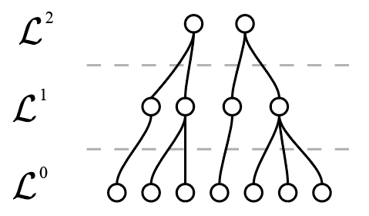
Interactions coupling
Top scale
ROI
embedding
Pixel
in ROI
Image
Data hierarchy
Embedding

Slide 16
Interactions coupling: Top-down
Image
Data hierarchy
Embedding

Slide 17
Interactions coupling: Top-down
Image
Data hierarchy
Embedding

Slide 18
Interactions coupling: Bottom-up
Image
Data hierarchy
Embedding

Slide 19
Zoom-factor coupling
Which level?
Target number
heuristic
Image
Data hierarchy
Notes:
Heuristic example: amount of points that can be embedding given a certain screen space

Slide 20
Transition stability
Image
Data hierarchy
Embedding
Notes:
Coherence, Mental map -> Requirement R3

Slide 21
Transition stability
Image
Data hierarchy
Embedding

Slide 22
Demo
Region of
interest
Coupled
embedding

Slide 23
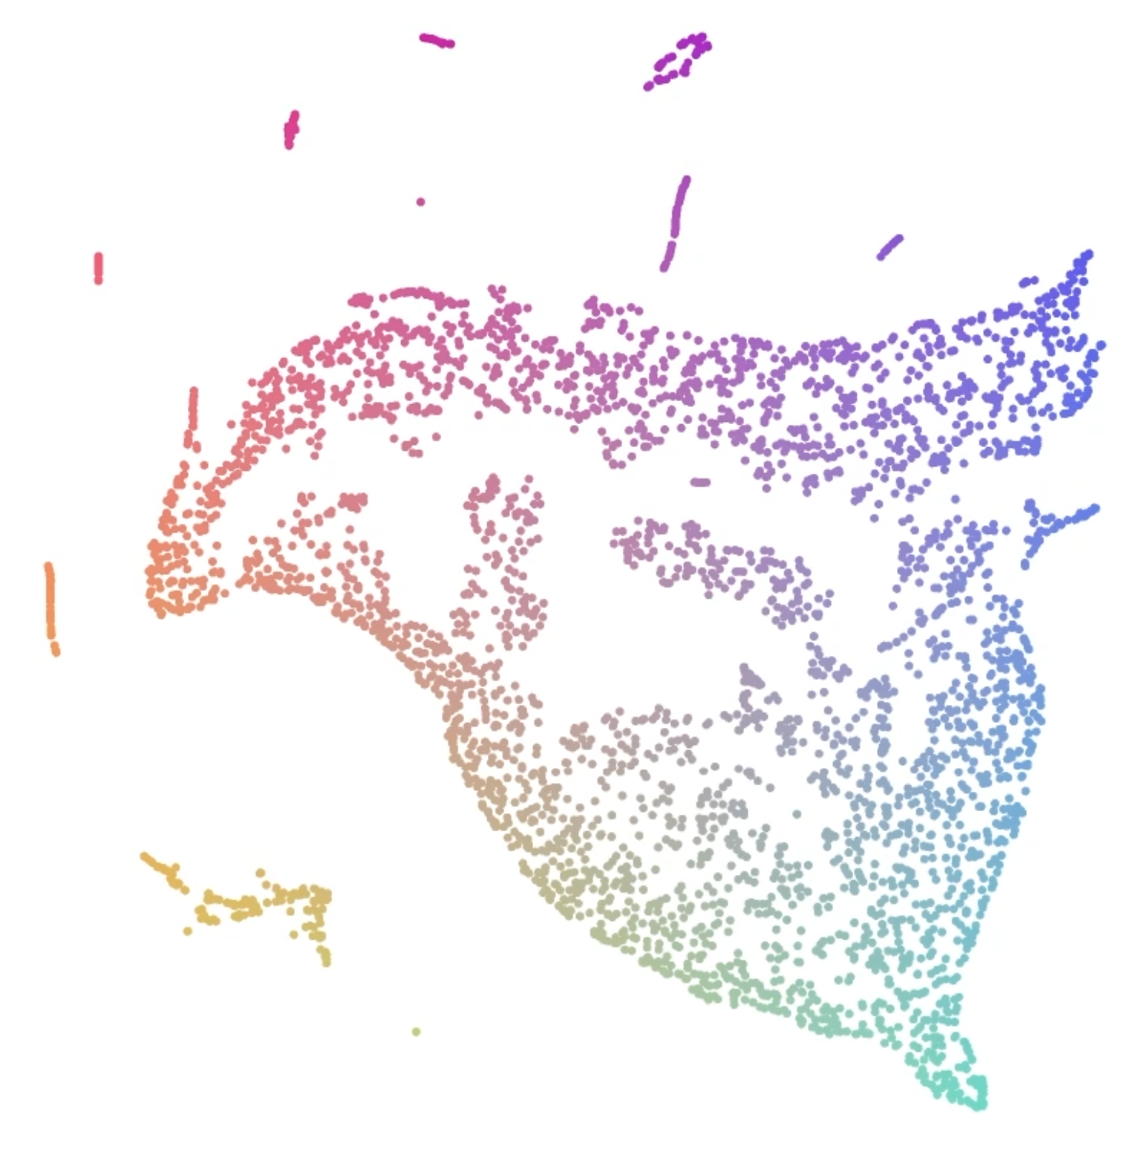
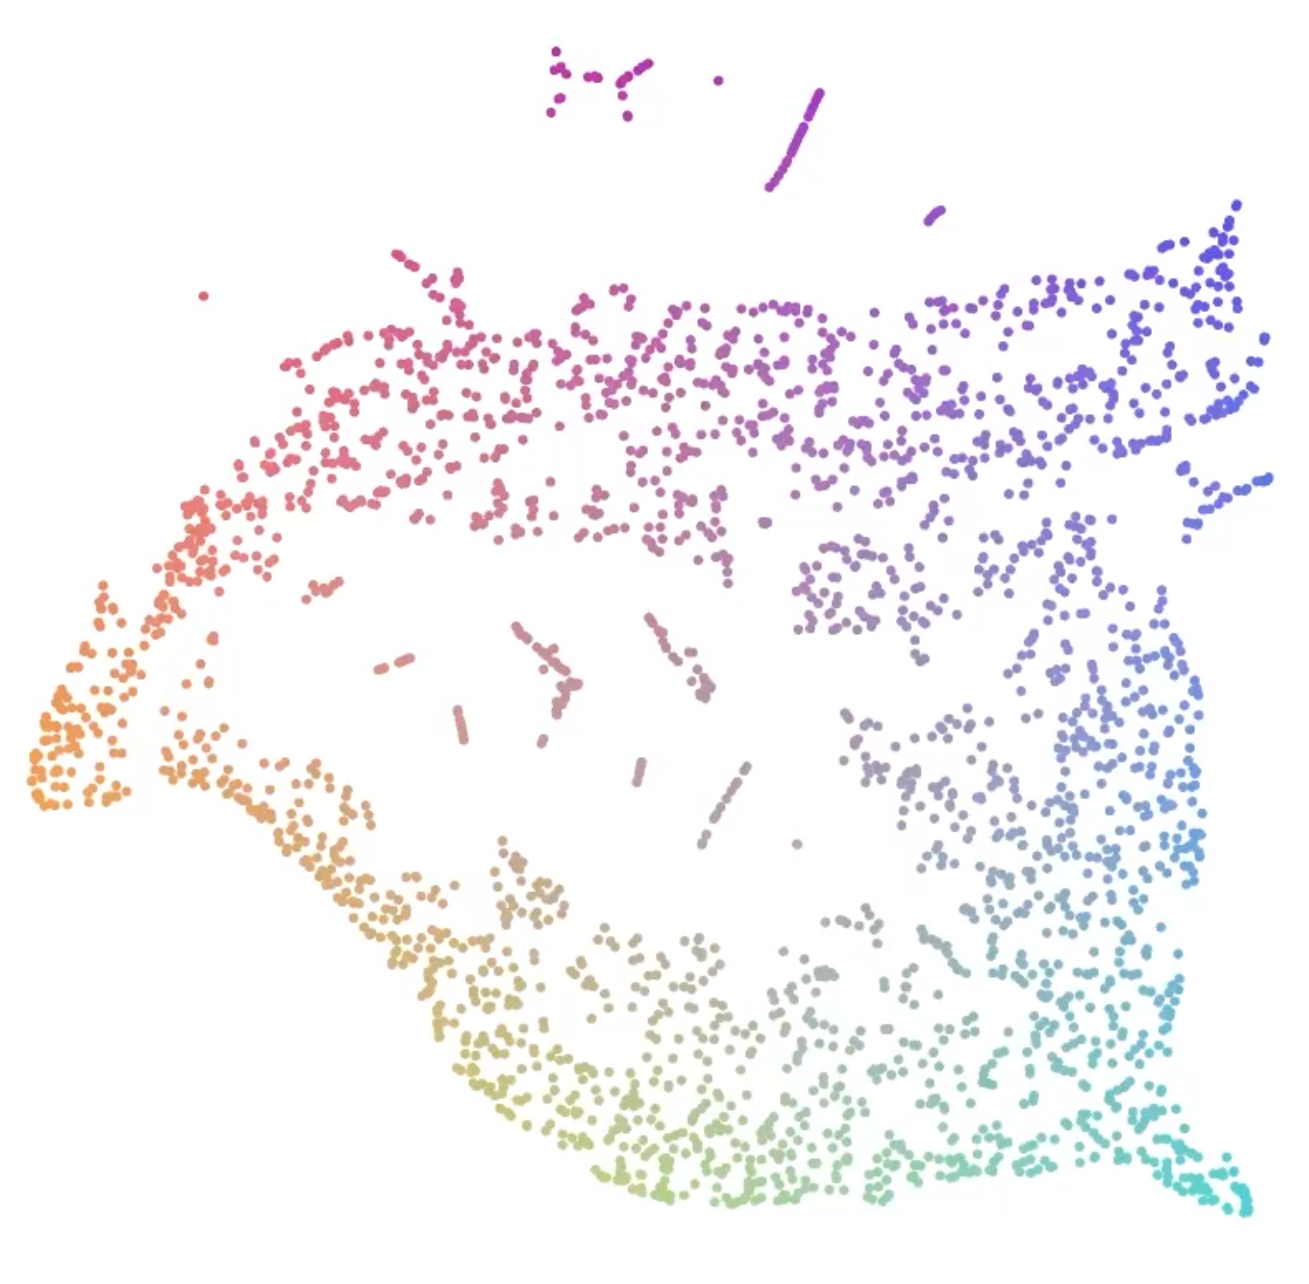
Conclusion
Some limitations:
I
Interactions for
coupled
exploration
II

Slide 24
Interactions for Seamlessly Coupled Exploration of High-Dimensional Images and Hierarchical Embeddings
ManiVaultStudio/ImageEmbeddingCoupling
Alexander Vieth, Boudewijn Lelieveldt, Elmar Eisemann, Anna Vilanova, Thomas Höllt

Slide 25
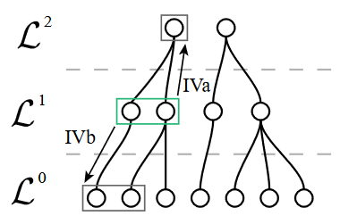
Coarsen & Refine
Interaction with image should be reflected in embedding view
Image
Embedding hierarchy
Notes:
Interaction with image should be reflected in embedding view

Slide 26
Coupling image navigation & embedding hierarchy
Tasks
T1 navigate (zoom or pan) in image space,
T2 explore the attribute space of a ROI,
T3 request more or less detail of a ROI’s attribute space.

