Slide 1
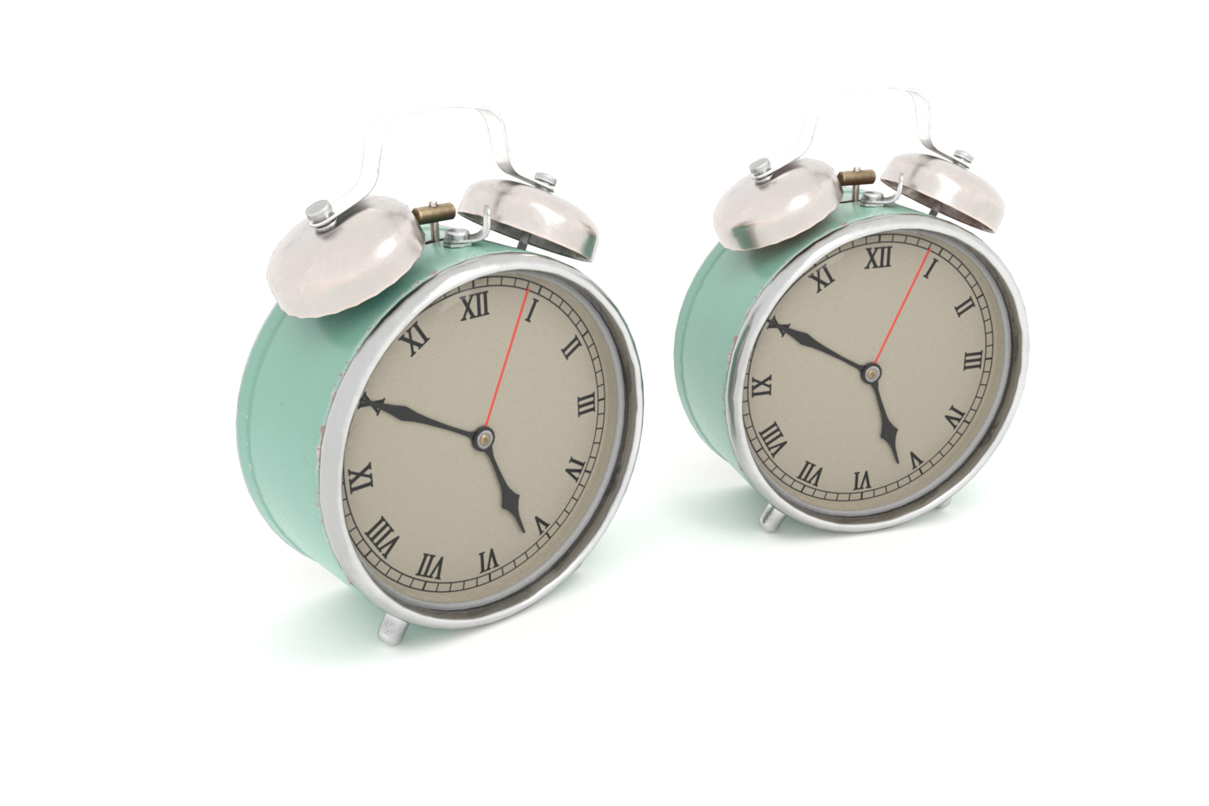

Metameric
Spectral Uplifting via
Controllable Color Constraints
Mark van de Ruit and Elmar Eisemann

Slide 2


Slide 3
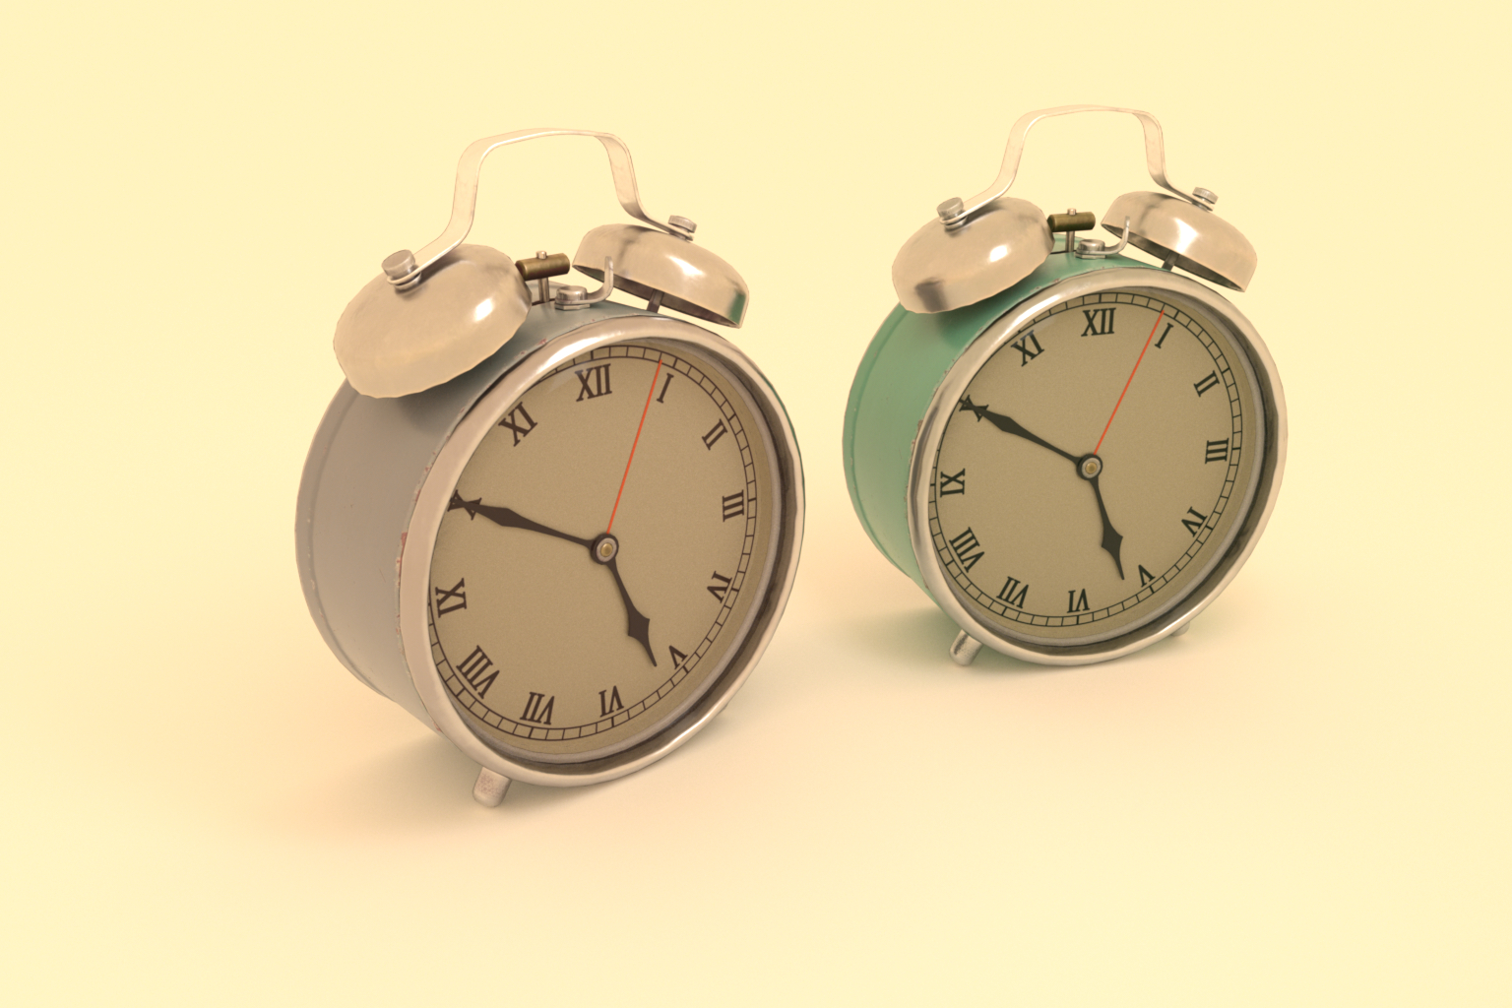


Slide 4
Metameric: Spectral Uplifting via Controllable Color Constraints

Slide 5
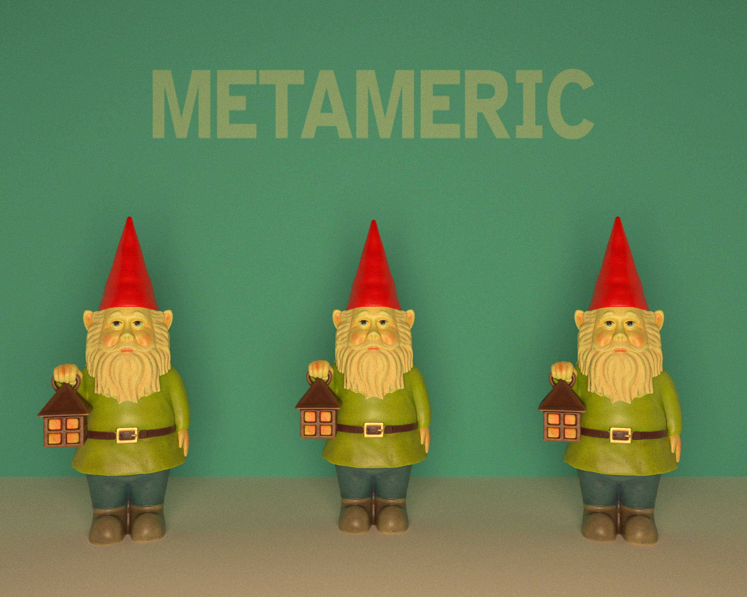
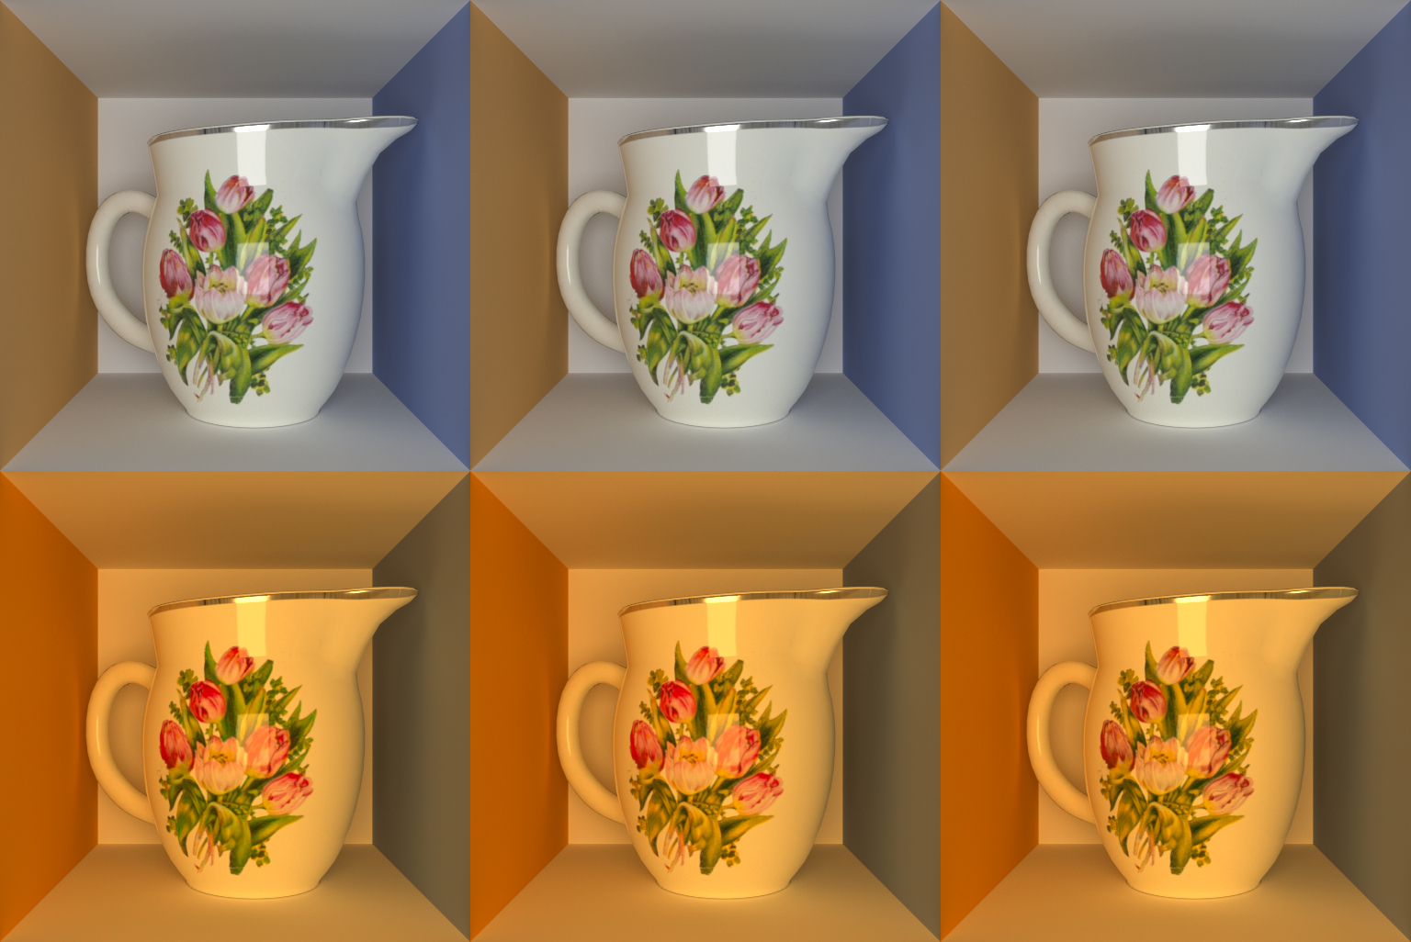
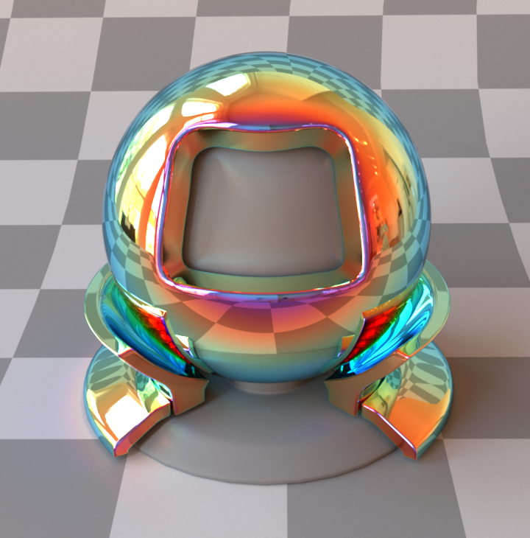
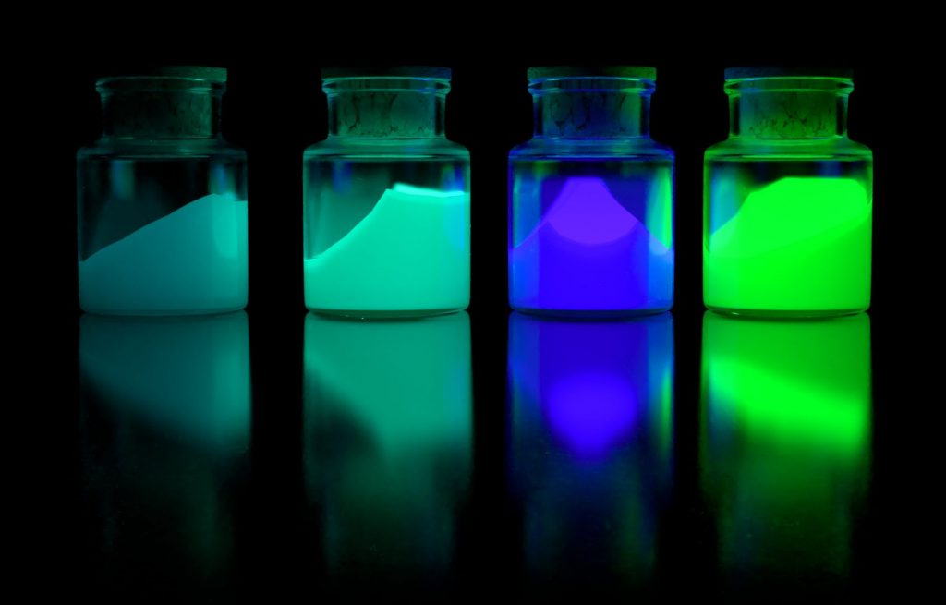


Slide 6
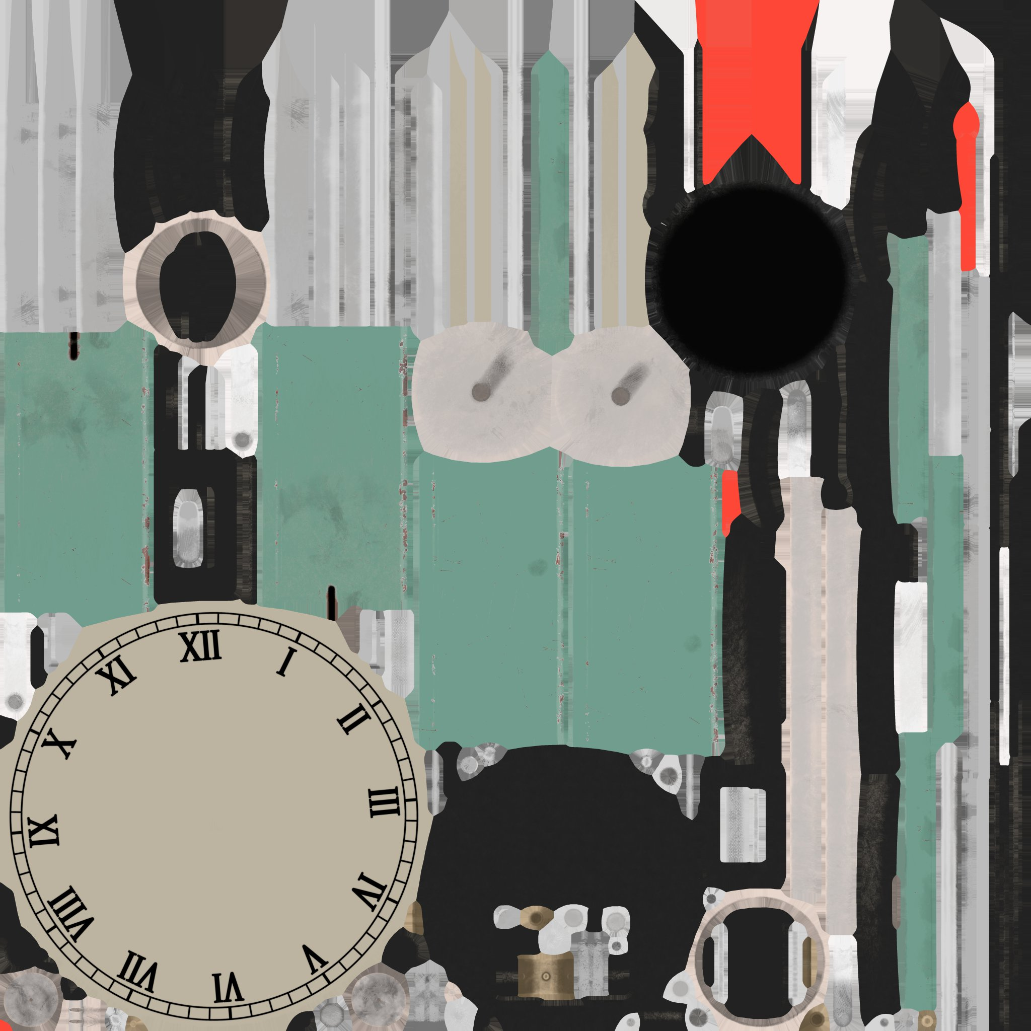



Spectral rendering
spectral texture
spectral data

Slide 7
Spectral uplifting
RGB texture
spectral data
Some kind of
mapping

Slide 8
Problem
Mappings
Materials may need consideration
under multiple lights/sensors.
Many metamers correspond
to a single color.
Most upliftings correspond
one metamer to a color.
Metamer set
(many spectra)
Color signal
(one color)
Uplift
(one spectrum)
Color signal
(one color)
8

Slide 9
Contributions
Simple uplifting with constancy control.
Compact spectral texture representation.
Toolkit enabling constrained uplifting.

Slide 10
Method
Convex hull generation
Constrained reflectance generation
Linear interpolation

Slide 11
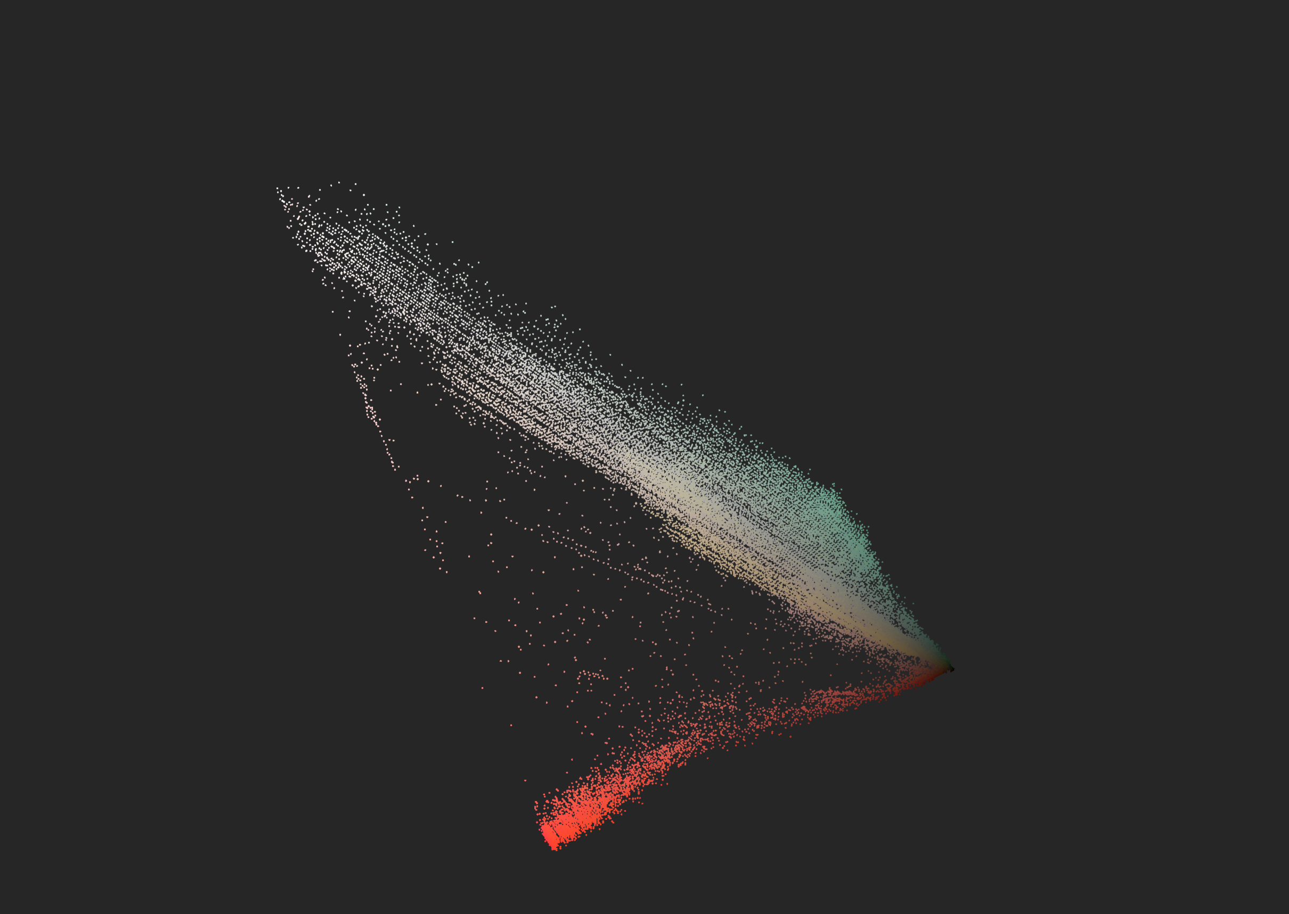
Method
RGB texture
linear color space
Convex hull generation
Constrained reflectance generation
Linear interpolation

Slide 12
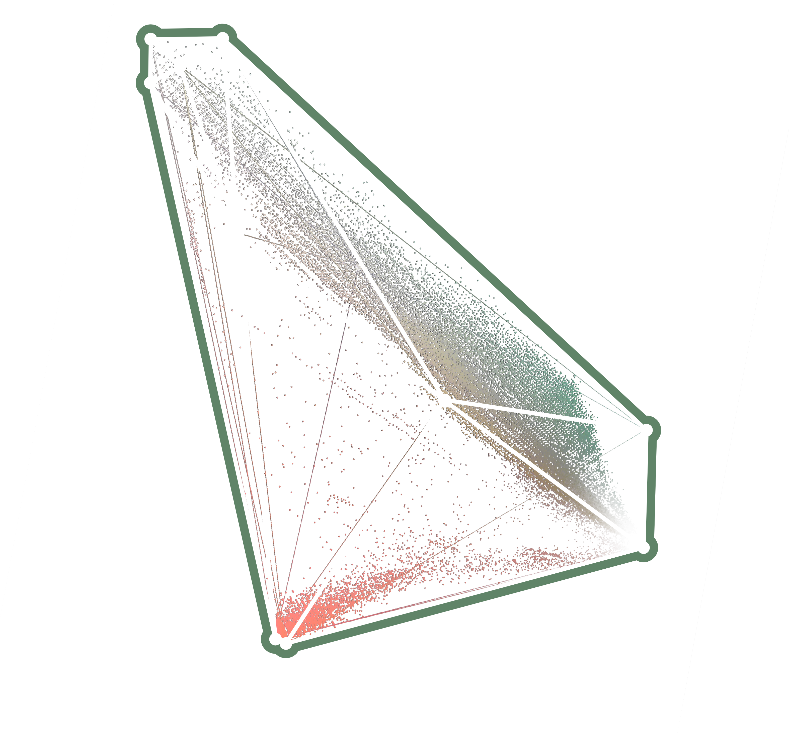
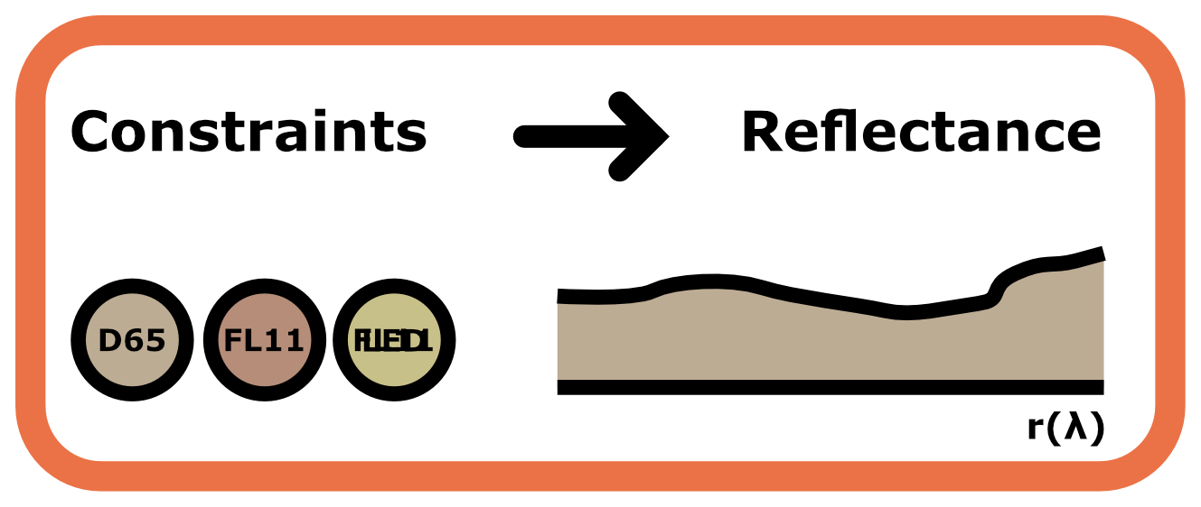
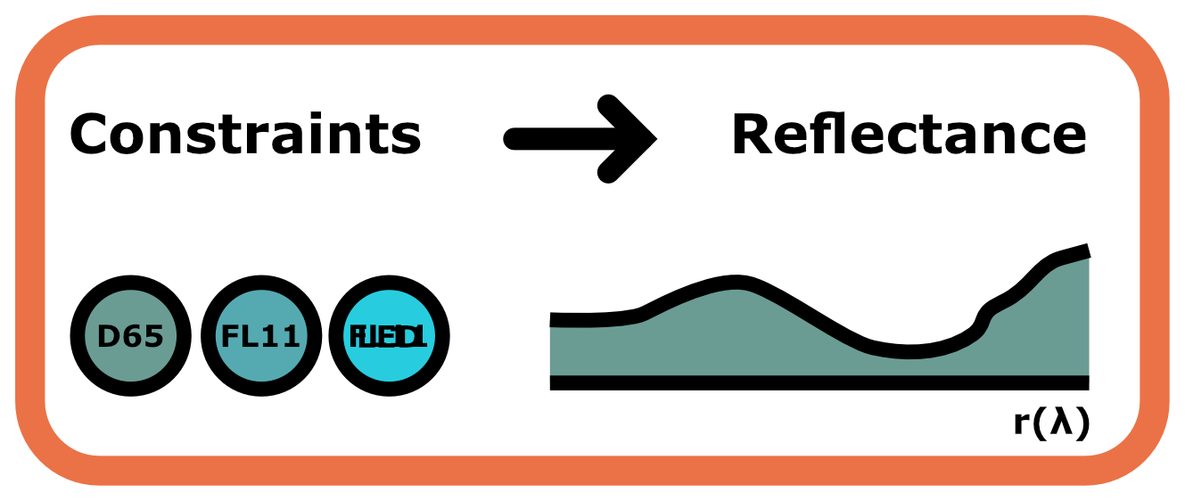
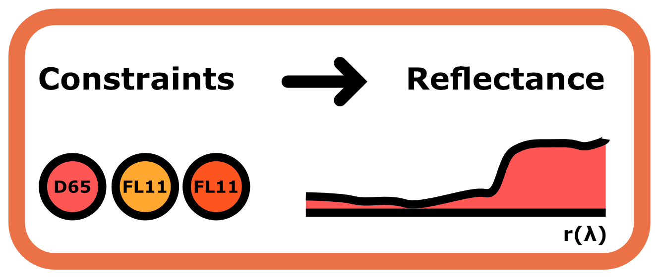
Method
linear color space
simple convex
hull
Convex hull generation
Constrained reflectance generation
Linear interpolation

Slide 13
Method
simple convex
hull
vertex
reflectances
Convex hull generation
Constrained reflectance generation
Linear interpolation

Slide 14
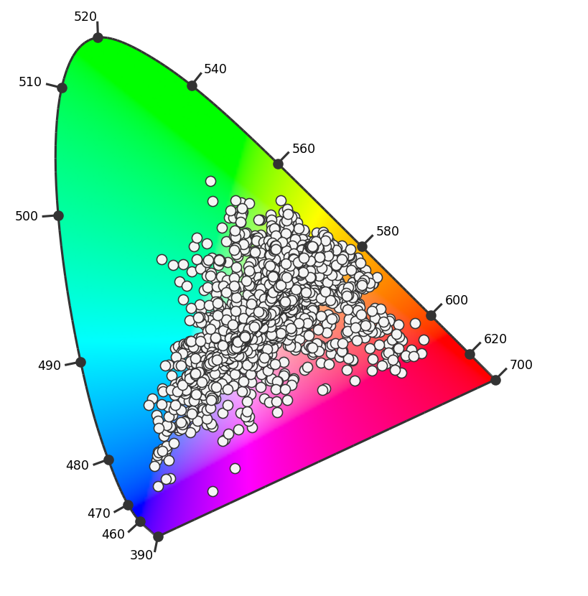
Method
Data-based generation
~41M reflectances
PCA basis (> 3)
Weighted sums
simple convex
hull
vertex
reflectances
Convex hull generation
Constrained reflectance generation
Linear interpolation
Zhang et al. 2016. Metamer Mismatching in Practive Versus Theory. Journal of the Optical Society of America.
Jozef Cohen. 1964. Dependency of the Spectral Reflectance Curves of the Munsell Color Chips. Psychonomic Science.

Slide 15
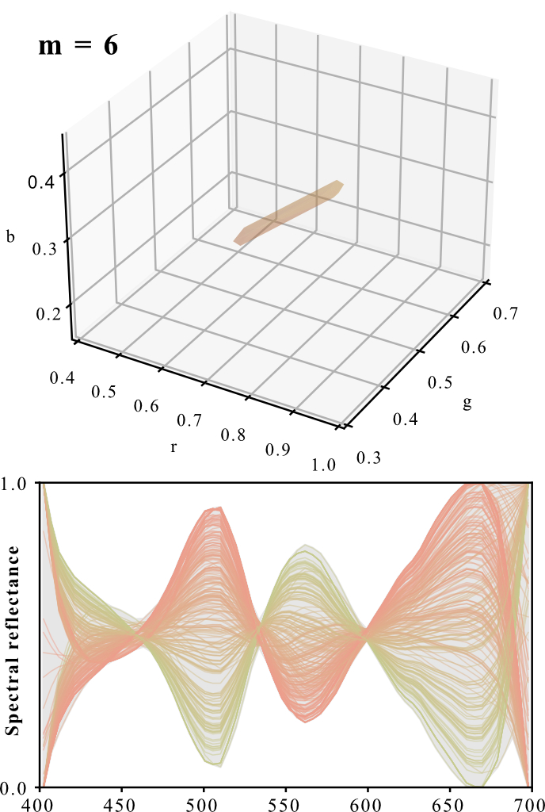
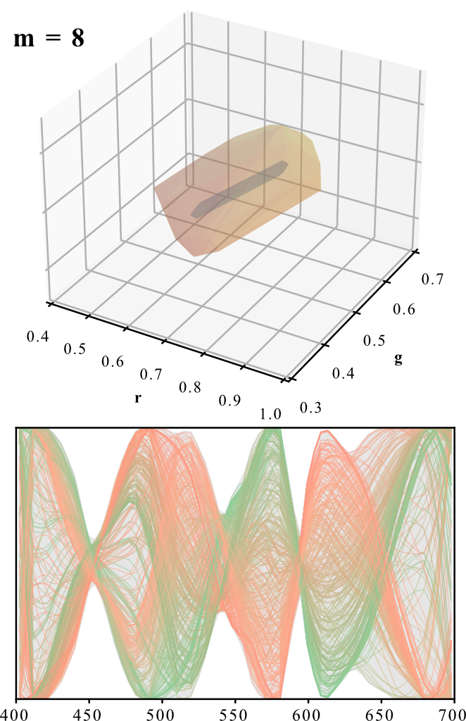
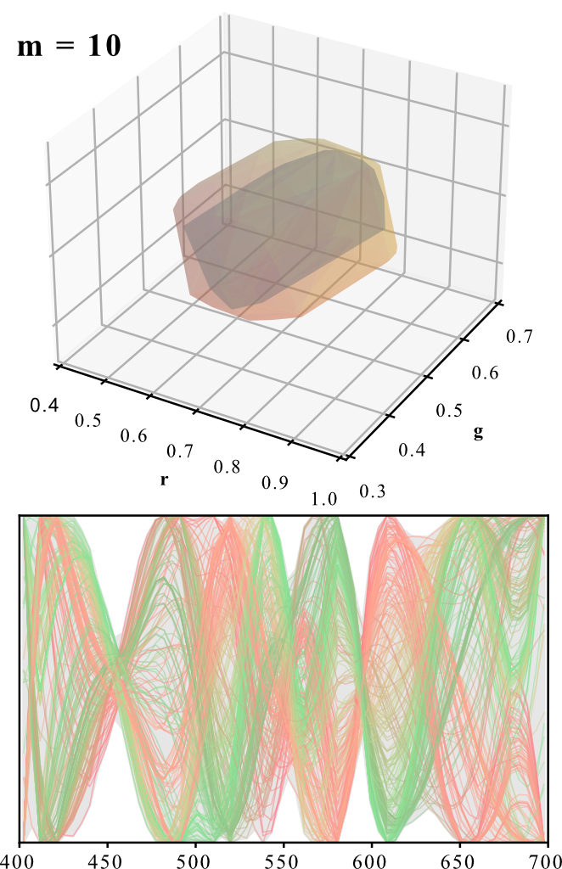
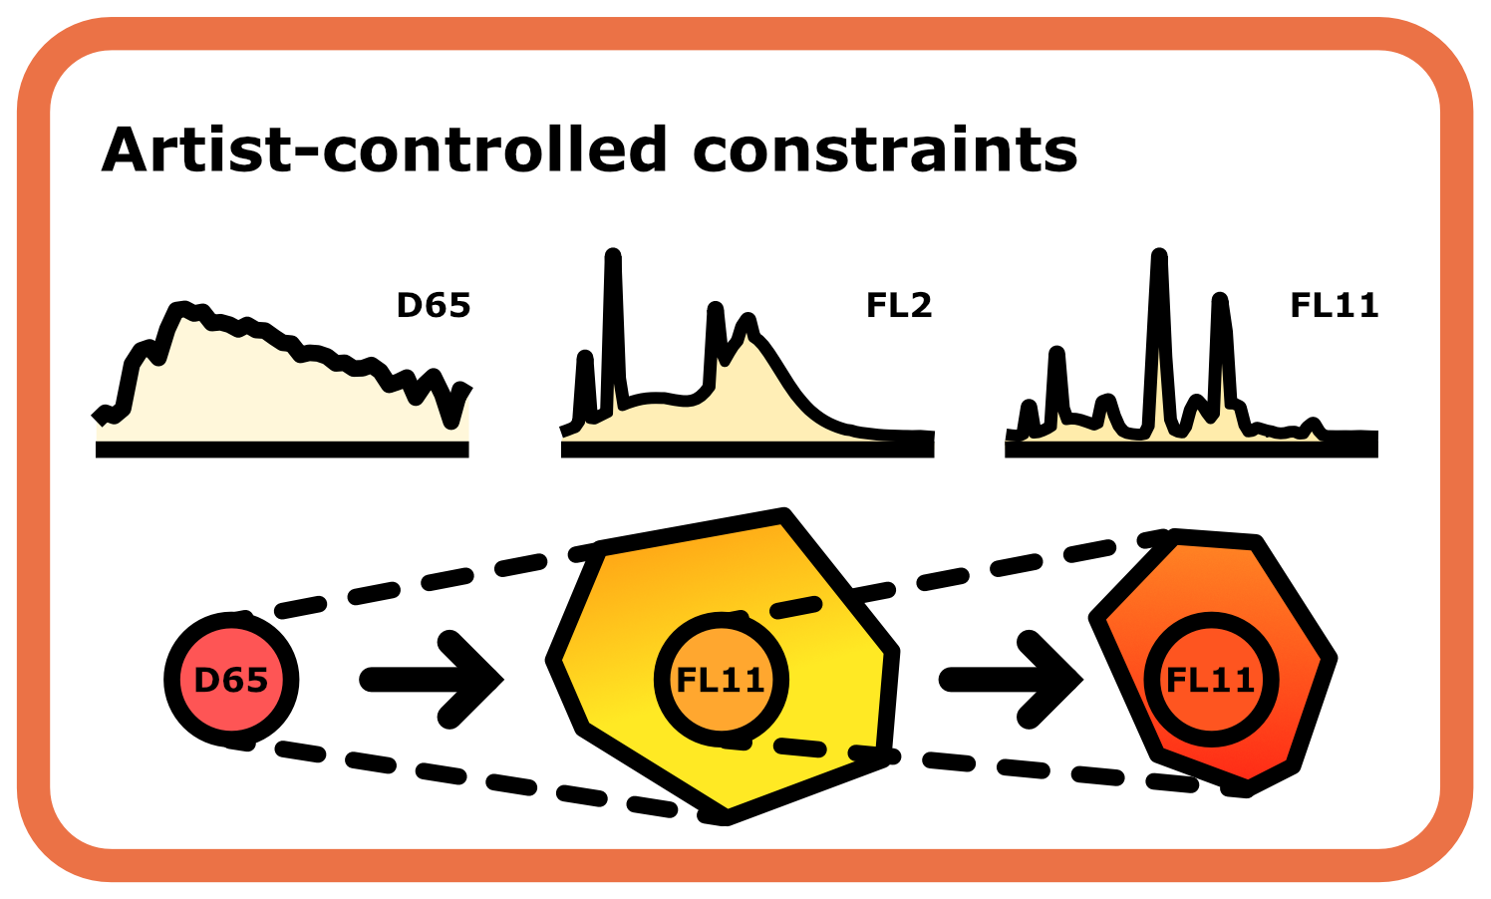
Method
Convex hull generation
Constrained reflectance generation
Linear interpolation

Slide 16
Method
Metamer mismatch volumes
Convex hull generation
Constrained reflectance generation
Linear interpolation
Mackiewitz et al. 2019. Spherical Sampling Methods for the Calculation of Metamer Mismatch Volumes. Journal of the Optical Society of America.

Slide 17
Method
Convex hull generation
Constrained reflectance generation
Linear interpolation

Slide 18
Method
simple convex
hull
Convex hull generation
Constrained reflectance generation
Linear interpolation

Slide 19



Method
Convex hull generation
Constrained reflectance generation
Linear interpolation

Slide 20
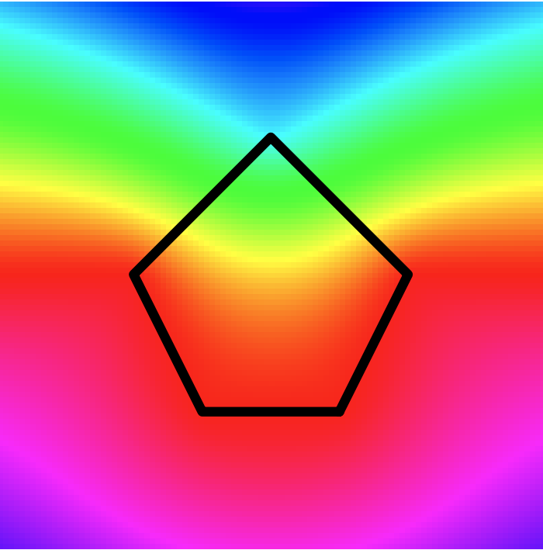
Method
Generalized Barycentrics
Convex hull generation
Constrained reflectance generation
Linear interpolation
Ju et al. 2005. Mean Value Coordinates for Closed Triangular Meshes. ACM Siggraph.

Slide 21
Method
Texture data
Convex hull generation
Barycentrics (w*h*d)
Constrained reflectance generation
Linear interpolation
Reflectances (d)

Slide 22
Method
Convex hull generation
Constrained reflectance generation
Linear interpolation

Slide 23
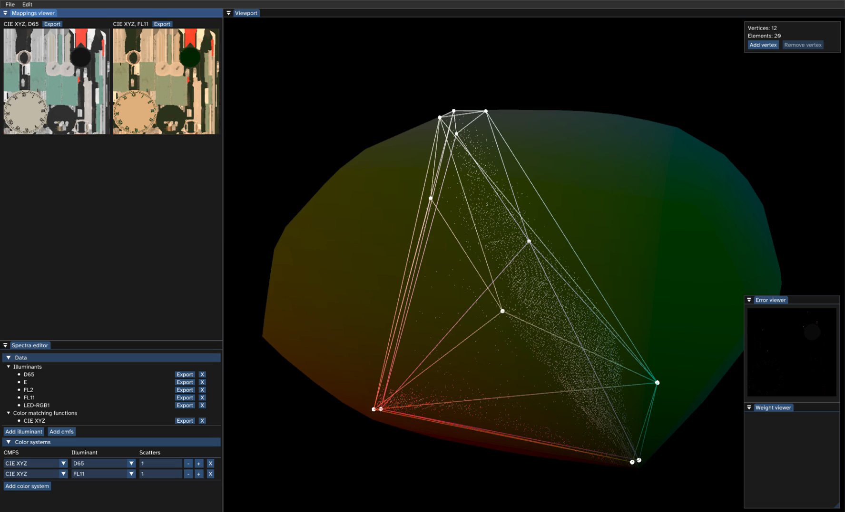

Slide 25

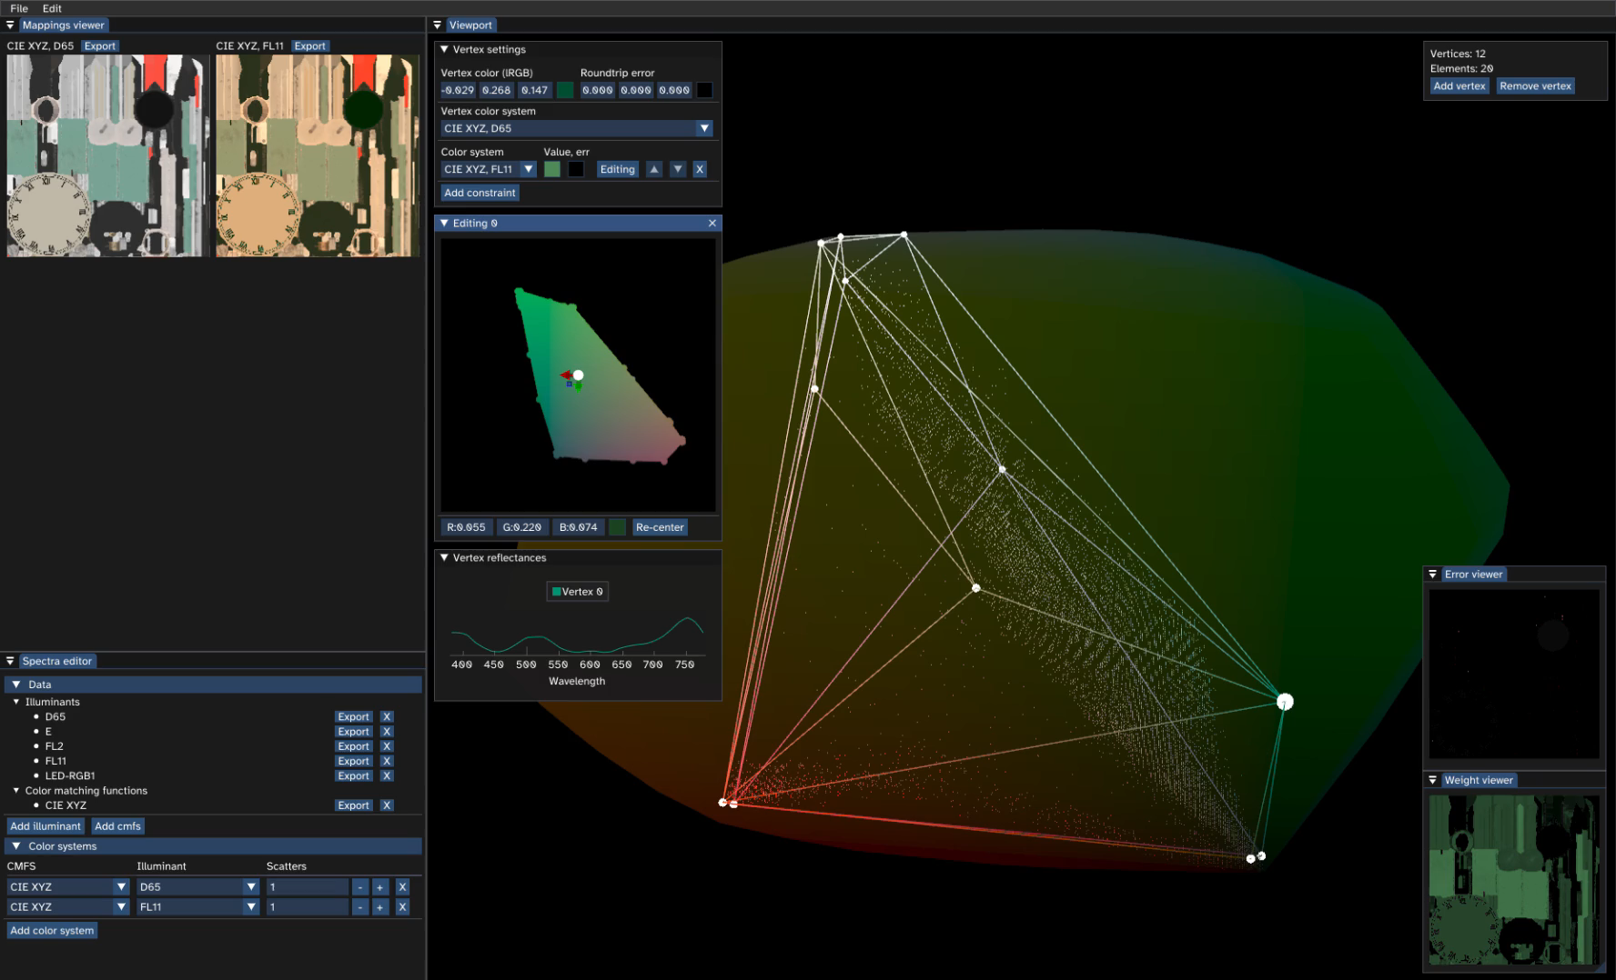

Slide 26
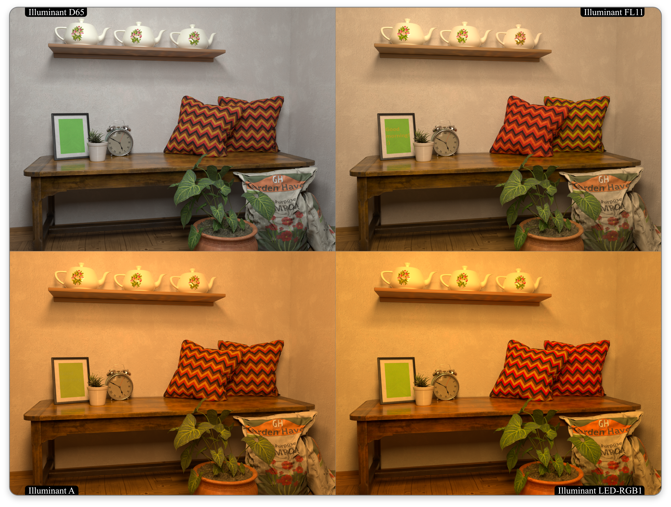
Constraint
D65
FL11
Reflectance
Mismatching

Slide 27
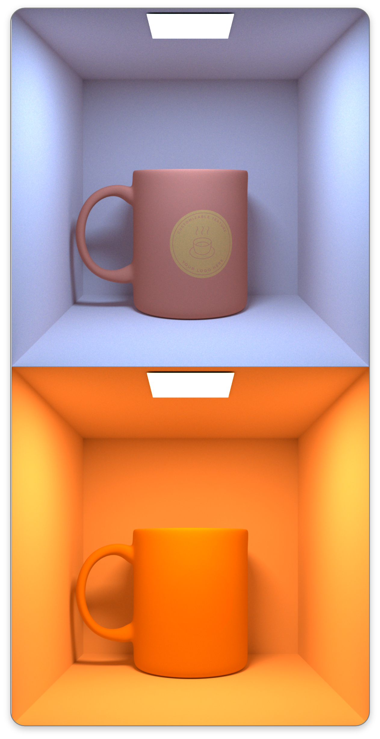
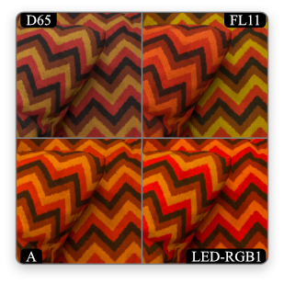
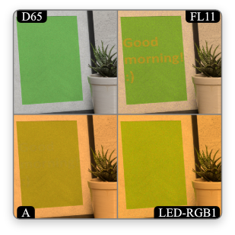
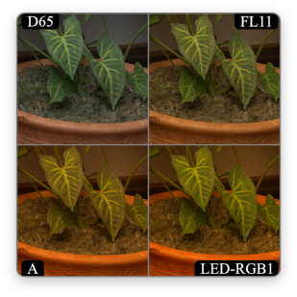

Slide 28
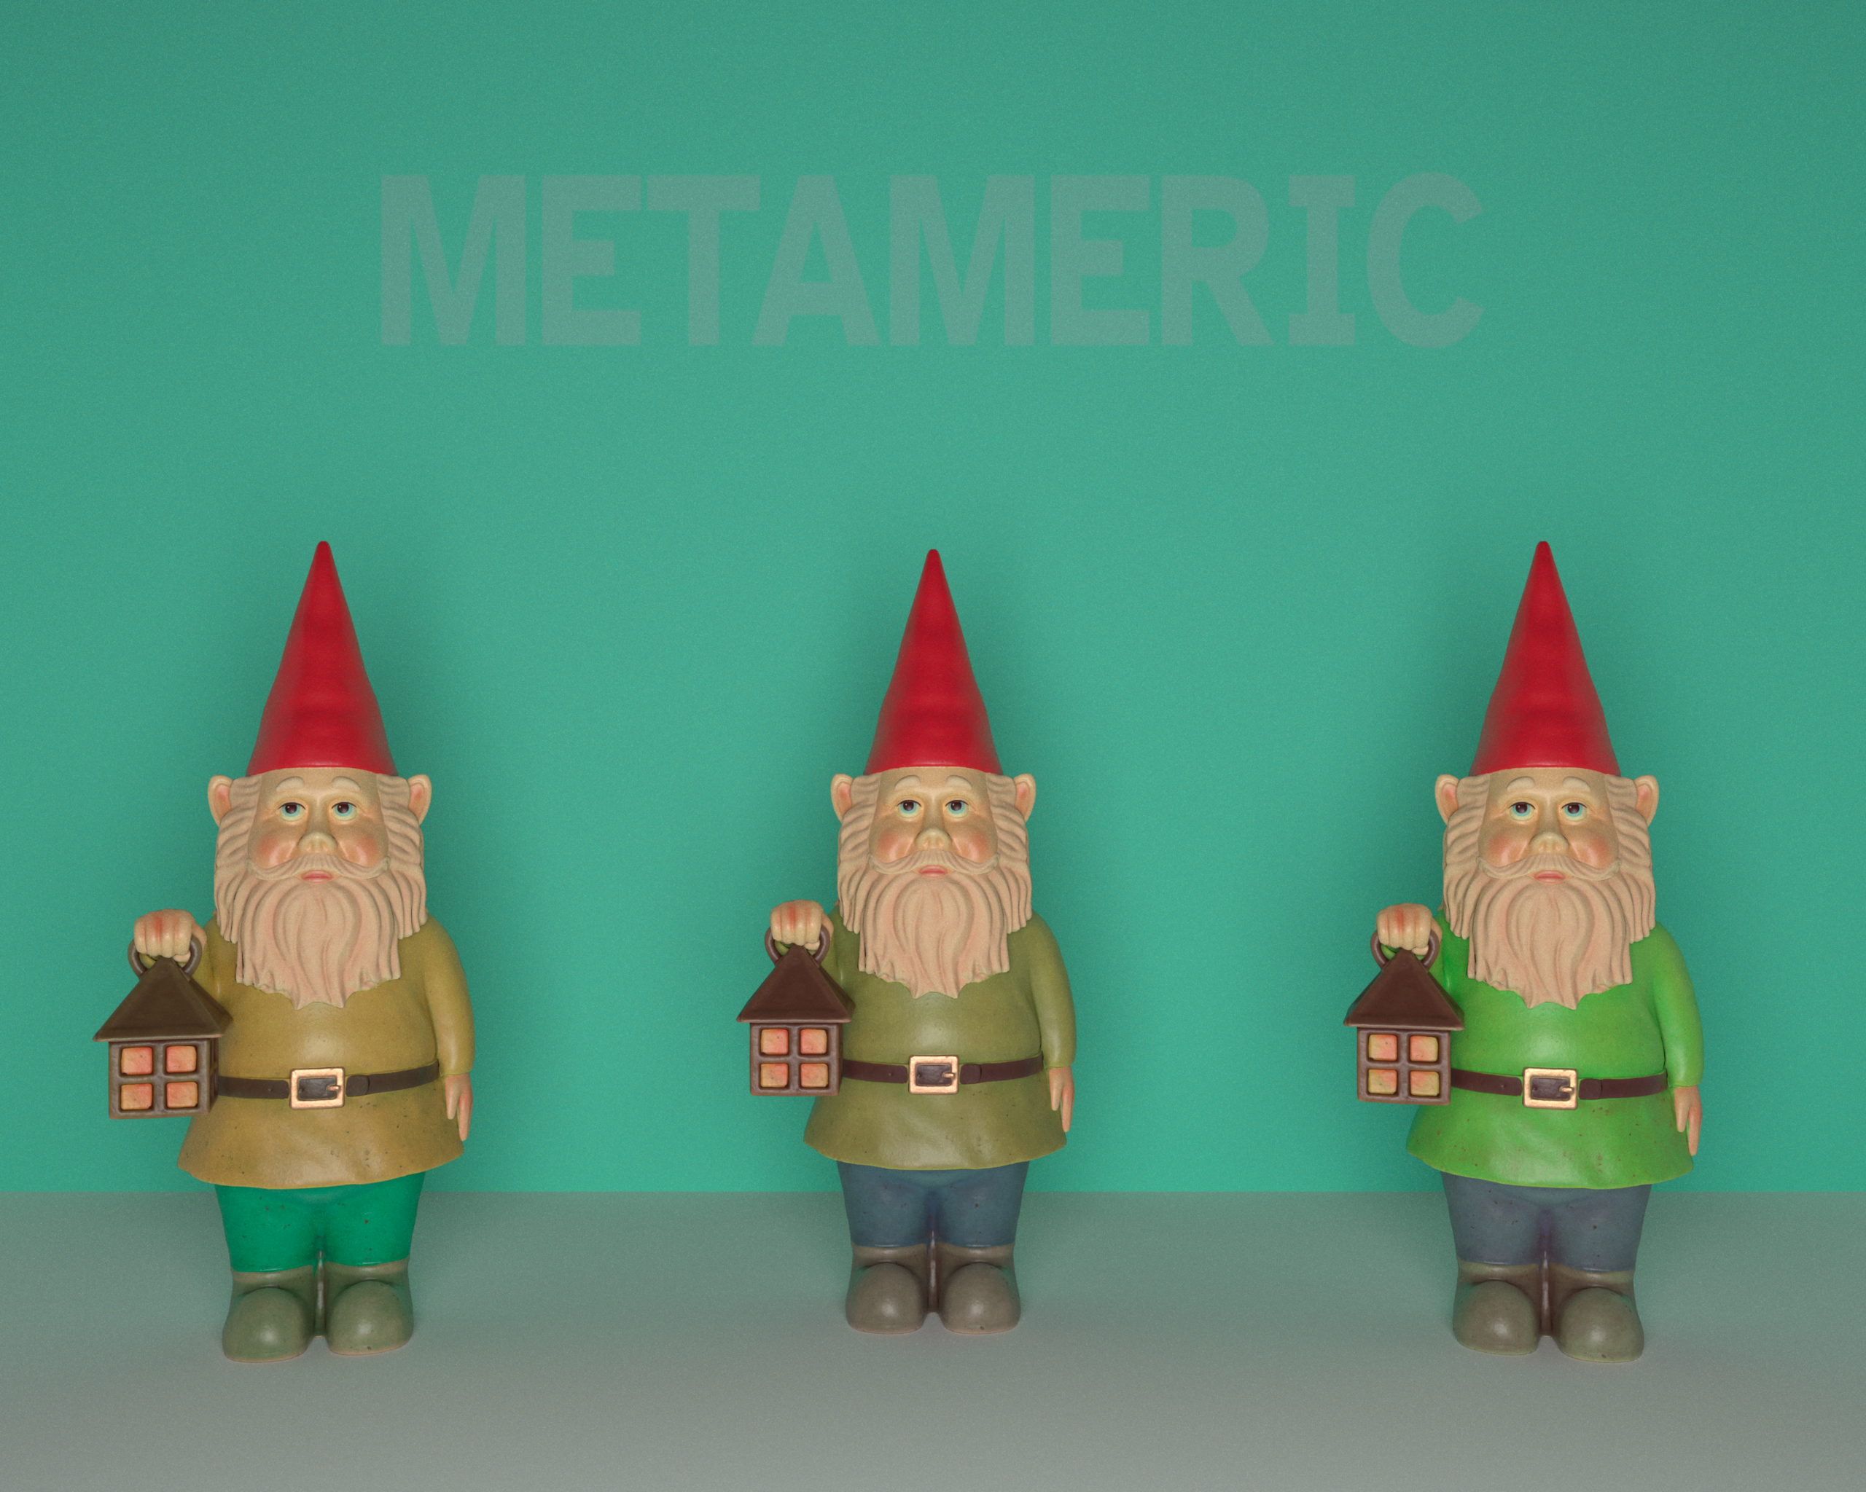
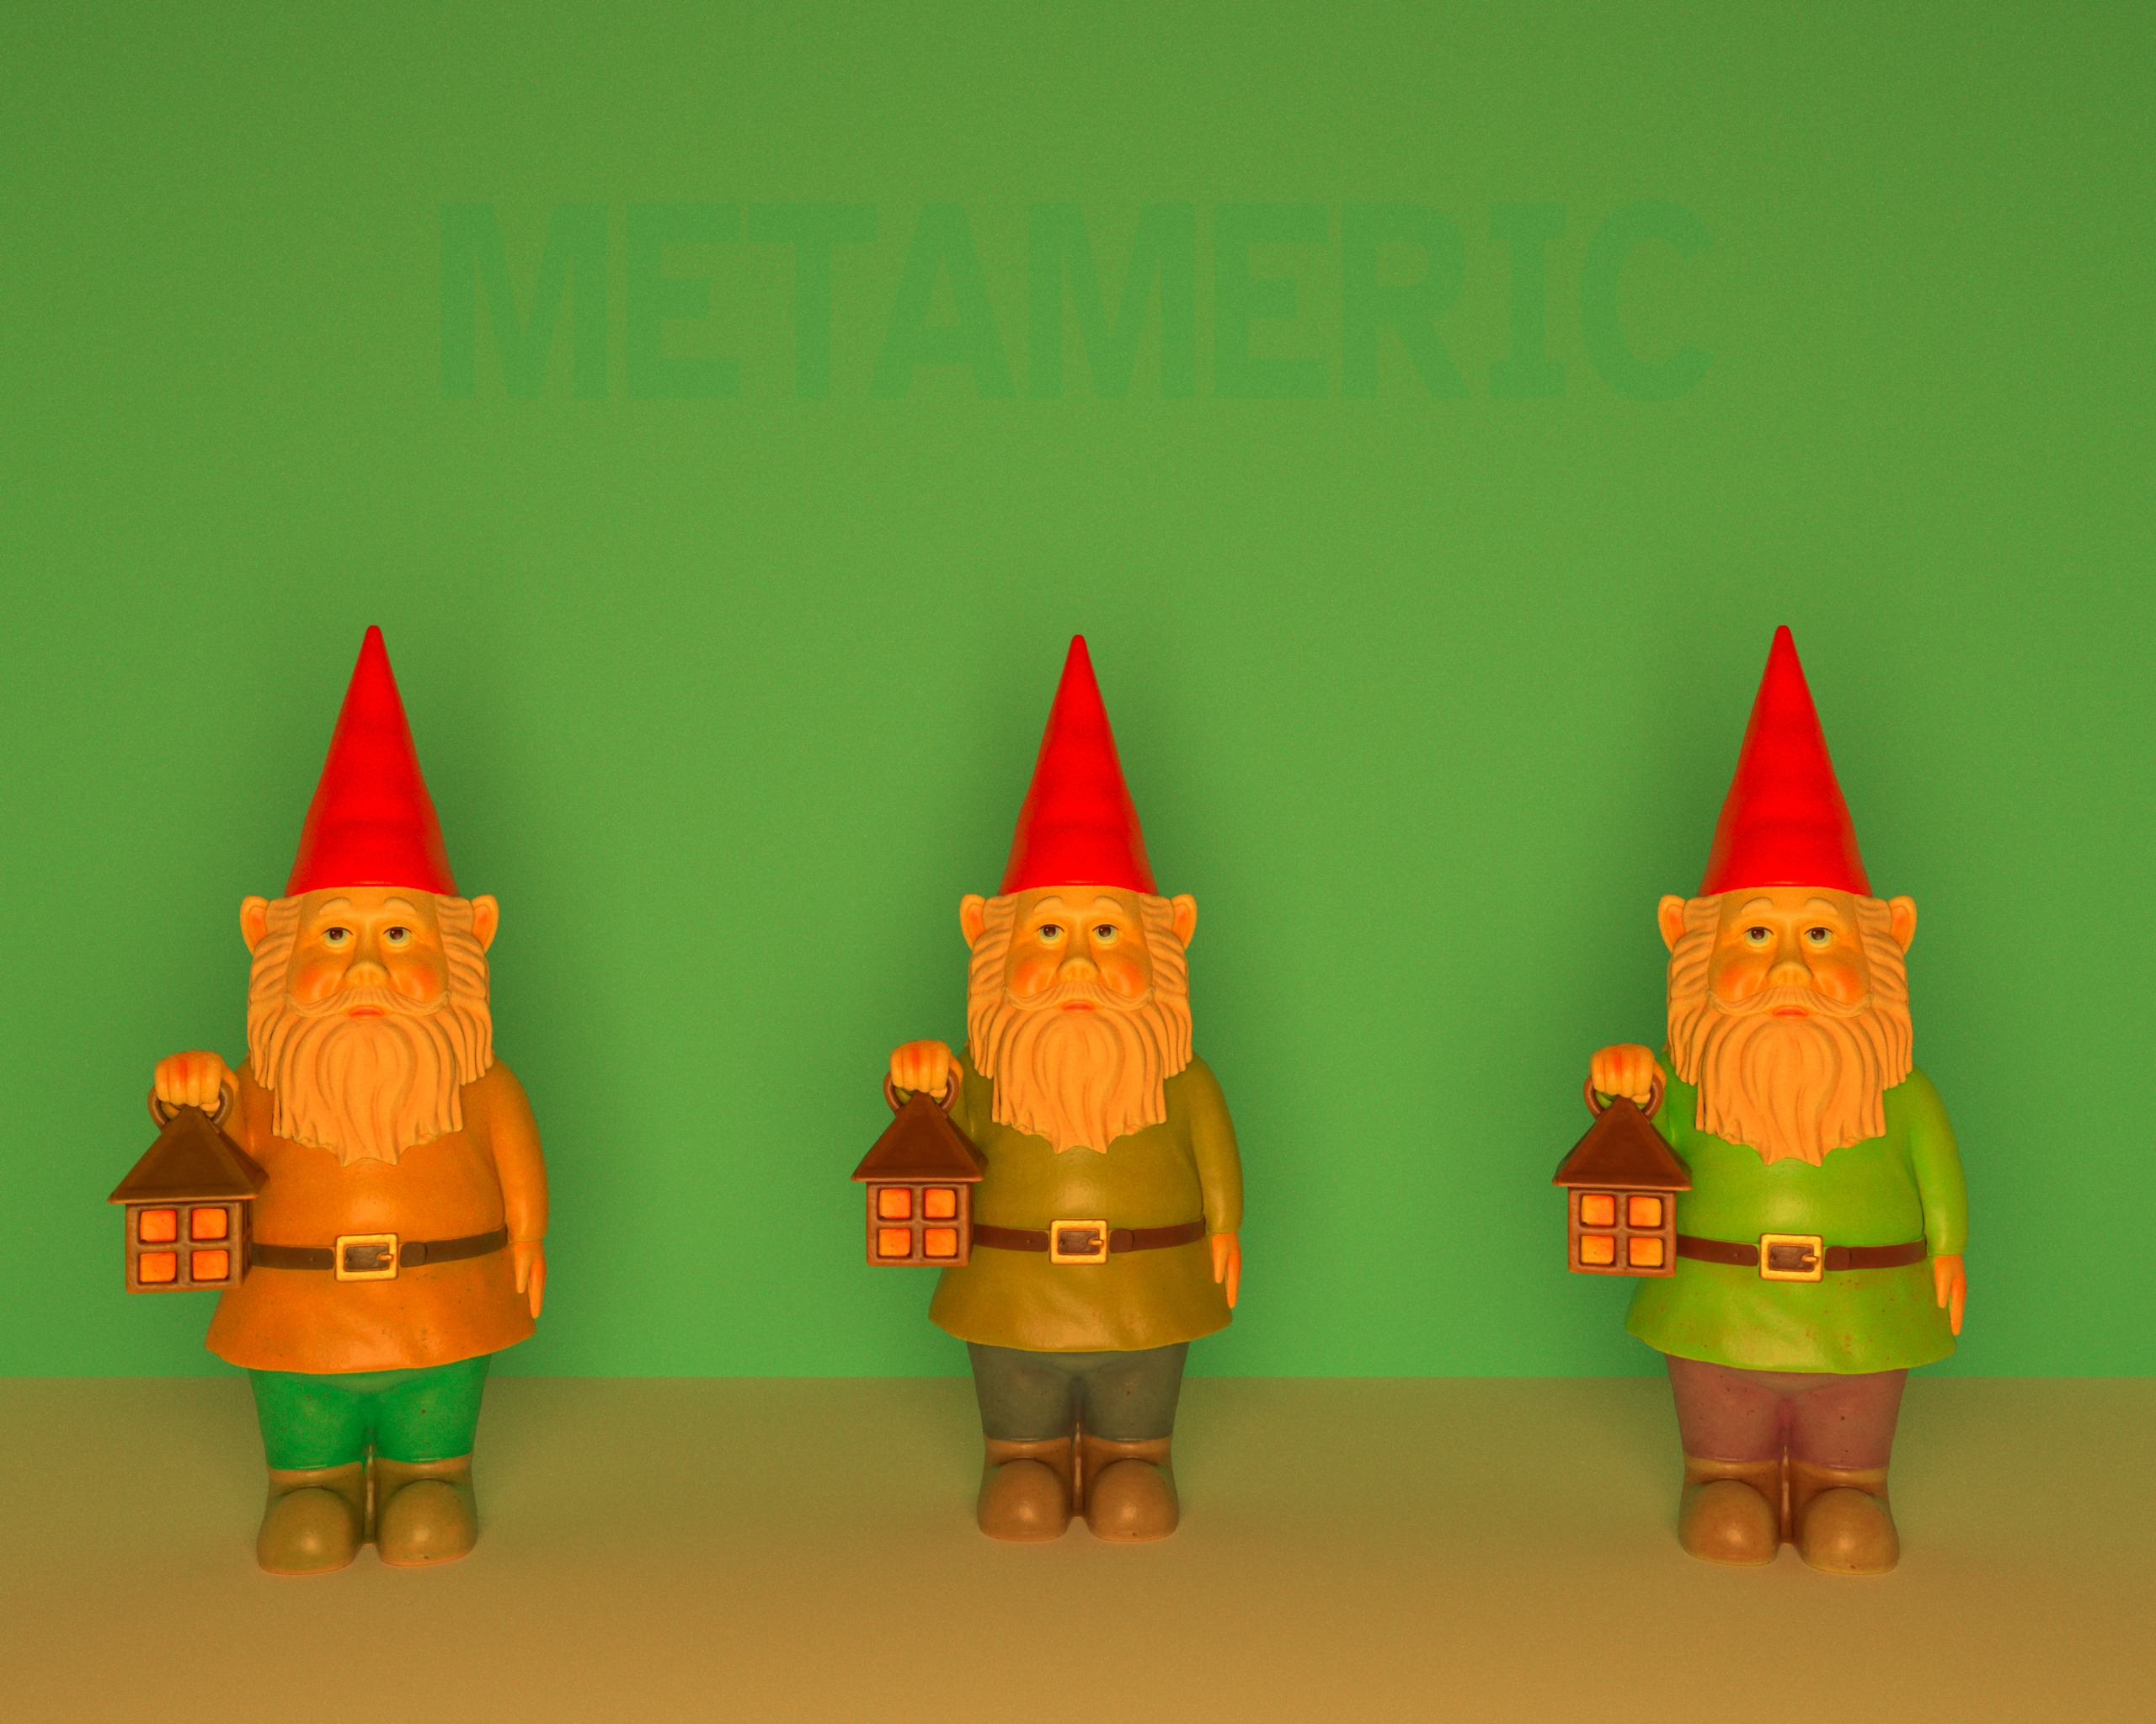
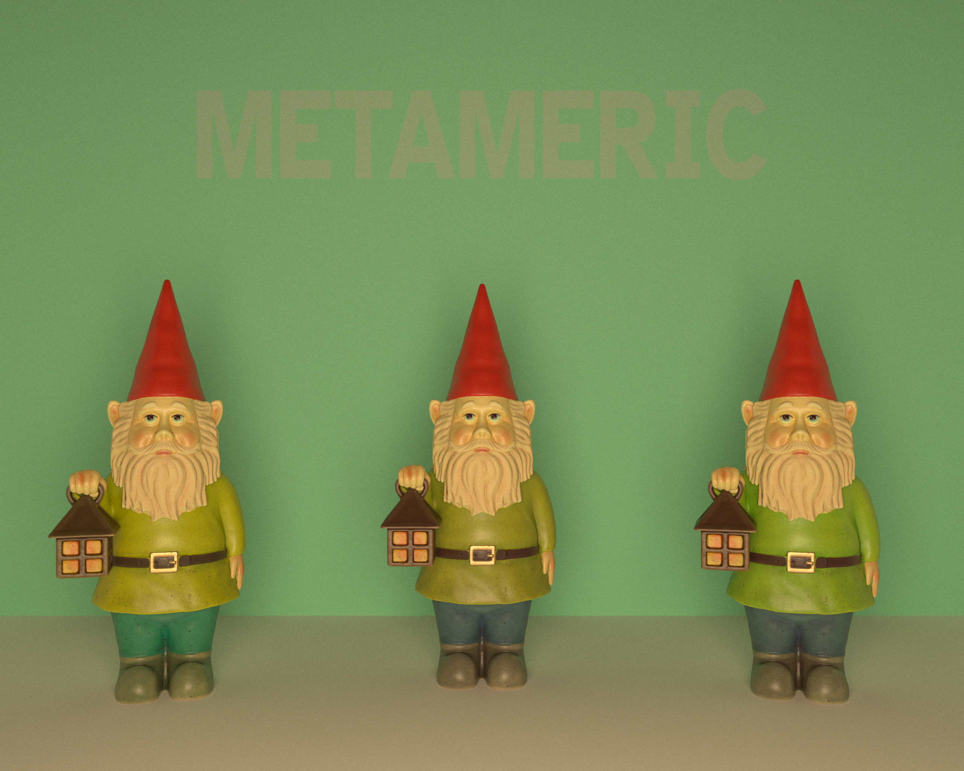

Slide 29
In summary
Simple uplifting with constancy control.
Compact spectral texture representation.
Toolkit enabling constrained uplifting.
  Includes a Mitsuba 3 plugin

Slide 30

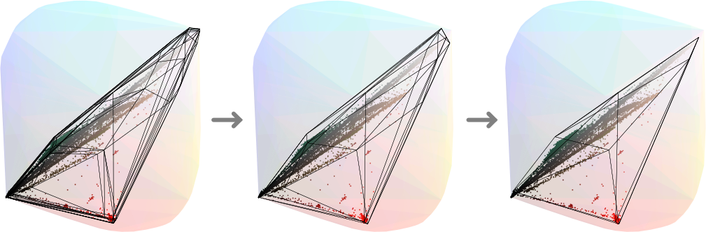
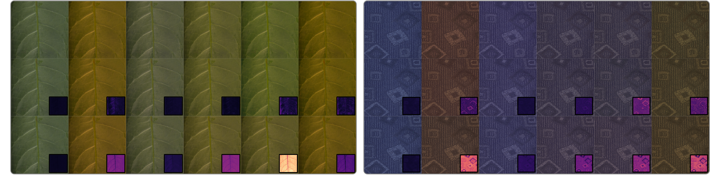

In paper

Slide 31
Metameric
Spectral Uplifting via
Controllable Color Constraints
Mark van de Ruit and Elmar Eisemann

