Slide 1
Gradient-Guided Local Disparity Editing
Leonardo Scandolo Pablo Bauszat Elmar Eisemann
Delft University of Technology

Slide 2
What is disparity ?
Retinal disparity/Vergence
Screen disparity
Screen
disparity
screen
Notes:
Vergeance in eyes determines how far away we perceive an object, and disparity refers to the difference in these angles.
On screen this translates to an actual pixel distance between an object shown for left and right eyes.
You can see the difference for example when viewing red-cyan anaglyph stereo images without glasses.

Slide 3
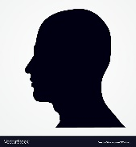
Depth cues
Occlusion
Shadows
Texture
Similarities
Binocular disparity
Accommodation
Uncomfortable
Comfortable
Viewer comfort
Notes:
Many depth cues can be represented on a stereo screen, but not all.
In particular, accommodation is fixed at the screen distance, and contradicts the binocular disparity.
This clash leads to viewer discomfort.

Slide 4
Depth cues
Screen
Notes:
Another example is creating something very far away, it would require binocular disparity to be an exact value, which is different for different viewers at different viewing positions.
This is another reason to restrict the disparity range and tweak disparity to ensure that it produces a good stereo effect for the given range of disparity values.
So there are artistic decisions involved into how to distribute the available disparity range.

Slide 5
Previous work
Manual editing through Maya or specialized tools as Ocula/Mistika
Global map (akin to tone mapping) for disparity retargeting
Original disparity
Final disparity
Lang et al., Nonlinear disparity mapping for stereoscopic 3D, ACM TOG 2010
Oskam et al, Oscam-optimized stereoscopic camera control for interactive 3d, ACM TOG, 2011
Koppal et al, A Viewer-Centric Editor for 3D Movies, IEEE CG&A, 2011
Yan et al., Depth Mapping for Stereoscopic Videos, IJCV 2013
Wang et al, Comfort-driven disparity adjustment for stereoscopic video, CVM, 2016
Kellnhofer et al, GazeStereo3D: Seamless disparity manipulations, TOG, 2016
Notes:
Normally this edition work is done manually, through 3D edition software, some of which is specialized by expert stereographers.
Edits can also be defined globally, by changing the relationship between disparity and depth to be non-linear.
There are many works that take this approach and obtain different mappings based on the underlying model and goals.

Slide 6
Previous work
Automatic optimization for autostereoscopic displays
Disparity optimization for motion in depth
Chapiro et al., Optimizing Stereo-to-Multiview Conversion for Autostereoscopic Displays, CGF 2014
Kellnhofer et al., Optimizing Disparity for Motion in Depth, EGSR 2013
Notes:
Previous work has identified that global schemes are insufficient and analyze the scene in order to determine where disparity can aid to the perception of depth differences.
Such local control of disparity is also typically used by stereographers, except that their approach is to put disparity where they determine to be important for a given intent.
For example important objects or characters may be given a larger range of disparities in order to better show their full shape, and flatten the background which is of less importance.

Slide 7
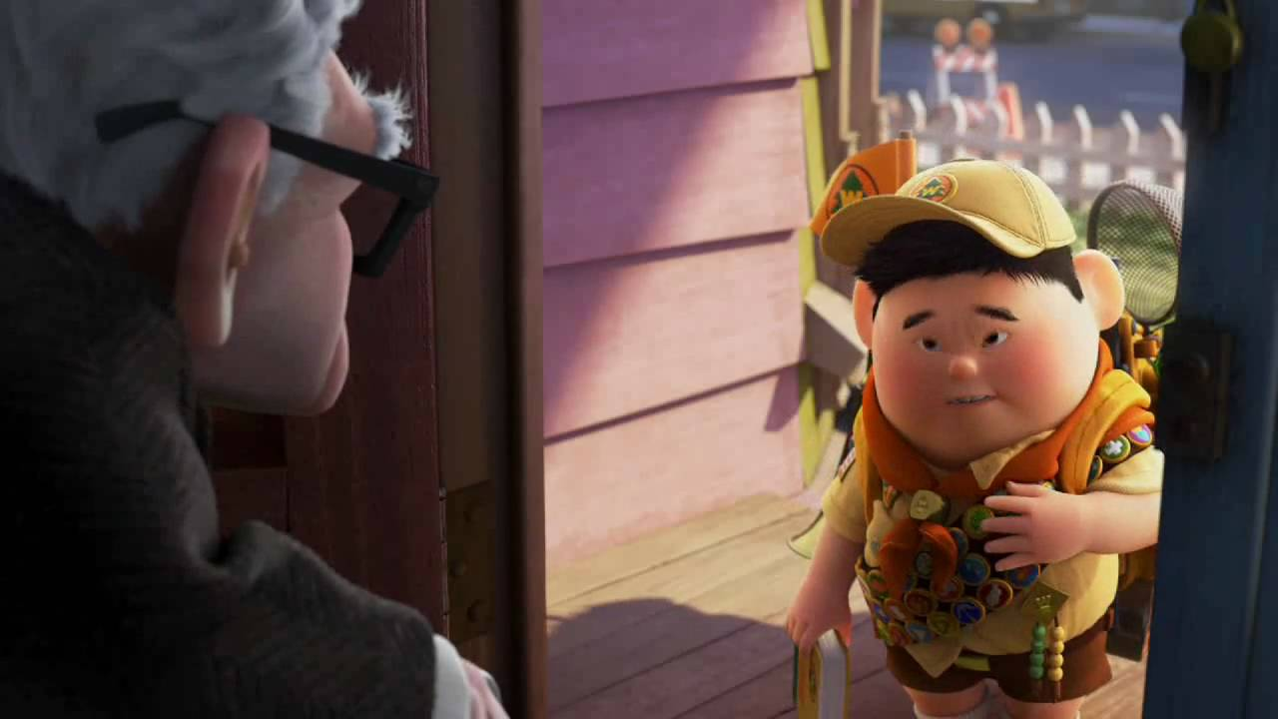
Why disparity editing ?
Artistic intent
Image courtesy of Walt Disney Pictures.
Notes:
In our case we want to enable artists to influence the distribution of disparity in the scene.
In practice this is very common, but had to be done manually for artistic purposes, which is very tedious.
This is where we want to assist the artist.
In the example image from the movie UP, disparity editing was used to flatten the character of Carl to convey sadness, while the young more dynamic character was made rounder in depth to make it stand out.

Slide 8
What’s the difficulty ?
Original
Edited
Disconnection
Depth inversion
View direction
View direction
Notes:
Modifying disparity may seem a simple thing to do, but it’s not, because the moment it is modified, it can start introducing inconsistencies with the rest of the scene.
In this example we have an image of a lion head statue which looks very flat and we would like to make it stand out more, and also move the back wall further back.
IF we simply modify the roundness of the object, as in the right image, you can see that now it looks like the statue is going through the wall. Also the back wall seems disconnected from the rest of the scene.
This is what we are going to work on.
Please notice that this modification works only on the disparity values and not on the geometry, since the lion still occludes the back wall.

Slide 9
Disparity map
Disparity map
Stereo image pair
Notes:
So how exactly do we modify the disparity of a 3D scene.
In this work we will make heavy use of a disparity map, which is an image computed from the middle-view from the left and right eyes (or cameras) where we compute a disparity value for each pixel.
This disparity map then is used in order to create a final stereo image pair.

Slide 10
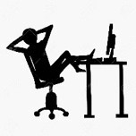
What’s the goal ?
Original
Edited
Goal (edited + fix)
Notes:
As explained by simply changing a few disparity properties of some object the result will not look convincing, and a lot of manual work has to go into harmonizing all the disparity values in a scene in order for it to look good.

Slide 11
Disparity map
Disparity map
+ Our algorithm
Notes:
In this work we strive to assist the artist to obtain a consistent result that still reflects the artistic intent, and only requires to modify a few high level disparity properties of object.

Slide 12
Our method

Slide 13
Disparity modifications in our algorithm
Modification of roundness
Disparity offsetting
Disparity matching
Interface preservation

Slide 14
What is disparity editing ?
Different types of editions
$$Make character rounder$$
View direction
Roundness
Notes:
What typical disparity editions do we want to support.

Slide 15
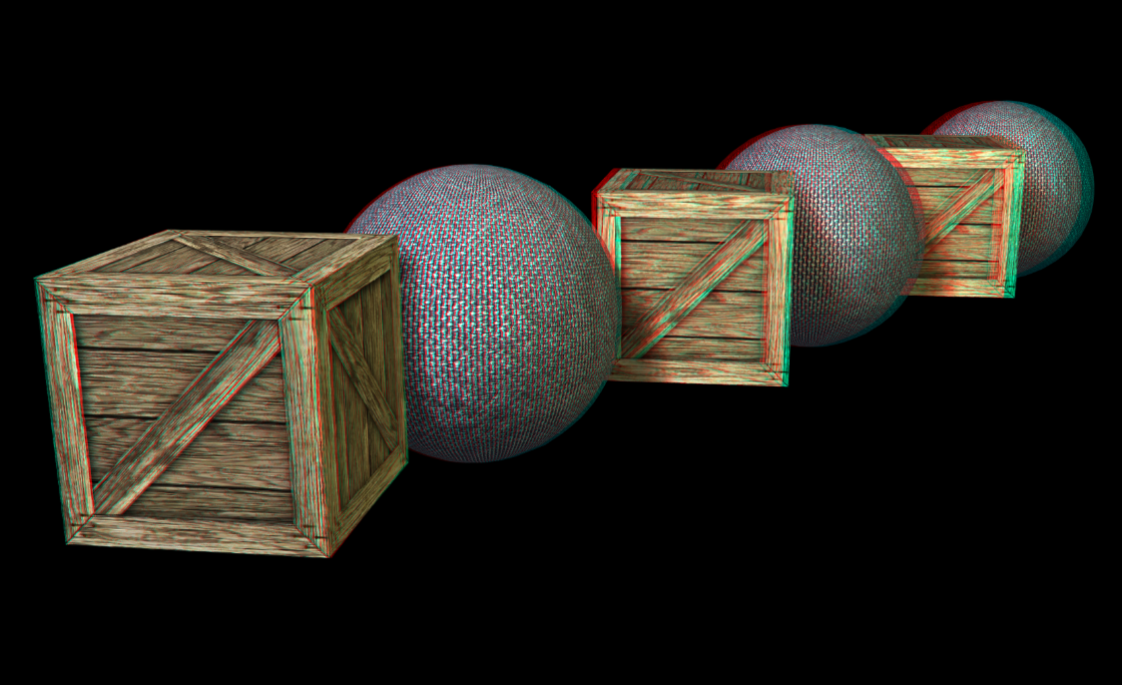
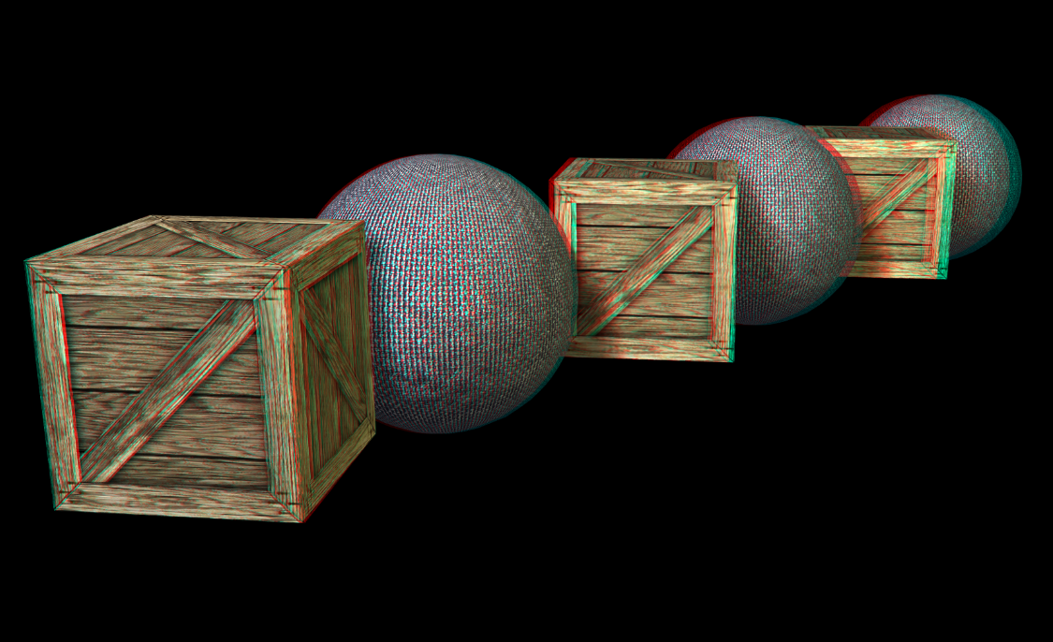
What is disparity editing ?
Different types of editions
$$Make character rounder$$
Roundness
Notes:
In this example you can see that the two first spheres are rounder in the right image, even though the rest of the scene remains the same.

Slide 16
What is disparity editing ?
Different types of editions
$$Move character back$$
View direction
Offset
Notes:
Another example is adding an offset to an object in depth, meaning to push it backwards or forwards in depth.

Slide 17
What is disparity editing ?
Different types of editions
$$Match character and tree$$
View direction
Matching
Notes:
Similarly, we may want to achieve a similar effect by matching the disparity of two points.

Slide 18
What is disparity editing ?
Different types of editions
Offsetting disparity
Notes:
Here, we have pushed the second sphere back in depth.

Slide 19
What is disparity editing ?
Different types of editions
$$Move wall forward+$$
$preserve wall/torch$ interface
View direction
Interface preservation (after other editions)
Notes:
A similar edition command is to maintain the disparity difference at the interface of two objects, so that when an object’s disparity is modified, the rest move with it.
In this example we move a wall closer to the camera, and we want the torch to move with it.

Slide 20
Disparity modifications in our algorithm
Modification of roundness
Disparity offsetting
Disparity matching
Interface preservation

Slide 21
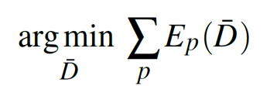
Formalizing artist input
Original disparity map: 2d grid (screen pixels)
D: N² → R
Goal: Optimized disparity map, follows artist edits but avoids depth inversions
$\overline{\text{D}}$: N² → R
Artist edits are formulated as linear constraints
Minimize a cost function.
Notes:
So, to formalize what I just explained, we will start with a function on a grid, the original disparity map.
Our goal is to obtain another grid of the same size that follows the artist edits but does not contain disparity errors.
We will do this by formalizing what we mean by artist edits and disparity errors as constraints, and minimizing an energy function to follow those constraints.

Slide 22
Formalizing artist input
We use the gradient $\overline{\text{G}}$ of $\overline{\text{D}}$ (and G of D) to define some of the constraints.
Roundness:
Notes:
Formalizing the artist edits is done in some cases via defining a goal gradient.
For example, increasing roundness of an object can be formalized as increasing the gradient of the pixels associated with that object.
Likewise, retaining the interface between two objects amounts to retaining the gradient of the pixels in the interface between the object.

Slide 23
Formalizing artist input
Disparity offset anchor:
Notes:
Formalizing the artist edits is done in some cases via defining a goal gradient.
For example, increasing roundness of an object can be formalized as increasing the gradient of the pixels associated with that object.
Likewise, retaining the interface between two objects amounts to retaining the gradient of the pixels in the interface between the object.

Slide 24
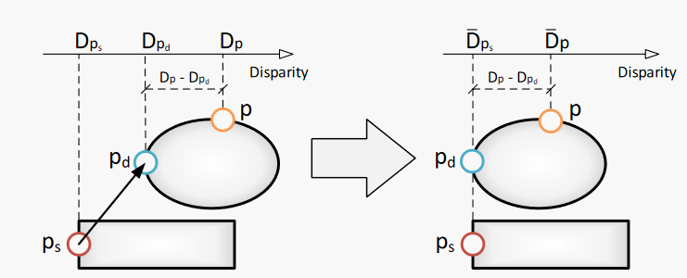
Formalizing artist input
Disparity matching points:
Notes:
Formalizing the artist edits is done in some cases via defining a goal gradient.
For example, increasing roundness of an object can be formalized as increasing the gradient of the pixels associated with that object.
Likewise, retaining the interface between two objects amounts to retaining the gradient of the pixels in the interface between the object.

Slide 25
Formalizing artist input
Interface preservation:
Notes:
Formalizing the artist edits is done in some cases via defining a goal gradient.
For example, increasing roundness of an object can be formalized as increasing the gradient of the pixels associated with that object.
Likewise, retaining the interface between two objects amounts to retaining the gradient of the pixels in the interface between the object.

Slide 26
Let’s try it out!
Notes:
So lets try out our system, and see what we get if we increase the roundness of the lion head by 2 and solve the system, aaaand, nothing changed, we still get the same inconsistent image as before.

Slide 27
Formalizing disparity errors
$Move$ tree backwards
The most important disparity error is depth inversion.
Compare
sign($\tilde{G}$(p)) ≠ sign($G$(p)) → enforce $\overline{G}$(p) = $G$(p)
G : original map gradient
$\tilde{G}$ : modified map gradient
Likewise, other errors can be eliminated, such as high disparities near screen edges.
It only suffices to define them as a constrain in terms of D or its gradient.
$$D$$
$$\tilde{D}$$
$$x$$
$$x$$
$G$(p) > 0
$\tilde{G}$(p) < 0
Notes:
So we need some more magic.
Fortunately, there’s a elegant solution to impose these consistency constrains as linear constrains in our system well.
If we take the disparity map where we blindly apply the artist edits, and compare its gradient to the original gradient, depth inversions occur where the gradient changes its sign.
We can detect those pixels and impose the original gradient to maintain the relative disparity.

Slide 28
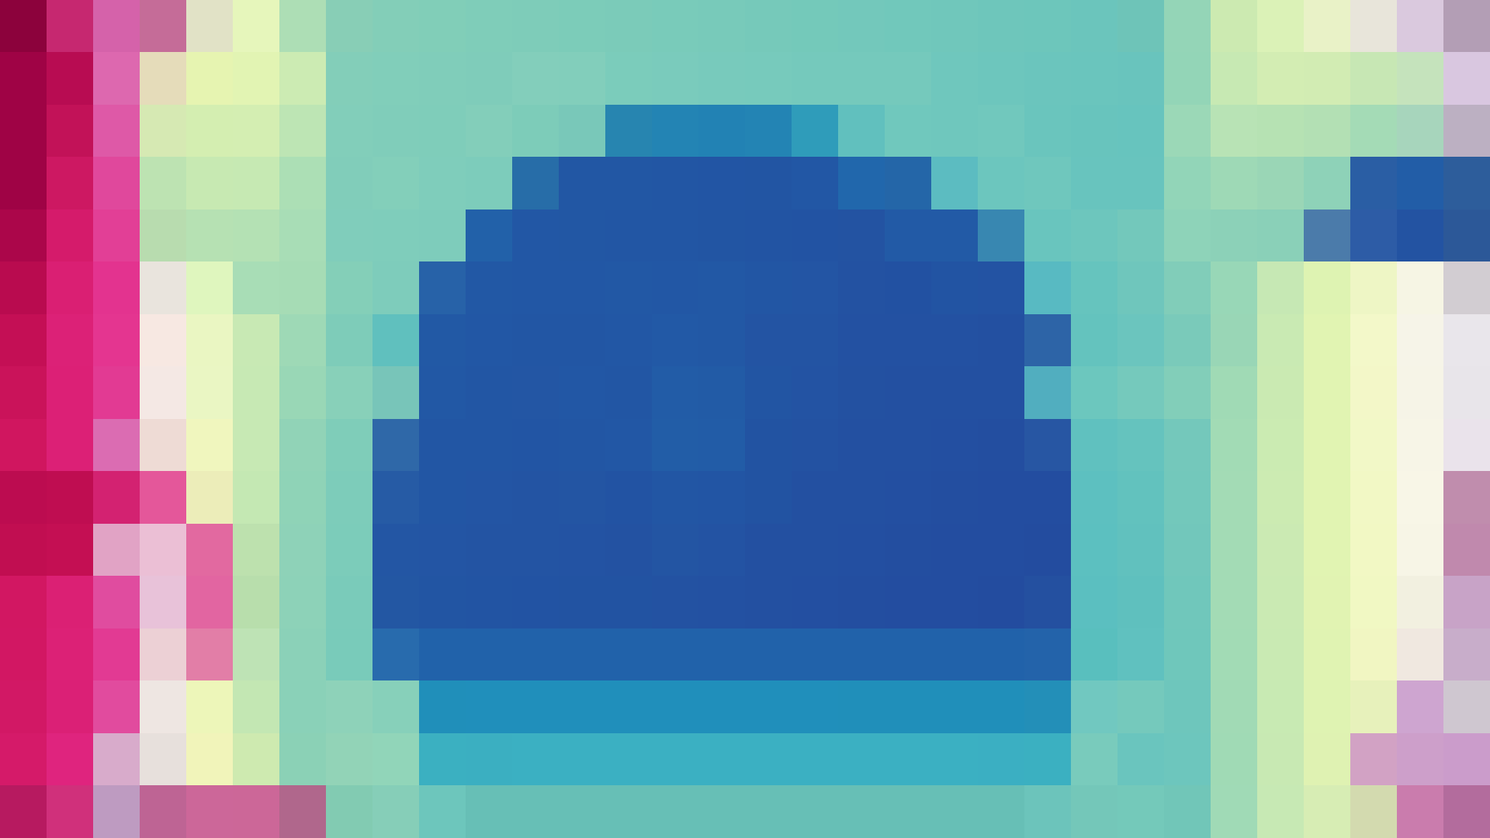
Optimization procedure
We use a multi-scale approach.
Create subsequently halved versions of the same system, up to 16x16.
For each level from smallest to largest:
Run 10 iterations of a Jacobi solver.
Up-sample the result as starting solution for next level.
The solver is fast enough to be used interactively as the artist edits.
Notes:
Finally, we perform a multi-scale optimization procedure us ng the gradient as one of the constraints: a modified Poisson solver.

Slide 29
Great! We have an optimized disparity map … now what ?
Given the disparity map, we can apply it to a mono image and use warping techniques* to obtain a stereo image pair.
Problem: Disocclusions
?
*Didyk et al., Adaptive image-space stereo view synthesis, VMV 2010
Notes:
Once we obtain the final disparity values, we need to create the two stereo images.
If we start from a single image with no further information, this can only be done via an image warping procedure.
This method is well studied and works well, but it has the drawback that when an object is shifted horizontally to create the stereo effect, the background is disoccluded. Without background information we can only use heuristics to imagine what was behind the objects.

Slide 30
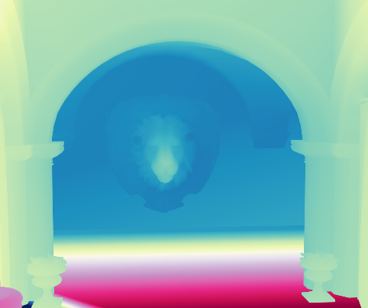
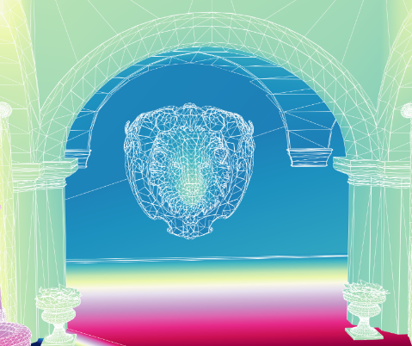
Render-based stereo image generation
Render-based approach Background is rendered at disocclusions
Left view
Sample disparity at vertices
Compute optimized disparity map
Project vertices to map
Right view
Move vertices horizontally according to disparity to create left/right images
Notes:
If we have the full 3D information, then we can do much better.
Given a disparity map, we can render the stereo images such that the background will simply be rendered into them.
This can be done by sampling the disparity for each vertex of the scene from the disparity map, and then when rendering, shifting the vertices horizontally to left or right according to that disparity.

Slide 31
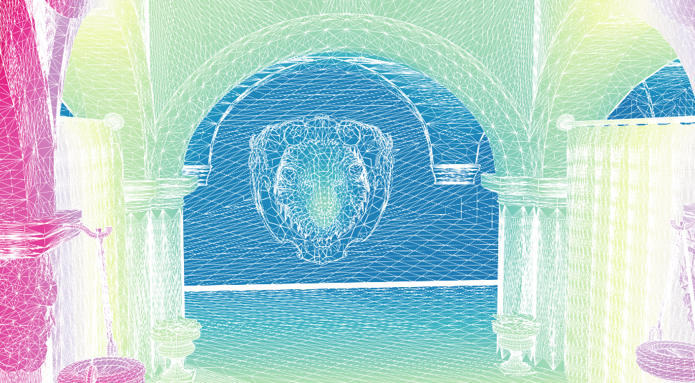
Render-based stereo image generation
Final disparity is piecewise linear across triangles.
Does not work for large triangles.
Solution: Adaptive tessellation
Notes:
This method is not without drawbacks.
The most important problem is that if the disparity is only sampled at vertices, the disparity of every pixel is a linear combination of the disparity at the vertices. This means we approximate the goal disparity map with a piecewise linear function.
If the triangles are too large, then the disparity is approximated poorly.
Therefore we use adaptive tessellation to maintain the size of the triangles small.

Slide 32
Render-based stereo image generation
Disparity reprojection : from disparity map to vertex.
What happens when the vertex is occluded or off-screen ?
Use weighed average of neighborhood samples.
No valid samples: use original disparity.
Notes:
Another issue is that some vertices may not be visible in the disparity map.
In that case we can sample nearby the projection point to find samples corresponding to the same object to use.
In the case we cannot find any sample, we can still fall back to the original disparity values.
Since triangles are small, the absence of nearby samples means the object is most likely not visible at all and therefore not a problem.

Slide 33
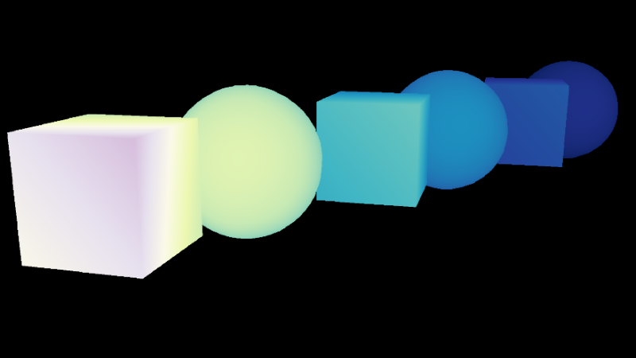
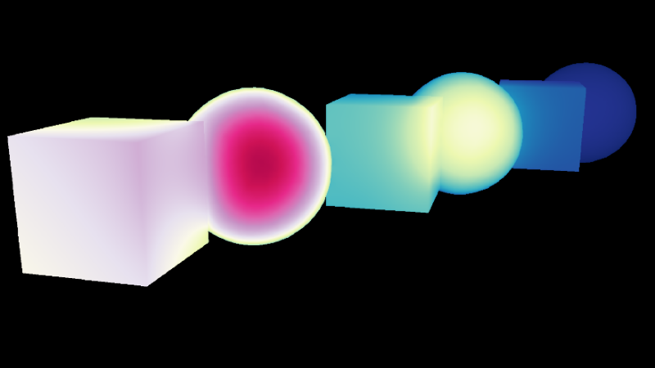
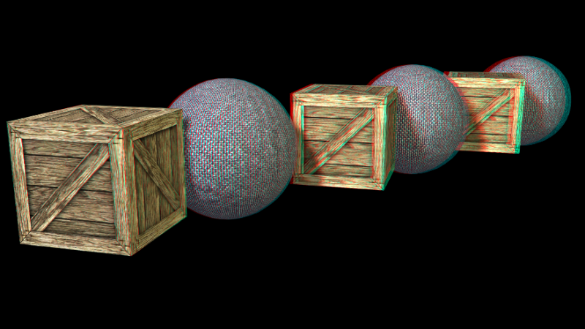
Render-based stereo image generation
Big advantage: decoupling resolution of disparity map and final image.
Original
Optimized at 1:1 resolution
Optimized at 1:8 resolution
Notes:
One of the benefits of our approach is that we have effectively decoupled the resolution of the disparity map from the resolution of the final stereo images. This is because we sample the disparity map to obtain the vertex disparities, and the sampling does not depend on the resolution.
This means we can perform the optimization at a much smaller resolution than the stereo image resolution, and therefore target very large image resolutions, while maintaining real-time or interactive performance.

Slide 34
Results

Slide 35
Results: Video example
Notes:
This is an example video of the tool being used.

Slide 36
Results: Video example
Notes:
This is an example video of the tool being used.

Slide 37
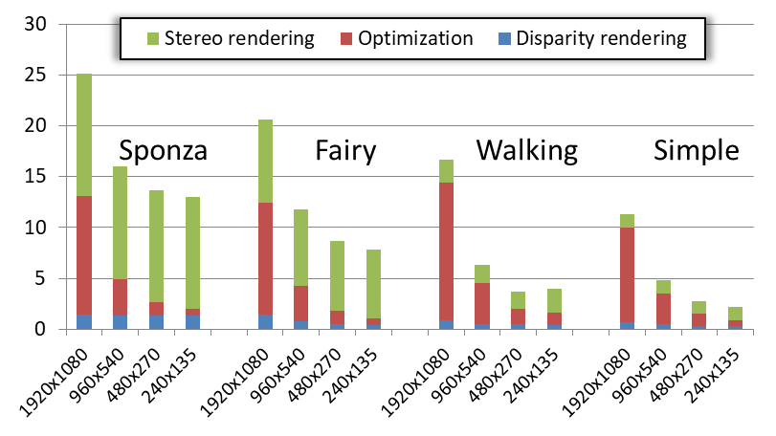
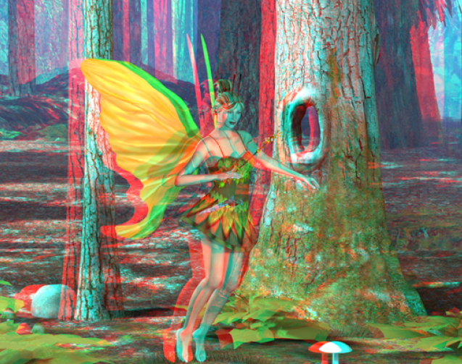
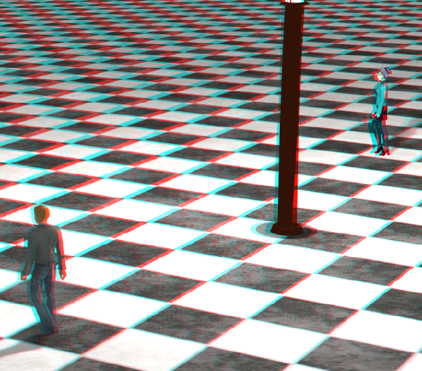
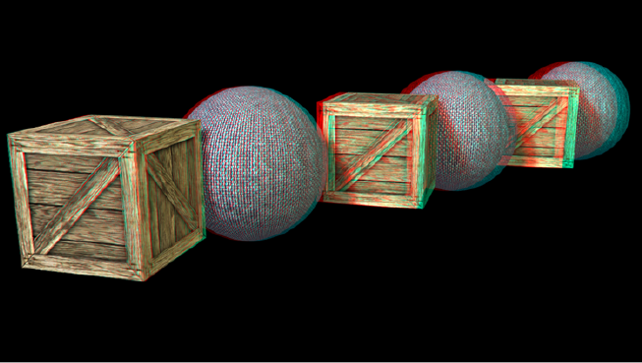
Results: Optimization times
Notes:
Although we have not put much work in optimizing our code, we achieve real-time edition rates even for full-HD resolution.
The addition of some constraints mean a more complex energy function, and therefore the optimization time will increase slightly.

Slide 38
Conclusion
New intuitive method for editing disparity content
Fast enough to provide interactive feedback to artists
Works on disparity alone (no modification of underlying geometry)
Can be easily extended: simply add further tools as constrains
Notes:
To conclude I will summarize.
We presented a new interactive and intuitive disparity editing framework.
We work directly on disparity, without modifying geometry, to maintain the look of the original content.
And lastly, the way it was presented, further tools can be easily incorporated into the framework, by simply incorporating them as further constraints to the optimization procedure.

Slide 39
Gradient-Guided Local Disparity Editing
Leonardo Scandolo
Pablo Bauszat
Elmar Eisemann
http://graphics.tudelft.nl

Slide 40
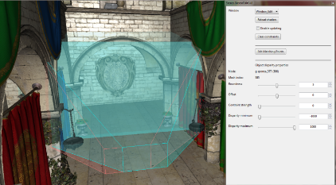
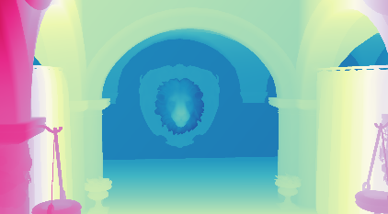
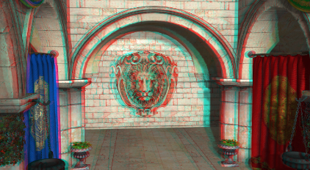
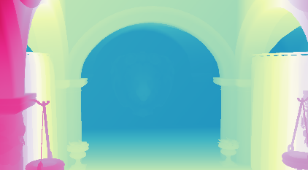
Overview
Artist input
Initial
disparity
estimate
Optimized
disparity
Final stereo pair
Initial
disparity estimation
Vertex
disparity projection
Disparity optimization
Original
disparity
Notes:
In order to do this, we will put together a pipeline that takes the original scene and its disparity, along with artist edits.
Using that, we can create an initial disparity estimate of the final scene in order to find possible disparity errors.
We then use all this information in an optimization process to obtain a disparity values that respect the artist edits but avoids errors.
Finally, I will also explain how to go from the optimized disparity to the stereo image.

Slide 41
Why local editing ?
Original
Global match
Local match
Notes:
This is an interesting example where monocular cues still give a perception of depth, but allows us to modify the disparity values

