Slide 1
A Fast Geometric Multigrid Method for Curved Surfaces
Ruben Wiersma, Ahmad Nasikun, Elmar Eisemann, Klaus Hildebrandt

Slide 2

Linear systems on curved surfaces
$$Ax=y$$
Notes:
Linear systems on curved surfaces show up in many places in geometry processing

Slide 3
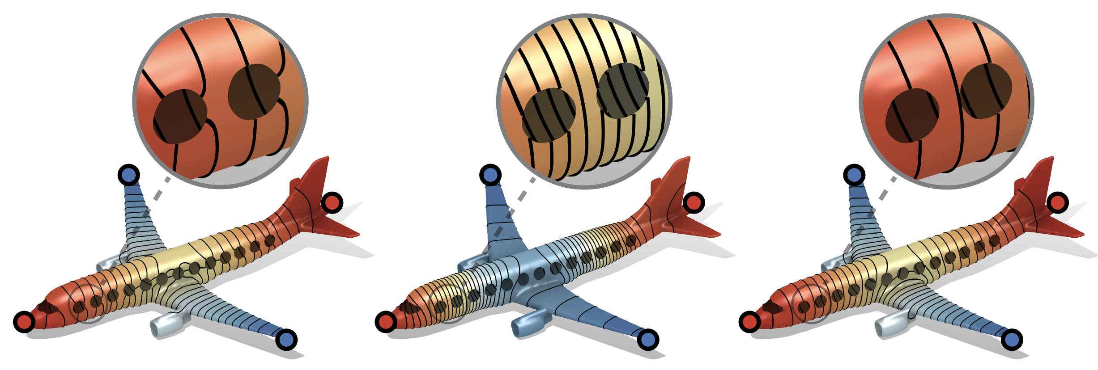
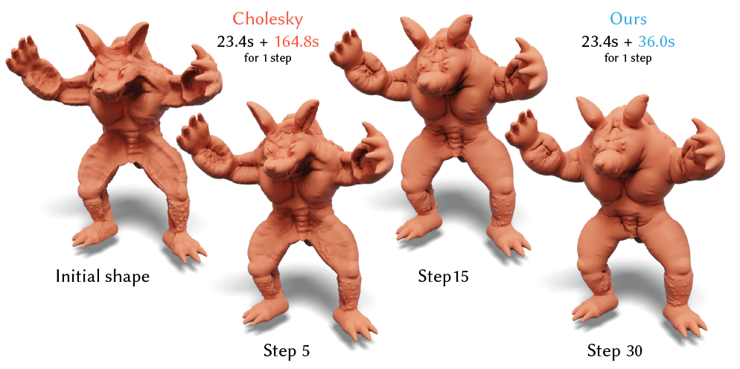
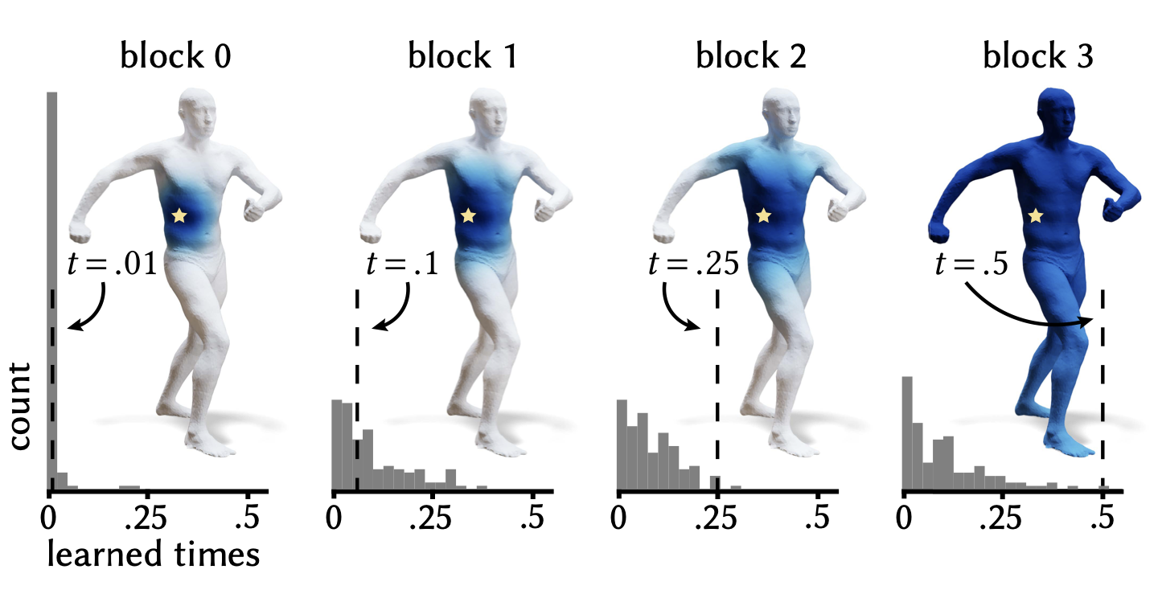
Linear systems on curved surfaces
[Stein et al. 2020]
Data smoothing
[Skouras et al. 2012]
Simulation
DiffusionNet [Sharp et al. 2022]
Shape analysis
Machine learning
Notes:
Smoothing data
Simulation and animation
Shape analysis and machine learning
And we're only getting started!

Slide 4
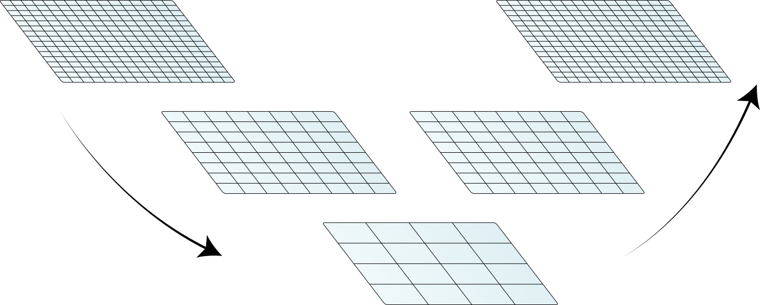
Multigrid methods solve efficiently
Input
Output
Direct solve
Notes:
One way to solve these systems efficiently is to use a Multigrid Method. The idea is to solve the system not only on one grid

Slide 5
Multigrid methods solve efficiently
Input
Output
Restrict
Prolong
Direct solve
Notes:
but on several grids of varying size. Because iterative solvers converge very quickly depending on the grid size, the use of multiple grids improves the convergence of the solver.
The basis of a multigrid solver is the grid hierarchy and the associated prolongation and restriction operators …

Slide 6
Multigrid methods solve efficiently
Input
Output
Restrict
Prolong
Direct solve
Notes:
that map between the grids of the hierarchy.

Slide 7
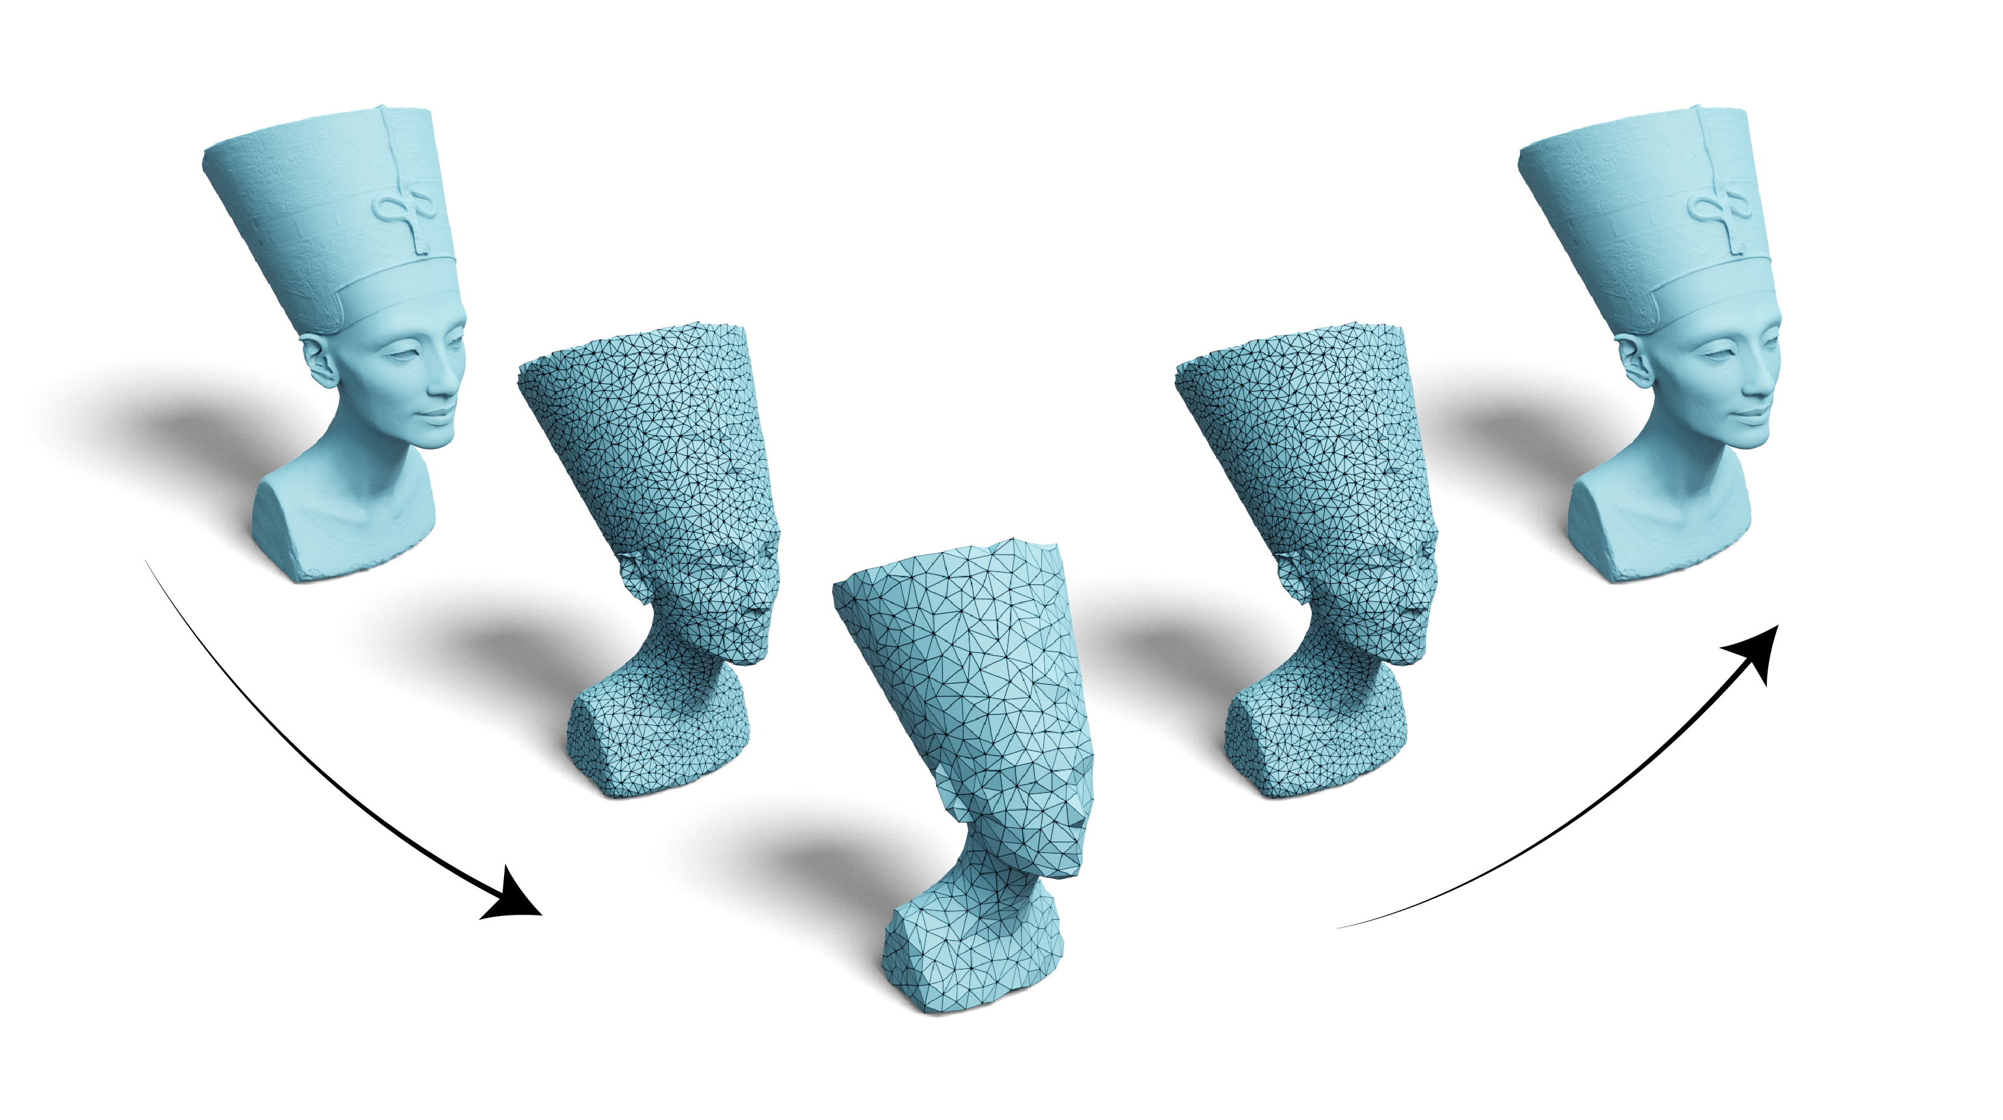
But what about curved surfaces?
Restrict
Prolong
Notes:
While hierarchies for regular grids in Euclidean domains are well studied, the construction of efficient multigrid hierarchies for irregular meshes or point clouds is an active research question.
In our analysis of related work, we identify two approaches to designing Geometric Multigrid methods on curved surfaces.

Slide 8
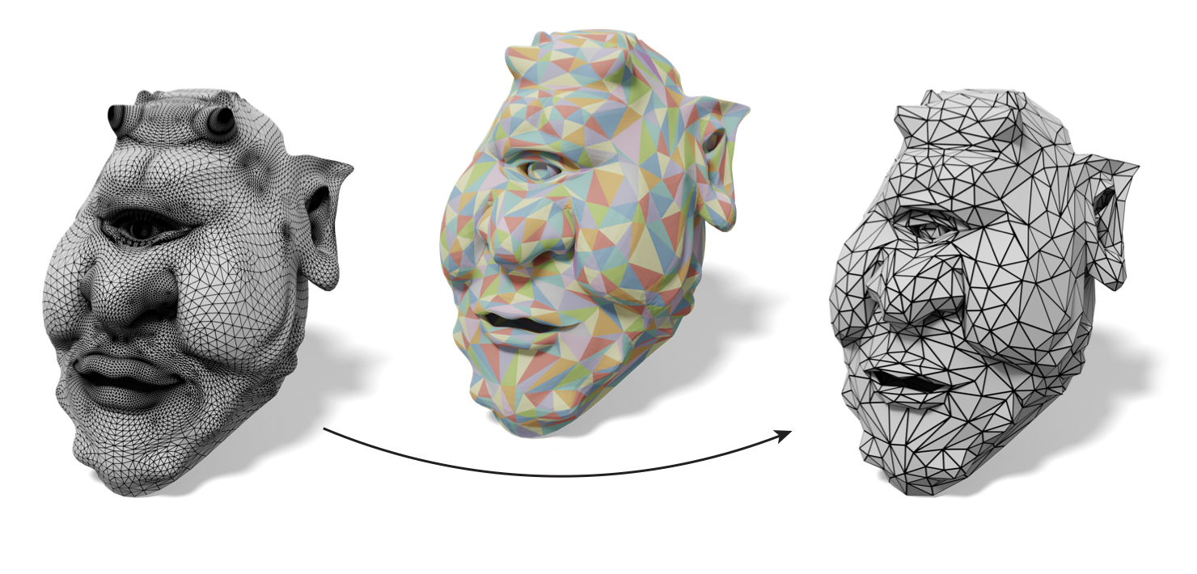
Coarsening meshes and mapping
Mapping
Slow construction
Faster convergence
Coarsening
Bad meshes, point clouds
Intrinsic prolongation [Liu et al. 2021]
Notes:
The first is to construct a hierarchy of meshes by mesh coarsening and then mapping between the meshes. A recent example is the intrinsic multigrid scheme by Liu and colleagues. This approach obtains efficient prolongation operators that lead to fast convergence. The downside of this approach is a costly hierarchy construction that does not generalize easily to other representations, such as non-manifold meshes and point clouds.

Slide 9
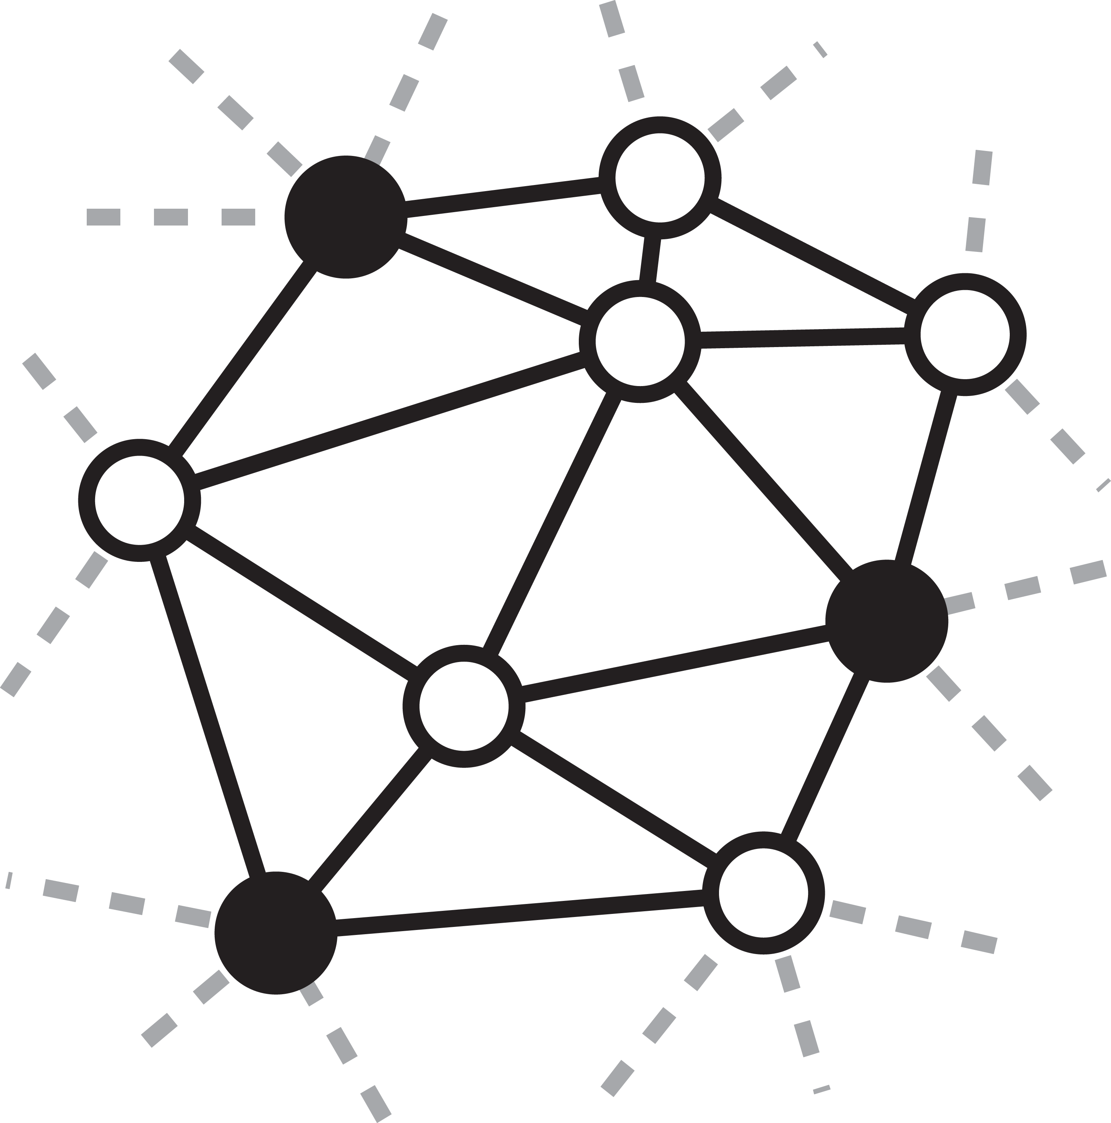
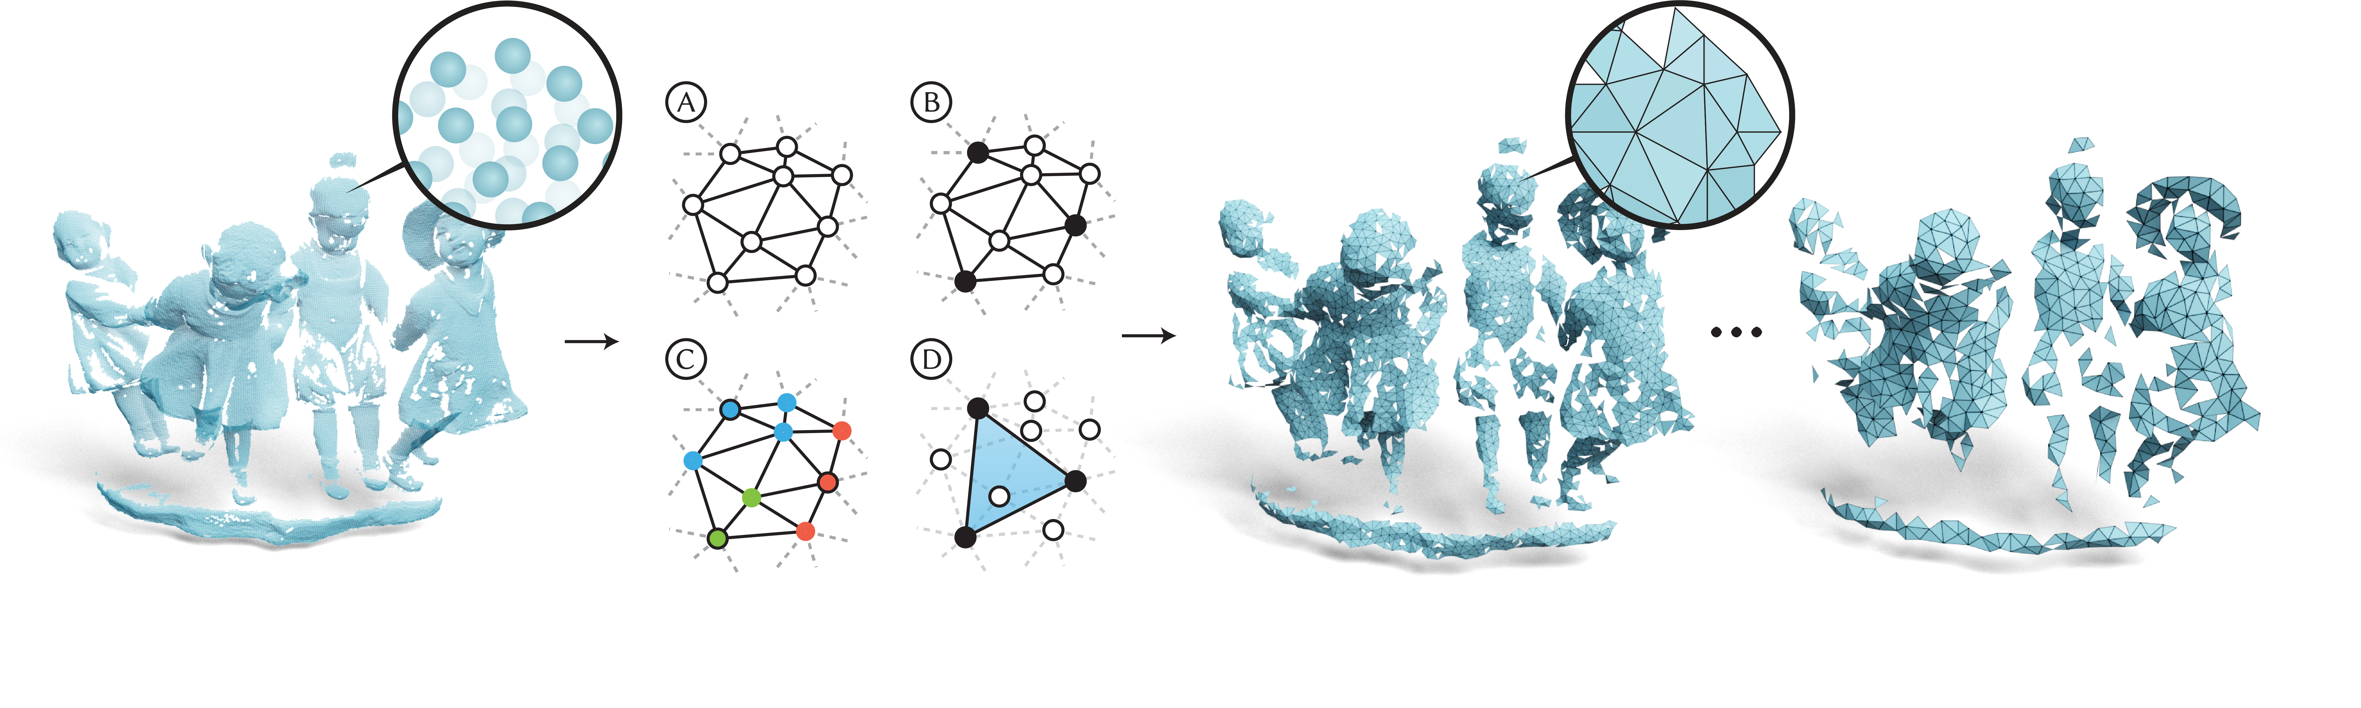
Graph coarsening
Fast construction
Works on any graph
Converges slowly
Graph coarsening [Shi et al. 2006]
Notes:
The second approach is to represent levels by graphs. The input could be a point cloud, where the edges are nearest neighbors or a mesh where the edges are taken from the mesh. The hierarchy is created by coarsening the edge graph of the input mesh and an example is the work by Shi and colleagues from 2006. This approach results in a fast construction and works on any graph but has slower convergence.

Slide 10
Gravo MG
Graph Voronoi Multigrid
Notes:
With our approach, called Gravo Multigrid, we seek to combine the strengths of both approaches: yielding both fast construction times and fast convergence and working on many different inputs, such as non-manifold meshes and point clouds.

Slide 11
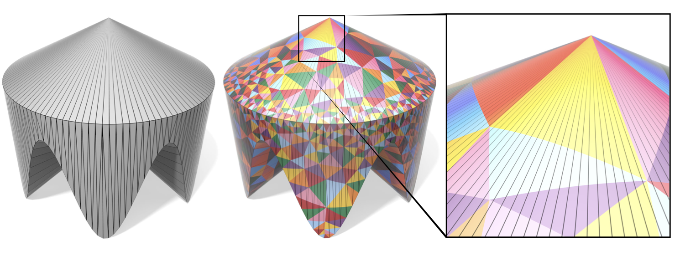
Let’s use intrinsic Delaunay triangulations
[Sharp, Gillespie and Crane, 2021]
Notes:
We start with a simple idea: What if we could compute Delaunay triangulations on points sampled from the surface? Then we could compute prolongation weights using barycentric coordinates. This gives us a couple of nice properties: we could just sample points on the surface and then compute a triangulation. That means we don’t need edge contractions.

Slide 12
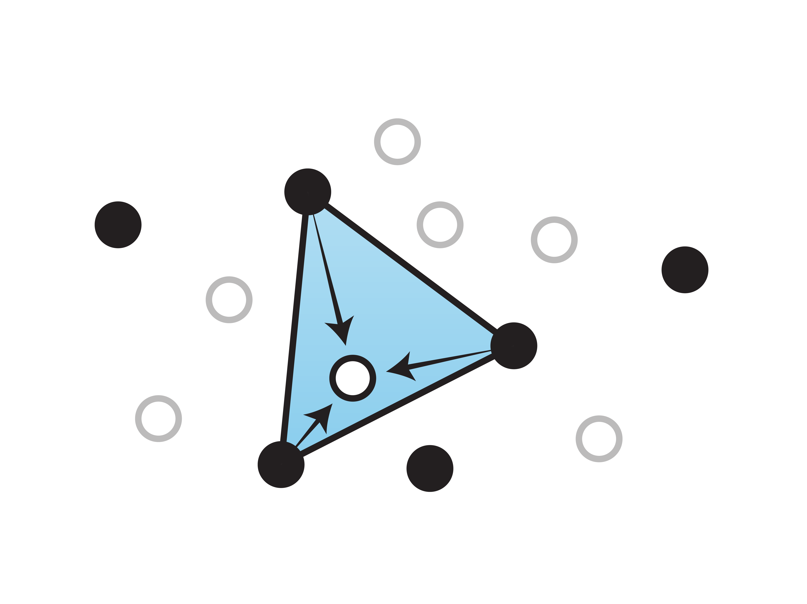
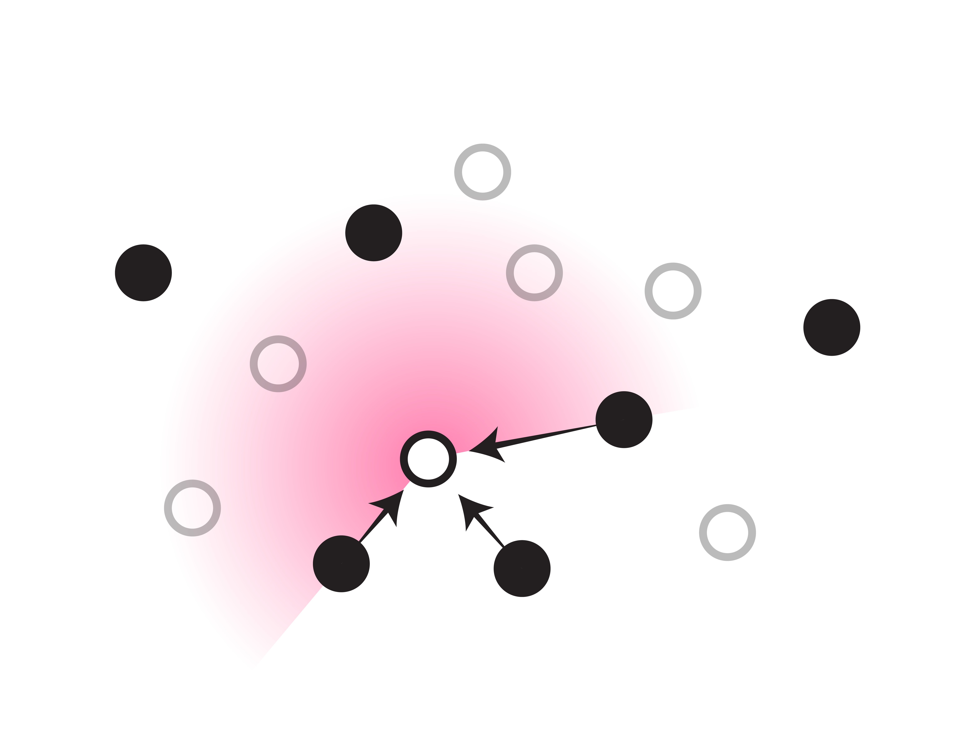
Prolonging from all directions
3 nearest
Notes:
Second, during prolongation, a fine point always receives information from multiple directions from the coarse points, because they form a containing triangle. This is not guaranteed to happen, for example, with just selecting the three nearest neighbors.

Slide 13
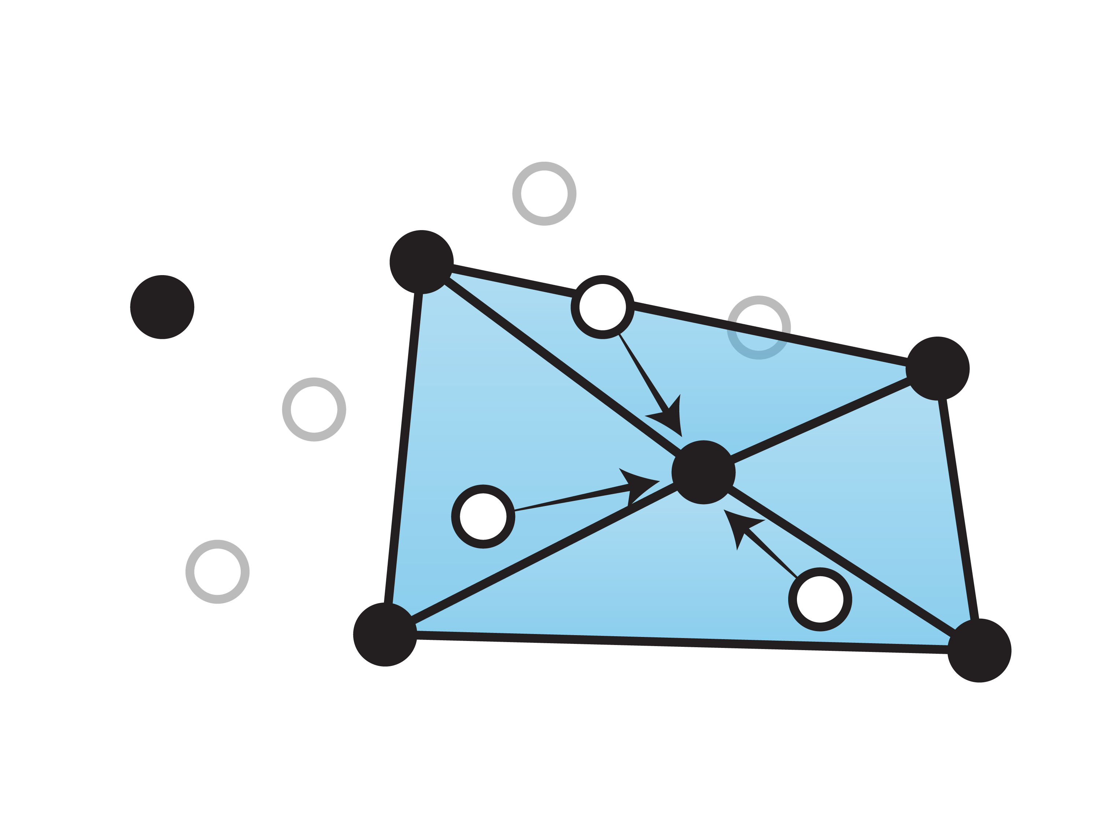
Restricting from all directions
Notes:
Vice-versa, during restriction, each coarse point always receives information from multiple directions around the points.

Slide 14
Minimal entries in prolongation matrix
Notes:
Finally, we keep the number of points in each row of the prolongation matrix to a minimum: 3. This results in fast operations during solving.

Slide 15
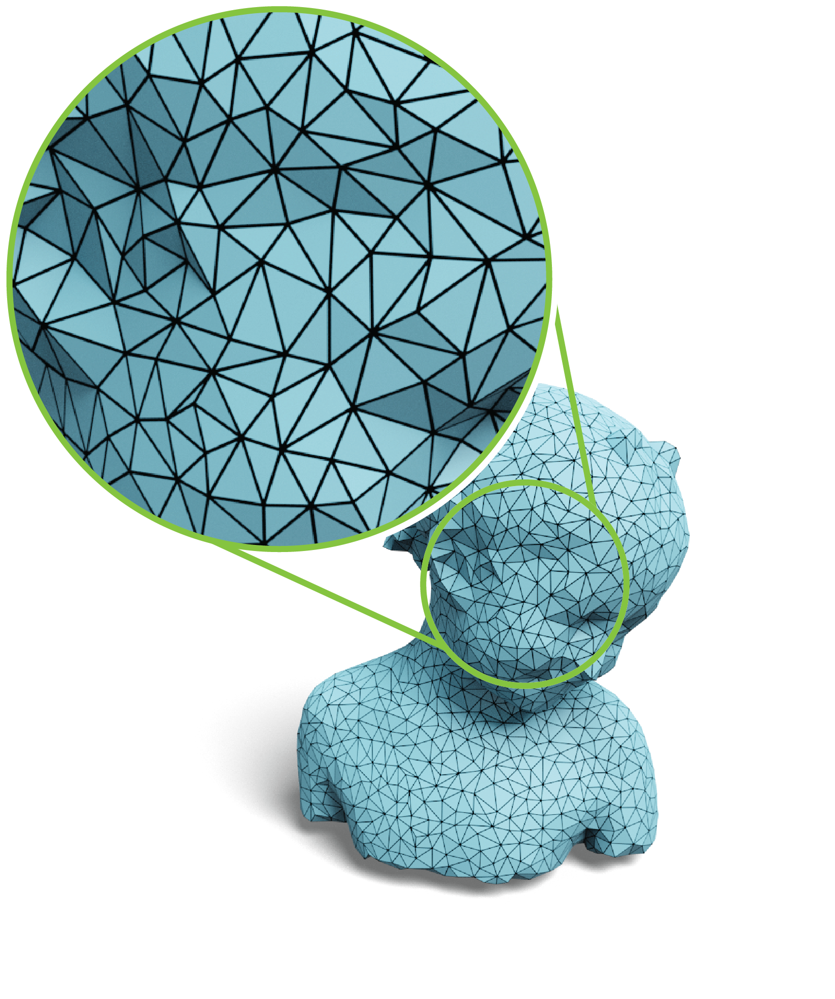
Can we mimic Delaunay triangles?
Notes:
However, computing intrinsic Delaunay triangulations is complicated to transfer to different representations and could be expensive. While we do think there’s value in trying this, our main goal for this work was to push the efficiency of the hierarchy construction while maintaining solving times and supporting more surface representations. So we asked the question: Can we mimic this idea in some way and still benefit from fast solving times?

Slide 16
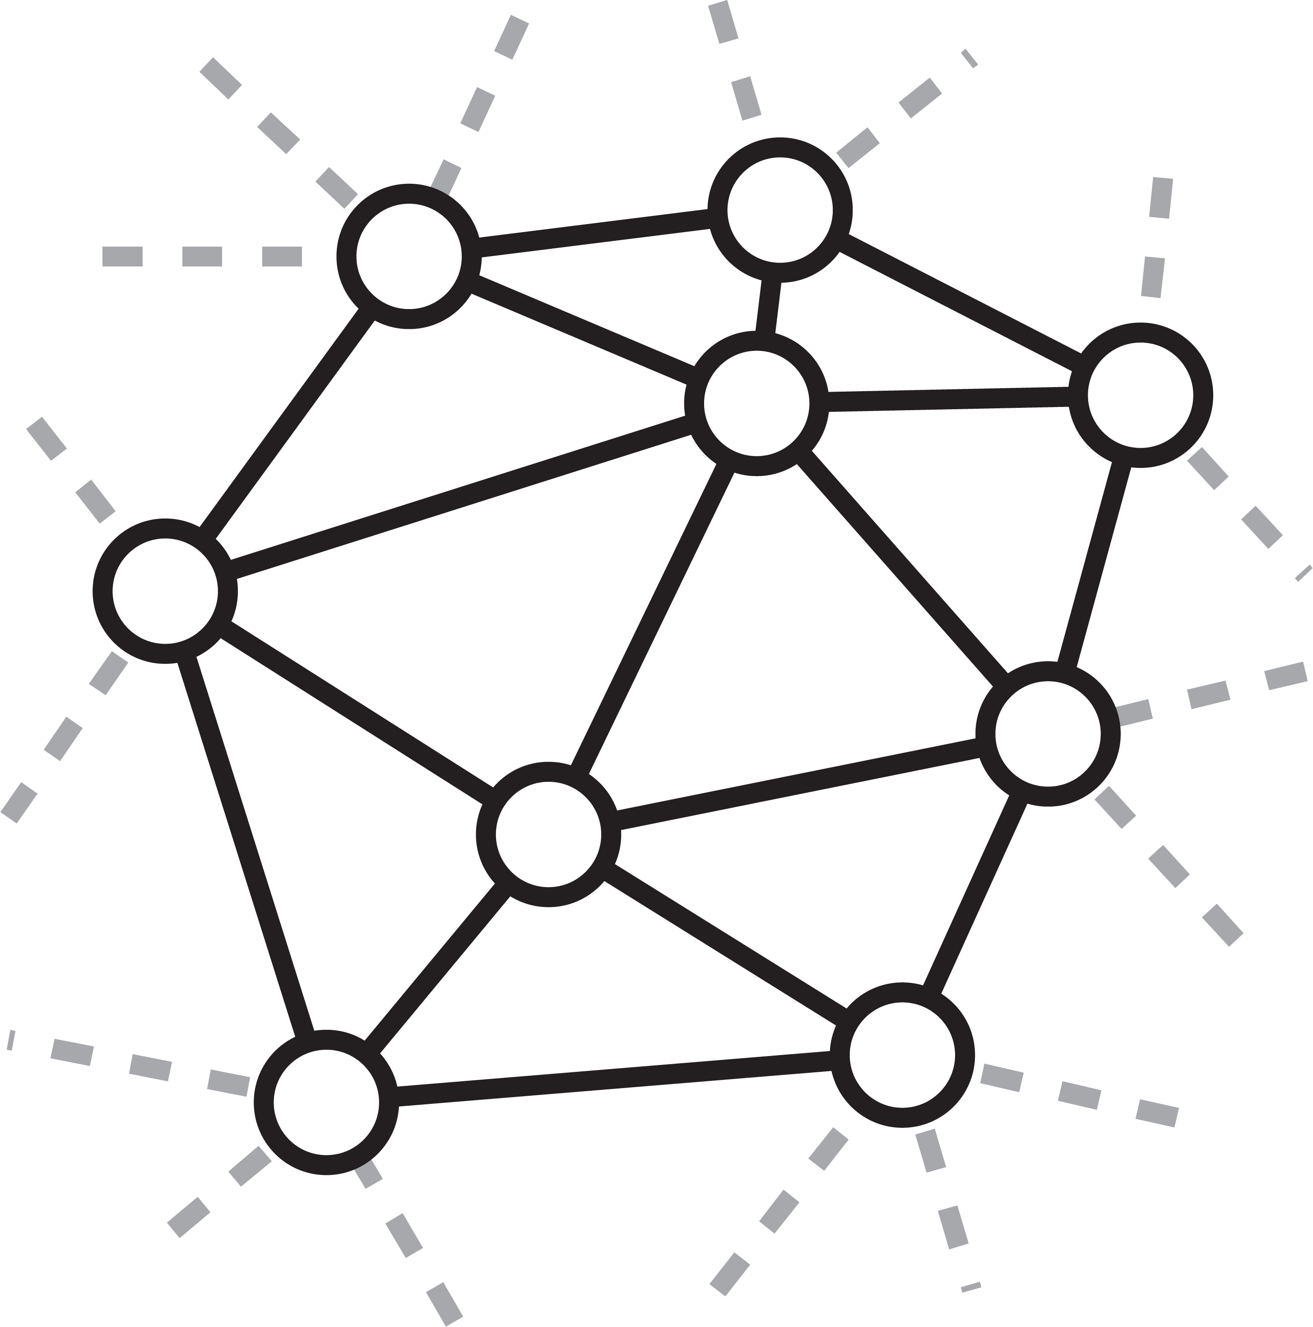
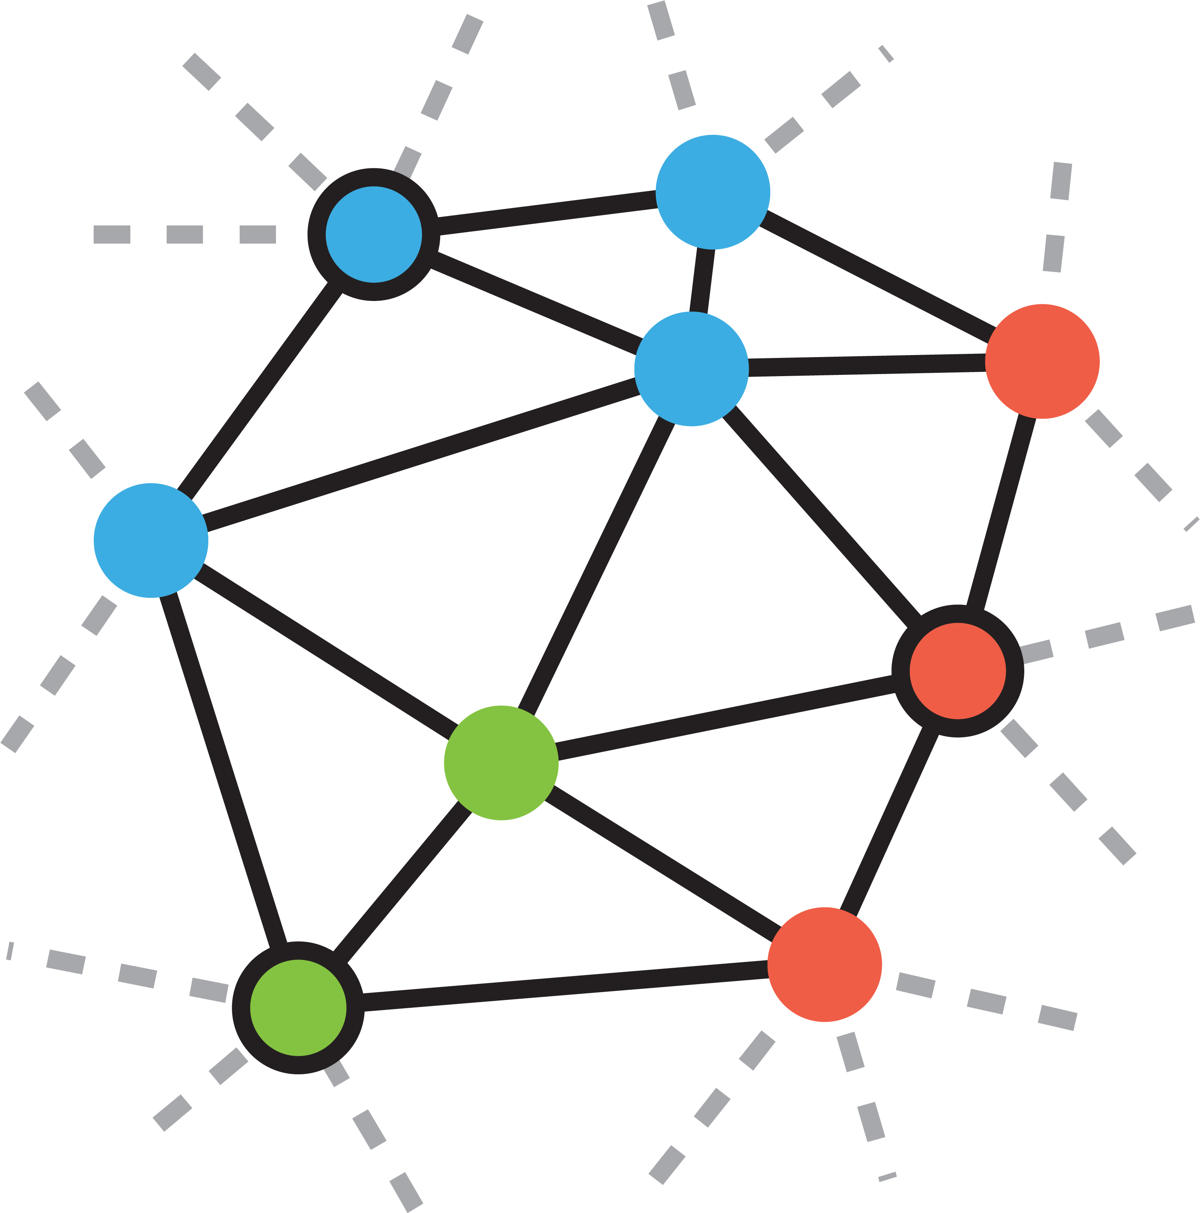
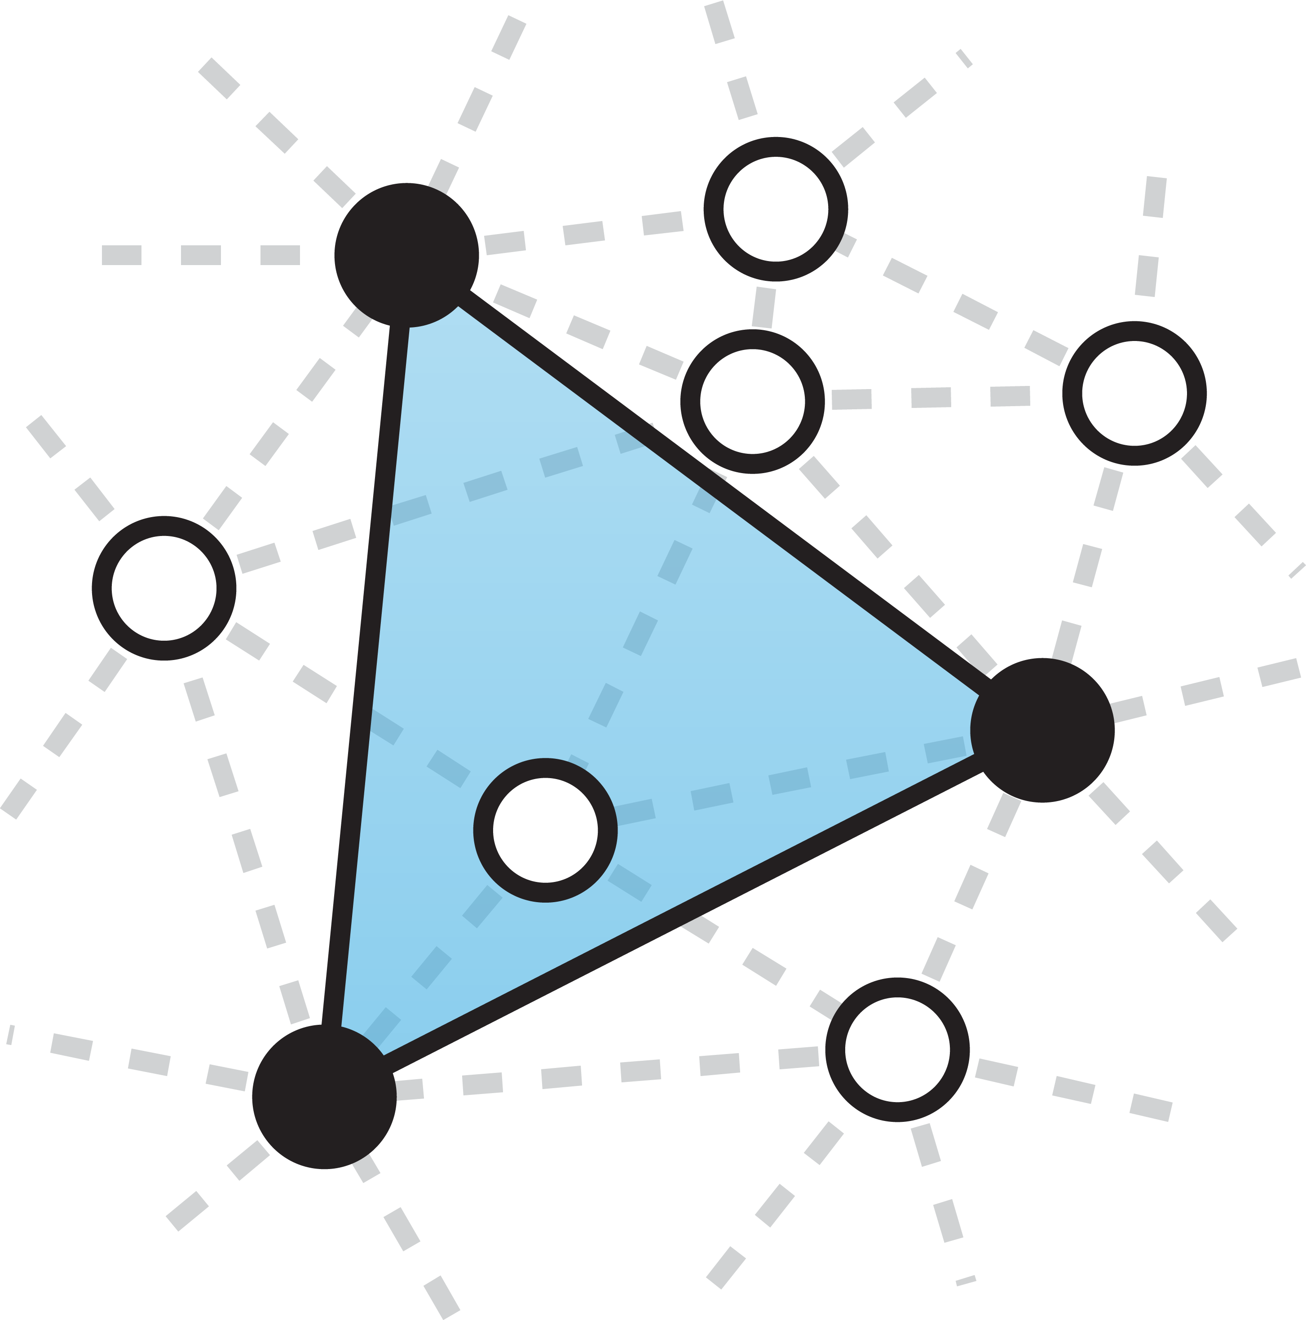
Graph Voronoi Multigrid
Sample points
Compute Graph Voronoi diagram
Construct triangles
Compute prolongation weights
Notes:
The result is Gravo Multigrid, which gets is name from the use of graph Voronoi cells during construction. Gravo MultiGrid consist of the following steps: first, we sample points from the surface using a fast sampling strategy. Next, we compute a graph Voronoi diagram, followed by the construction of triangles based on this diagram. Finally, we compute prolongation weights using barycentric coordinates.
Let’s look at these steps in more detail.

Slide 17
Fast uniform sampling
Notes:
In the sampling step, we look for a spatially uniform set of points on the surface. We use an algorithm based on the maximum independent set: we sweep once over the set of points, picking one point at a time if its eligible.

Slide 18
Fast uniform sampling
Notes:
Initially, all points are eligible. When we add a point to the sample set, we mark the points within a geodesic ball of p as ineligible.

Slide 19
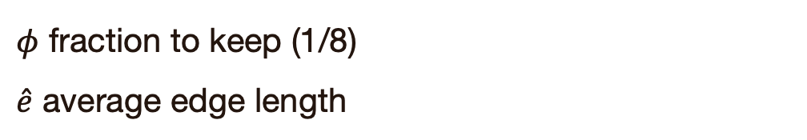
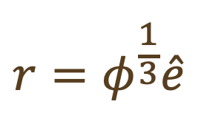
Fast uniform sampling
$$r=φ^{\frac{1}{3}}\hat{e}$$
$φ$ fraction to keep (1/8)
$\hat{e}$ average edge length
Notes:
The radius r is based on the fraction of points we wish to keep and the average edge length.

Slide 20
Fast uniform sampling
Notes:
We repeat this, until we’ve passed along all points.

Slide 21
Fast uniform sampling

Slide 22
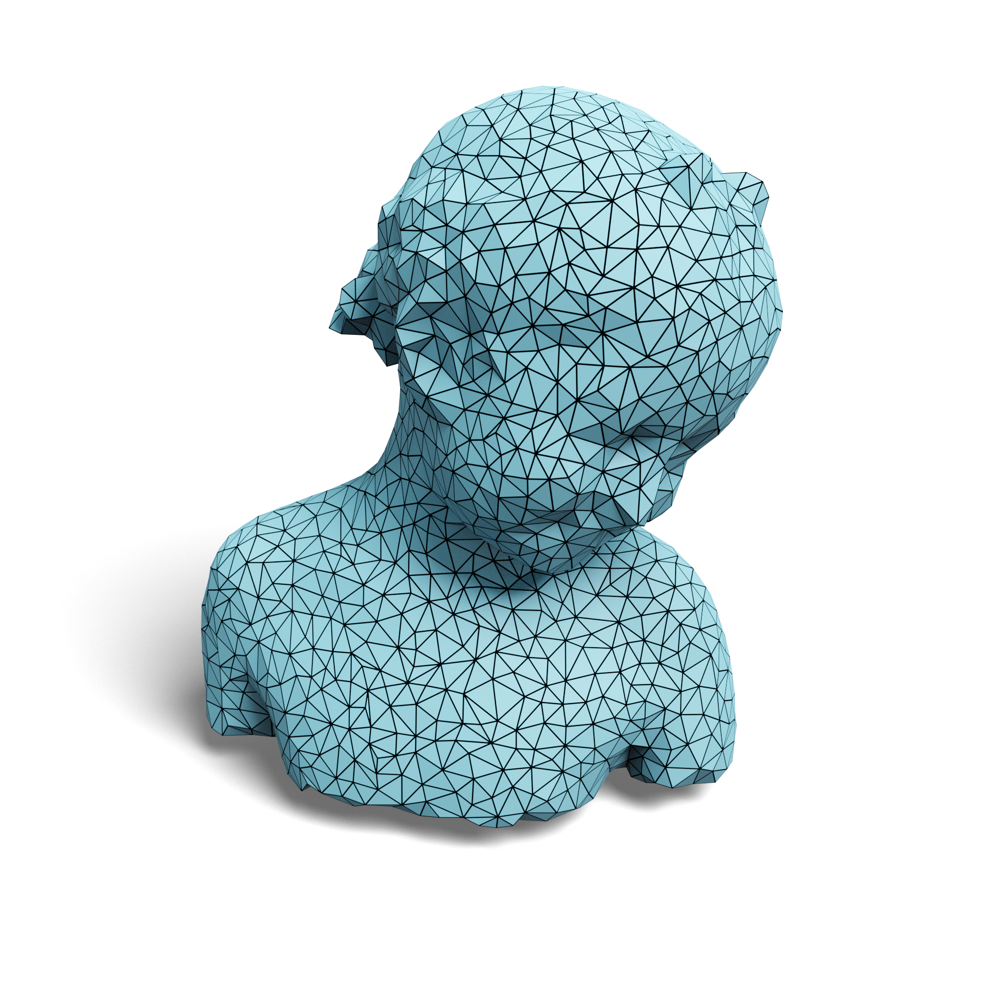
Fast uniform sampling
Geodesic distances in 2-ring
Notes:
On curved surfaces, we use a geodesic ball and only search the 2-ring for marking points as ineligible. This is a trade-off between efficiency and achieving the desired sampling ratio.

Slide 23
Graph Voronoi diagrams
Notes:
Next, we construct a graph Voronoi diagram around each point. This is done with a fast multi-source Dijkstra algorithm. Each sampled point now has a graph Voronoi cell around it, defined on the points in the finer level.

Slide 24
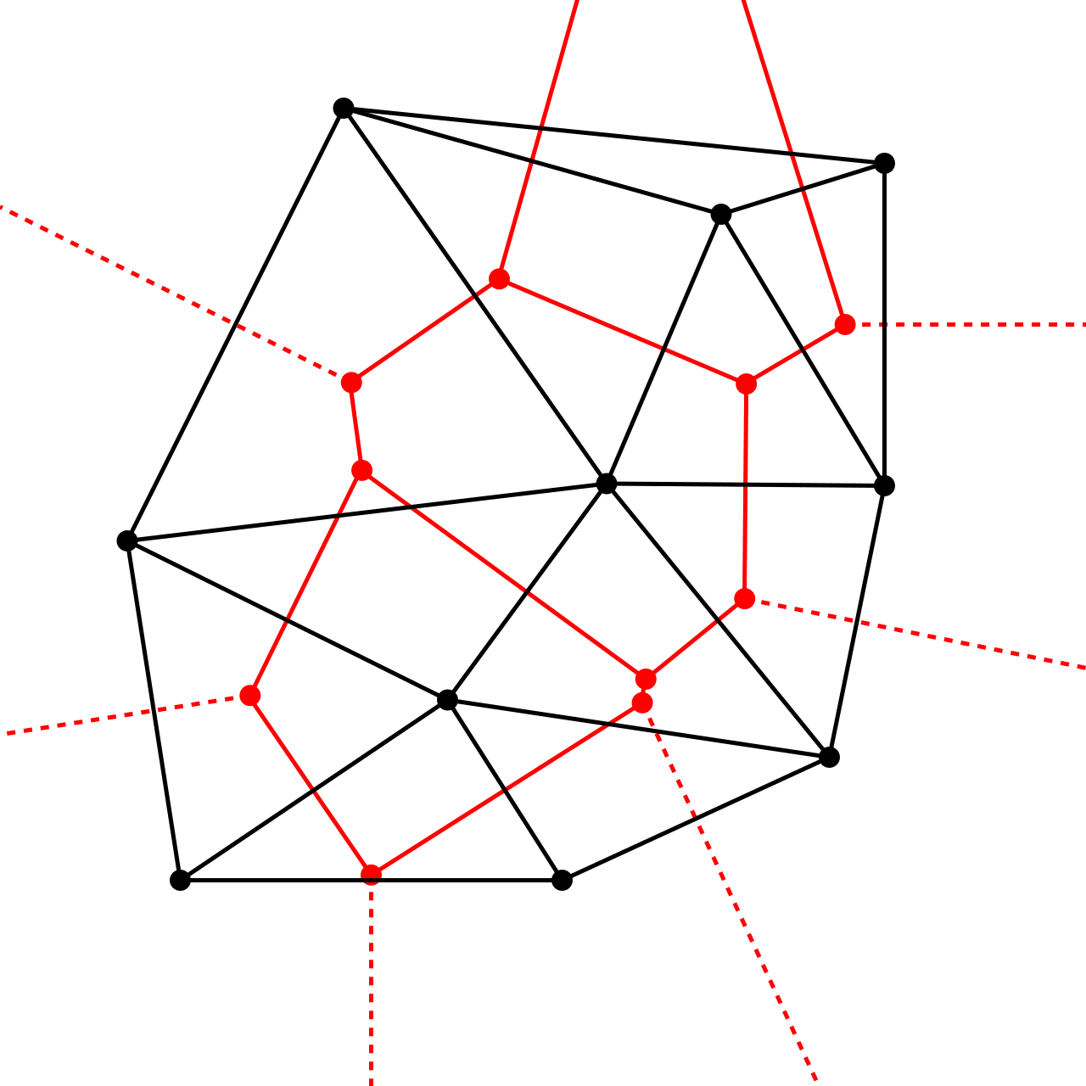
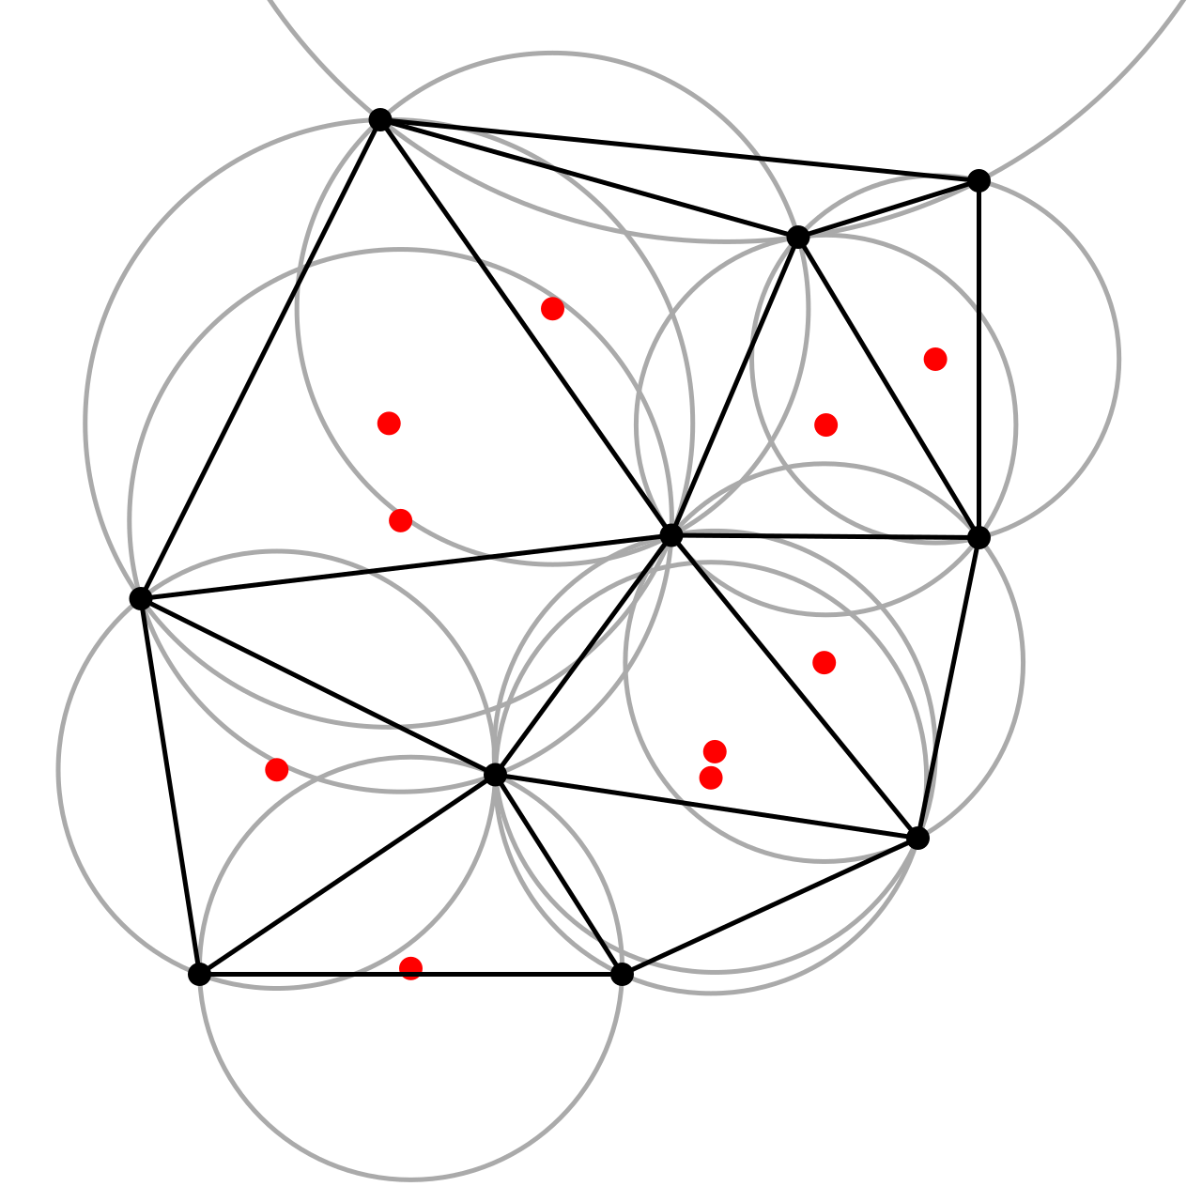
Voronoi ↔ Delaunay
↔
Notes:
This is where our guiding idea of using Delaunay triangles shows up again: for a continuous Voronoi diagram, the Delaunay triangulation is the dual of the Voronoi diagram.

Slide 25
Building triangles
Notes:
We mimic this idea by creating triangles from the edges connecting neighboring Voronoi cells.

Slide 26
Building triangles
Notes:
We mimic this idea by creating triangles from the edges connecting neighboring Voronoi cells.

Slide 27
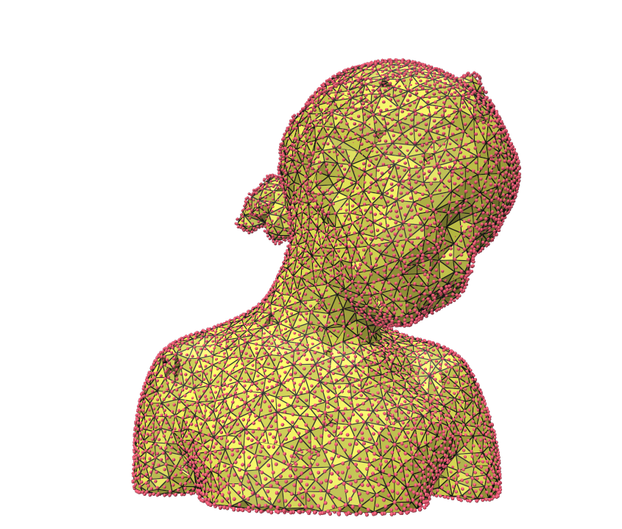
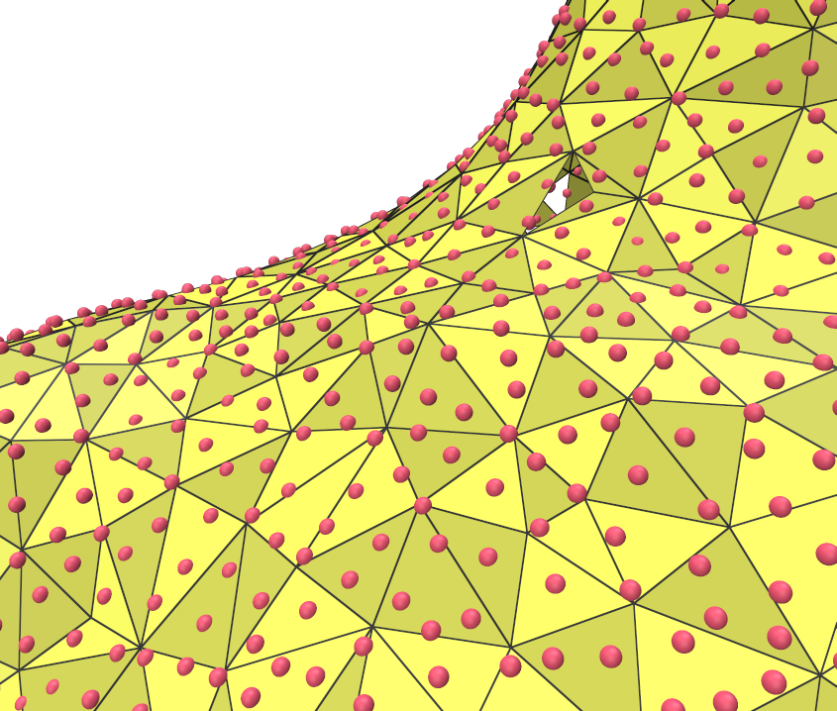
Building triangles
Notes:
On a curved surface, that looks like this: the red points are the non-sampled points and the triangles are the ones we find with our algorithm

Slide 28
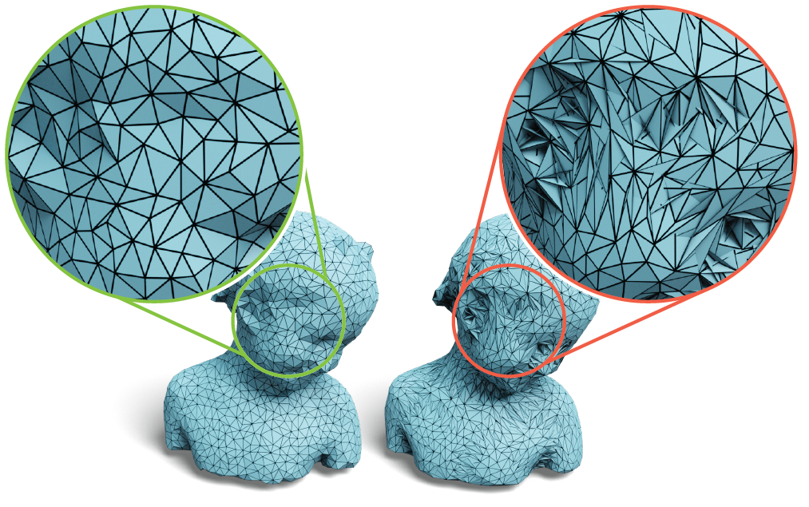
Nice triangles
Notes:
The result is a highly uniform triangulation (because of uniform sampling) and nice, regular triangles. On the left, you see our result and on the right is what would happen if you consider any triangle in the one ring.
These 'bad' triangles result in worse convergence and use more time in later stages, because we have to consider more triangles in subsequent steps.

Slide 29
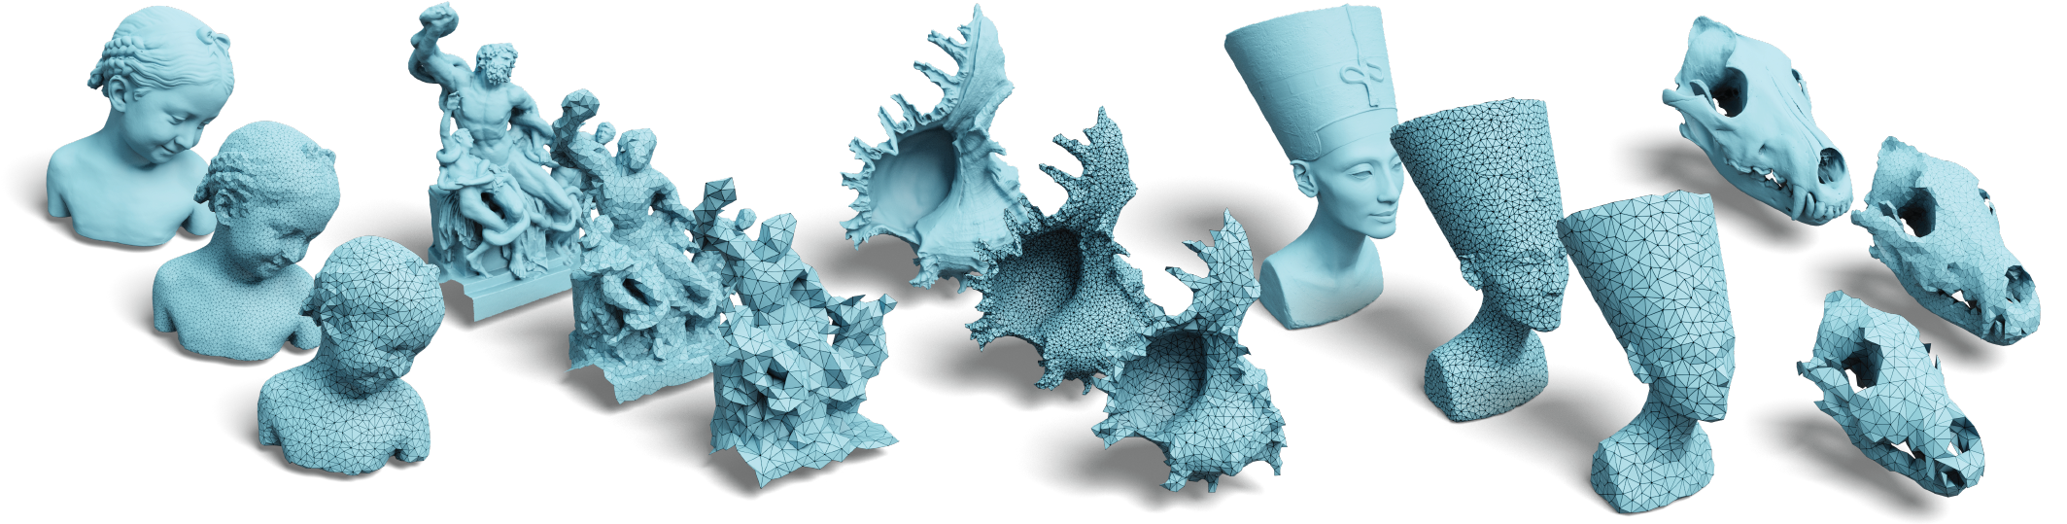
Repeat for each level
Notes:
We repeat this process for each level and find for many types of shapes that we get remarkably nice triangulations.

Slide 30
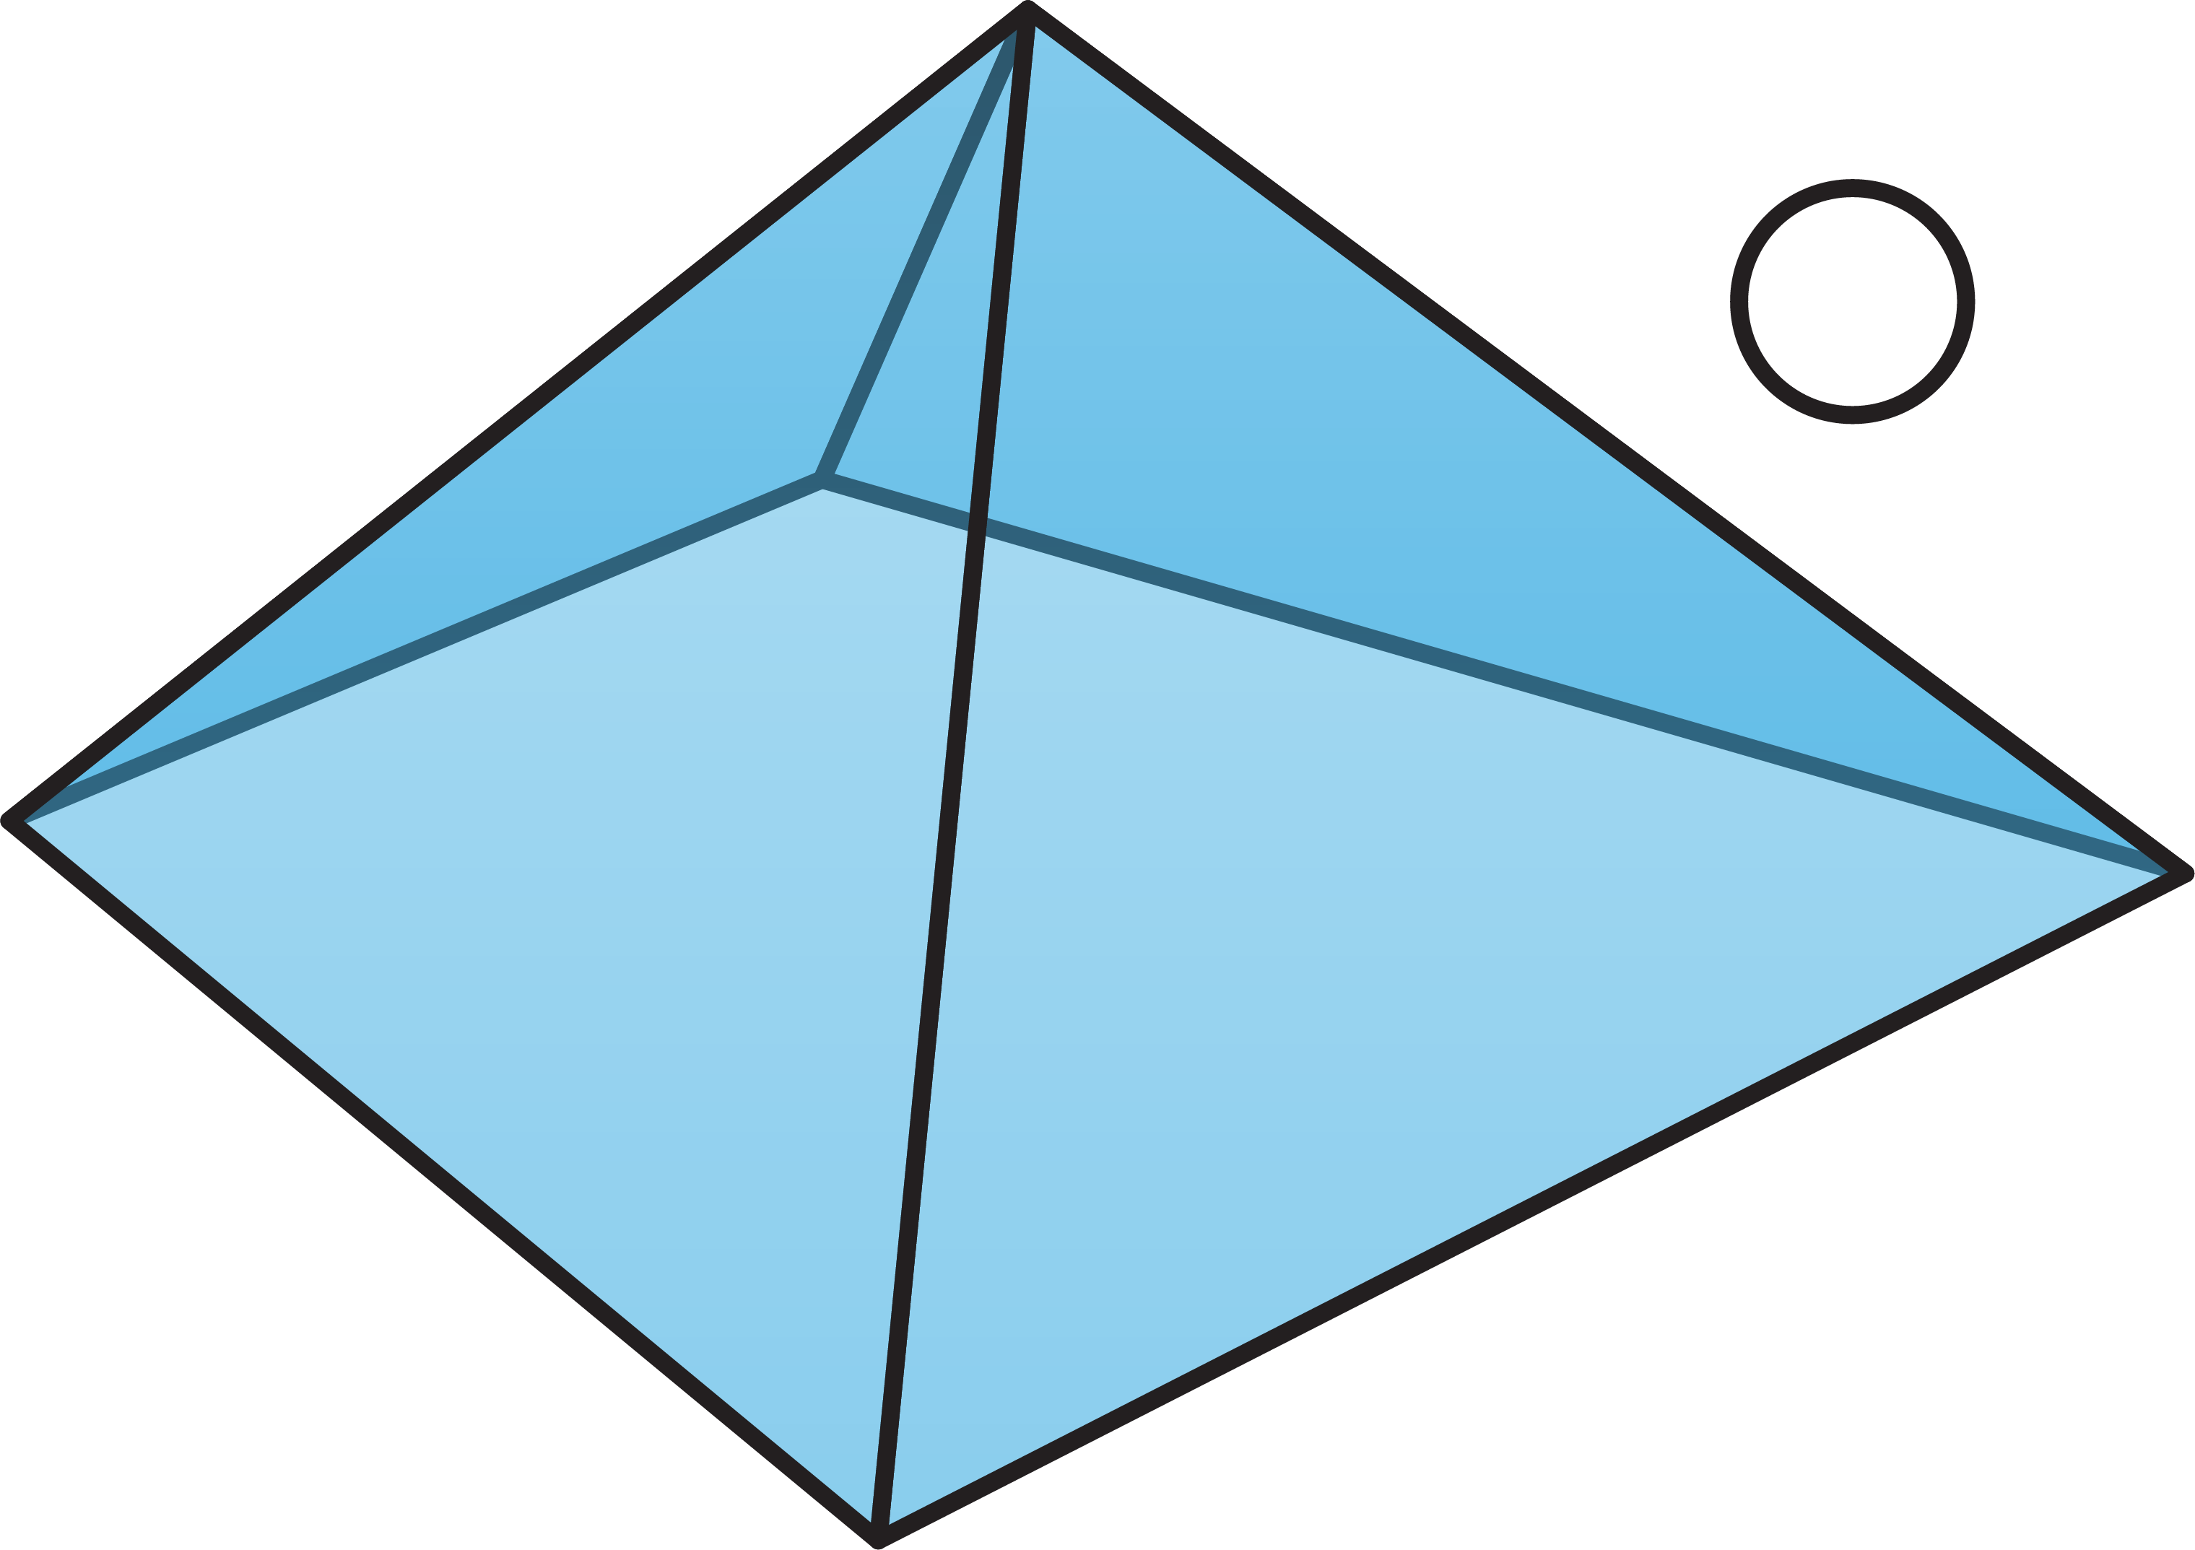
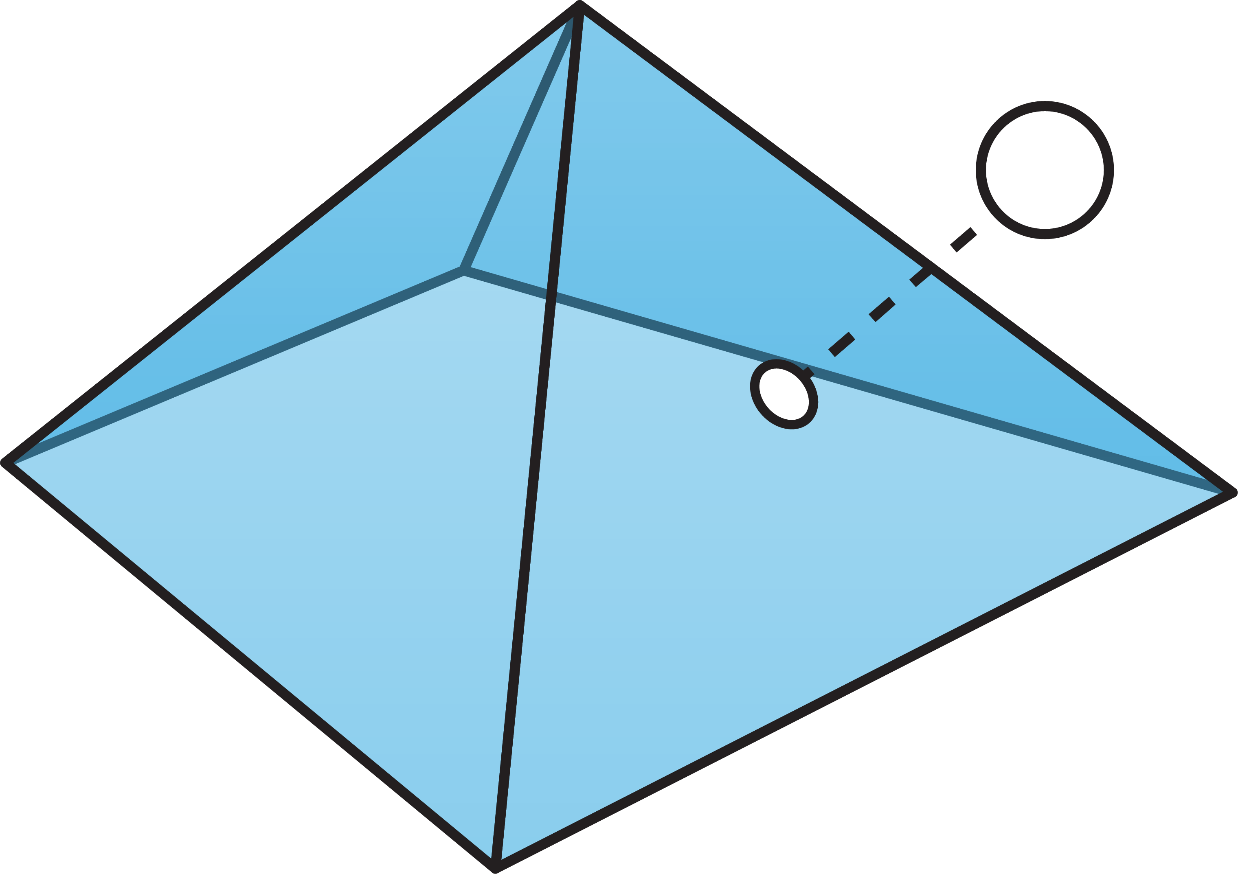
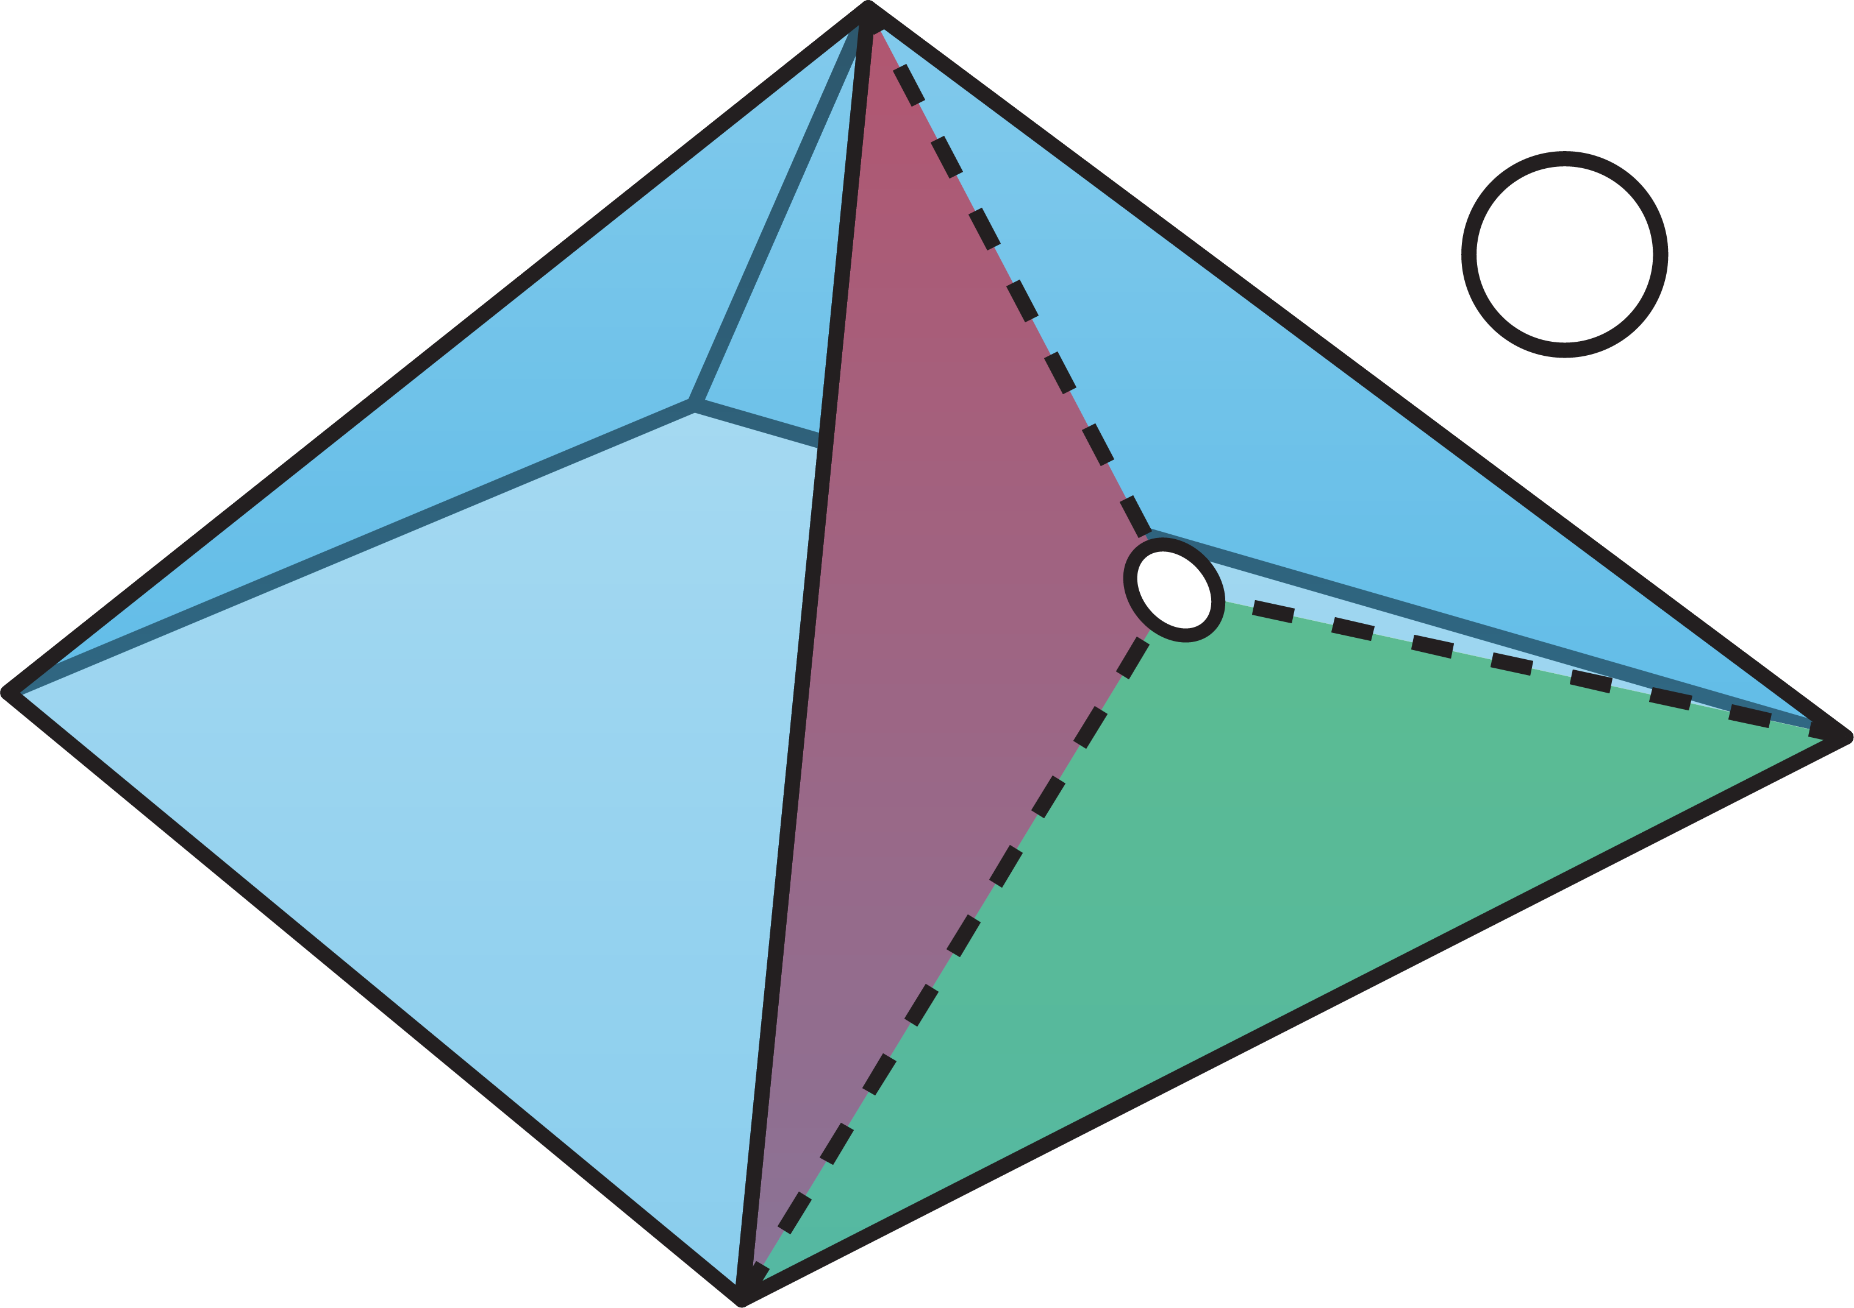
Prolongation weights
Notes:
Given these triangles, we compute prolongation weights by performing a closest point projection to this triangulation and then computing barycentric coordinates.

Slide 31
Prolongation weights
Notes:
These are then stored in a highly sparse, rectangular prolongation matrix, which is used in the multigrid solver.

Slide 32
Graph Voronoi Multigrid
Notes:
Let’s recap: We now have a way to 1. take in any mesh or point cloud, 2. downsample our input quickly to get a hierarchy of points and 3. compute a fast triangulation for each level that can be used to get prolongation weights.

Slide 33
Results
Bravo, Gravo?
Notes:
Let's take a look if we can also solve fast.

Slide 34
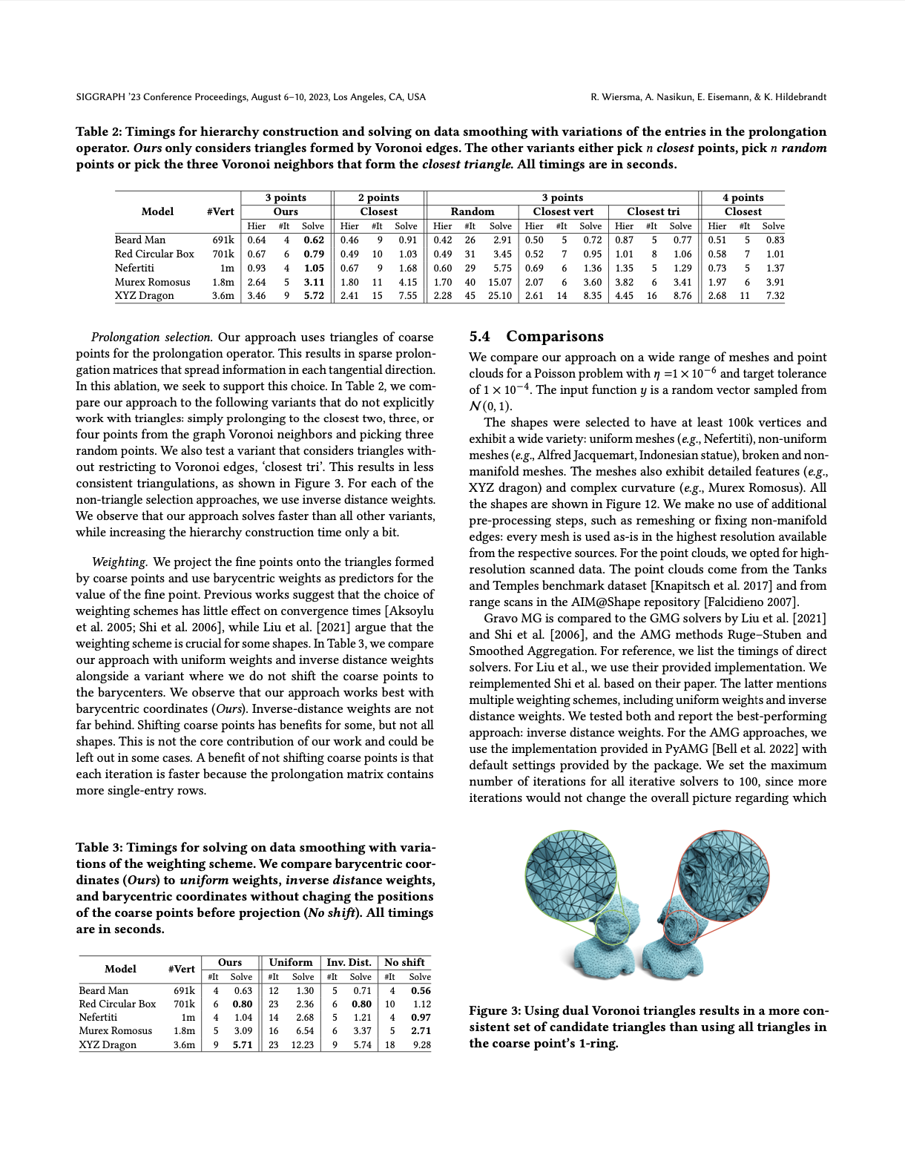
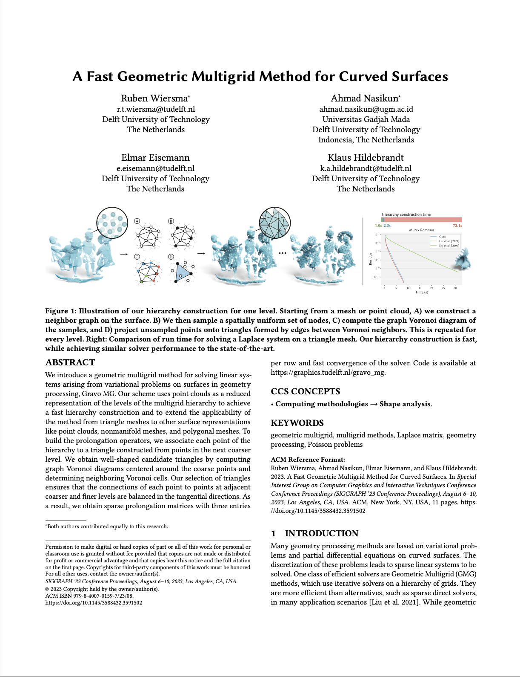
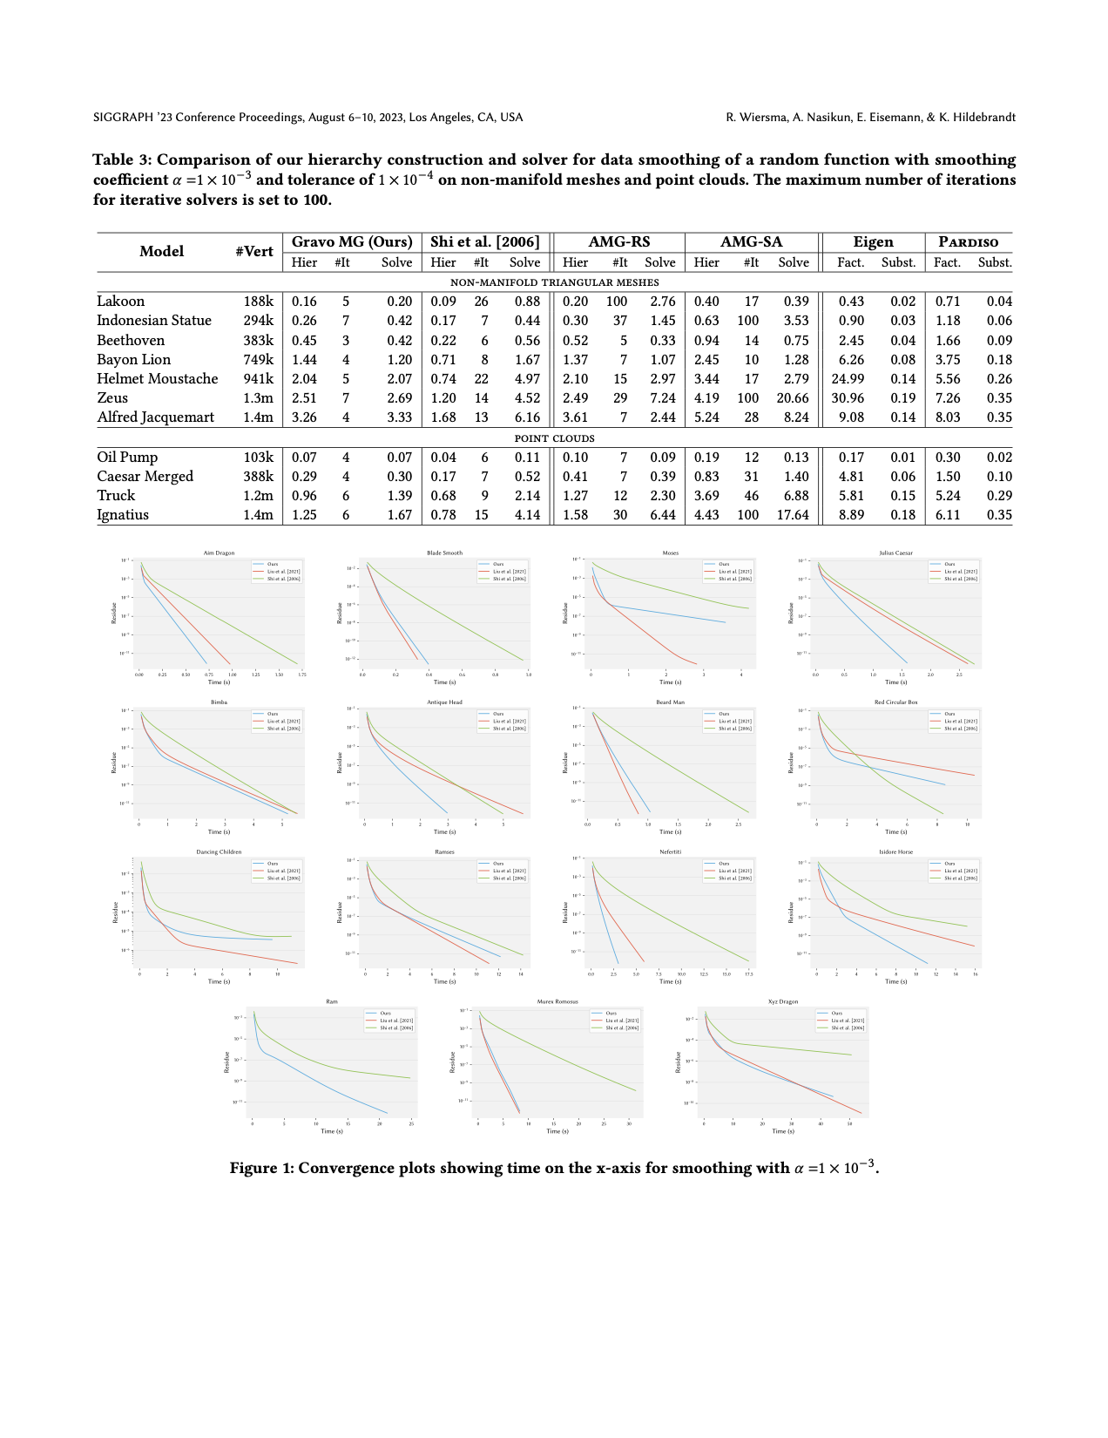
More results in the paper
Comparisons
Ablations
Notes:
In this talk, I will focus on the comparisons that we did. We have a set of ablation studies in the paper, that pick apart each choice in the algorithm.

Slide 35

Comparisons, comparisons, comparisons
Construction time
Solving time
[Liu et al. 2021]
Algebraic
Multigrid
Direct Solvers
Eigen, PARDISO
[Shi et al. 2021]
Notes:
In our comparisons, we compare against the methods by Shi and colleagues from 2006 and Liu and colleagues from 2021 and look at two things: how fast can we construct the hierarchy? And how fast can we solve/converge to a solution? We also compare to other Algebraic Multigrid Approaches and for reference, compare to direct solvers.

Slide 36
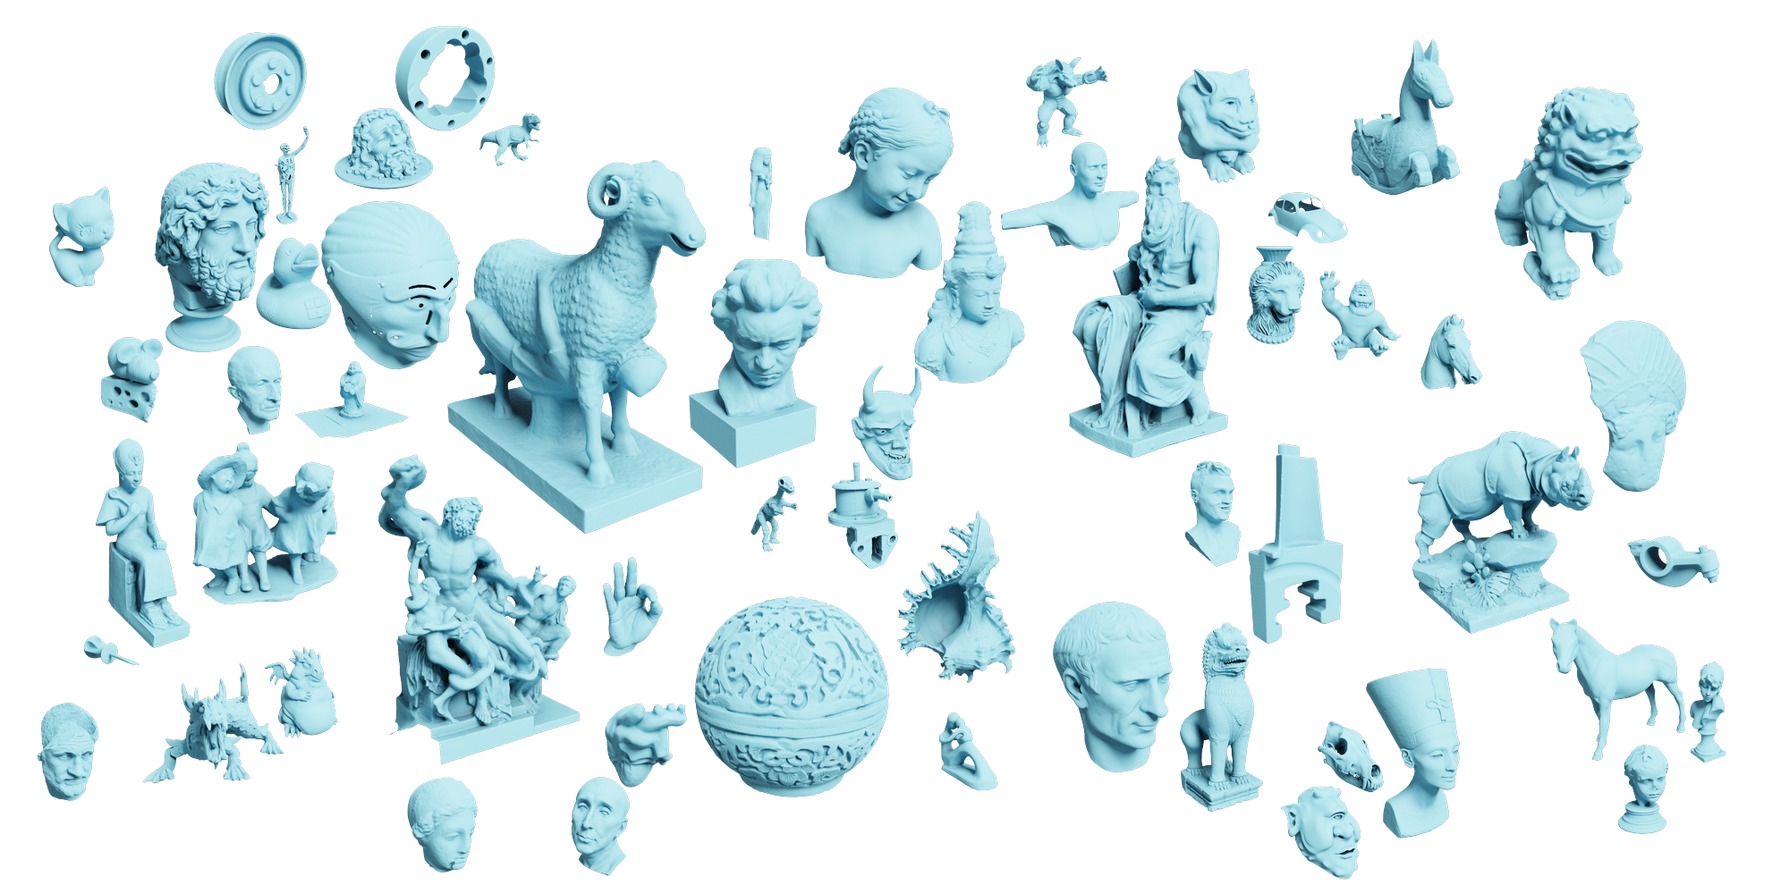
Meshes, meshes everywhere
Notes:
We tested on over 50 input shapes, including non-manifold meshes [click]

Slide 37
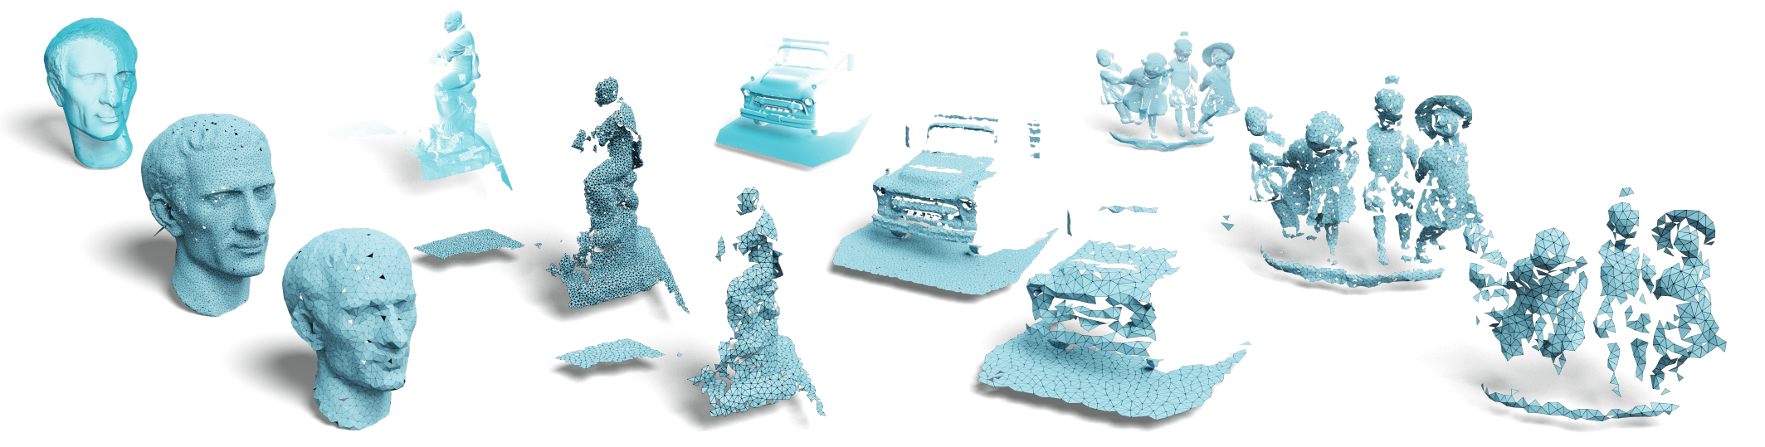
Not just meshes
Notes:
and point clouds

Slide 38
Faster construction
Notes:
Now, for some of our main findings.
- During construction, we are only 1.8x slower than the graph based approach by Shi and colleagues.
- But we are 36x faster in construction than the intrinsic multigrid method by Liu and colleagues.

Slide 39
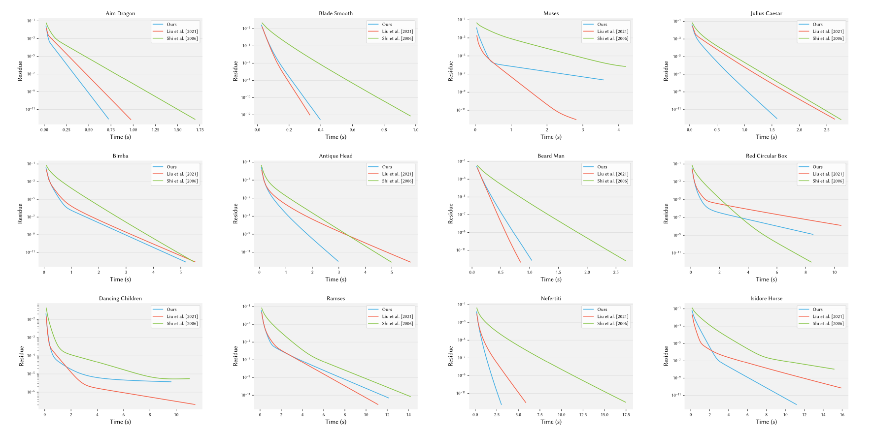

On par with solving
Notes:
With regards to convergence, we see similar behavior to Liu and colleagues. In our paper, we show convergence plots for a whole number of shapes.

Slide 40
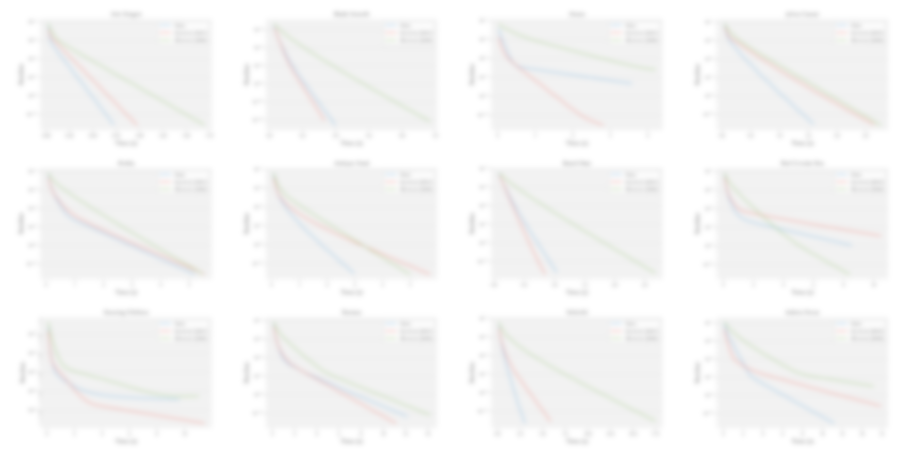
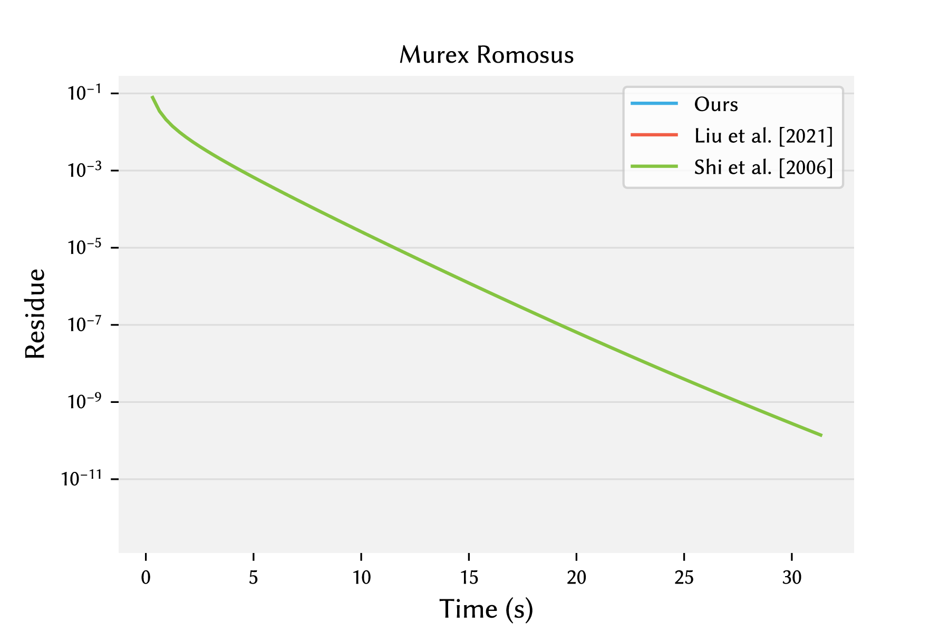
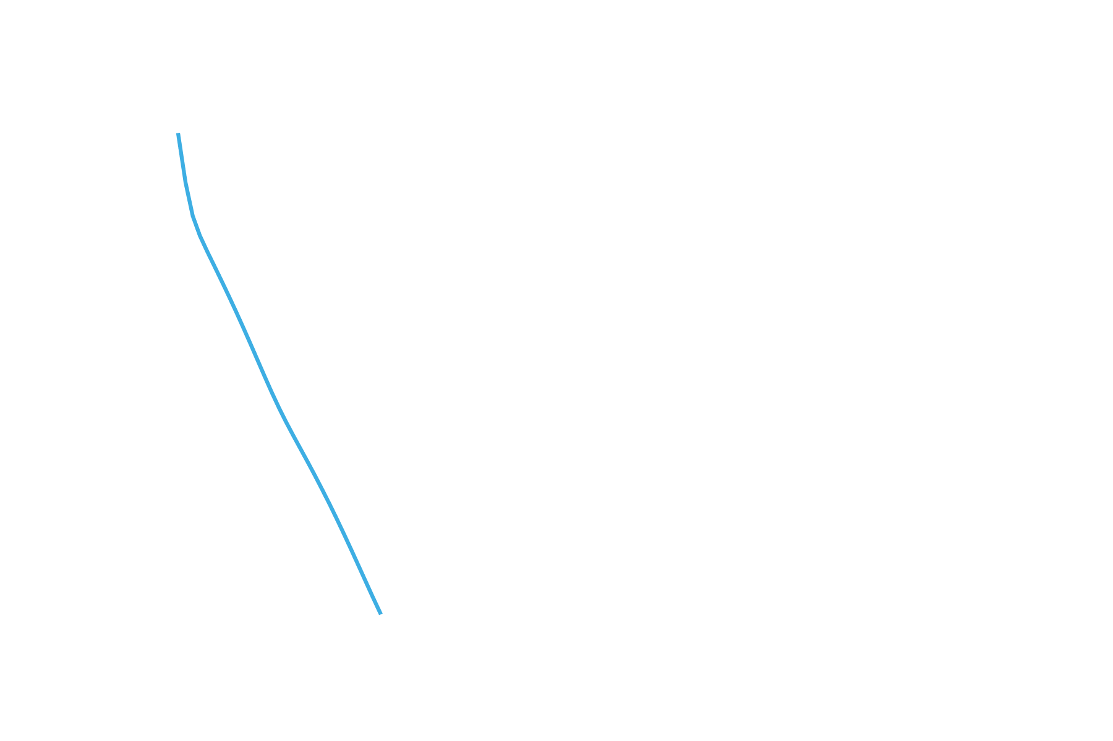
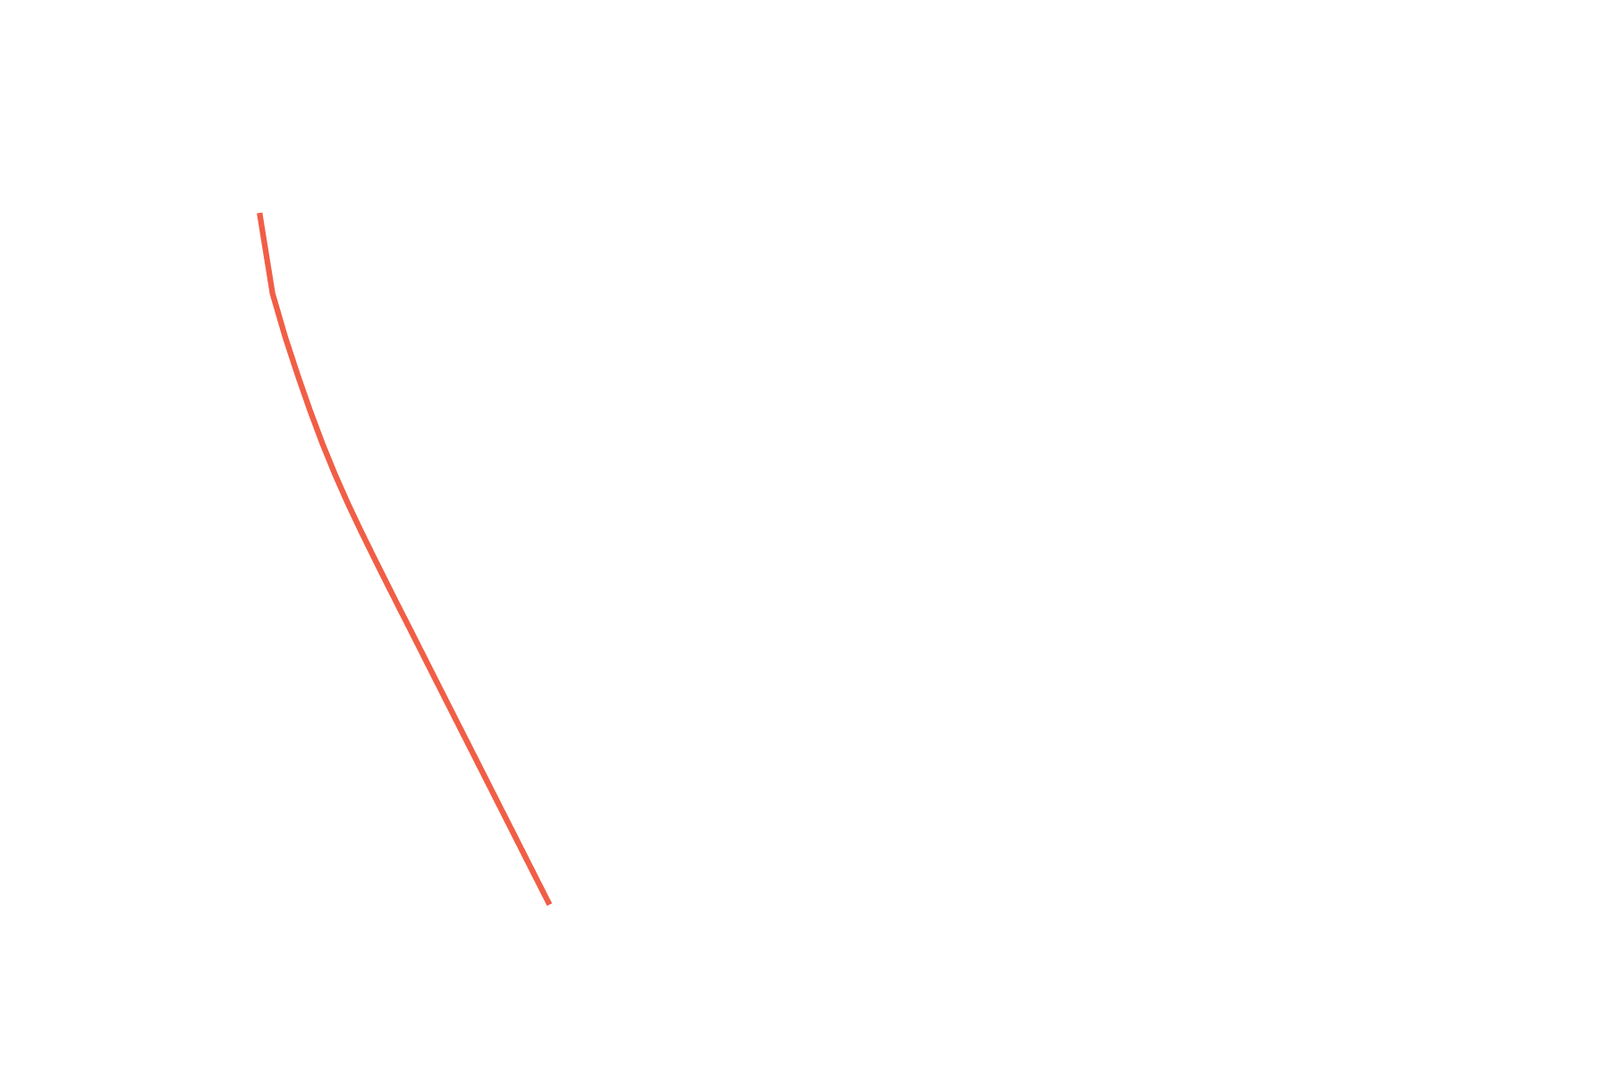
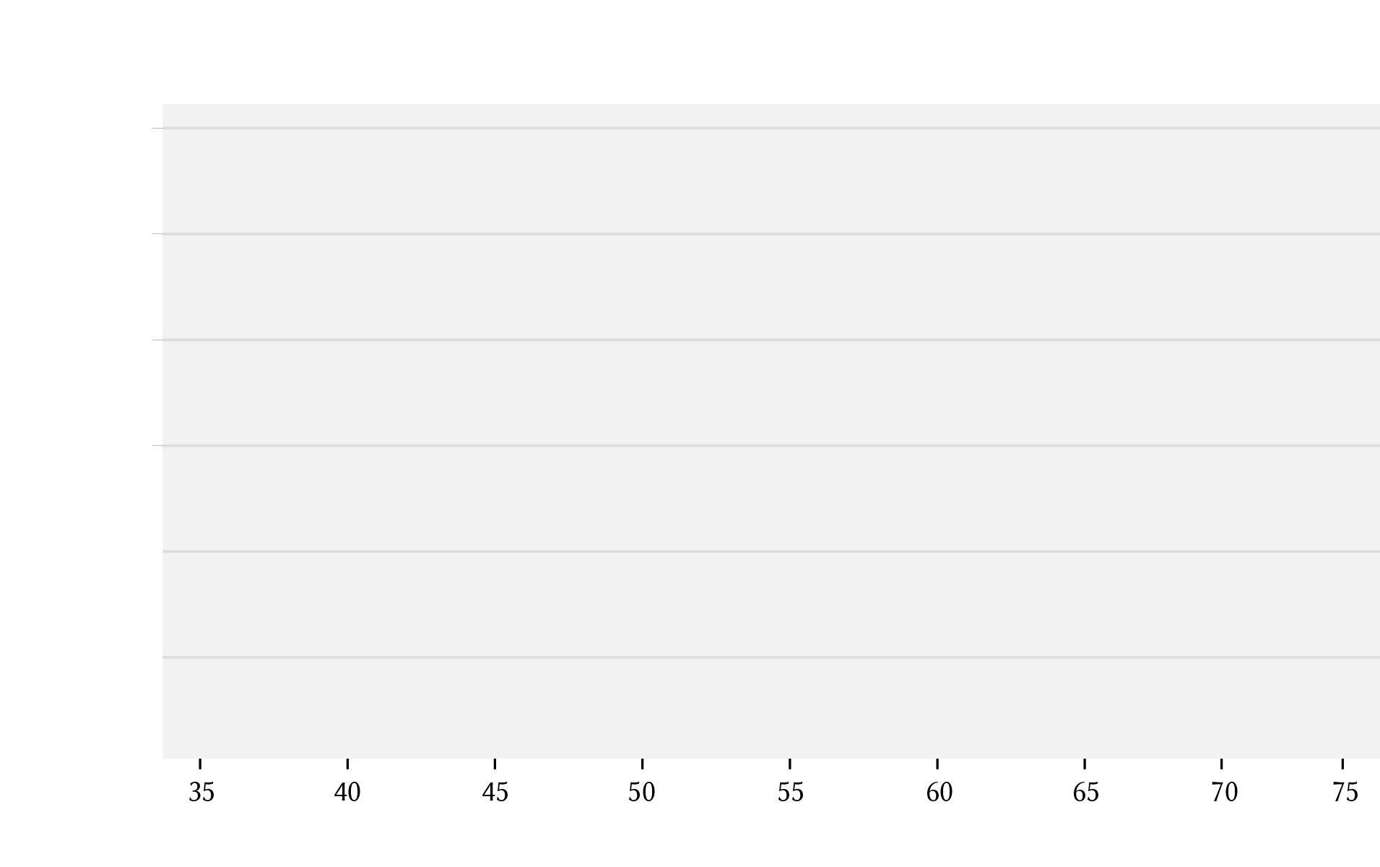
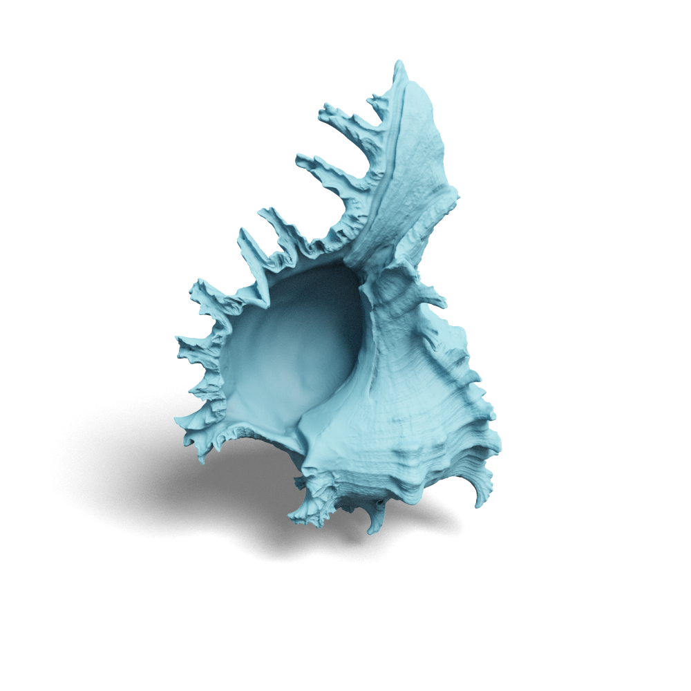
On par with solving
Notes:
In many cases, the result looks like this: Liu and Gravo MG converge very quickly, while the graph based approach struggles. If we now include the hierarchy construction time

Slide 41
Including hierarchy construction
Notes:
We see a clear benefit of using Gravo MG over previous approaches

Slide 42
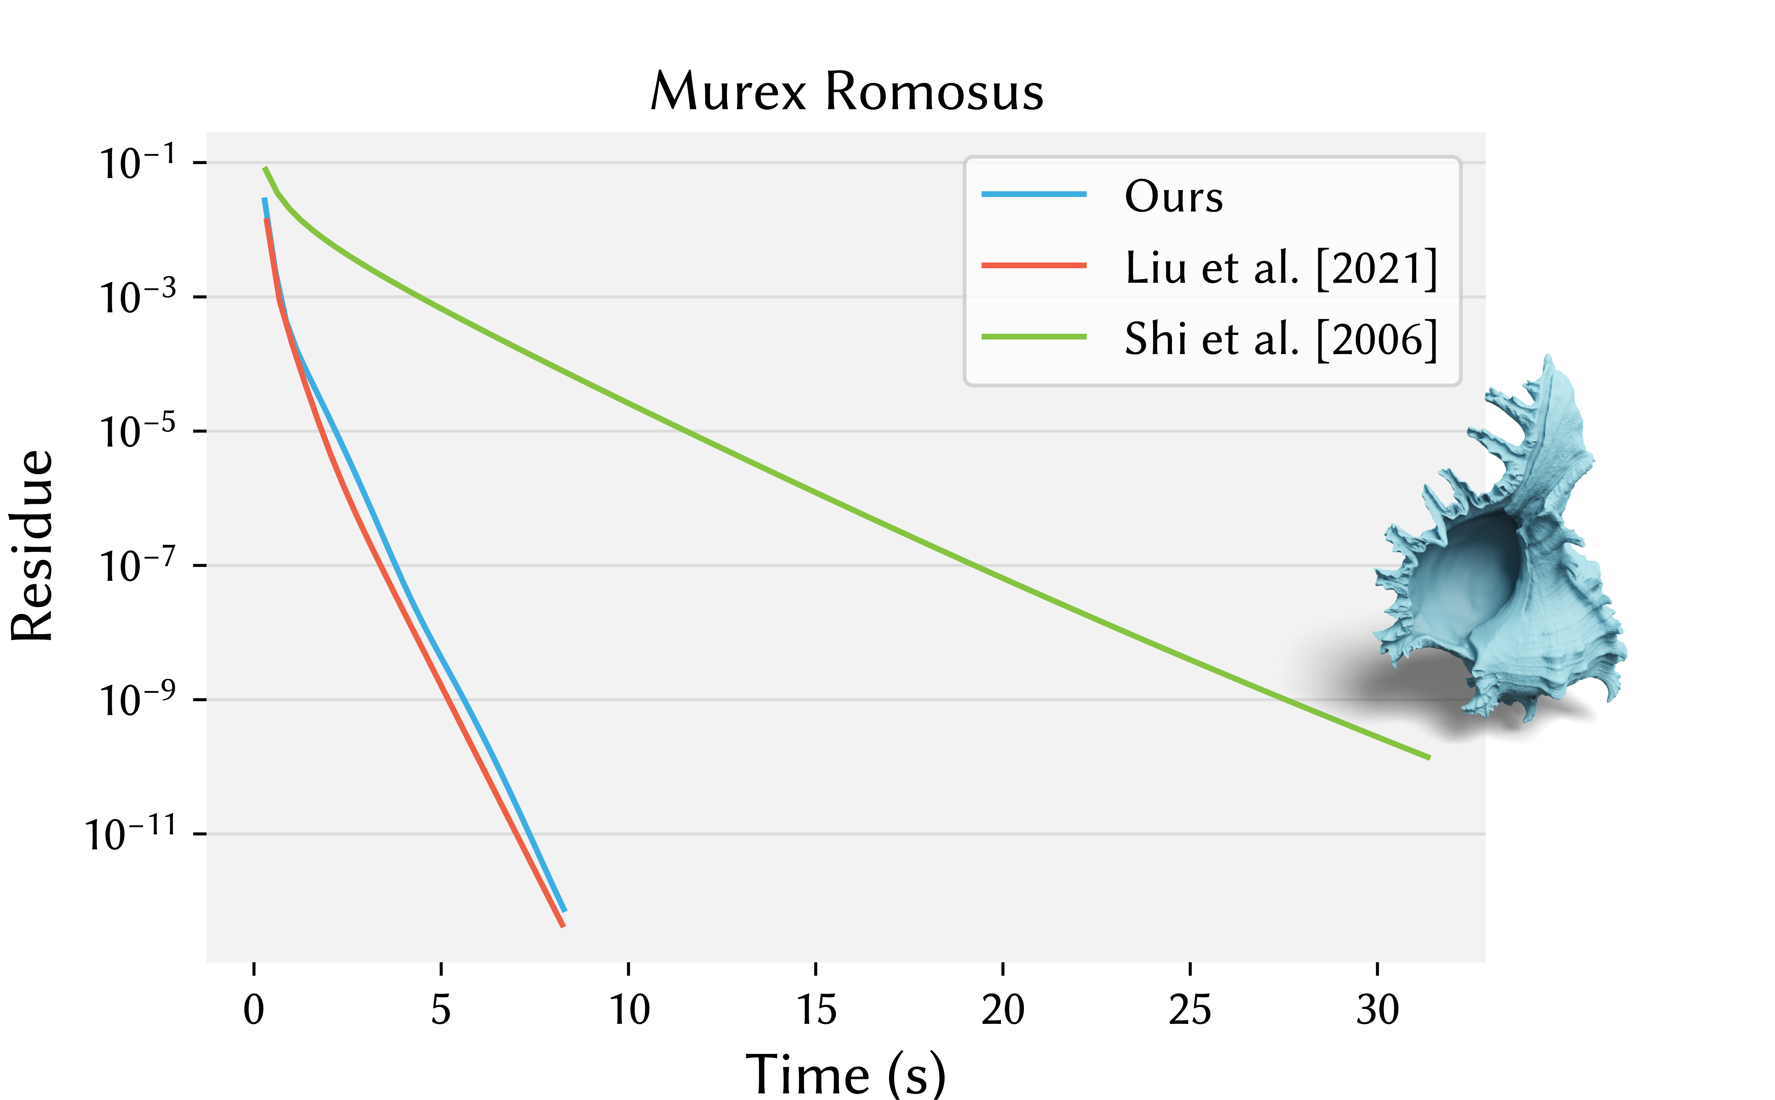
On par with solving
3% faster
than Liu et al. [2021]
274% faster
than Shi et al. [2006]
Poisson problem on 50 shapes
42
Notes:
When comparing timings for a fixed target tolerance on a Poisson problem for over 50 shapes, we find that we are 3% faster than Liu and colleagues, showing that we maintain the fast solving behavior and we are 274% faster than Shi and colleagues, showing that this geometric approach is indeed worth it.

Slide 43
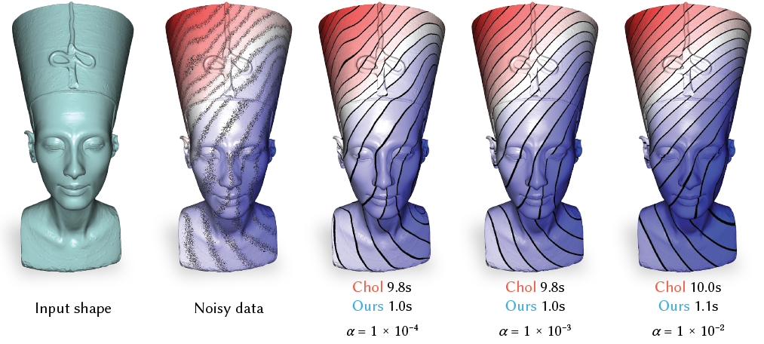
Applications – Data smoothing
Notes:
Finally, we show how our approach can be useful in applications, building on previous work. For example in data smoothing.

Slide 44
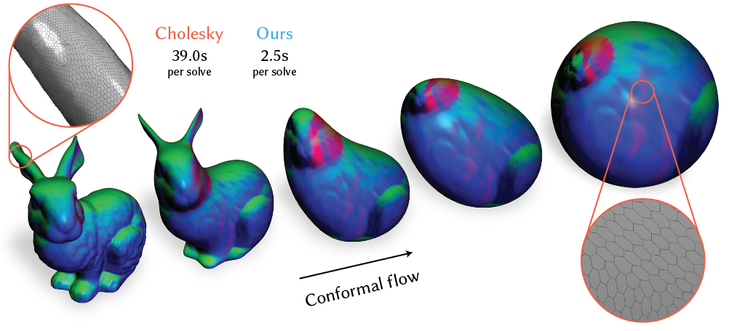
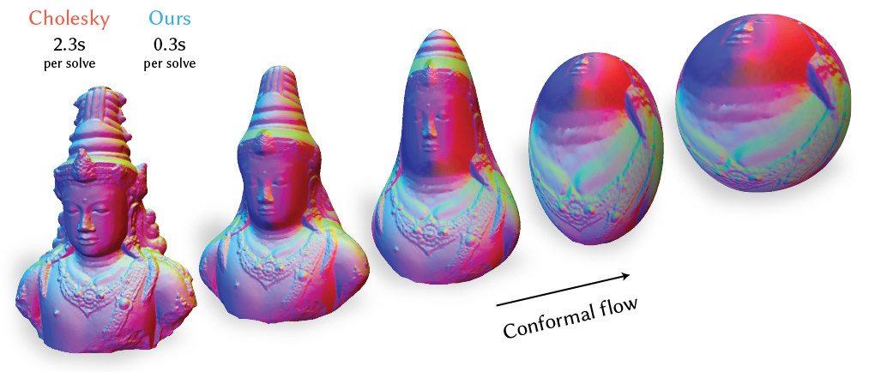
Applications – Conformal flow
Notes:
Conformal flow, on a non-manifold mesh and polygonal meshes

Slide 45
Applications - Simulation
Notes:
And in simulation

Slide 46
Try it yourself
graphics.tudelft.nl/gravo_mg
pip install gravomg
Notes:
We hope you will find Gravo MG useful for your problems and are happy to share our code at graphics.tudelft.nl/gravo_mg. You can also include our solver as a library in c++ or use it directly with python through pip install gravomg. Let's hope you'll join us, in saying Bravo, Gravo!

