Slide 1
DeltaConv: Anisotropic Operators for Geometric Deep Learning on Point Clouds
Ruben Wiersma, Ahmad Nasikun, Elmar Eisemann, Klaus Hildebrandt
Notes:
Thank you for joing our presentation on DeltaConv. My name is Ruben Wiersma. This work is a collaboration with: Ahmad Nasikun, Elmar Eisemann and Klaus Hildebrandt.

Slide 2
DeltaConv: Anisotropic Operators for Geometric Deep Learning on Point Clouds
Ruben Wiersma, Ahmad Nasikun, Elmar Eisemann, Klaus Hildebrandt
Notes:
Thank you for joing our presentation on DeltaConv. My name is Ruben Wiersma. This work is a collaboration with: Ahmad Nasikun, Elmar Eisemann and Klaus Hildebrandt.

Slide 3
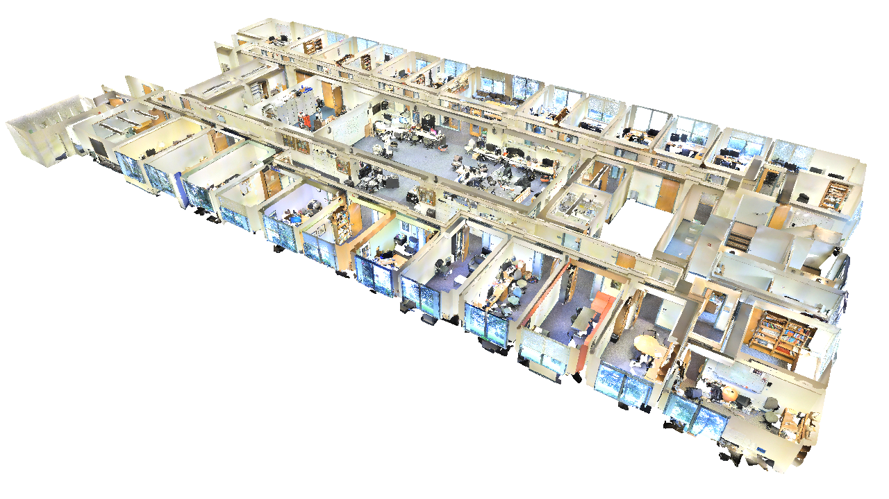
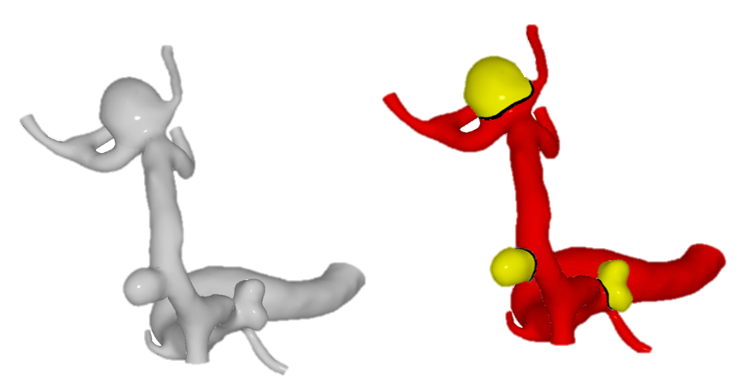
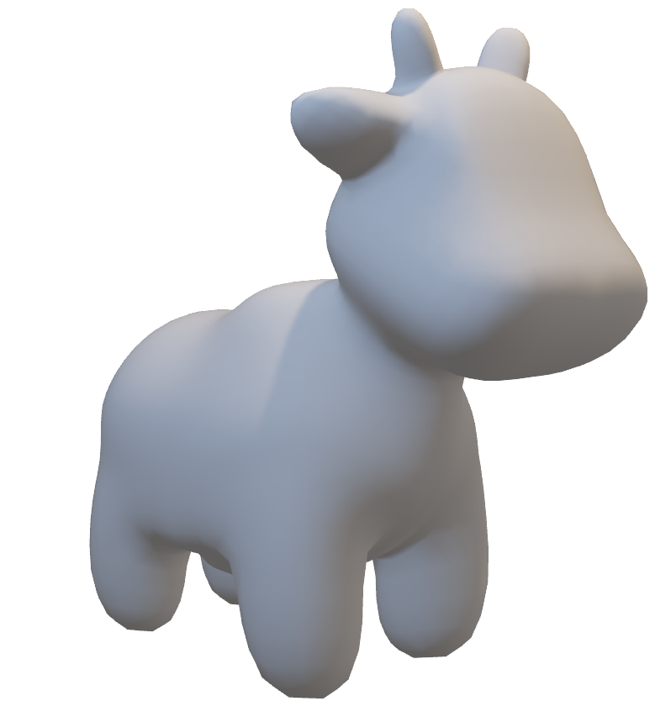
Lots of data on curved surfaces
S3DIS
[Armeni et al. 2017]
Spot
Keenan Crane
Aneurysm data
[Lawonn et al. 2019]
Notes:
Lots of data in our world is captured from curved surfaces. For example, point clouds are scanned in robotics and augmented reality, 3D models are created by artists and product designers, and doctors look at 3D data to diagnose patients. How can we use all that data?

Slide 4
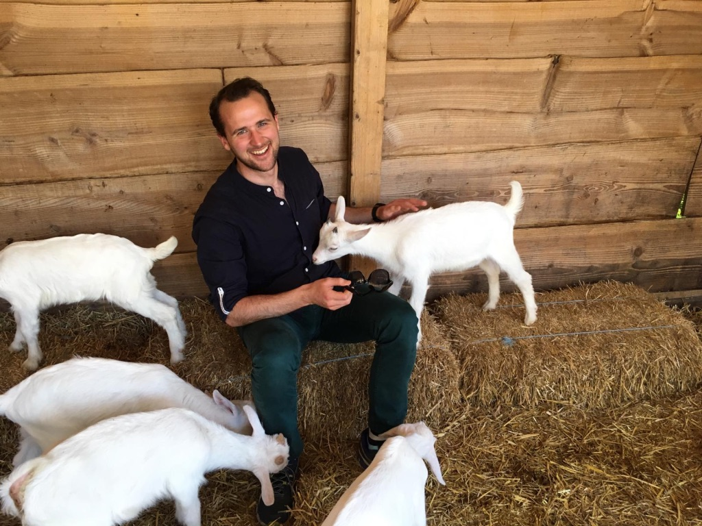
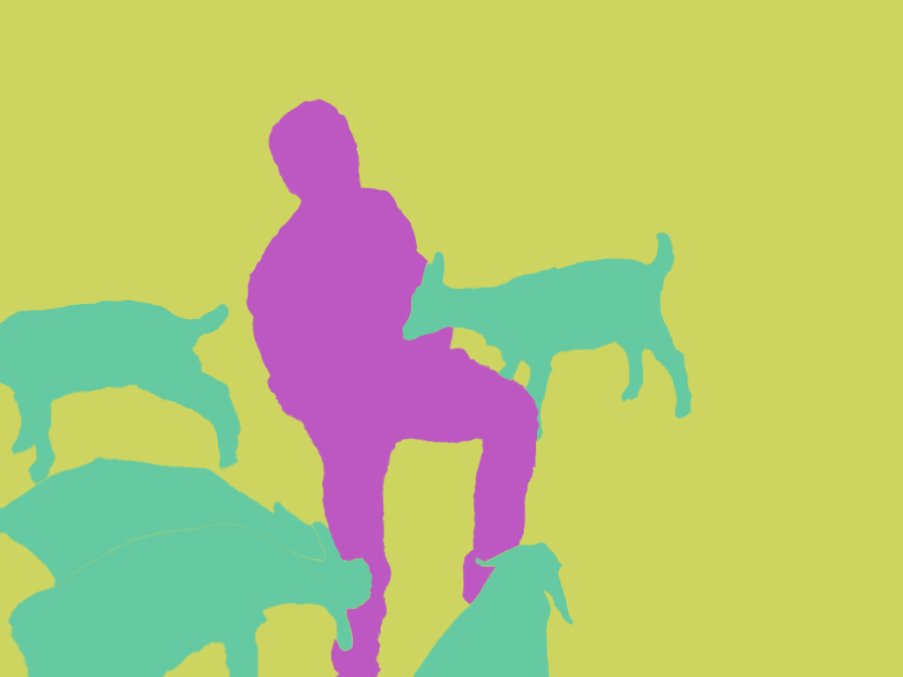
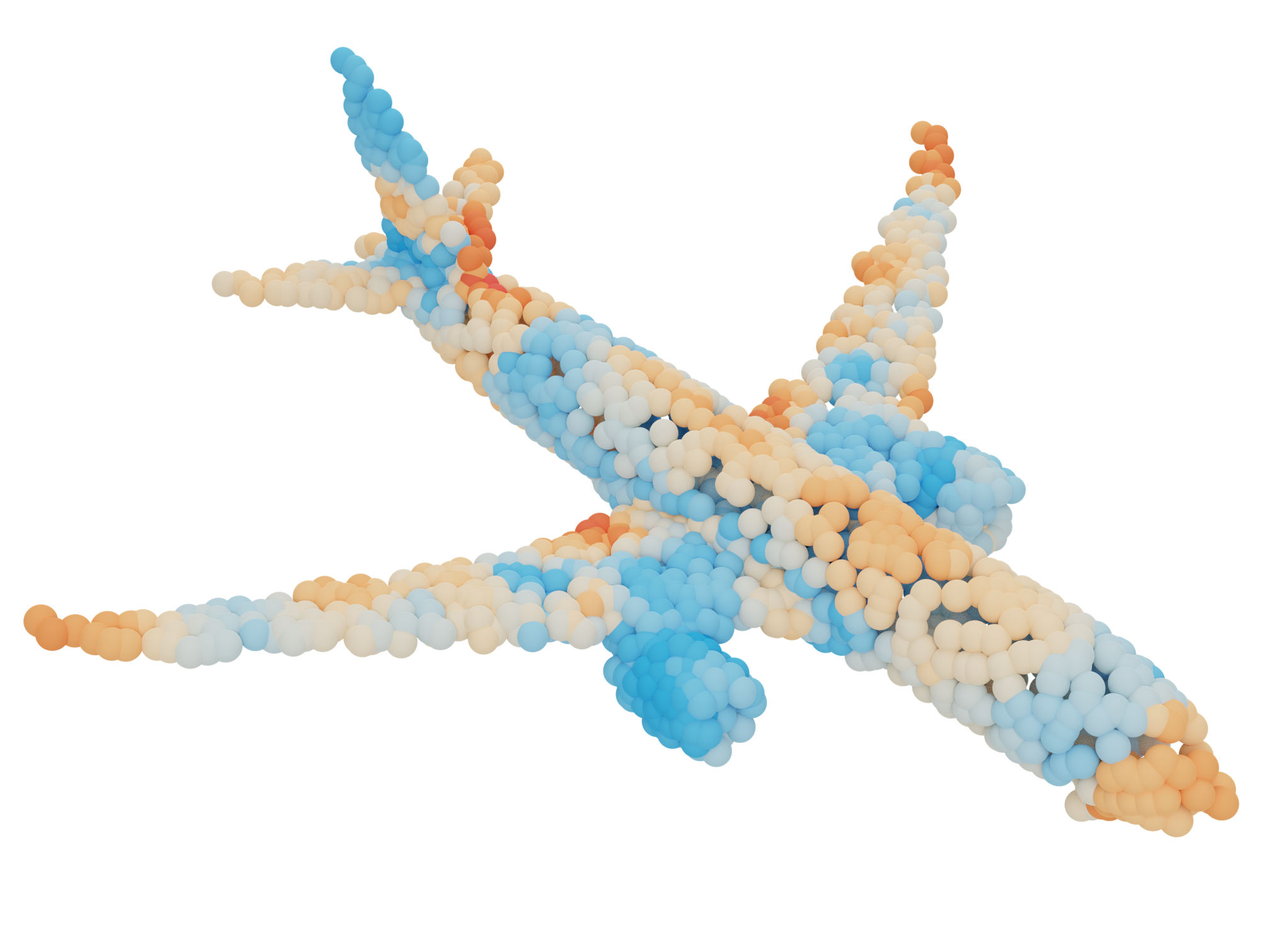
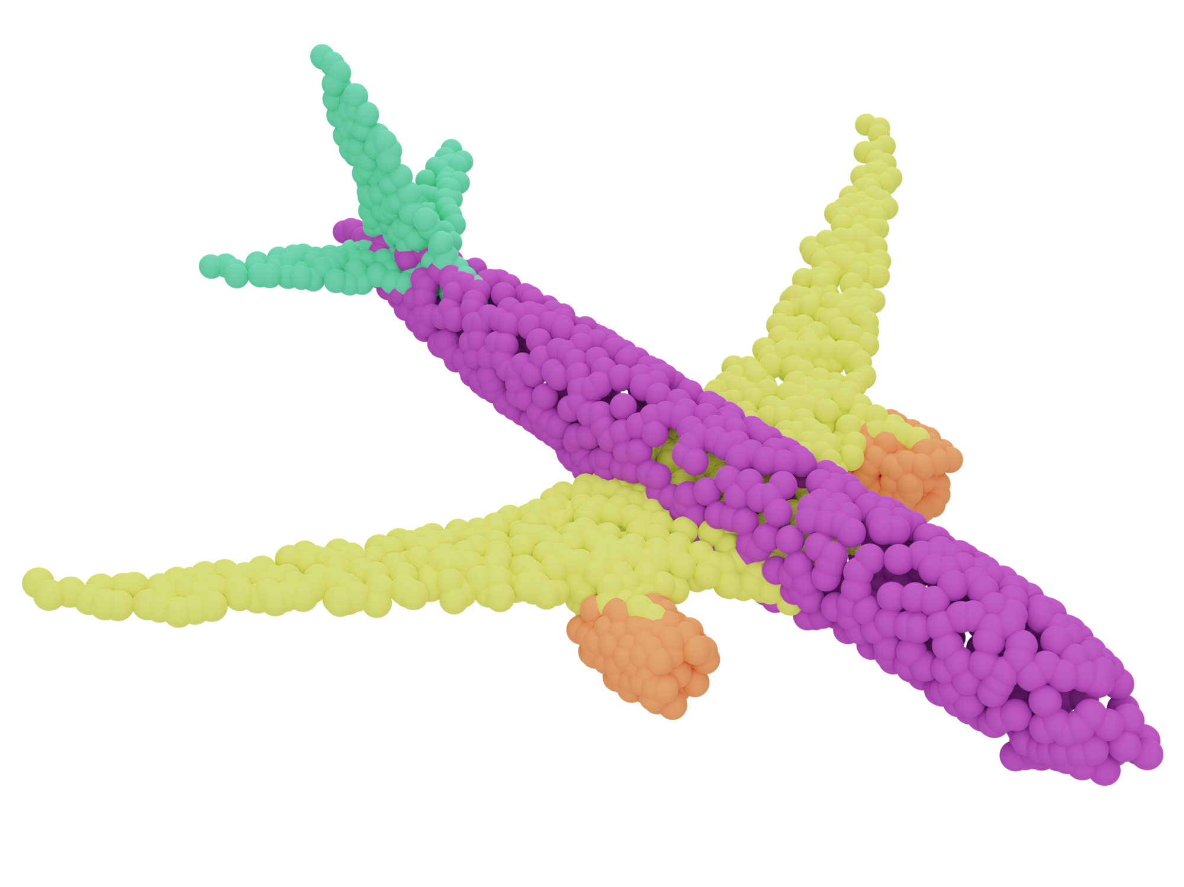
Neural networks on images
CNNs
✨
?
✨
Notes:
On images people have found Convolutional Neural Networks or CNNs to be very effective. Such networks could be used, for example, to segment images. In this presentation, we seek to design similar networks, but for surfaces in 3D. On a surface, we might want to segment a shape into its parts, such as the engines and wings of an airplane. In our paper, we focus on point clouds, as they are widely available. We assume there is some surface underlying the point cloud, which is why we’ll discuss surfaces in general in most of the presentation. Let’s first consider why CNNs work so well on images.

Slide 5
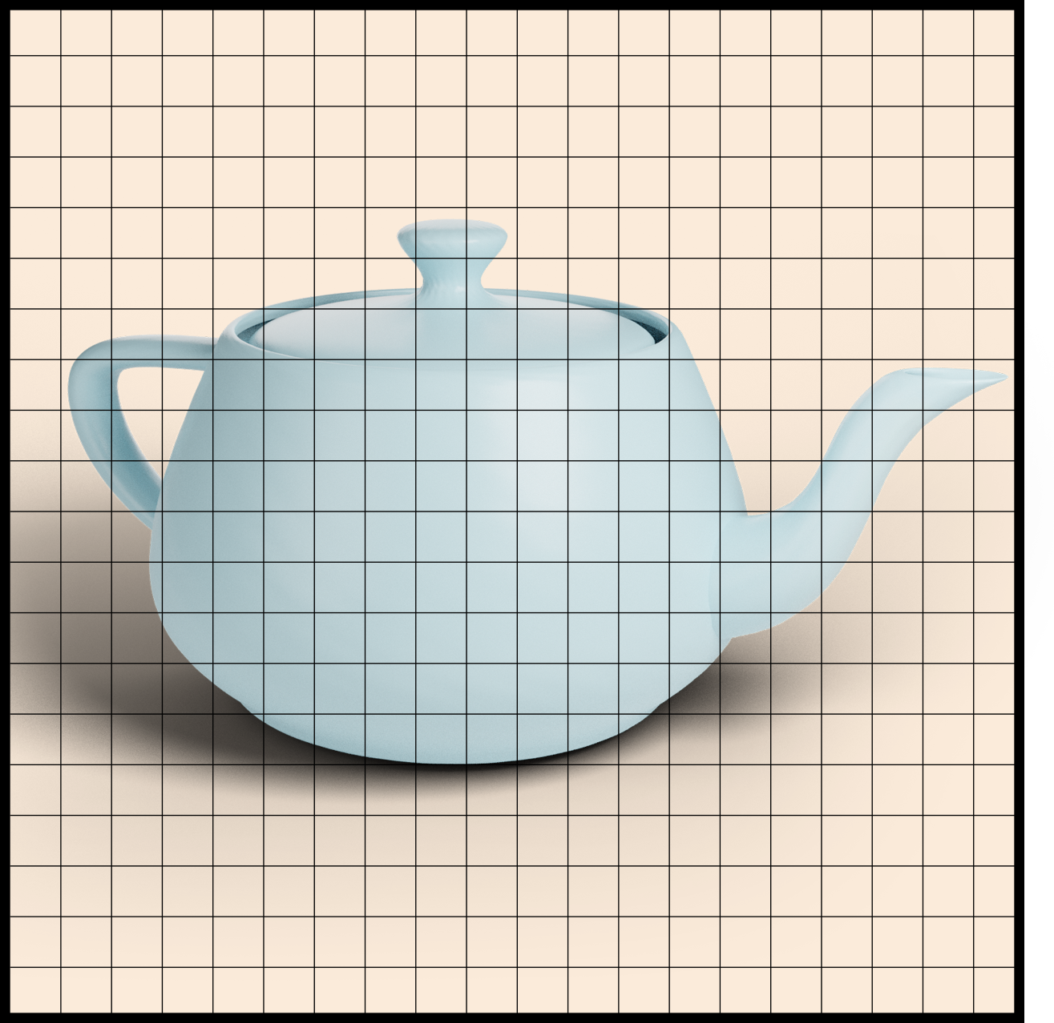
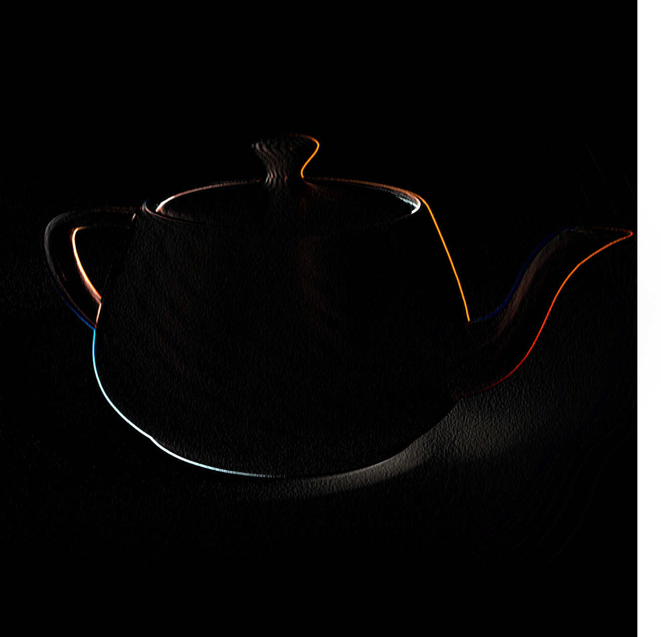
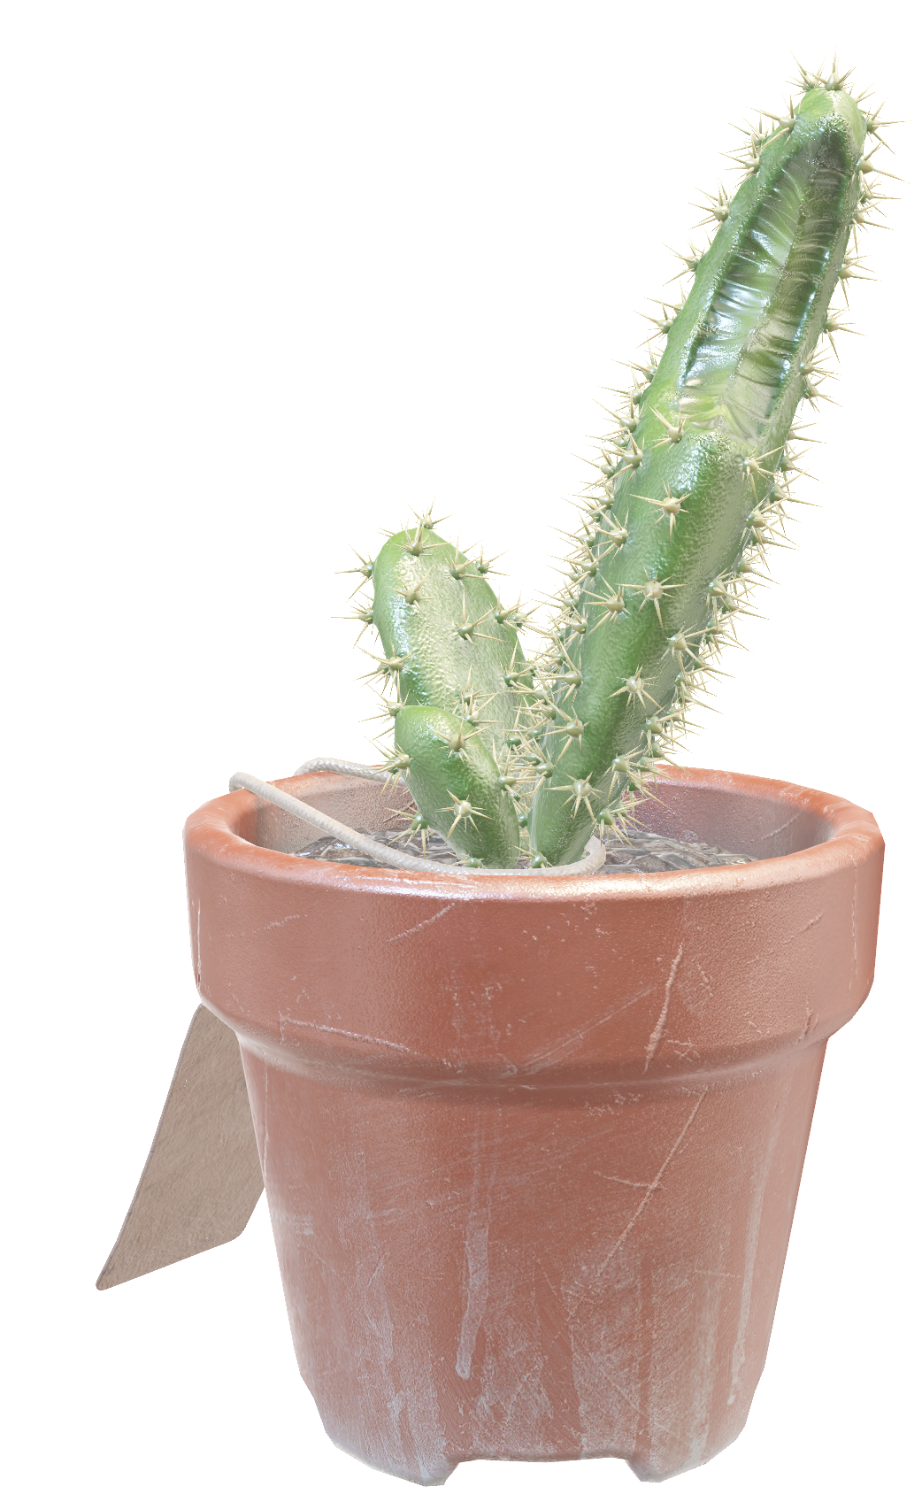
CNNs fit the data
Optimize kernel weights
+ Weight sharing (efficient)
+ Translation invariance
CNNs fit the data
Notes:
In CNNs we convolve a kernel over the input and optimize the weights in the kernel. With this construction, we share weights, which is efficient. We also enforce translation invariance, meaning that we can find patterns such as vertical edges or faces, no matter where they are. This makes CNNs a good fit for image data.
We would like the same for surfaces.

Slide 6
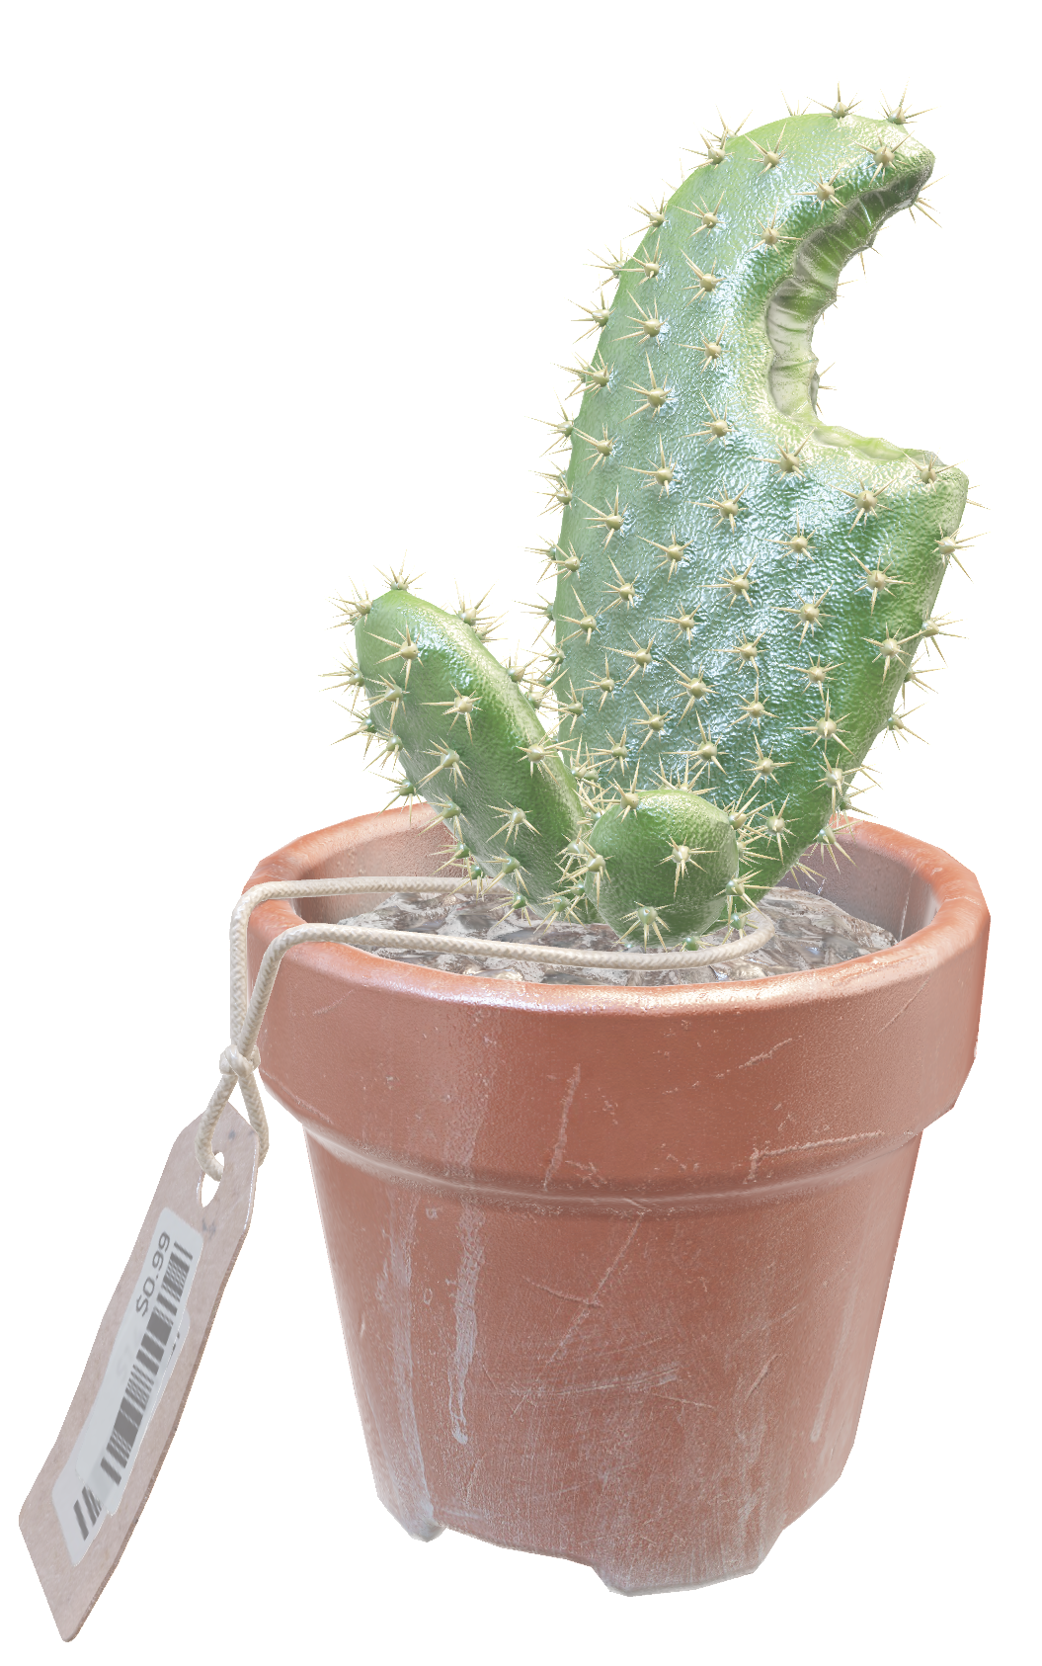
We want the same for surfaces
Cactus courtesy of Sketchfab user vvc
Notes:
There are many localized features on a surface, such as ridges,

Slide 7
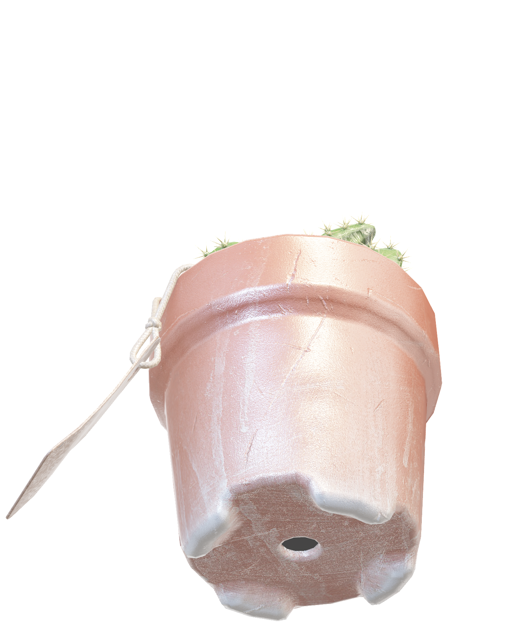
We want the same for surfaces
Ridges
Notes:
… corners

Slide 8
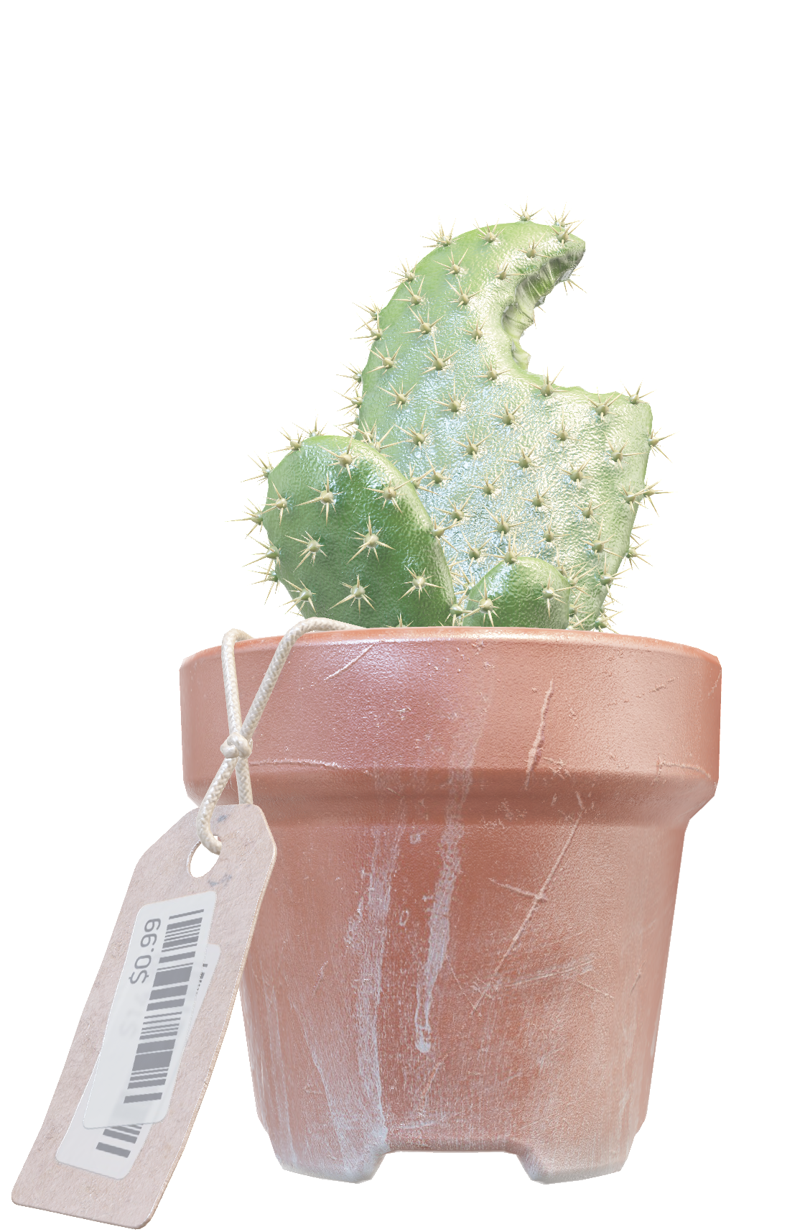
We want the same for surfaces
Corners
Notes:
… and recurring patterns

Slide 9
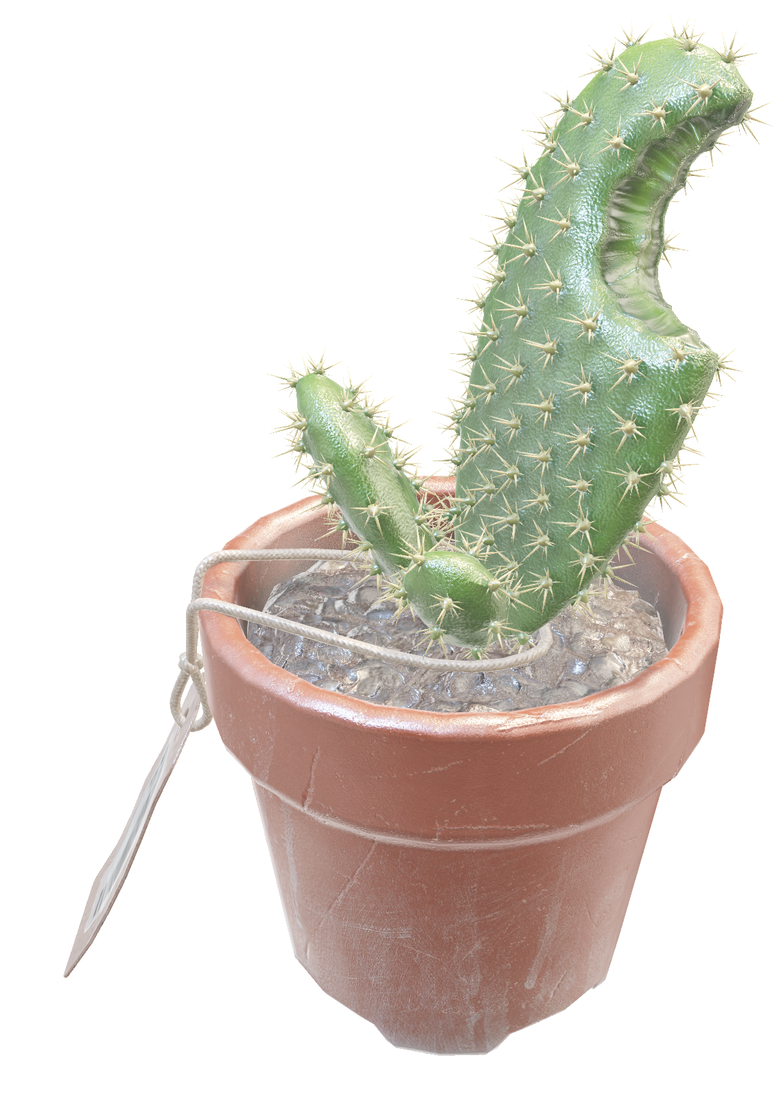
We want the same for surfaces
Patterns

Slide 10
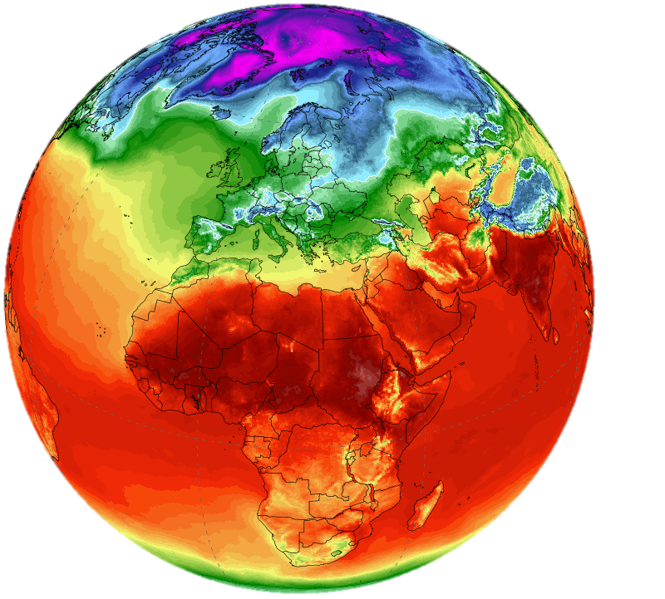
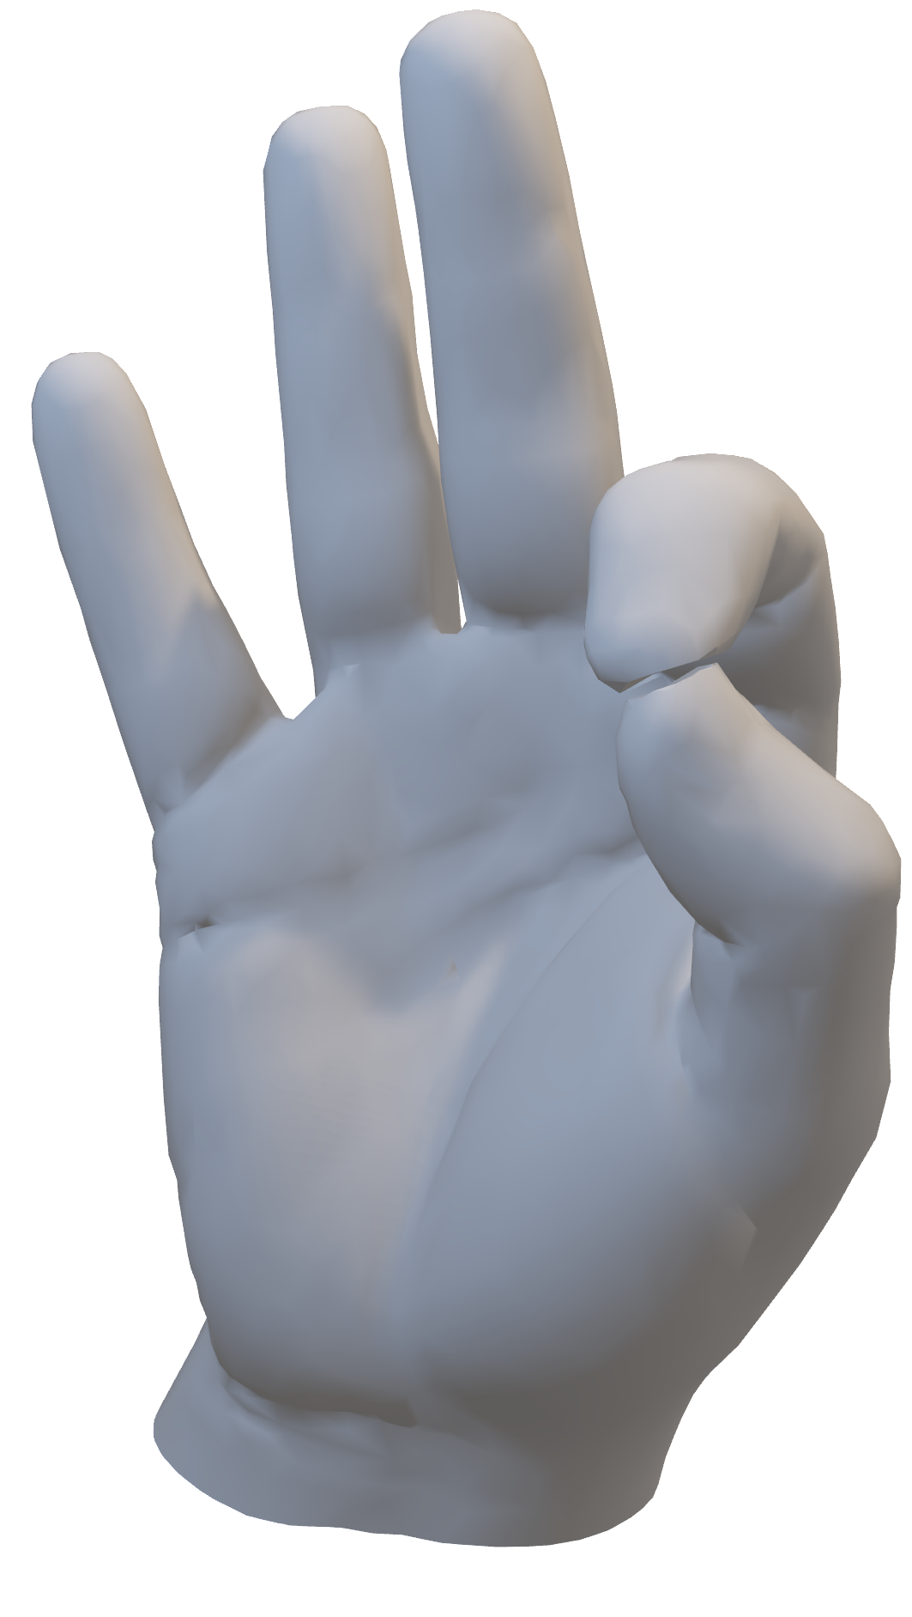
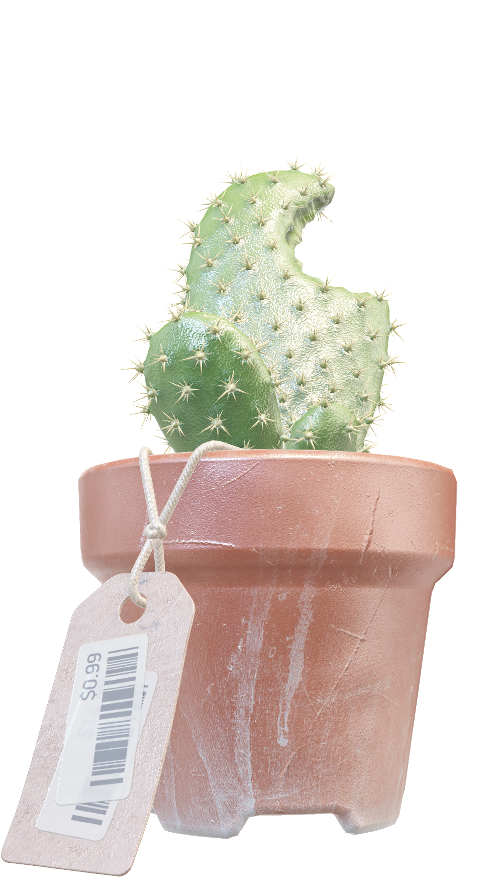
We want the same for surfaces
Color
Temperature
from Climate Reanalyzer (https://ClimateReanalyzer.org),
Climate Change Institute, University of Maine, USA
Notes:
More generally, we’re talking about any signal on the surface. A good example is color, but you could also think of measurements around the globe, such as temperature.

Slide 11
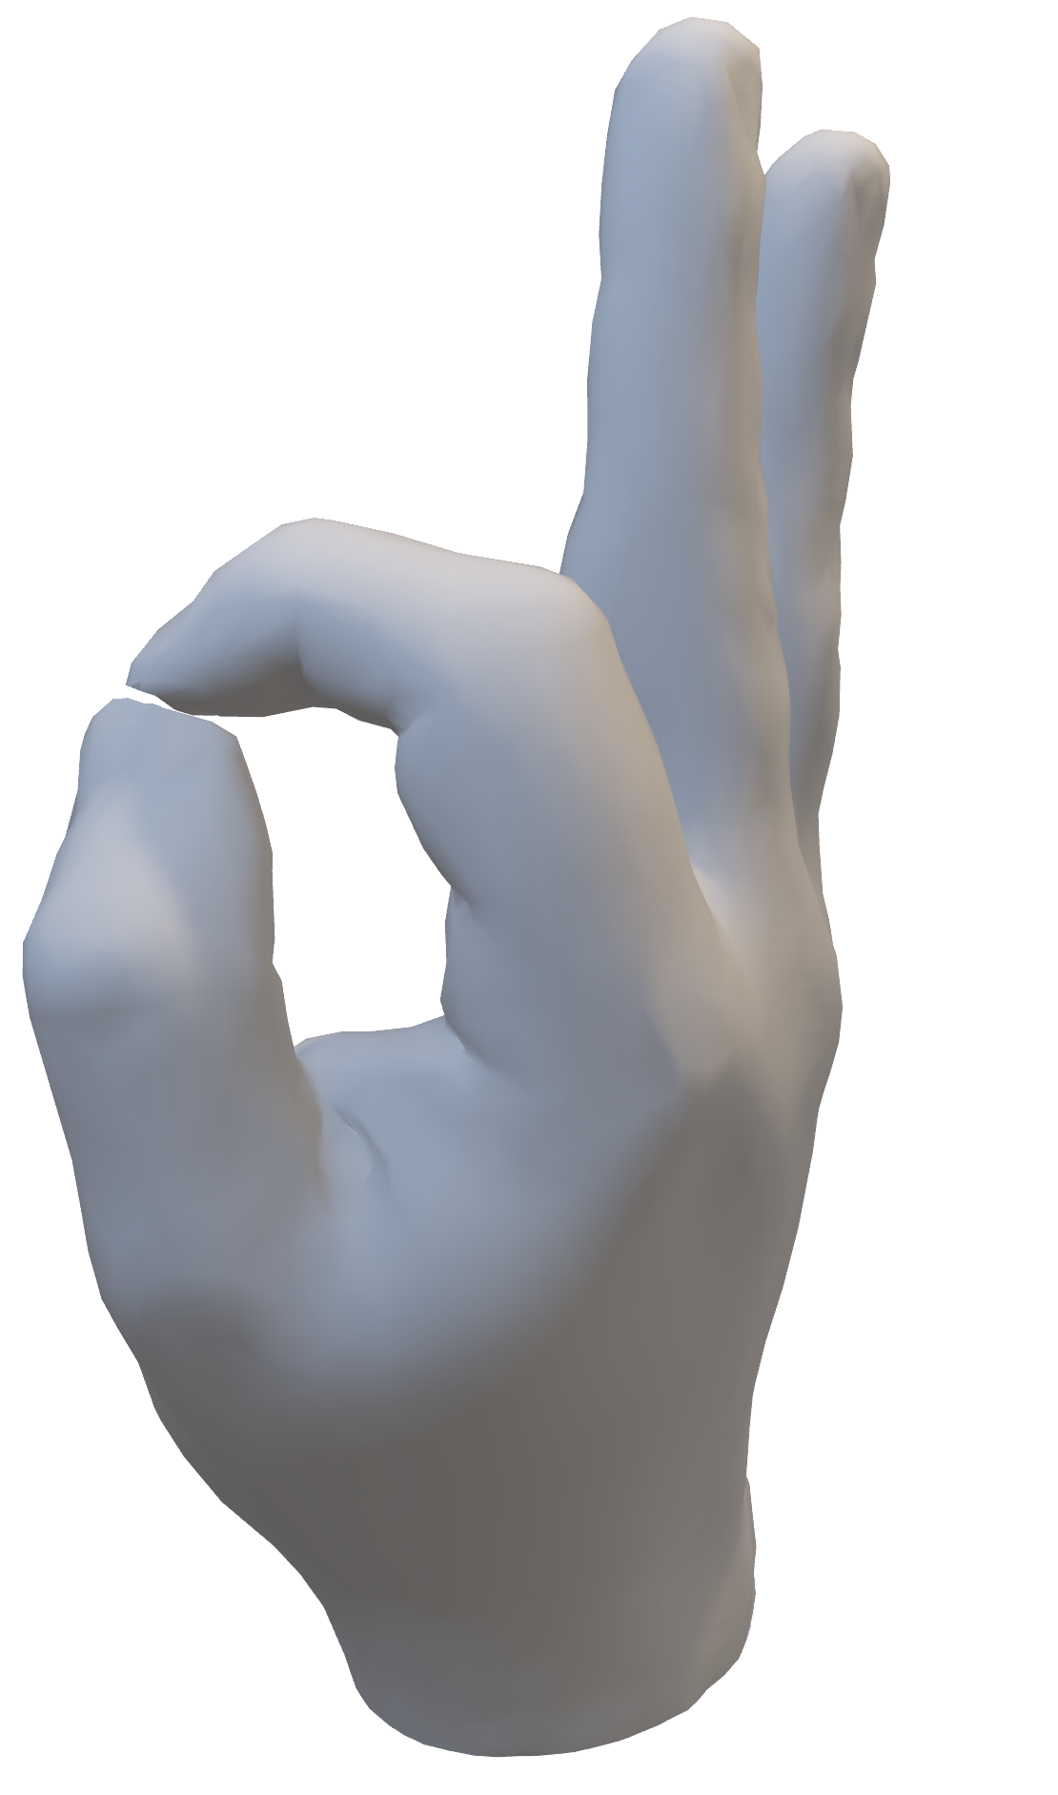
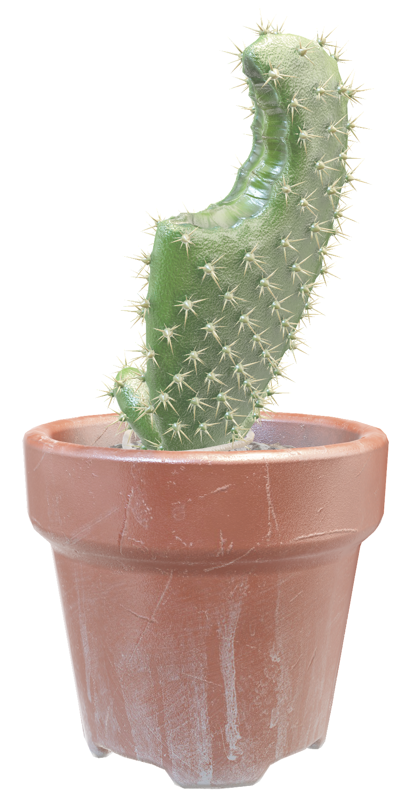
We want the same for surfaces
Convolutions
on surfaces
Notes:
We can benefit from applying local, convolution-like operators on such signals. In our work, we try to create intrinsic convolutions

Slide 12
We want the same for surfaces
Convolutions
on surfaces
Intrinsic
+ Robust to isometric deformations
+ 2D instead of 3D
+ Skips empty space
Intrinsic convolutions fit curved surfaces

Slide 13
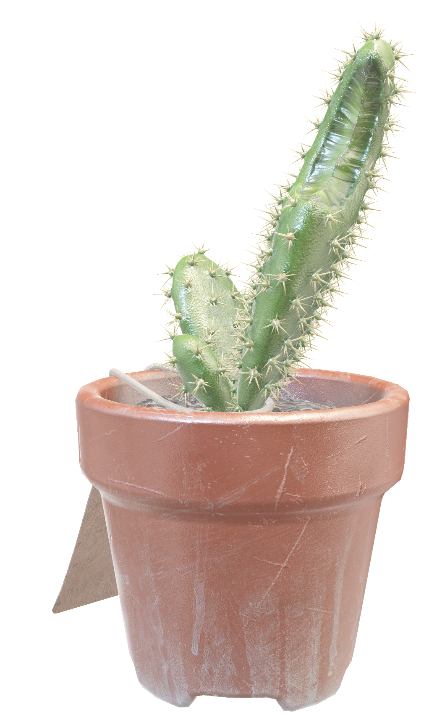
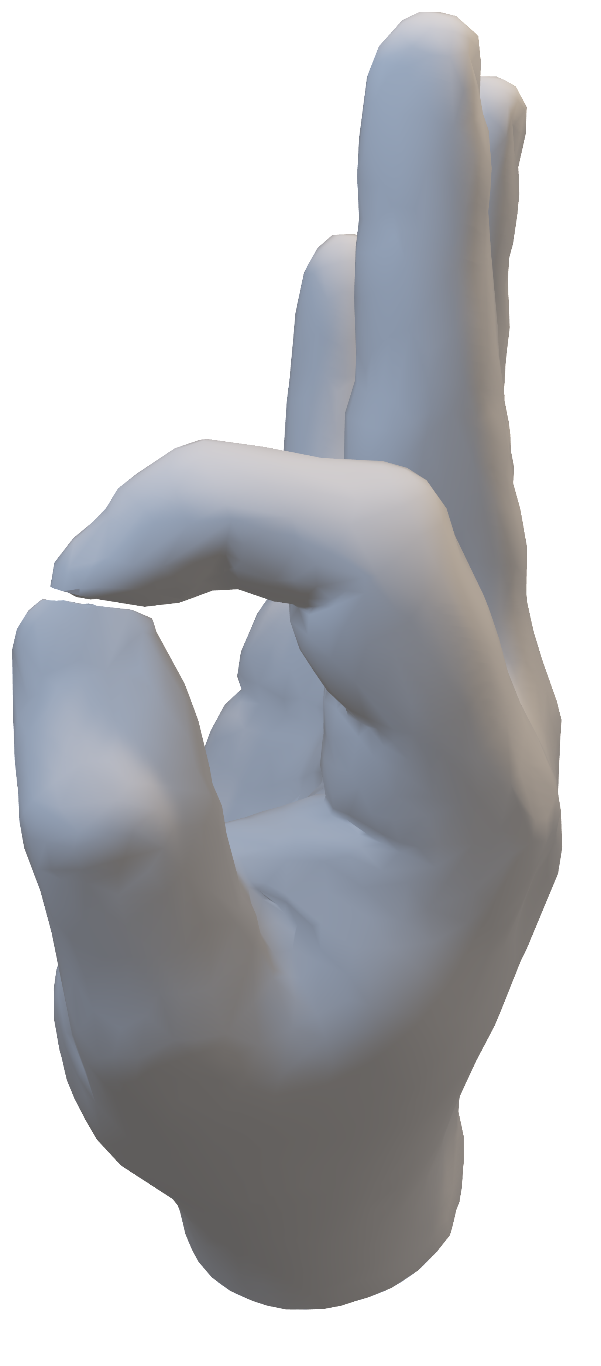
We want the same for surfaces
Convolutions
on surfaces
B
Extrinsic
A
Intrinsic
Intrinsic
+ Robust to isometric deformations
+ 2D instead of 3D
+ Skips empty space
Intrinsic convolutions fit curved surfaces
Notes:
A clear example of this intrinsic viewpoint is computing distances on shapes. An extrinsic approach would measure the distance directly from A to B. An intrinsic approach would move along the surface, giving you a geodesic distance.
Intrinsic operations are robust to isometric deformations, deformations that don’t stretch or squeeze the surface. Examples are moving your fingers, your arms or your legs. In reality these deformations are not purely isometric, but an intrinsic convolution would be much more suited to such deformations than an extrinsic one. We also learn and apply filters in 2D, instead of 3D, and we naturally skip empty space, which is more efficient.
Just like CNNs fit image data, intrinsic convolutions fit curved surfaces.

Slide 14
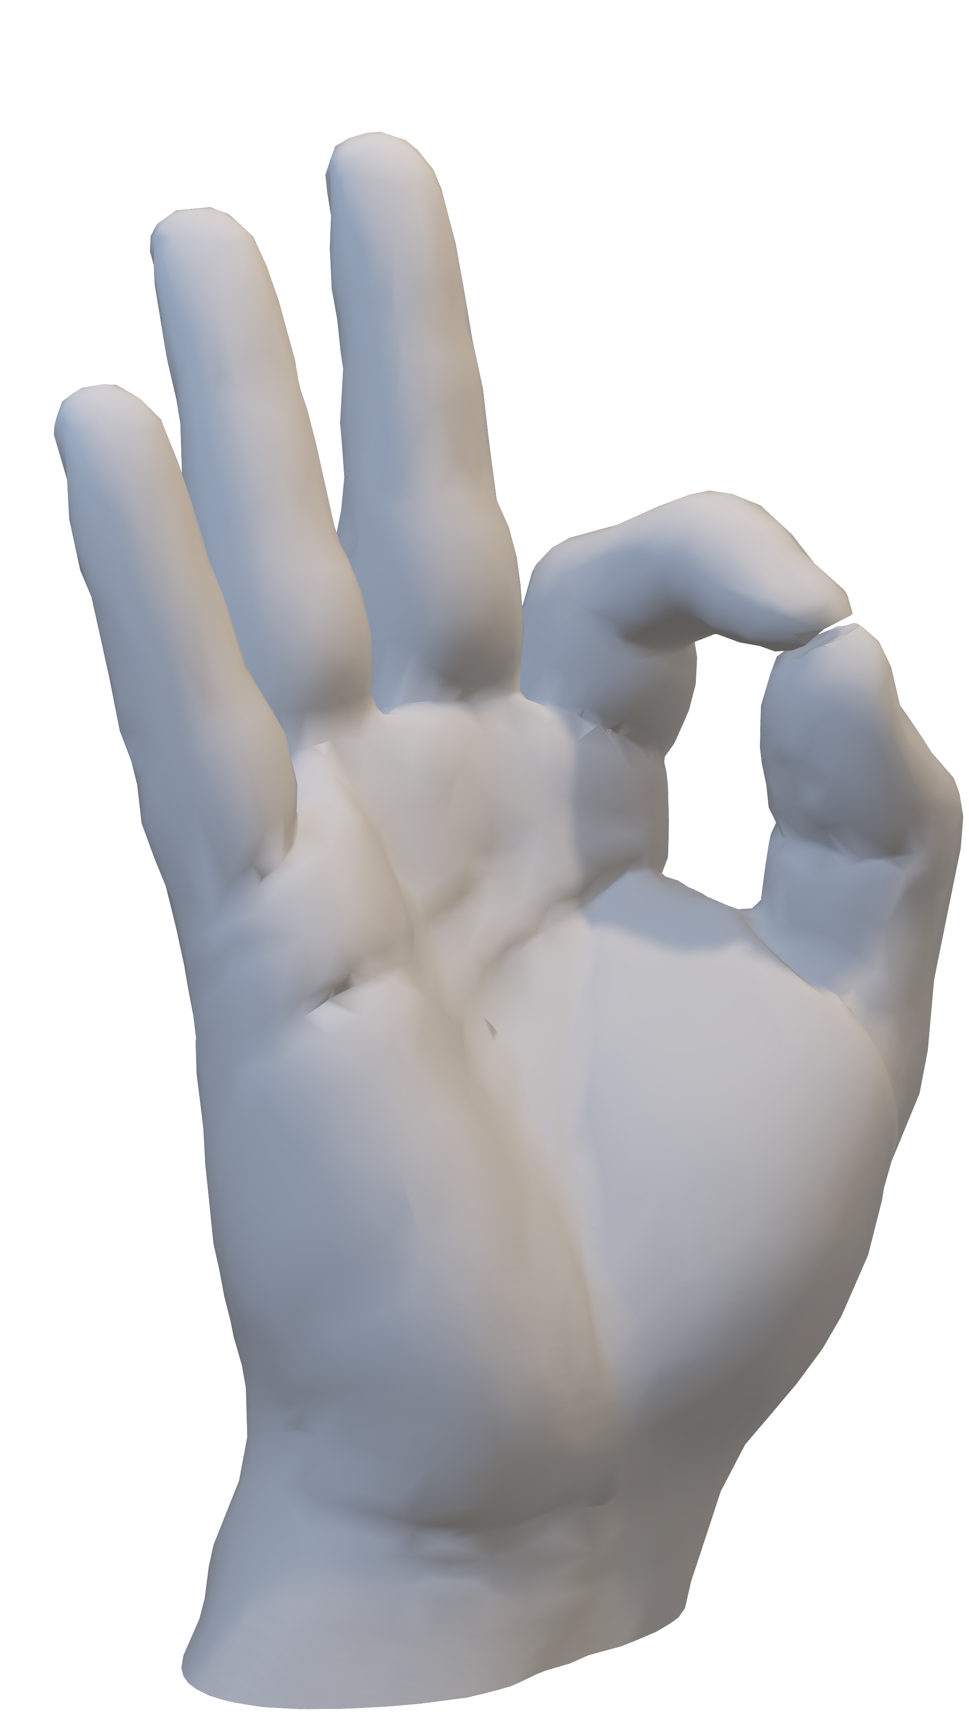
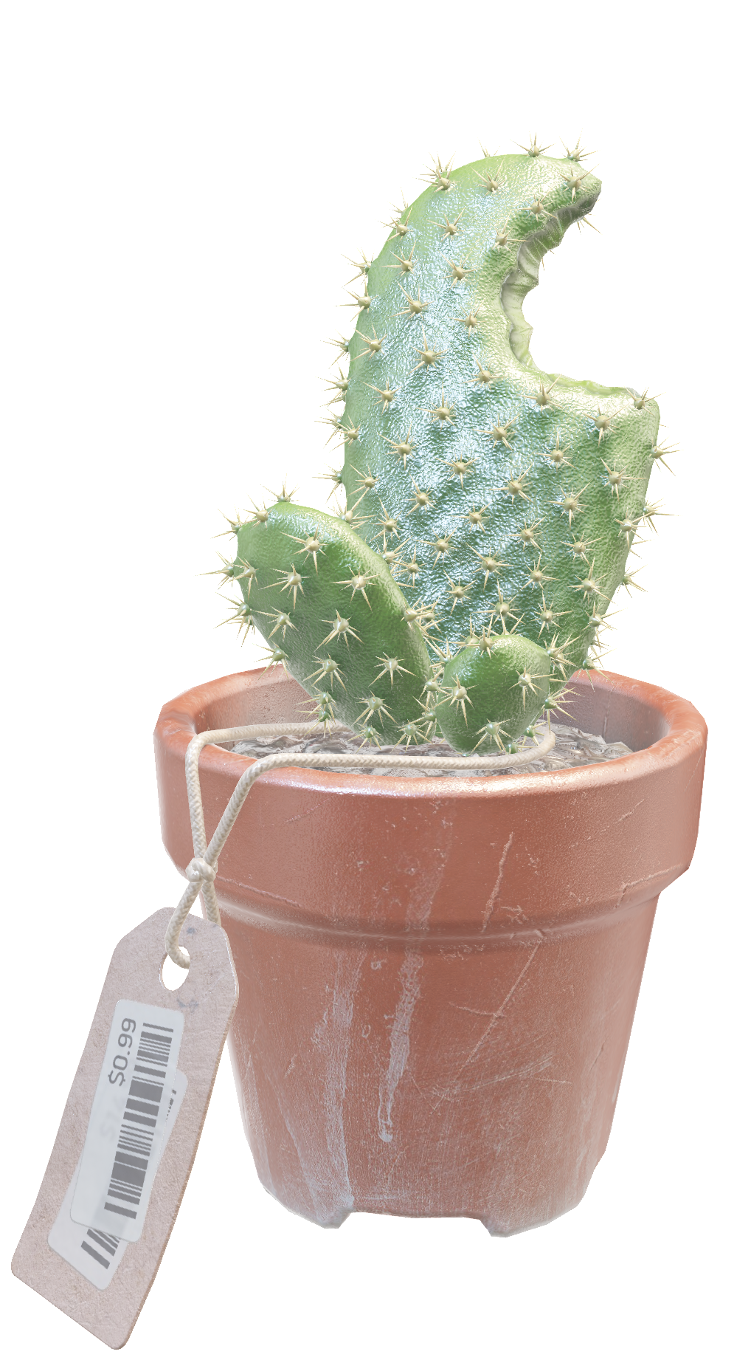
Our world is anisotropic
Ridges, edges, corners
Have a direction
  a.k.a. they are anisotropic
Anisotropic convolutions
Notes:
But let's add a complicating factor. You see these ridges, edges and corners. They all have a certain direction, they are anisotropic. This can be informative. So, we’d like our convolutions to be anisotropic as well.

Slide 15
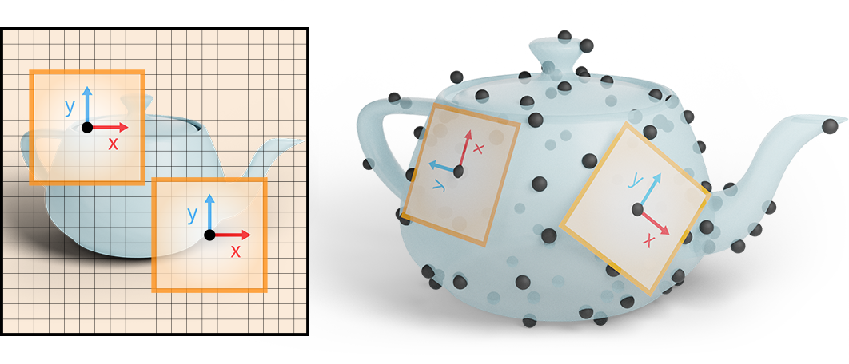
Image CNNs can use a global coordinate system
Notes:
On images, it’s straightforward to apply anisotropic convolutions, because we have a global coordinate system: the pixel grid.

Slide 16
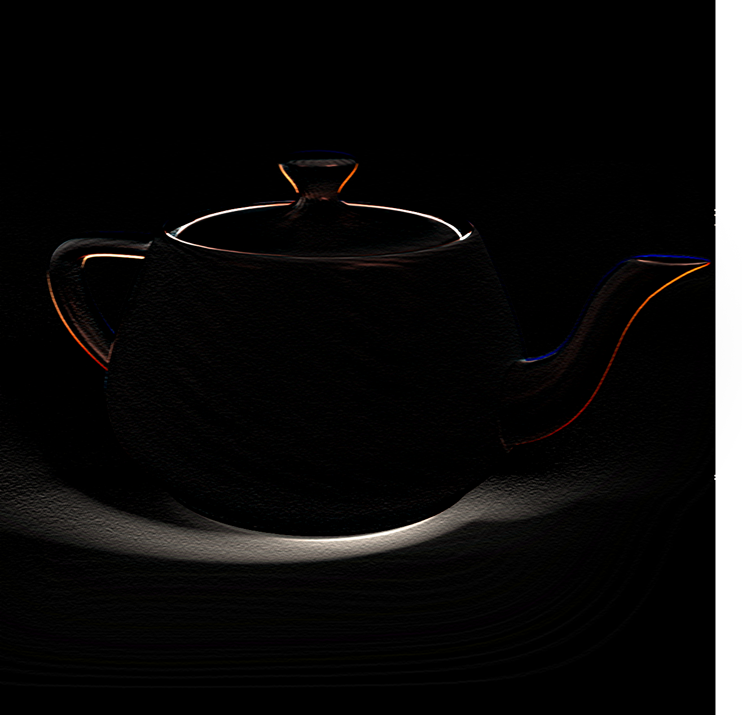
How does an image CNN use coordinates?
Notes:
We could find vertical edges with a vertical edge kernel and do the same with a horizontal edge kernel.

Slide 17
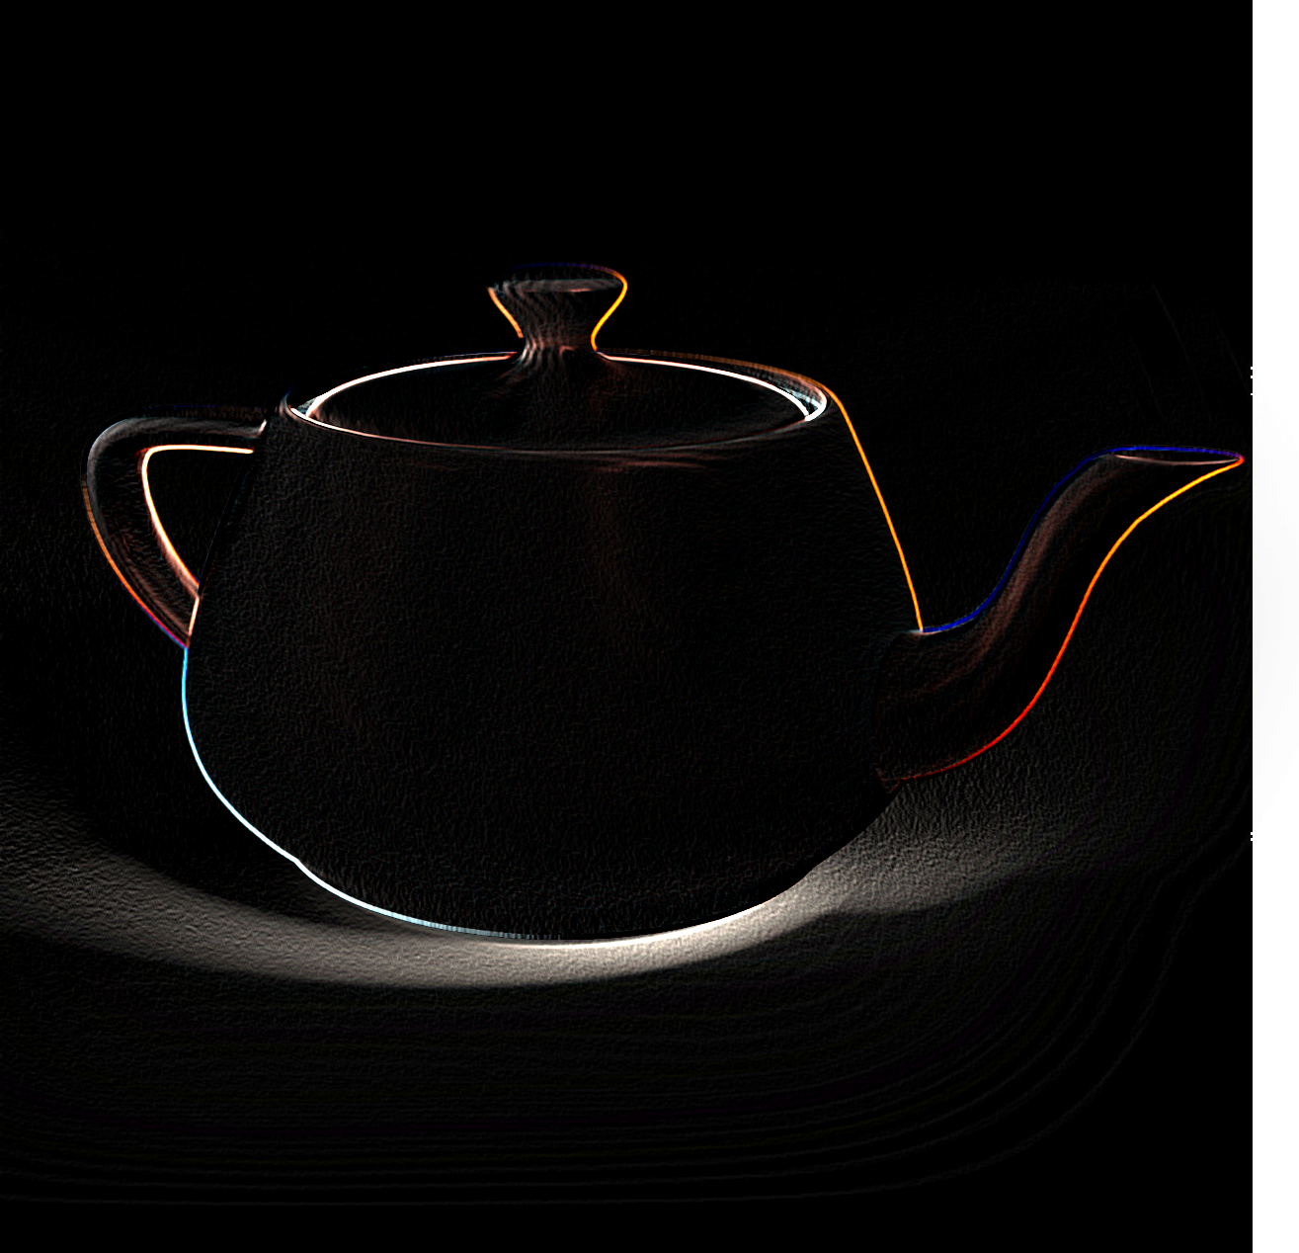
How does an image CNN use coordinates?
+
Notes:
These can be combined in neural networks to construct more complex features, such as corners and shapes. Notice how much we depend on a consistent reference point for concepts such as ‘horizontal’ or ‘vertical.

Slide 18
Surfaces have no global coordinate system
Notes:
On surfaces, we cannot guarantee a global coordinate system without stretching or distorting the surface. If we apply anisotropic filters, we cannot consistently align them intrinsically. How do we proceed?

Slide 19
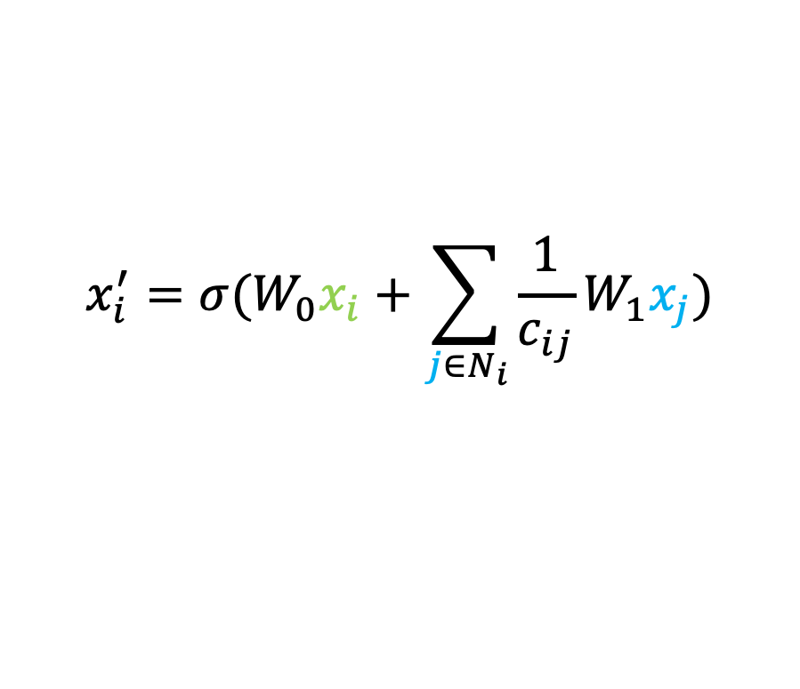
What did others do?
Graph- and point based
  GCN
$$x_{i}^{′}=σ(W_{0}x_{i}+\sum_{j∈N_{i}}{\frac{1}{c_{ij}}W_{1}x_{j}})$$
[Kipf and Welling, 2016]
Notes:
The first way is to ignore directions. In a way, this is what some previous works do: GCN is a local graph convolution which multiplies the same weight matrix with the features of each neighbor and then aggregates with a sum.

Slide 20
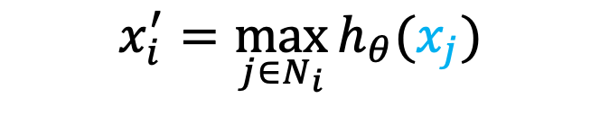
What did others do?
Graph- and point based
  GCN, PointNet++
$$x_{i}^{′}=\max_{j∈N_{i}}{h_{θ}(x_{j}})$$
[Qi et al., 2017]
Notes:
PointNet++ uses the same multi-layer perceptron for each point, but aggregates with a maximum.

Slide 21
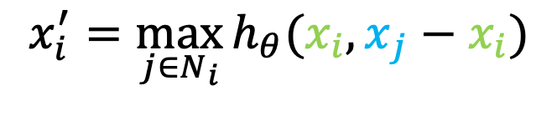
What did others do?
Graph- and point based
  GCN, PointNet++, EdgeConv
$$x_{i}^{′}=\max_{j∈N_{i}}{h_{θ}({x_{i}, x}_{j}−x_{i}})$$
[Wang et al., 2019]
Notes:
EdgeConv, uses point-pair features, differences along edges. The maximum difference is not isotropic but the direction of the change is not used by the convolutions.

Slide 22
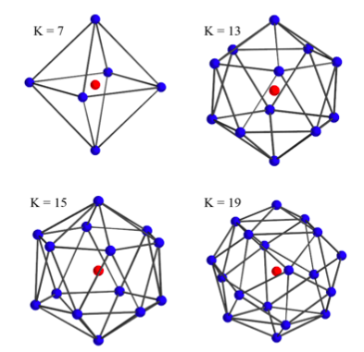
What did others do?
Graph- and point based
  GCN, PointNet++, EdgeConv
3D kernel (extrinsic)
  KPConv, MinkowskiNet, SSCN
KPConv
[Thomas et al. 2019]
Notes:
Many works use extrinsic convolutions and create filter kernels in 3D. A well known example is KPConv, which can also optimize the location of kernel points to fit to the surface.
While these filters can be anisotropic, they are not intrinsic. So this is orthogonal to our goal.

Slide 23
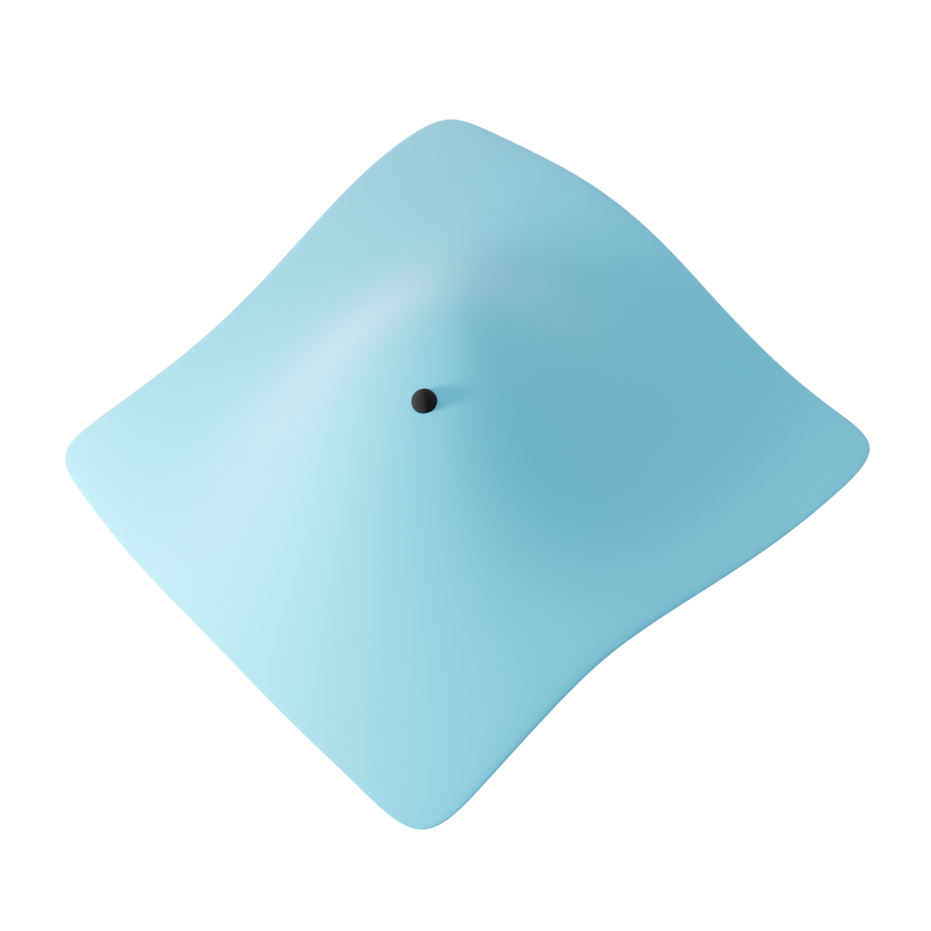
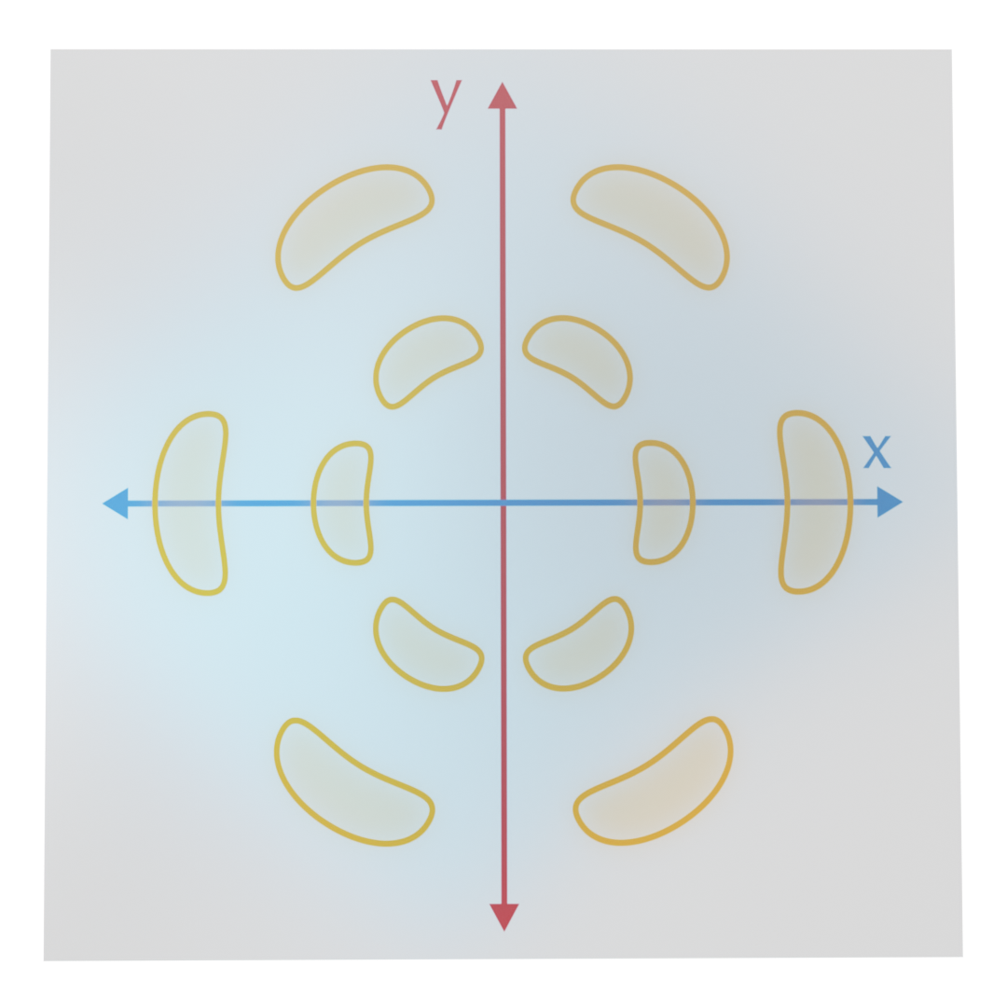
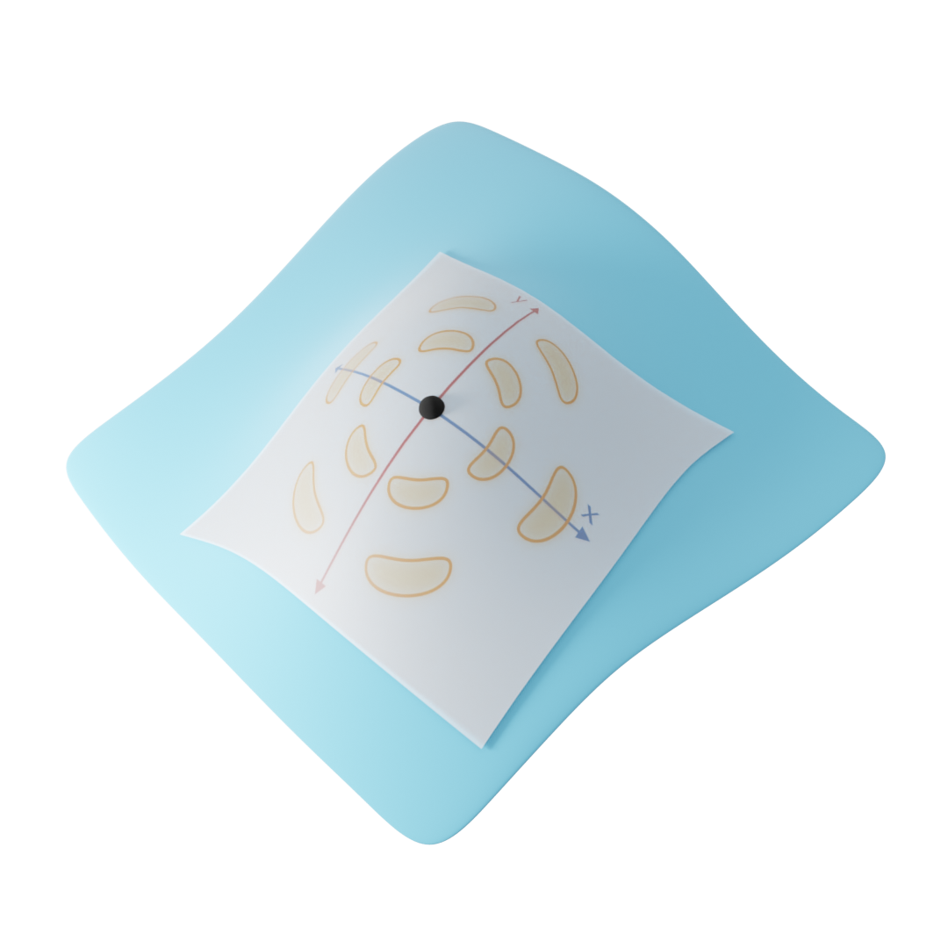
What did others do?
Graph- and point based
  GCN, PointNet++, EdgeConv
3D kernel (extrinsic)
  KPConv, MinkowskiNet, SSCN
2D kernels on surfaces (intrinsic)
  GCNN, ACNN, MoNet, MDGCNN, HSN
Notes:
Finally, we’ve seen charting based approaches. These approaches learn a kernel in 2D, and apply it to the surface using the exponential map. Some approaches use rotation-equivariant kernels and parallel transport to correct for unaligned coordinate systems. This exponential map used in these approaches is relatively expensive to compute and most approaches ignore the angular distortion introduced by the mapping.

Slide 24
DeltaConv is
Anisotropic
Intrinsic
Notes:
In this talk, we’re introducing DeltaConv, which is anisotropic and intrinsic, working directly on the surface.

Slide 25
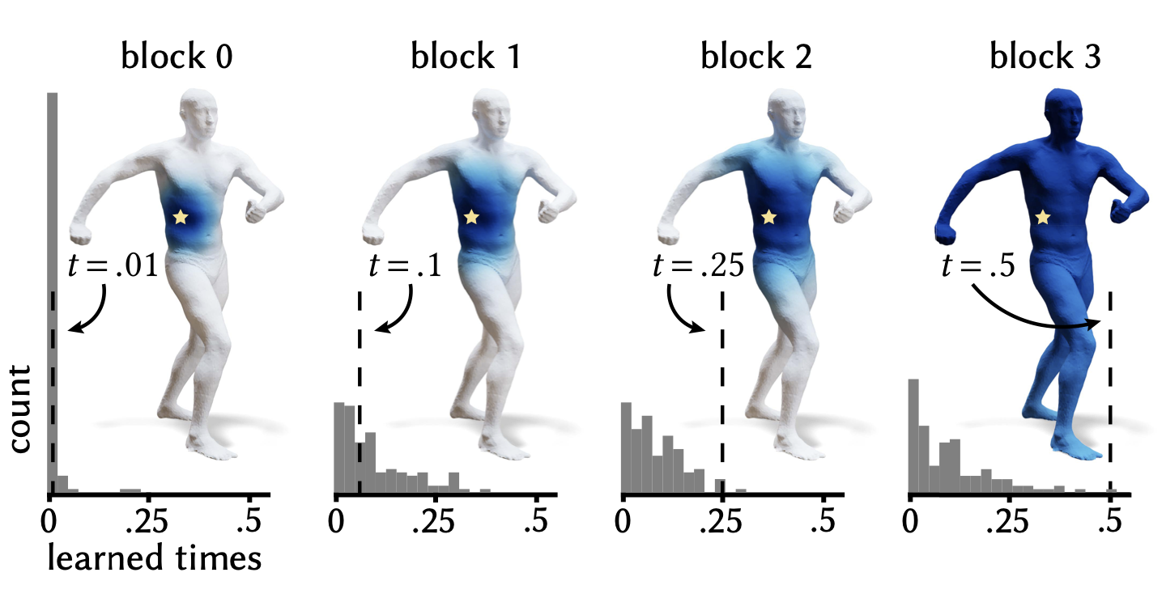
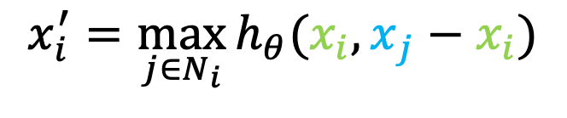
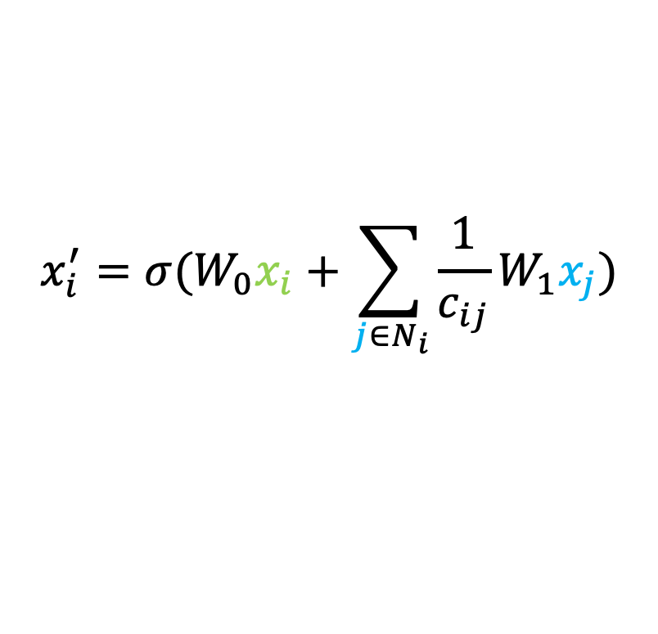
Convolutions and operators
Operators from vector calculus
  Laplacian, Gradient, Divergence
  Operators are coordinate-independent
Used in geometric deep learning
  Laplacian: GCN, EdgeConv
  Laplacian + gradient: DiffusionNet
$$x_{i}^{′}=σ(W_{0}x_{i}+\sum_{j∈N_{i}}{{\frac{1}{c_{ij}}W}_{1}x_{j}})$$
$$x_{i}^{′}=\max_{j∈N_{i}}{h_{θ}({x_{i}, x}_{j}−x_{i}})$$
DiffusionNet
[Sharp et al. 2022]
Notes:
In DeltaConv, we shift the focus from designing filter kernels to using operators from vector calculus, such as the Laplacian, gradient, and divergence. Such operators are coordinate-independent, which in practice means that the encoding of directional information is abstracted away from the neural network.
Operators have been used before in geometric deep learning. GCN uses the graph Laplacian and EdgeConv’s design is inspired by the Laplacian. DiffusionNet learns diffusion times on the surface with an eigendecomposition of the Laplacian and applies the spatial gradient. In DeltaConv, we use additional operators and connect them in different ways. For example, we retain directional information throughout the network by maintaining a stream of vector features.

Slide 26
Act 1
Introducing the cast
Notes:
Let's start by introducing the operators that we are using.

Slide 27
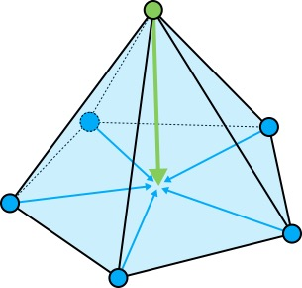
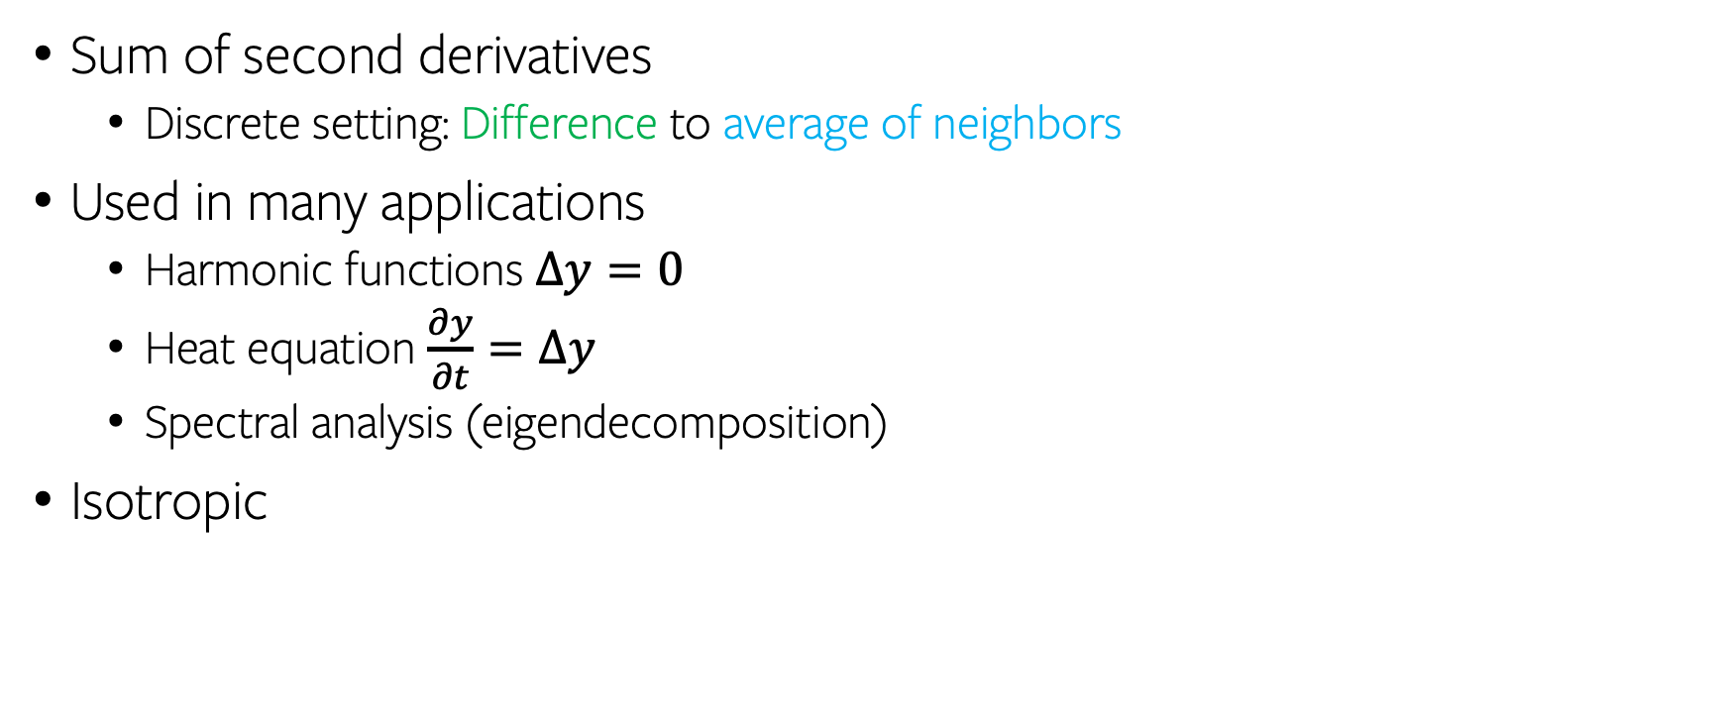
Laplacian
Sum of second derivatives
  Discrete setting: Difference to average of neighbors
Used in many applications
  Harmonic functions $Δy=0$
  Heat equation $\frac{∂y}{∂t}=Δy$
  Spectral analysis (eigendecomposition)
Isotropic
Notes:
First, the Laplacian. This operator computes the sum of second derivatives along every coefficient. An intuitive understanding in the discrete setting is that it computes the average of a point’s neighbors and then gives you the difference to that average.
The Laplacian is widely used in differential equations, and shape analysis.
But a downside of using only this operator is that it’s isotropic.

Slide 28
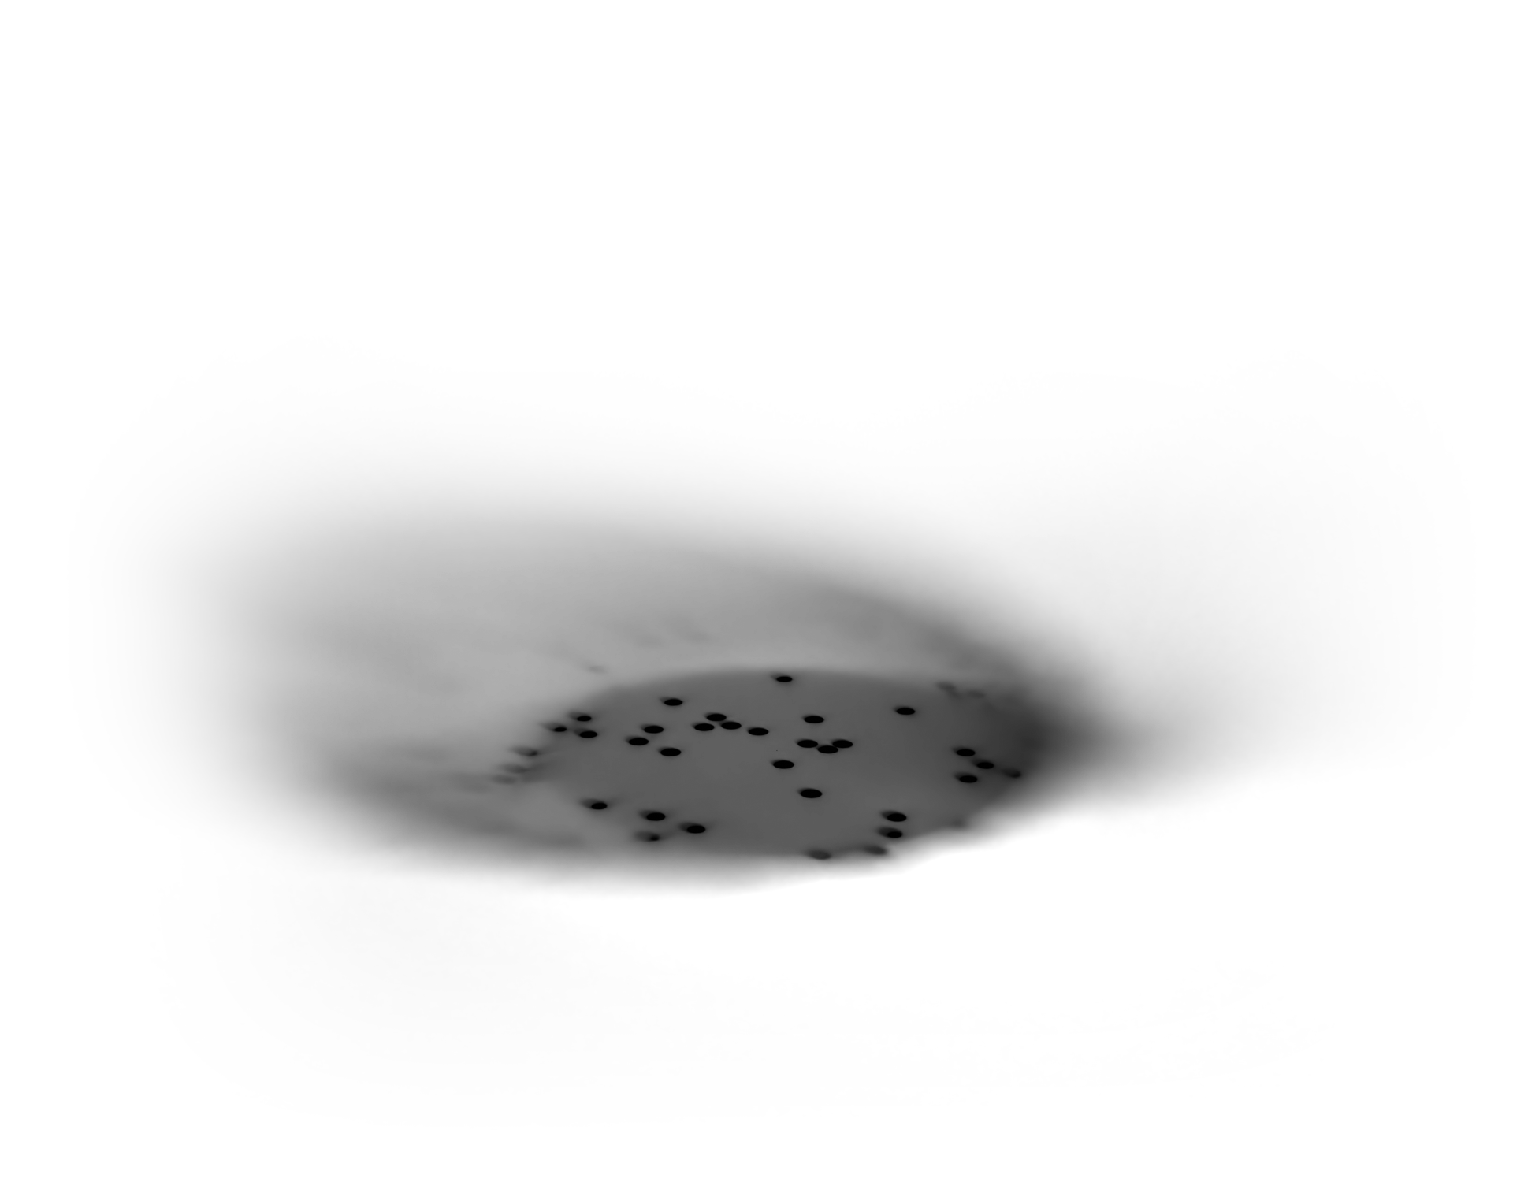
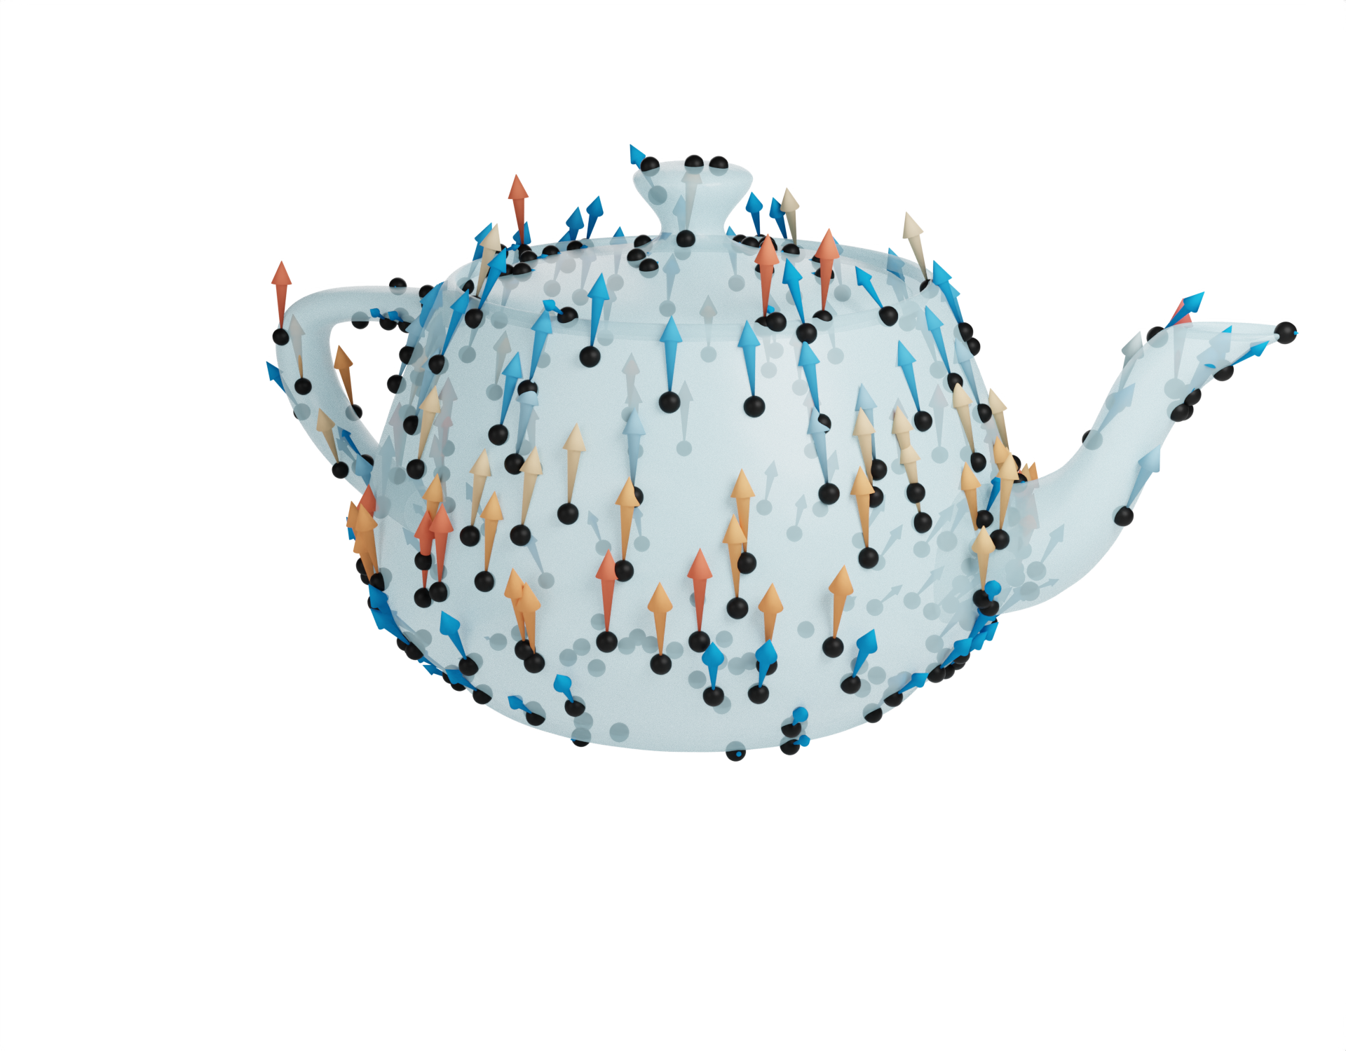
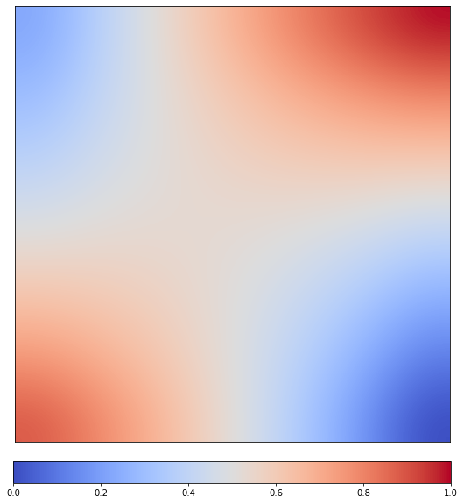
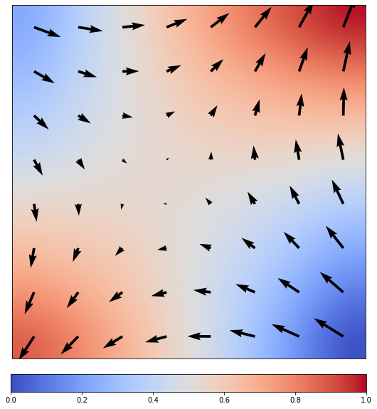
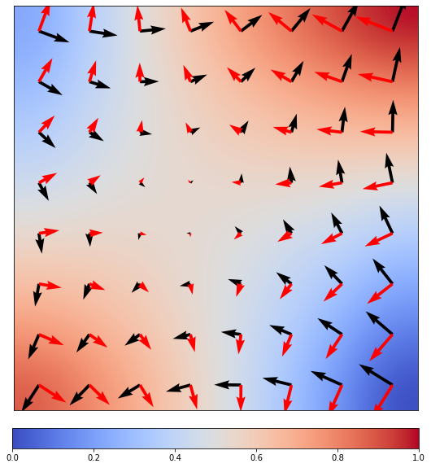
Gradient, co-gradient
Largest rate of change + direction
Co-gradient
On surfaces: tangential
Notes:
Next, the gradient and co-gradient. The gradient represents the largest rate of change and the direction of that change as a vector at each point. The co-gradient is a 90-degree rotated variant of the gradient. Which, in practice, allows us to rotate vectors.
On surfaces, gradients can be fully represented as tangent vectors.

Slide 29
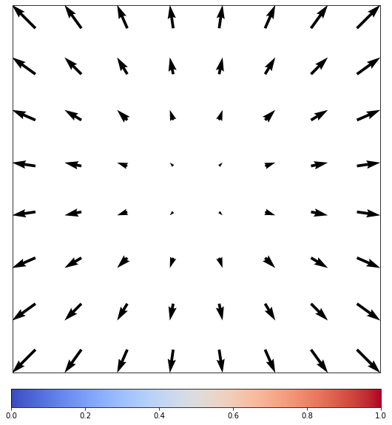
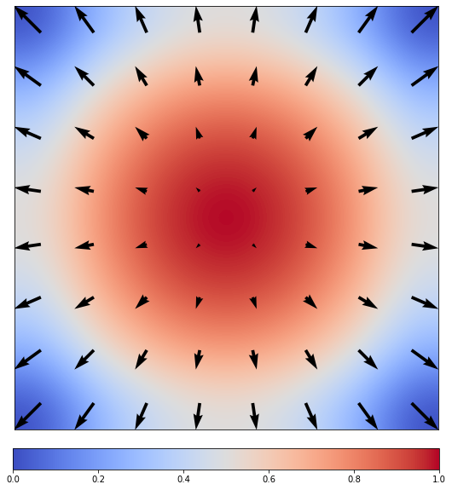
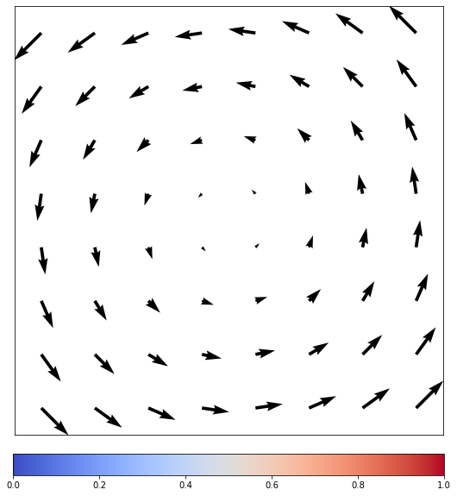
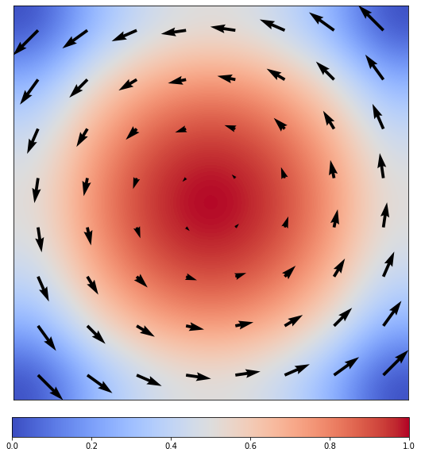
Divergence, curl
div Sinks and sources
curl Vortices
Notes:
Divergence and curl are commonly used to analyze vector fields. Divergence measures how much a vector field points out of a point and curl measures how much a vector field rotates around a point.

Slide 30
Act 2
There and back again
Notes:
We use these operators in a neural network to compute local features.

Slide 31
Scalars and vectors
Scalars
90-degree rotation
grad co-grad
div curl, norm
Vectors
Notes:
We start with the observation that each operator either outputs scalars or vectors. Gradient maps from scalars to vectors and divergence from vectors to scalars. Co-gradient and curl are simply 90-degree rotations of gradient and divergence.

Slide 32
De Rham Complex Properties
Scalars
curl grad F = 0
grad co-grad
div curl, norm
Vectors
Notes:
Note that first applying gradient, followed by curl always returns 0.

Slide 33
De Rham Complex Properties
Scalars
div co-grad F = 0
grad co-grad
div curl, norm
Vectors
Notes:
And the same can be said for first applying co-gradient and then divergence.

Slide 34
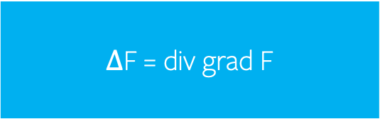
Laplacian “There and back again” [Baggins]
Scalars
$Δ$F = div grad F
grad co-grad
div curl, norm
Vectors
Notes:
For the Laplacian, we have to compute two derivatives, which means we go there and back again. For scalars [click], we go to vectors with gradient [click] and back again [click] with divergence.

Slide 35
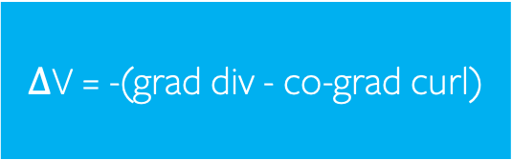
Laplacian “There and back again” [Baggins]
Scalars
$Δ$V = -(grad div - co-grad curl)
grad co-grad
div curl, norm
Vectors
Notes:
For vectors, we go to scalars with divergence and curl and back again with gradient and co-gradient. In our neural networks, we’ll separate scalars and vectors into two streams that run throughout the network.

Slide 36
Scalar and vector streams
Scalars
grad co-grad
div curl, norm
Vectors
Notes:
And connect them with these operators.

Slide 37
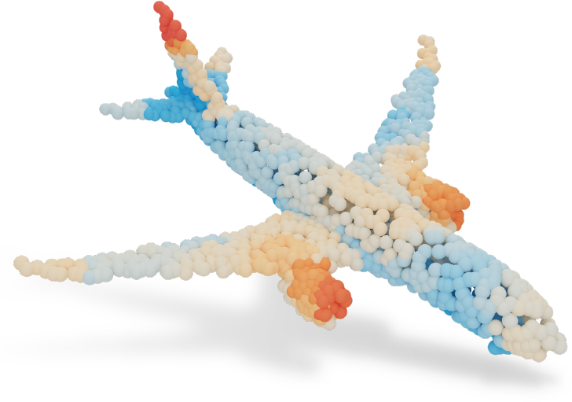
Building a feed-forward neural network
Scalars
0.3
0.9
0.6
0.1
0.9
0.3
C^{in}
C^{in}
0.2
0.8
⋮
⋮
Vectors
Notes:
DeltaConv can be used as a layer in neural networks and you would typically stack multiple layers of DeltaConv after each other. The input to each layer is a set of features for each point. In human terms, these features could describe ‘edge-likeness’, or ‘cornerness’, but the neural network derives features most useful for the task at hand.

Slide 38


Building a feed-forward neural network
Scalars
C^{in}
Vectors
Gradient is coordinate-independent
C^{in}
⋮
Notes:
In the vector stream, each point has multiple [vector] features. These features don’t only have a strength, but also a direction.
We choose to encode vector features by their coordinates in the tangent plane. I hope this triggers something in you: we just explained that local coordinate systems are not aligned. In fact, we could pick any rotation around the normal.
However, each vector feature is the result of coordinate independent operators. Gradient and divergence analyse functions and vector fields, they don’t depend on the coordinate system that is used to encode their input or output. We could pick any coordinate system we like.

Slide 39
Building a feed-forward neural network
Scalars
C^{in}
Vectors
C^{in}
Notes:
Next, computing features

Slide 40
Building a feed-forward neural network
Scalars
C^{in}
C^{out}
θ
MLP Weighted sum, non-linearity, repeat
Vectors
C^{in}
C^{out}
θ
Vector MLP Weights and sums vectors, non-linearity on norms
Notes:
First of all, we can learn per-point features using Multi-Layer perceptrons. We take a weighted sum of the input features, apply a non-linearity and repeat for a number of layers. For vectors, this process is similar: take a weighted sum of the vectors, apply a non-linearity to the vector norms, and repeat. Note that each of these operations acts on vectors as a whole and does not depend on the coordinate system.

Slide 41
Operators connect the streams
Scalars
C^{in}
Laplacian, Identity
C^{out}
θ
grad co-grad
div curl, norm
Vectors
C^{in}
C^{out}
θ
Hodge-Laplacian, Identity
Notes:
Next, computing [local] features. We connect from the scalar stream to the vector stream with gradient and co-gradient. Back to the scalar stream with divergence, curl, and the vector norm. Finally, the Laplacians are added inside the streams.

Slide 42
Combining and composing operators
Scalars
C^{in}
Laplacian, Identity
C^{out}
θ
grad co-grad
div curl, norm
Vectors
C^{in}
C^{out}
θ
Hodge-Laplacian, Identity
Notes:
DeltaConv combines and composes the operators by concatenating their outputs along the feature dimension and feeding them to the multi-layer perceptrons.

Slide 43
DeltaConv
max
Scalars
C^{in}
C^{out}
θ
θ
+
grad co-grad
div curl, norm
Vectors
C^{in}
C^{out}
θ
Hodge-Laplacian, Identity
Notes:
We use maximum aggregation instead of the Laplacian in the scalar stream, as this is a very effective analogy of Laplacians for learning on point clouds, demonstrated by PointNet++ and EdgeConv.

Slide 44
Act 3
The pay-off
Notes:
What did we achieve?

Slide 45

Anisotropy?
Anisotropic diffusion [Perona-Malik, 1987]
$$\frac{∂y}{∂t}=∇⋅(c(\left|∇y\right|)∇y)$$
Notes:
First, we met our goal of creating anisotropic filters. A good way to illustrate this is with anisotropic diffusion as proposed by Perona and Malik. Here, the change of a function over time is described with

Slide 46
Anisotropy?
Anisotropic diffusion [Perona-Malik, 1987]
$$\frac{∂y}{∂t}=∇⋅(c(\left|∇y\right|)∇y)$$
Notes:
the gradient

Slide 47

Anisotropy?
Anisotropic diffusion [Perona-Malik, 1987]
$$\frac{∂y}{∂t}=∇⋅(c(\left|∇y\right|)∇y)$$
Notes:
a non-linearity applied to the gradient vector norms

Slide 48
Anisotropy?
Anisotropic diffusion [Perona-Malik, 1987]
$$\frac{∂y}{∂t}=∇⋅(c(\left|∇y\right|)∇y)$$
Notes:
and divergence

Slide 49

Anisotropy?
Anisotropic diffusion [Perona-Malik, 1987]
$$\frac{∂y}{∂t}=∇⋅(c(\left|∇y\right|)∇y)$$
Solve by explicit integration over time
Notes:
We can ‘solve’ this equation by integrating over time.

Slide 50

Anisotropy?
1 step
5 steps
10 steps
20 steps
40 steps
Astronaut image courtesy NASA
Notes:
As the number of timesteps increases, the signal is diffused along certain directions. The result [click] is that edges are preserved.
DeltaConv has all the building blocks necessary to perform anisotropic diffusion:

Slide 51

DeltaConv is anisotropic
max
Scalars
C^{in}
C^{out}
θ
θ
+
$$\frac{∂y}{∂t}=∇⋅(c(\left|∇y\right|)∇y)$$
grad co-grad
div curl, norm
Vectors
C^{in}
C^{out}
θ
Hodge-Laplacian, Identity
Notes:
gradient

Slide 52
DeltaConv is anisotropic
max
Scalars
C^{in}
C^{out}
θ
θ
+
$$\frac{∂y}{∂t}=∇⋅(c(\left|∇y\right|)∇y)$$
grad co-grad
div curl, norm
Vectors
C^{in}
C^{out}
θ
Hodge-Laplacian, Identity
Notes:
A non-linearity on vector norms

Slide 53
DeltaConv is anisotropic
max
Scalars
C^{in}
C^{out}
θ
θ
+
$$\frac{∂y}{∂t}=∇⋅(c(\left|∇y\right|)∇y)$$
grad co-grad
div curl, norm
Vectors
C^{in}
C^{out}
θ
Hodge-Laplacian, Identity
Notes:
And divergence.

Slide 54

Ablations Perona-Malik
20 timesteps
Notes:
We can demonstrate this nicely on an image. We setup a simple ResNet and feed the unfiltered image as input. The network is optimized to output the target image, which was created with 20 anisotropic diffusion steps.
A network with DeltaConv can match the result.
Where previous point cloud- and image convolutions struggle. Note that even image CNNs don’t achieve the desired effect. We think this has multiple causes: for one, Perona-Malik requires a non-linearity on vector norms, which can be difficult for the image CNN to derive. Combine this with the fact that the number of sharp edges is relatively low, compared to the blurred areas. It could be simpler for the CNN to optimize to a blurring filter.

Slide 55
DeltaConv can control anisotropic diffusion time
Notes:
We can train the same network on targets with different diffusion times and the network with DeltaConv can get good approximations for each timestep, showing that it could learn to control diffusion times.
Finally, a part that I’m very excited about.

Slide 56
DeltaConv benefits from geometric operators
All operators are intrinsic
All operators are coordinate-independent
All operators are generalizable
  Hyperbolic space, higher dimensions
All operators are available for different discretizations
  In paper: images, point clouds
Notes:
DeltaConv builds on foundations of differential geometry. Therefore it inherits a lot of nice properties for curved surfaces.
All operators are intrinsic.
All the operators are coordinate-independent.
All operators are generalizable to other manifolds, such as hyperbolic spaces and higher dimension
And we already have nice discretizations. In this paper, we show that DeltaConv works effectively on images and point clouds.
Again, this is because we build on prior knowledge about how to analyse functions on curved surfaces.

Slide 57
DeltaConv: the ride
Experiments
Notes:
Let's take DeltaConv for a spin.

Slide 58

Architecture
Based on DGCNN [Wang et al. 2019]
Convolutions replaced by DeltaConv
Notes:
We start with the architecture proposed in DGCNN, the network around EdgeConv.
Each convolution is replaced with the operations in DeltaConv. The result is a very simple architecture with three to four convolution layers in a single scale.
You might notice that we use 3D coordinates as input to the network. We used such extrinsic features as input to compare with other works that use 3D positions. It would be possible to use intrinsic features as input, which would make the entire pipeline fully intrinsic and rotation invariant.

Slide 59
Operators on point clouds
Gradient, divergence for point clouds
  Moving least squares
Notes:
In our implementation we use moving least squares to compute gradient and divergence on a point cloud. We fit a quadratic polynomial to a small patch points.

Slide 60
Operators on point clouds
Gradient, divergence for point clouds
  Moving least squares
  Regularized and normalized (see paper)
  Robust to noise and sparse point clouds
Easy to use
  Curl, co-grad: 90-degree rotation
  Sparse matrix multiplication
  Code at github.com/rubenwiersma/deltaconv
Notes:
And then take its derivative. The operators are regularized and normalized to be robust to noise and sparse regions. The operators are easy to use: we can reuse gradient and divergence for co-gradient and curl and the operators are applied through efficient sparse matrix multiplication. You can find our code on github.

Slide 61

Comparisons
Chair
Classification
ModelNet40
Segmentation
ShapeNet
Method
PointNet++
DGCNN
KPConv rigid
PointTransformer
GBNet
CurveNet
DeltaNet (ours)
Delta-U-ResNet(ours)
Mean Class Acc. | Overall Acc.
- | 90.7
90.2 | 92.9
- | 92.9
90.6 | 93.7
91.0 | 93.8
- | 93.8
91.2 | 93.8
- | -
Mean inst. mIoU
85.1
85.2
86.4
86.6
-
86.8
86.6
86.9
More comparisons and citations in paper
Notes:
Of course, we were curious how DeltaConv compared to recent state of the art approaches on classification with ModelNet40 and Segmentation on ShapeNet. Often, these networks use more complex network architectures and recent advancements such as self-attention. Even then, DeltaConv is on par or better than the state-of-the-art, showing that it pays off to be aware of geometric constraints.
We also tested on more challenging data.

Slide 62


Comparisons real-world data
Classification
ScanObjectNN
  Noise, background points
  Translated, rotated, cut-off
Method | Accuracy
PointNet++ | 77.9
DGCNN | 78.1
KPConv rigid | -
PointTransformer | -
GBNet | 80.5
CurveNet | -
DeltaNet (ours) | 84.7
Notes:
ScanObjectNN is a classification task with objects from multiple scanned-room datasets. It includes noise and background points and there are variants of the data with translated and rotated bounding boxes. Even on the most difficult variant, we see a large improvement over previous work.
Next, we investigated how much we actually benefit from anisotropic information.

Slide 63
Ablations vector stream
Classification
ModelNet40
Segmentation
ShapeNet
Scalar convolution | Vector stream | Increased params | Mean Class Acc. | Overall Accuracy | Mean inst. mIoU
Laplace-Beltrami | - | - | 86.1 | 90.4 | 82.5
 | - | ✓ | 87.1 | 90.6 | 82.5
 | ✓ | - | 89.4 | 92.2 | 84.9
GCN | - | - | 87.3 | 90.4 | 81.1
 | - | ✓ | 87.3 | 90.8 | 81.2
 | ✓ | - | 90.6 | 92.8 | 85.1
Max aggregation | - | - | 89.2 | 92.2 | 85.7
 | - | ✓ | 89.5 | 92.6 | 85.7
 | ✓ | - | 91.2 | 93.8 | 86.1
Notes:
We first tested three networks that don’t use directional information in their convolutions: the Laplace-Beltrami operator, GCN, and a network with maximum aggregation.
Then we test two variants: one where we just increase the number of parameters and one where we add the vector stream, which results in the same number of parameters.
On both tasks and for every network, the vector stream increases the accuracy.
Finally, we evaluated the runtime of DeltaConv, compared to a very similar, seemingly simpler operation: EdgeConv.

Slide 64
Ablations speed
Compare with EdgeConv (no dynamic graph)
Points instead of edge-based features
  K times more MLP computations (e.g., k=20)
Classification
ModelNet40
Convolution | Data Transforms | Training | Backward | Inference
EdgeConv | k-nn | 196ms | 147ms | 186ms
DeltaConv (lapl.) | k-nn + ops | 80ms | 5ms | 80ms
DeltaConv | k-nn + ops | 130ms | 60ms | 125ms
Notes:
To our surprise, DeltaConv was actually much faster than EdgeConv. Look, for example, at the comparison of the backward pass: a 30 times improvement.
The reason for this is simple: DeltaConv computes directional features at each point instead of each edge. If you have 20 edges per point, EdgeConv apples the multi-layer perceptron 20 times for each point. This is hard to scale up to larger point clouds with more points per neighborhood.

Slide 65
DeltaConv
In short
Notes:
Concluding

Slide 66
Conclusion
Intrinsic anisotropic convolutions are challenging on surfaces
DeltaConv combines and composes geometric operators
  Intrinsic
  Anisotropic
Easy to use and efficient
Builds on foundations in geometry
Notes:
We saw that it’s difficult to design convolutions that are both intrinsic and anisotropic.
DeltaConv combines and composes geometric operators, resulting in a convolution that is intrinsic and anisotropic, which gives us improved performance.
DeltaConv is easy to use and efficient and builds on foundational properties and knowledge from analysis and geometry. We hope that it inspires more work that connects these fields.

Slide 67

Try DeltaConv yourself
github.com/rubenwiersma/deltaconv
$ pip install deltaconv
graphics.tudelft.nl
Notes:
You can try DeltaConv for yourself by downloading the source code on github or installing the package using pip. I’m excited to see what you’ll do with it. Thank you for your attention.

Slide 68
Discretizing the operators
Gradient, Divergence Moving Least Squares
Notes:
A short detour: How does one compute these operators. In our paper we use moving least squares. The short version is that we fit a 2nd order polynomial to a small patch of surface

Slide 69
Discretizing the operators
Gradient, Divergence Moving Least Squares
Notes:
And then take it’s derivative

Slide 70
Regularization is important
OFF
ON
Notes:
We use regularization during this step to make the operators robust to noise and sparse regions. On the left, the gradient without regularization results in exploding values, especially in sparse regions like the legs of the chair. This is corrected with the regularizer, as seen on the right.

Slide 71

Normalization
Normalize with max norm (infinity norm)
$$\hat{G}=G / {\left|G\right|}_{∞}$$
Multiple applications of gradient, diverging behaviour
Notes:
We also normalize the operators with the maximum norm or infinity norm, which serves as an upper bound on the scaling behaviour of the operators. We found that without this normalization, the features would diverge with each layer.

Slide 72
DeltaConv vs. Rotation-Equivariance (HSN)
 | DeltaConv | HSN
Streams | Scalar, Vector | Rotation-invariant/equivariant, complex valued
Learnable parameters | Scaling, summing, rotating features | Radial profile (scales sums), offset (rotates)
Stream connections | Geometric operators (grad, div, rotate) | Circular harmonics, complex valued
Exponential map | Not necessary | Exponential map for every point
Transport | Not necessary (div) | Parallel transport for every point-pair
Simpler, but not too simple – main benefits remain

Slide 73

Potential issue with kernels on exponential maps
Notes:
More importantly, there is theoretical shortcoming. The rotation-equivariant property holds in the tangent planes, but is not preserved by the exponential map, since it's not an isometry. The exponential map stretches and squeezes the flat tangent plane to fit onto the surface. This stretching and squeezing can be different in every direction and thus the rotation-equivariant property breaks. This is a problem for any rotation- or gauge-equivariant approach that applies kernels in flat spaces: they pretend the mapping is isometric.

Slide 74

Angular distortion of exponential map
Same angle on exponential plane
Different, depending on Gaussian curvature
Notes:
The exponential map introduces an angular distortion that depends on the gaussian curvature of a shape. You can see this clearly in the example of two spheres. These are constant curvature, with a curvature of 1 over the radius. A unit circle in the tangent plane is deformed differenly between the two spheres and this stretching depends on the gaussian curvature. The exponential map sees these spheres as being the same, even though they aren't.

Slide 75

Angular distortion of exponential map
Spheres: constant gaussian curvature
What about other manifolds?
  E.g., saddlepoints
Symmetrizes non-symmetric spaces
DeltaConv directly on the surface
Notes:
With spheres we have shapes with constant gaussian curvature that are seen as being the same even though aren't. This gets more complicated on other manifolds with changing curvature and non-linear stretching and squeezing, where a kernel on an exponential map could look at points with completely different curvature and think they are the same. In other words, equivariant approaches on curved manifolds symetrize spaces that are not symmeric.
What's nice about DeltaConv is that it operates directly on the surface, so we don't have this issue.

Slide 76

Ablations regularization
Notes:
We wanted to find out if the vector stream, our main argument for anisotropy actually benefits learning on surfaces. For this experiment, we tested a couple of scalar streams with the vector stream on top. In each, we find that the vector stream helps the network reach higher accuracy. This is also the case if we increase the number of parameters in the scalar stream.

Slide 77




Comparisons deformables
Notes:
And finally, we test our approach on deformables, because intrinsic convolutions are especially suitable for deformables. Again, we see that DeltaConv is very comfortable between state-of-the-art approaches.

