Slide 1
CNNs on Surfaces using rotation-Equivariant features
Ruben Wiersma, Elmar Eisemann, and Klaus Hildebrandt
Delft University of Technology

Slide 2
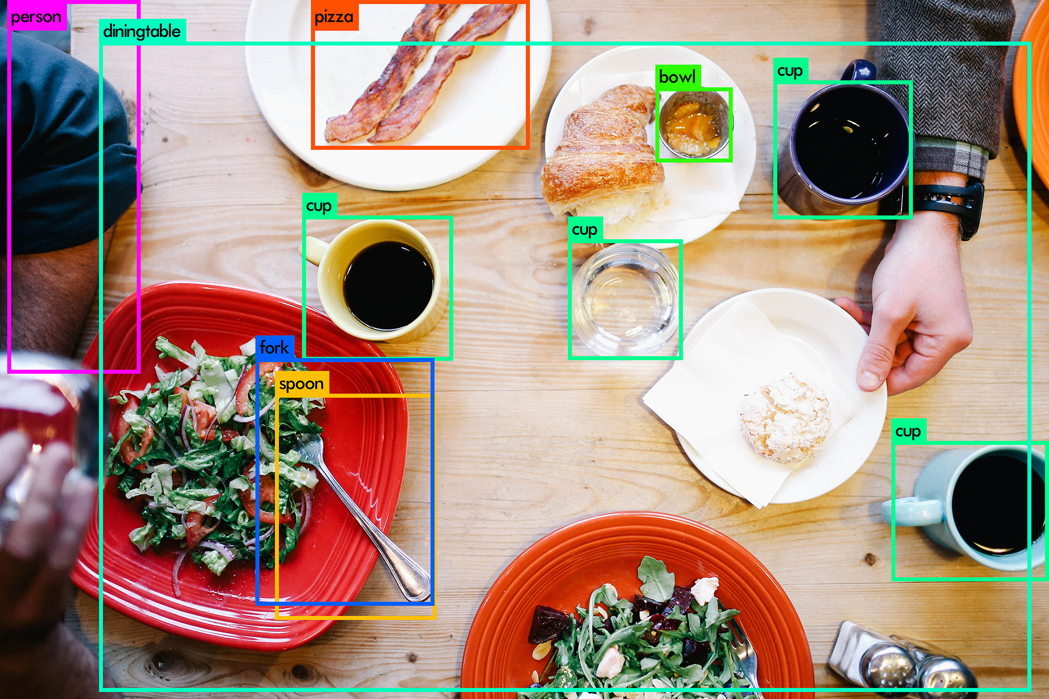
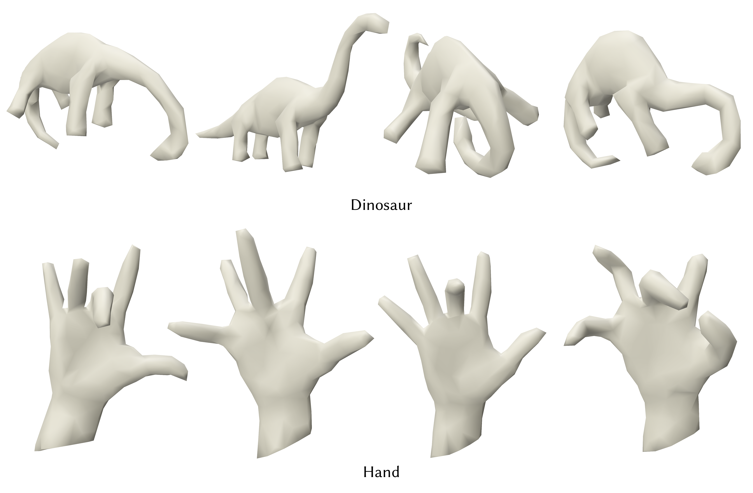
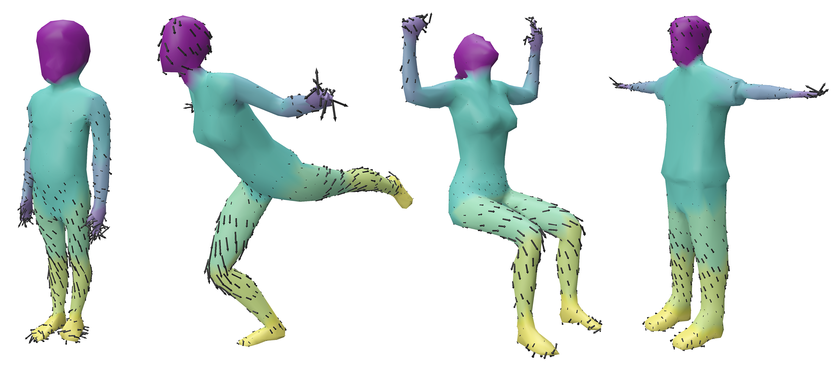
Geometric Deep Learning
Classification
Segmentation
Segmentation image credit: https://sthalles.github.io/deep_segmentation_network/

Slide 3
CNNs on images
Learn a template
Move over images
Weight sharing

Slide 4
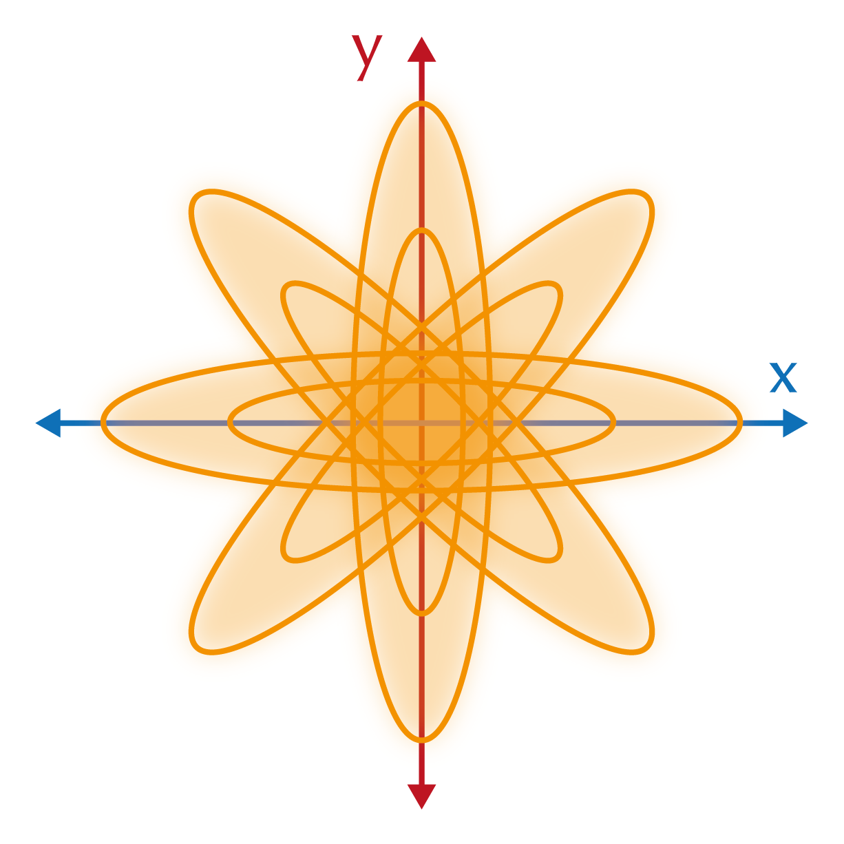
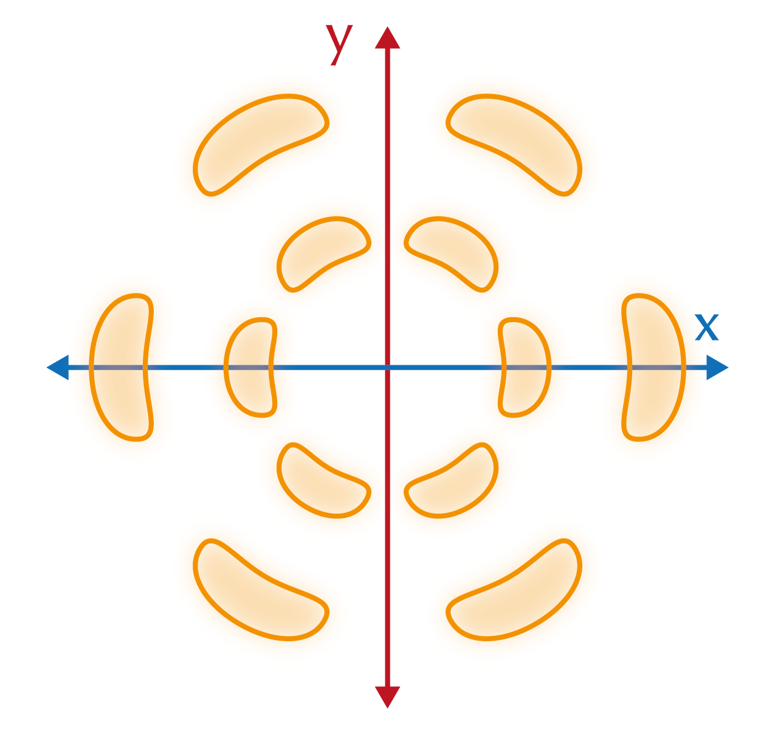
CNNs on surfaces
Charting approach
Learn kernel on $ℝ^{2}$
Identify $ℝ^{2}$with tangent plane at every point
Map tangent plane to surface
(e.g., exponential map)
Intrinsic (deformable shapes)
Many variants
GCNN [Masci et al. 2015], MDGCNN [Poulenard and Ovsjanikov 2018]
MoNet [Monti et al. 2017]
ACNN [Boscaini et al. 2016]
Notes:
Camera spot

Slide 5
Notes:
I want to move the filter along the surface

Slide 6
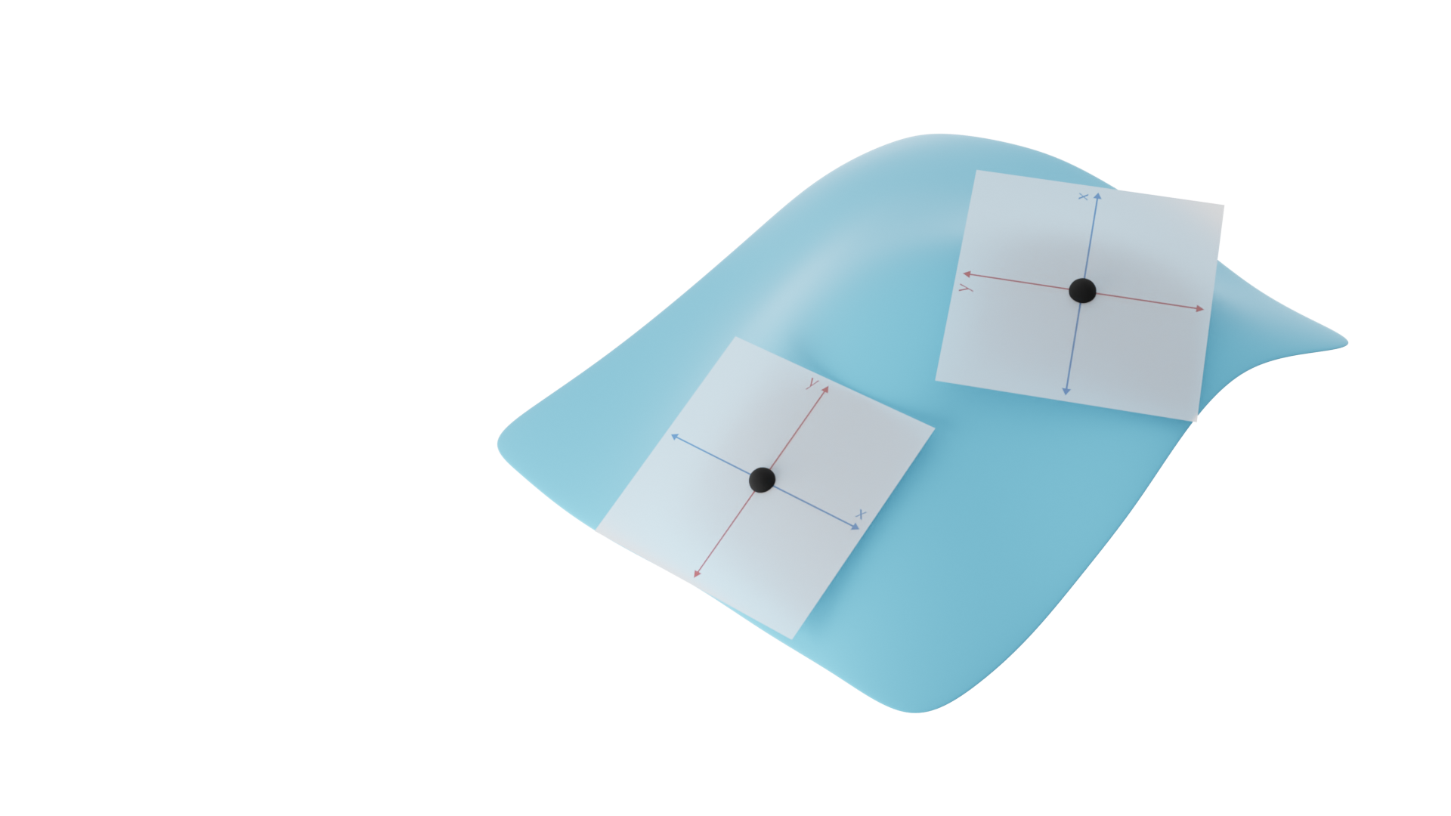
Rotation ambiguity problem
Notes:
Holonomy: if you parallel transport along a closed path, you have an angle with the first location
Show two images: moved over different curves, different rotations

Slide 7
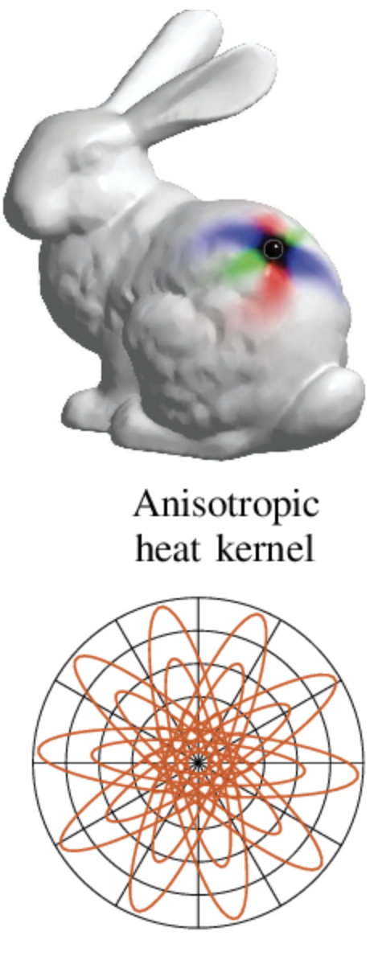
What did others do?
Aligning to a smoothed field (principal curvature)
e.g., ACNN, TextureNet [Huang et al. 2019], Parallel Frames [Pan et al. 2018]
Distortion, e.g. close to umbilics
Extrinsic
ACNN
[figures from Monti et al. 2017]
Notes:
Problem: distortion, for example: close to umbilics (every surface has umbilics)
Problem: extrinsic (!)

Slide 8
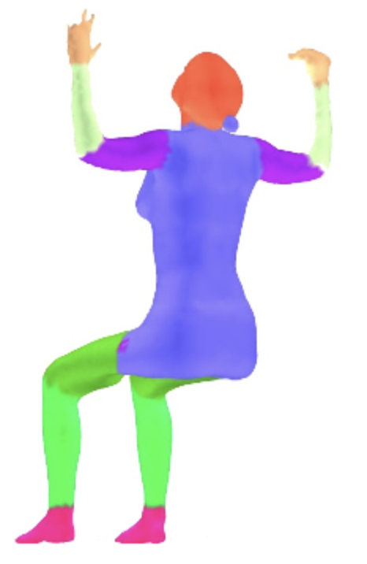
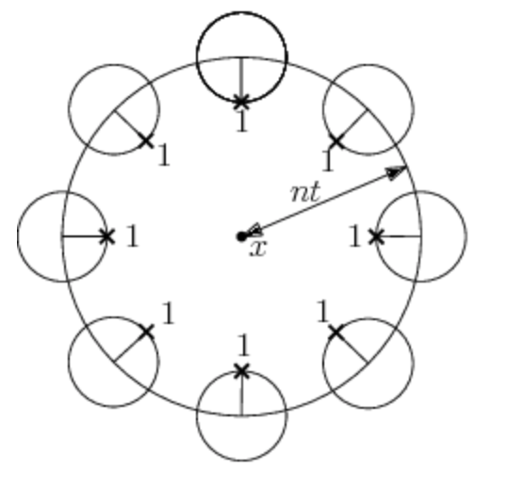
What did others do?
Applying at multiple rotations
e.g., GCNN (max), MDGCNN (parallel transport -> max)
Evaluate (and store) multiple rotations
Coarse angular discretization
MDGCNN
[Poulenard and Ovsjanikov 2018]
Notes:
Pass through network, relate with parallel transport

Slide 9
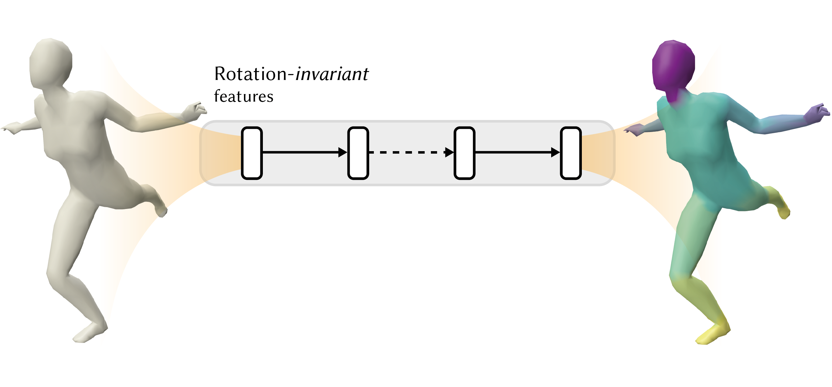
What did others do?
Rotation-invariant features
e.g., GCN [Kipf and Welling 2017], PointNet [Qi et al. 2017a]
Loss of expressiveness

Slide 10
Our approach
Harmonic Surface Networks

Slide 11
Harmonic Surface Networks properties
Fundamental approach to rotation ambiguity problem
Completely independent from choices of coordinate systems
Expressiveness of features

Slide 12
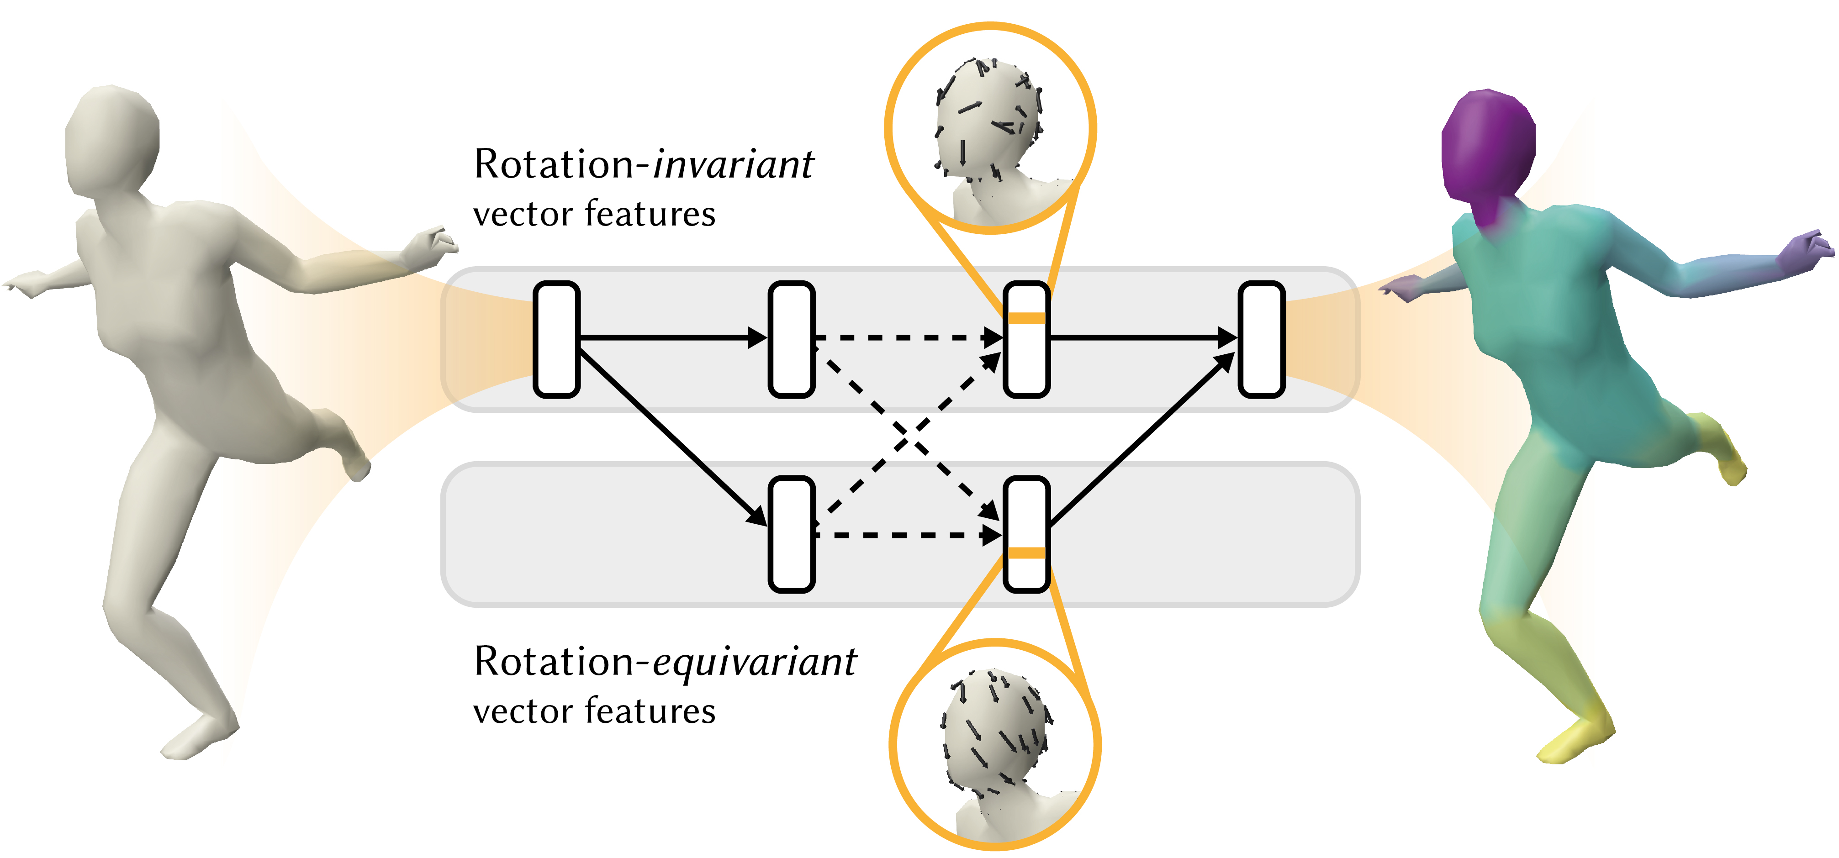
How?
Vector-valued (complex numbers)
Add a rotation-equivariant stream
Builds on Harmonic Networks [Worrall et al. 2017]
Notes:
Explain what rotation-equivariant features are: rotation-invariant is invariant to the choice of coordinate system, equivariant

Slide 13
Harmonic Surface Networks
Notes:
M=0, m=1: invariant, equivariant
This stream is equivariant
- Show with two images: filters rotate, or do not

Slide 14
Harmonic Surface Networks
Notes:
M=0, m=1: invariant, equivariant
This stream is equivariant
- Show with two images: filters rotate, or do not

Slide 15
Harmonic Surface Networks
Notes:
M=0, m=1: invariant, equivariant
This stream is equivariant
- Show with two images: filters rotate, or do not

Slide 16
Harmonic Surface Networks
Notes:
M=0, m=1: invariant, equivariant
This stream is equivariant
- Show with two images: filters rotate, or do not

Slide 17
Harmonic Surface Networks
Notes:
M=0, m=1: invariant, equivariant
This stream is equivariant
- Show with two images: filters rotate, or do not

Slide 18
Harmonic Surface Networks
Notes:
M=0, m=1: invariant, equivariant
This stream is equivariant
- Show with two images: filters rotate, or do not

Slide 19
Harmonic Surface Networks
Notes:
M=0, m=1: invariant, equivariant
This stream is equivariant
- Show with two images: filters rotate, or do not

Slide 20
Harmonic Surface Networks
Notes:
M=0, m=1: invariant, equivariant
This stream is equivariant
- Show with two images: filters rotate, or do not

Slide 21
Harmonic Surface Networks
Notes:
M=0, m=1: invariant, equivariant
This stream is equivariant
- Show with two images: filters rotate, or do not

Slide 22
Convolution operators within streams
Rotation-invariant kernel $R\left(r\right)e^{iβ}$
Learnable parameters
Radial profile $R\left(r\right)$
Phase offset $β$
Notes:
Radial profile, second term rotates the result, depending on angular location and phase offset

Slide 23
Convolution operators within streams
Rotation-invariant kernel $R\left(r\right)e^{iβ}$
Learnable parameters
Radial profile $R\left(r\right)$
Phase offset $β$
Notes:
Radial profile, second term rotates the result, depending on angular location and phase offset

Slide 24
Harmonic Surface Networks
Notes:
M=0, m=1: invariant, equivariant
This stream is equivariant
- Show with two images: filters rotate, or do not

Slide 25
Convolutions between streams
Rotation-equivariant kernel $R\left(r\right)e^{i\left(θ+β\right)}$
Uses angular coordinates
Notes:
Radial profile, second term rotates the result, depending on angular location and phase offset

Slide 26
Convolutions between streams
Rotation-equivariant kernel $R\left(r\right)e^{i\left(θ+β\right)}$
Uses angular coordinates
Notes:
Radial profile, second term rotates the result, depending on angular location and phase offset

Slide 27
Harmonic Surface Networks
Notes:
M=0, m=1: invariant, equivariant
This stream is equivariant
- Show with two images: filters rotate, or do not

Slide 28
What can we learn?
Input
Rot-Invariant
Rot-Equivariant
Example kernels
$R\left(r\right)=1−r$
$β=0$
Invariant smoothes
Similar to GCN
Equivariant can detect edges
Rotates with domain
Notes:
Todo: 0, 45, 90 degree rotations
Input: as scalar values

Slide 29
Harmonic Surface Networks
Notes:
M=0, m=1: invariant, equivariant
This stream is equivariant
- Show with two images: filters rotate, or do not

Slide 30
Harmonic Surface Networks
Notes:
M=0, m=1: invariant, equivariant
This stream is equivariant
- Show with two images: filters rotate, or do not

Slide 31
Harmonic Surface Networks
Notes:
M=0, m=1: invariant, equivariant
This stream is equivariant
- Show with two images: filters rotate, or do not

Slide 32
Convolution on a mesh
Aggregate features at every point with parallel transport
$$x_{i }^{\left(l+1\right)} =\sum_{j∈𝒩_{i}}{w_{j}\left(R\left(r_{ij}\right)e^{i(−θ+β)}P_{j→i}\left(x_{j}^{\left(l\right)}\right)\right)}$$

Slide 33
Parallel transport

Slide 34
Convolution on a mesh
Aggregate features at every point with parallel transport
$$x_{i }^{\left(l+1\right)} =\sum_{j∈𝒩_{i}}{w_{j}\left(R\left(r_{ij}\right)e^{i(−θ+β)}P_{j→i}\left(x_{j}^{\left(l\right)}\right)\right)}$$

Slide 35
Convolution on a mesh
Aggregate features at every point with parallel transport
$$x_{i }^{\left(l+1\right)} =\sum_{j∈𝒩_{i}}{w_{j}\left(R\left(r_{ij}\right)e^{i(−θ+β)}P_{j→i}\left(x_{j}^{\left(l\right)}\right)\right)}$$
New feature at point i

Slide 36
Convolution on a mesh
Aggregate features at every point with parallel transport
$$x_{i }^{\left(l+1\right)} =\sum_{j∈𝒩_{i}}{w_{j}\left(R\left(r_{ij}\right)e^{i(−θ+β)}P_{j→i}\left(x_{j}^{\left(l\right)}\right)\right)}$$
Sum over neighbours
(geodesic ball)

Slide 37
Convolution on a mesh
Aggregate features at every point with parallel transport
$$x_{i }^{\left(l+1\right)} =\sum_{j∈𝒩_{i}}{w_{j}\left(R\left(r_{ij}\right)e^{i(−θ+β)}P_{j→i}\left(x_{j}^{\left(l\right)}\right)\right)}$$
Parallel transport

Slide 38
Convolution on a mesh
Aggregate features at every point with parallel transport
$$x_{i }^{\left(l+1\right)} =\sum_{j∈𝒩_{i}}{w_{j}\left(R\left(r_{ij}\right)e^{i(−θ+β)}P_{j→i}\left(x_{j}^{\left(l\right)}\right)\right)}$$
Circular harmonic (inverse)

Slide 39
Convolution on a mesh
Aggregate features at every point with parallel transport
$$x_{i }^{\left(l+1\right)} =\sum_{j∈𝒩_{i}}{w_{j}\left(R\left(r_{ij}\right)e^{i(−θ+β)}P_{j→i}\left(x_{j}^{\left(l\right)}\right)\right)}$$
Vector Heat Method [Sharp et al. 2019]

Slide 40
Convolution on a mesh
Aggregate features at every point with parallel transport
$$x_{i }^{\left(l+1\right)} =\sum_{j∈𝒩_{i}}{w_{j}\left(R\left(r_{ij}\right)e^{i(−θ+β)}P_{j→i}\left(x_{j}^{\left(l\right)}\right)\right)}$$
Vertex weighting

Slide 41
Layers: Non-linearities
In traditional CNNs, apply directly to features:
$$\text{Re}\text{LU}\left(X\right)=\left\{\begin{aligned}X \text{if} \text{X}\text{>0} \\ 0 \text{otherwise}\end{aligned}\right.$$
For vector-valued features, apply to magnitude:
$$ℂ\text{−}\text{ReL}{\text{U}}_{b}\left(Xe^{iθ}\right)=\text{ReLU}\left(X+b\right)e^{iθ}$$
Notes:
Non-linearity: what would happen normally

Slide 42
Layers: Pooling
In traditional CNNs, aggregate features from local regions: $x_{i}^{(l+1)} =\frac{1}{|C_{i}|}\sum_{j∈C_{i}}{x_{j}^{(l)}}$
For vector-valued features: pooling with parallel transport
$$x_{i}^{(l+1)} =\frac{1}{|C_{i}|}\sum_{j∈C_{i}}{P_{j→i}\left(x_{j}^{\left(l\right)}\right)}$$
Notes:
Old ways: what would happen normally

Slide 43
What we got
Fundamental approach to rotation ambiguity problem
Vector-valued features + parallel transport
Rotation equivariant features commute with change of coordinate system
Completely independent from choices of coordinate systems
Output from rotation-invariant stream
Expressiveness of features
Rotation-equivariant features

Slide 44
Evaluation

Slide 45
Evaluation
Ablation studies
What is the benefit of the rotation-equivariant stream?
What is the benefit of local alignment with parallel transport?
Comparisons
How does our approach compare to state of the art?

Slide 46
Ablation studies
Classification
SHREC [Lian et al. 2011]
Segmentation [Maron et al. 2017]

Slide 47
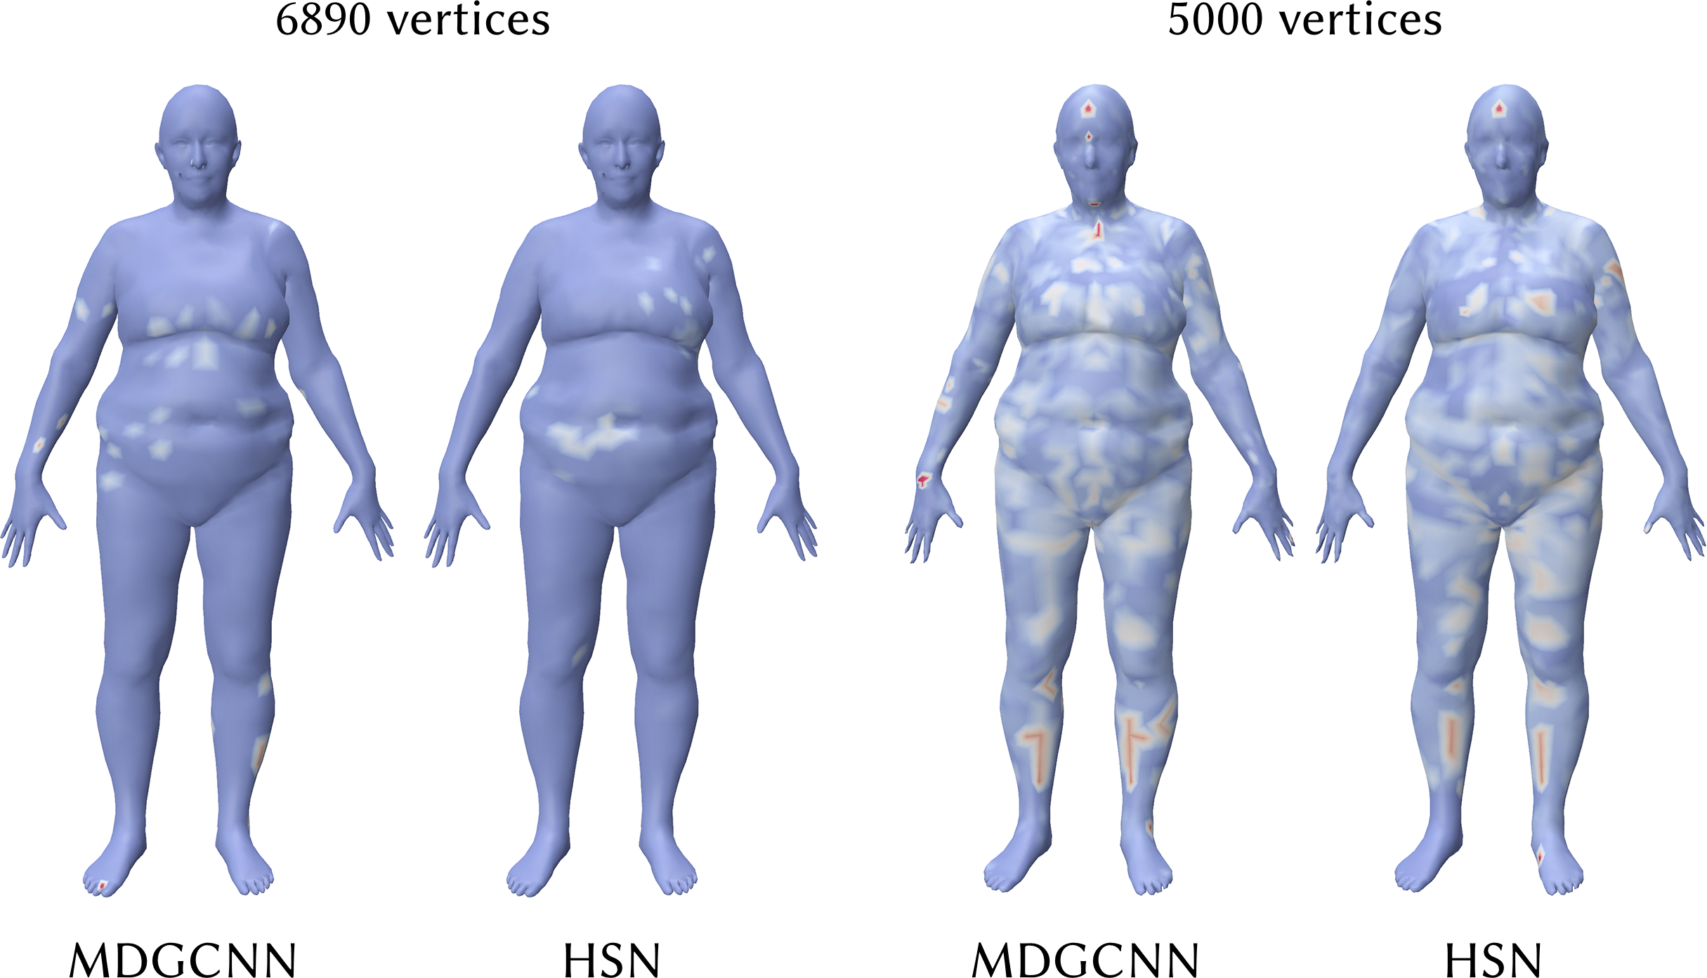
Comparisons
Correspondence
FAUST [Bogo et al. 2014]
Classification
SHREC [Lian et al. 2011]
Segmentation [Maron et al. 2017]

Slide 48
Architecture
Rotation-invariant
Rotation-equivariant

Slide 49
Shape Classification
Ablation
SHREC ’11
30 classes
Train set 300 meshes
Test set 120 meshes

Slide 50
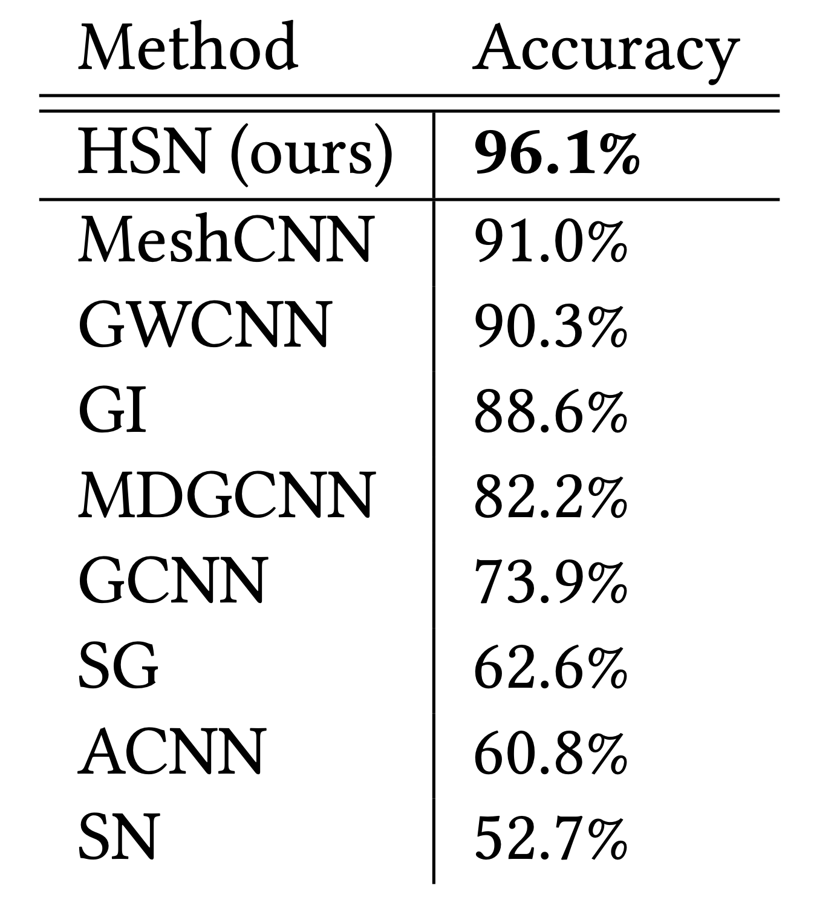
Shape Classification
Comparison
SHREC ’11
30 classes
Train set 300 meshes
Test set 120 meshes

Slide 51
Shape Segmentation
Ablation
Proposed by Maron et al. 2017
8 classes
Train set 381 meshes (varying sources)
Test set 18 meshes

Slide 52
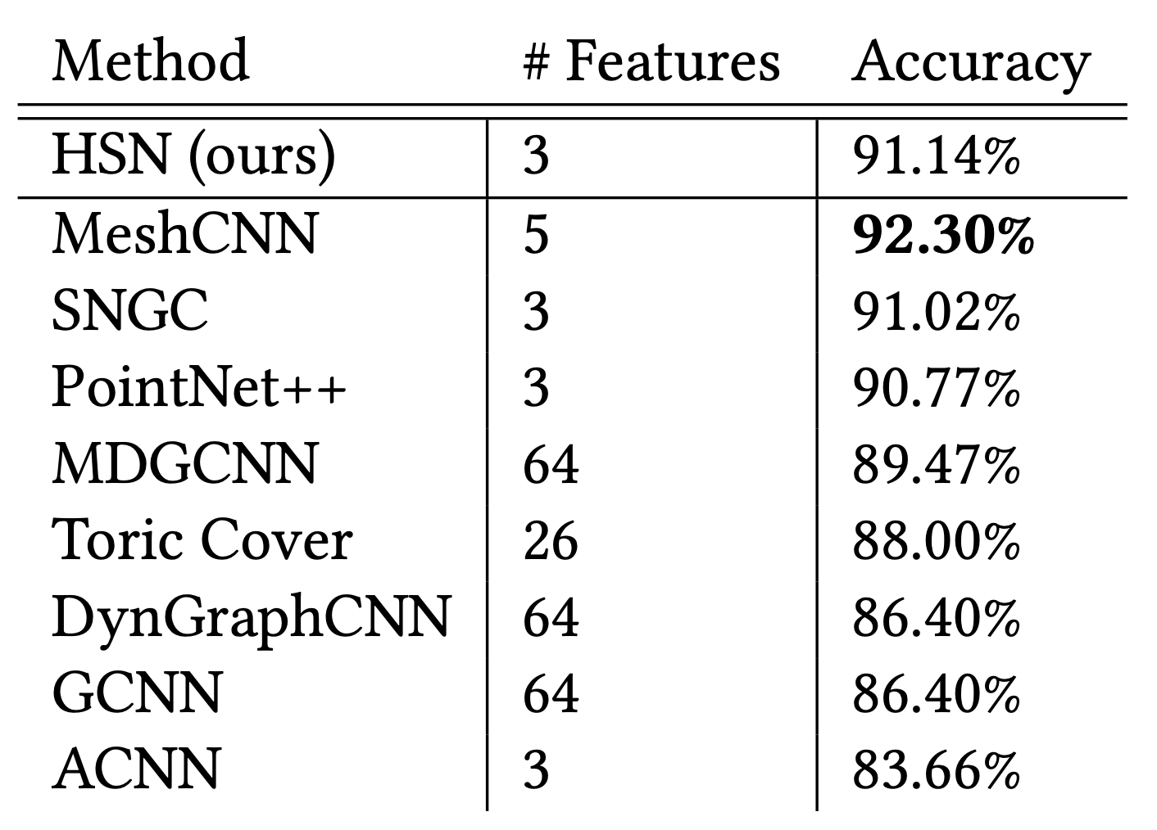
Shape Segmentation
Comparison
Proposed by Maron et al. 2017
8 classes
Train set 381 meshes (varying sources)
Test set 18 meshes
Notes:
Differences with MeshCNN, [different features, rotation invariant, etc.]

Slide 53
Second-to-last layer, rotation-equivariant features
Notes:
Better examples

Slide 54
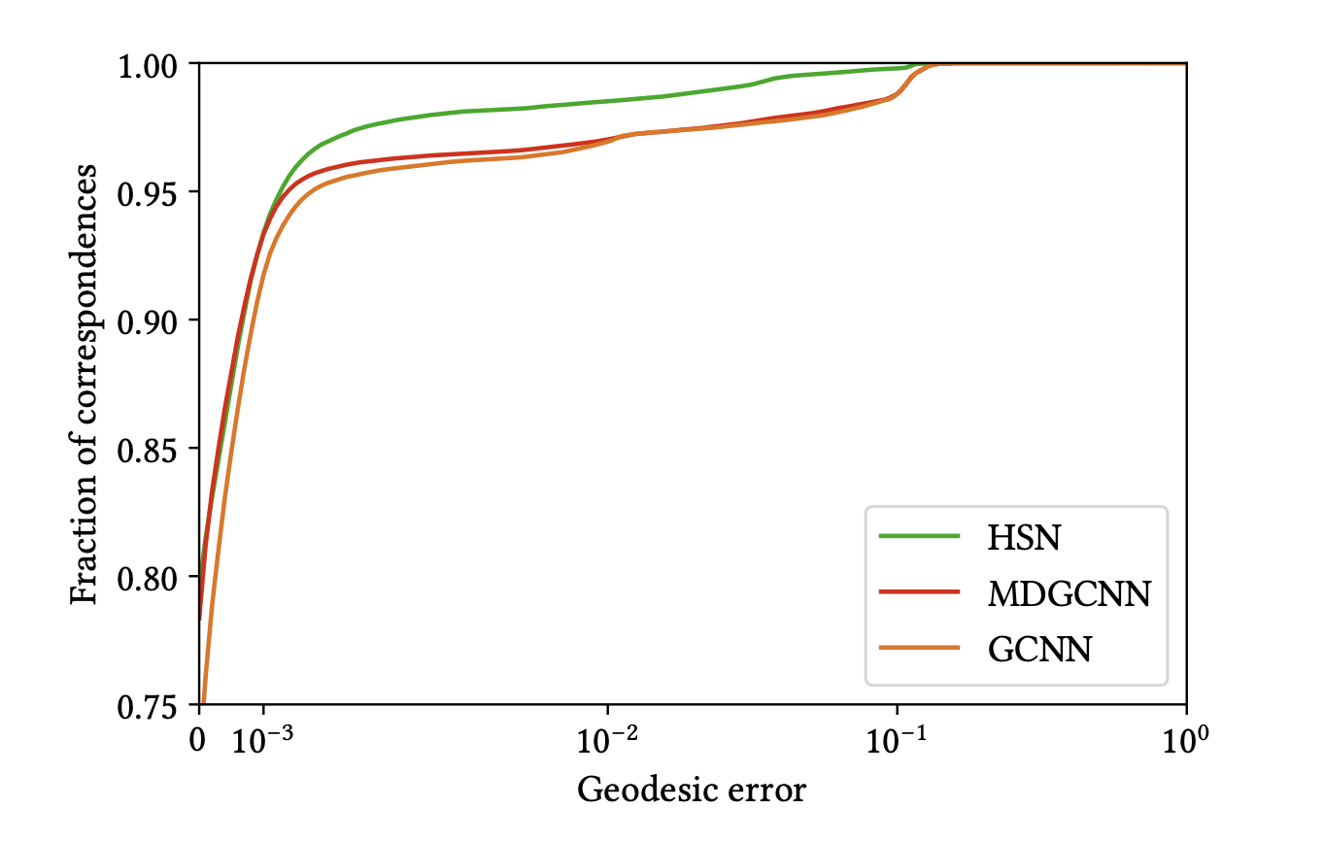
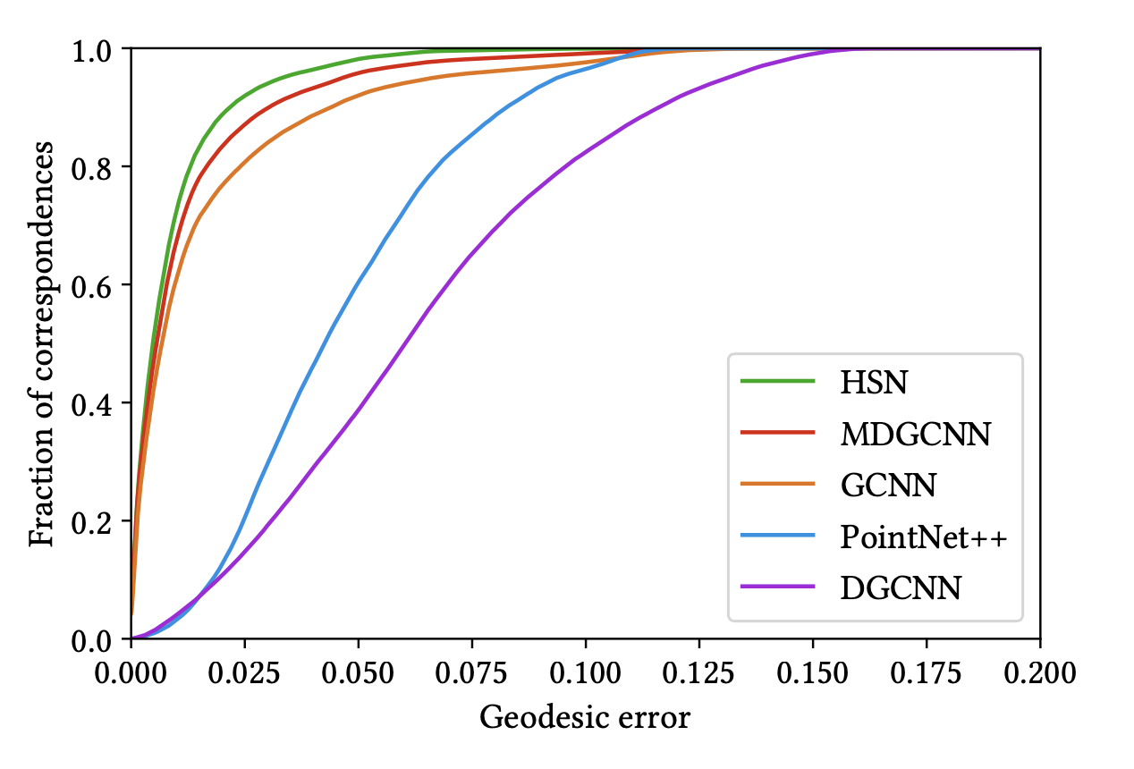
Correspondence
Comparison
FAUST dataset (Bogo et al. 2014)
Train set 80 meshes
Test set 20 meshes
SHOT descriptors

Slide 55
Conclusion

Slide 56
Looking back
Harmonic Surface Networks
Rotation-equivariant, vector-valued features
Organized in streams
Convolution operators on meshes with equivariance property
Result: no rotation ambiguity
Experiments indicate improved performance
Notes:
Rotation ambguity -> weight sharing, holonomy, etc.

Slide 57
What’s next?
Point cloud implementation
Riemannian exponential map, adapt discrete convolution
Applications of rotation-equivariant streams (tangent vectors)
Higher dimensions
Notes:
Can enable new applications of geometric deep learning networks
Non-commutativity

Slide 58
Thank you!
Code available graphics.tudelft.nl/~ruben

