Slide 1
Volume Stylizer: Tomography-based Volume Painting
Oliver Klehm¹, Ivo Ihrke^{1,2}, Hans-Peter Seidel¹, Elmar Eisemann³
¹ Max-Planck-Institut für Informatik
² Saarland University
³ TU Delft
I3D 2013
23/03/2012
Notes:
Thank you and welcome.
This talk is about a technique to artistically adjust the appearance of volumes.
What do I mean by adjusting the appearance?

Slide 2
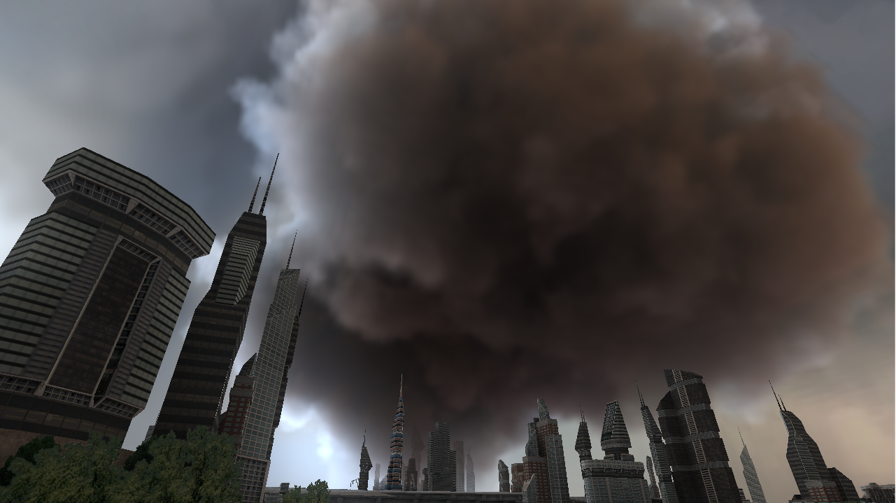
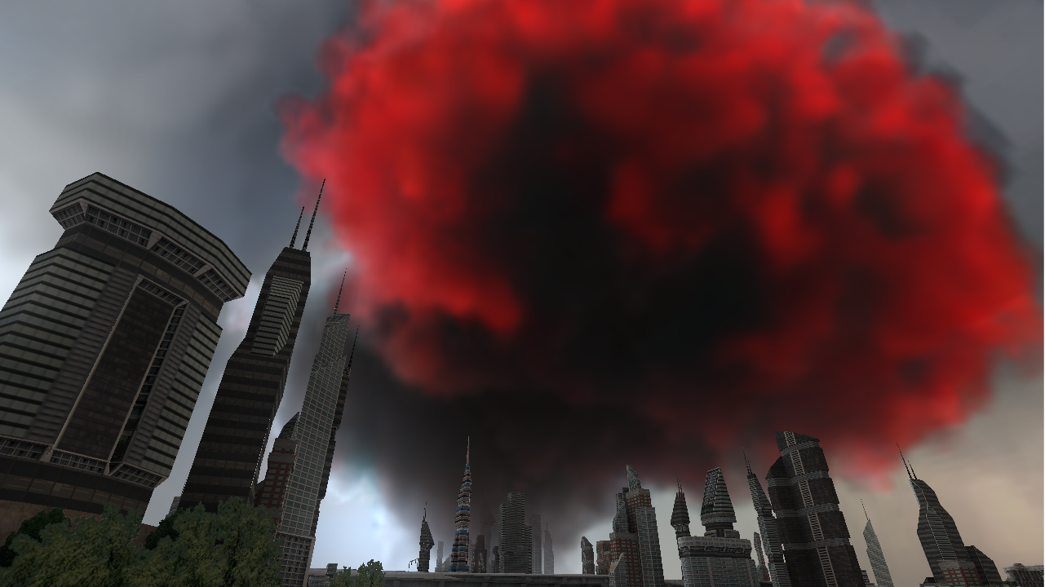
Notes:
Here, we see a cloud hovering over a city, lit by an environment map.
To support the atmospheric tension an art director may want to introduce strong colors and contrast such as this
<CLICK>
In the following I will detail how to specify a desired appearance and how we can change the parameters of the volume accordingly.

Slide 3
Motivation
Want to influence the appearance of volumes (voxels)
Editing on a fine-grained level is non-intuitive
No suitable tools available
A Programmable System For Artistic Volumetric Lighting [Nowrouzezahrai2011]
Approach:
Inverse rendering: editing by painting
Notes:
We want to provide a tool to influence the appearance of volumes by adjusting its parameters.
Changing the parameters by hand is highly non-intuitive.
Mostly related is the recent work of Disney, where they provide tools to control photon beams, a specialized kind of light source.
However, they cannot derived volume parameters.
So, what’s our approach?
<CLICK>
We want to provide inverse rendering for volumes.
That means, the user edits volume properties by painting target images.
Hereby, we modify parameters of the standard, physically-motivated model for volumes
Ok, so let me describe how our goal looks like and how we want to achieve it.

Slide 4
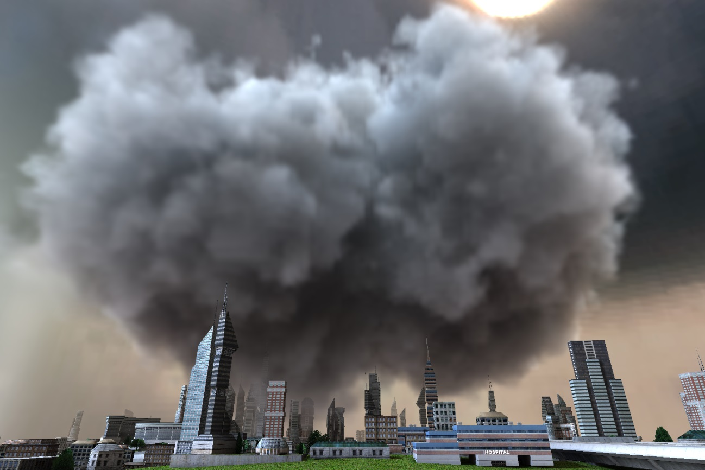
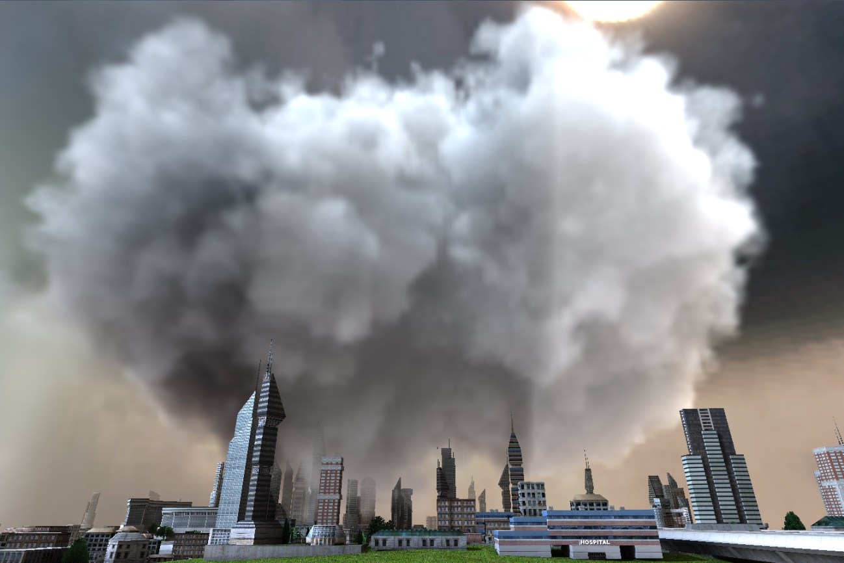
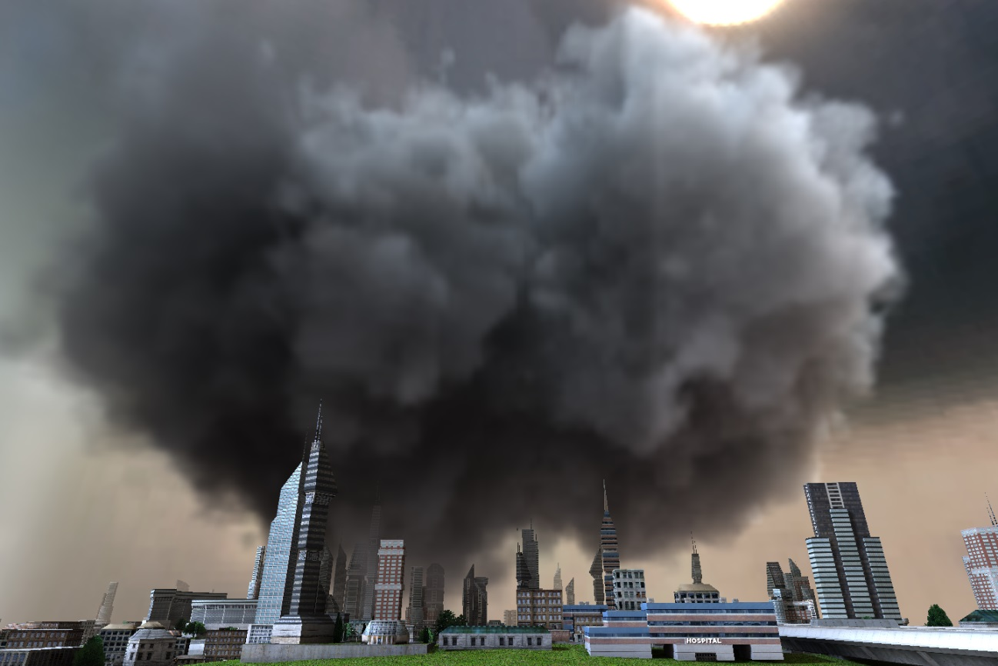
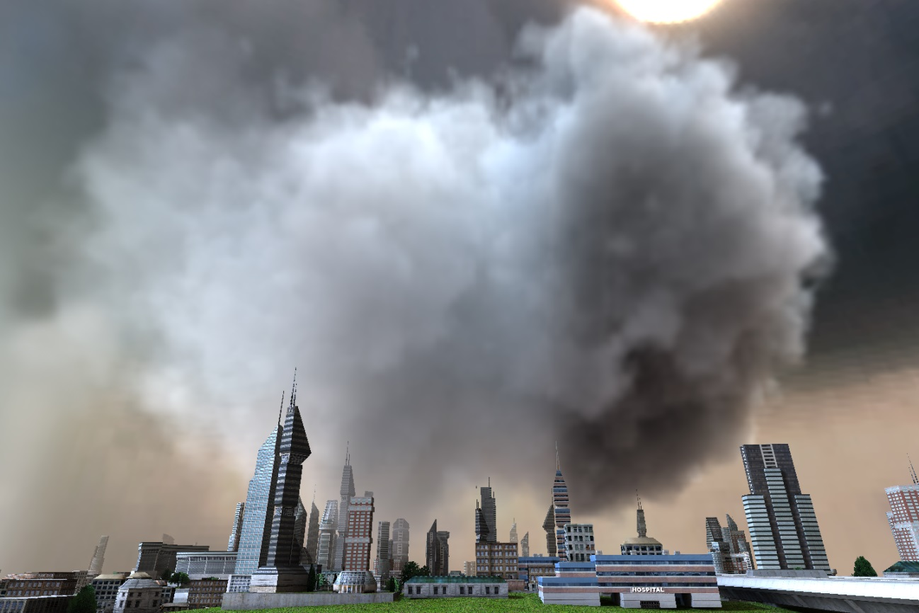
Our Goal
What do we modify
Volume parameters (per voxel)
Emission
Albedo
Extinction
Notes:
First, we want to modify volume parameters and we want to do that on a per voxel level.
Here you see an example cloud, that will demonstrate the parameters.
What are these parameters…
<CLICK>
First, we have emission, which is simply a glow per voxel.
Adding a constant emission makes everything brighter.
<CLICK>
Next, We have the albedo, that defines how much of the incoming light is scattered and not absorbed.
Now I change it and you see the effect of three different albedos.
<CLICK>
The most interesting thing to optimize for is extinction.
It describes the overall count of particles and by that the density and the shape of the volume.
In the example, I simply scaled the existing extinction value.
Unfortunately, optimizing for extinction is very tricky, which is why we can only optimize for it under very special conditions and I will mostly ignore it in this talk.
However, albedo and emission can be optimized together or independently.

Slide 5
Our Goal
What do we modify
Volume parameters (per voxel)
From what do we edit the parameters
Arbitrary input images (target views)
In practice: rendered images that were painted
Notes:
Ok, now that we know what to optimize, we can look at the input to the optimization.
Our goal is to match the rendering of the volume with given target images.
That means, the user simply paints anything and the system tries to find the parameters that produce a rendering that best matches the images.
In practice, painting a new desired rendering of a volume from scratch is quite hard.
Therefore we prefer the idea of stylization.
So, the user renders the volume with current parameters from a number of viewpoints, and uses these renderings as input for stylization.
Let me give you an example.

Slide 6
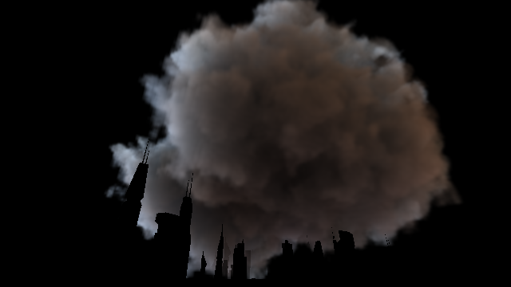
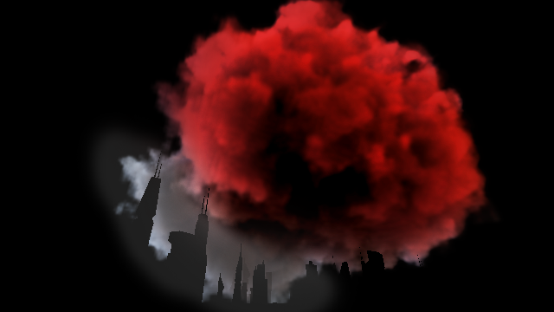
Our Goal: Volume Painting
Notes:
This is the volume rendering of the cloud with subtracted background.
Now, the user simply paints this image.
<CLICK>
Here, we make it dramatic and make this side very reddish and with high contrast, while for the other side, we slightly reduce the contrast.
In our prototype we decided to not re-implement photoshop for all possible image manipulations, but rather let the user use his favorite image processing software to perform the stylization.
Now, from a different point of view
<CLICK>

Slide 7
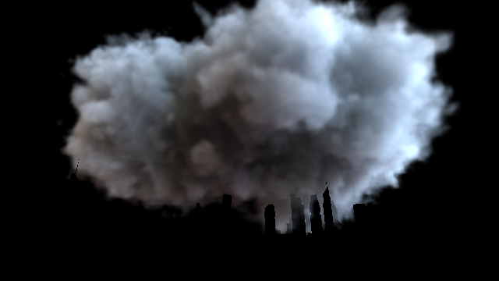
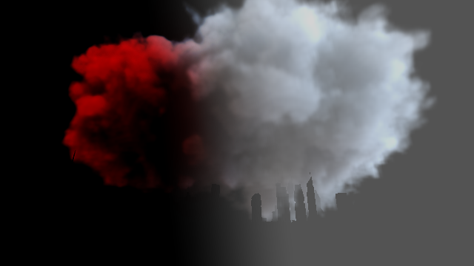
Our Goal: Volume Painting
Notes:
We make again one side more reddish with increased contrast and reduce the contrast for the other side.
Ok, what else do we need for the optimization

Slide 8
Our Goal
What do we modify
Volume parameters (per voxel)
From what do we edit the parameters
Arbitrary input images (target views)
In practice: rendered images that were painted
Additional required information
Per image: camera parameters (viewing position, direction)
Lighting, scene
How do we optimize
Per-pixel difference to input image
Linear problem
Inconsistent input -> least-squares solution
Notes:
Of course, we require some additional information like the camera parameters for each view.
Further, the scene and the lighting have to be fixed for the optimization.
The remaining question is, how do we optimize.
<CLICK>
We want to match the rendering with the target views, thus we want to minimize their difference.
However, as you may have already thought, the user can paint anything and it can be completely non-sense.
But even with useful input, it is not possible to draw multiple images, that can be perfectly matched with some set of parameters.
So, our input is inconsistent, we therefore define the optimal solution as the least-squares solution.
And one more important remark, this is all single-scattering.
Now, let’s look at more details of the optimization.

Slide 9
Specific Goal
Given: each pixel k of target view as a constraint pixel
Data associated: ray origin, direction, target radiance
Try to reconstruct volume properties, such that computed radiance matches target radiance (per pixel k)
Notes:
We have given constraint pixels
<CLICK>
, that describe the view-ray with its origin, direction and target radiance.
<CLICK>
Now, we try to optimize for volume parameters such that the computed radiance and the target radiance match up.
Why is this difficult?

Slide 10
Problem overview
A single pixel may influence many voxels
And vice versa…
Notes:
Well, a single constraint pixel k is influenced by many voxels and a voxel is usually seen by many constraint pixels.
Ok, it’s not a simple task.
So, let’s look at more details of rendering to understand what has to be done for the optimization.

Slide 11
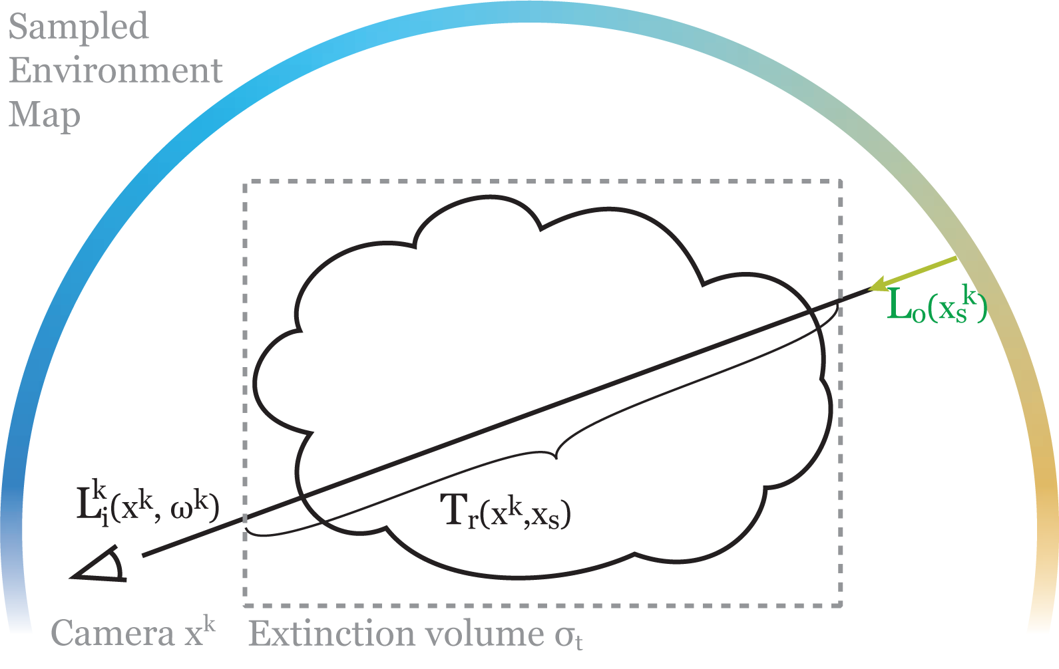
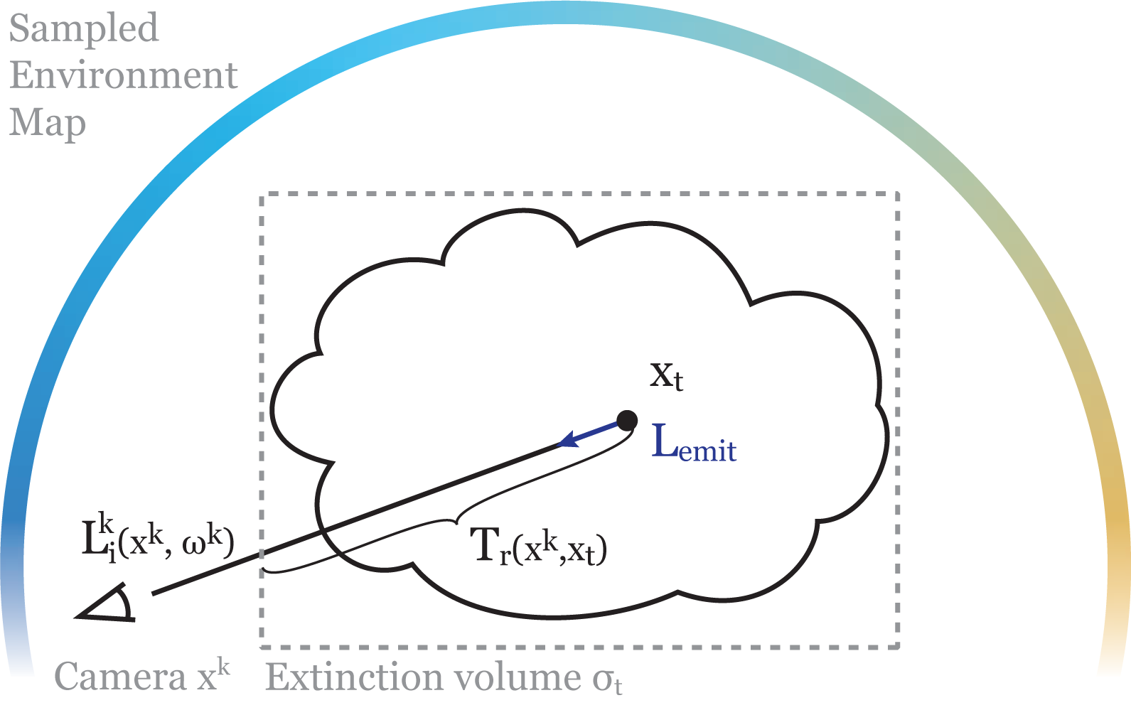
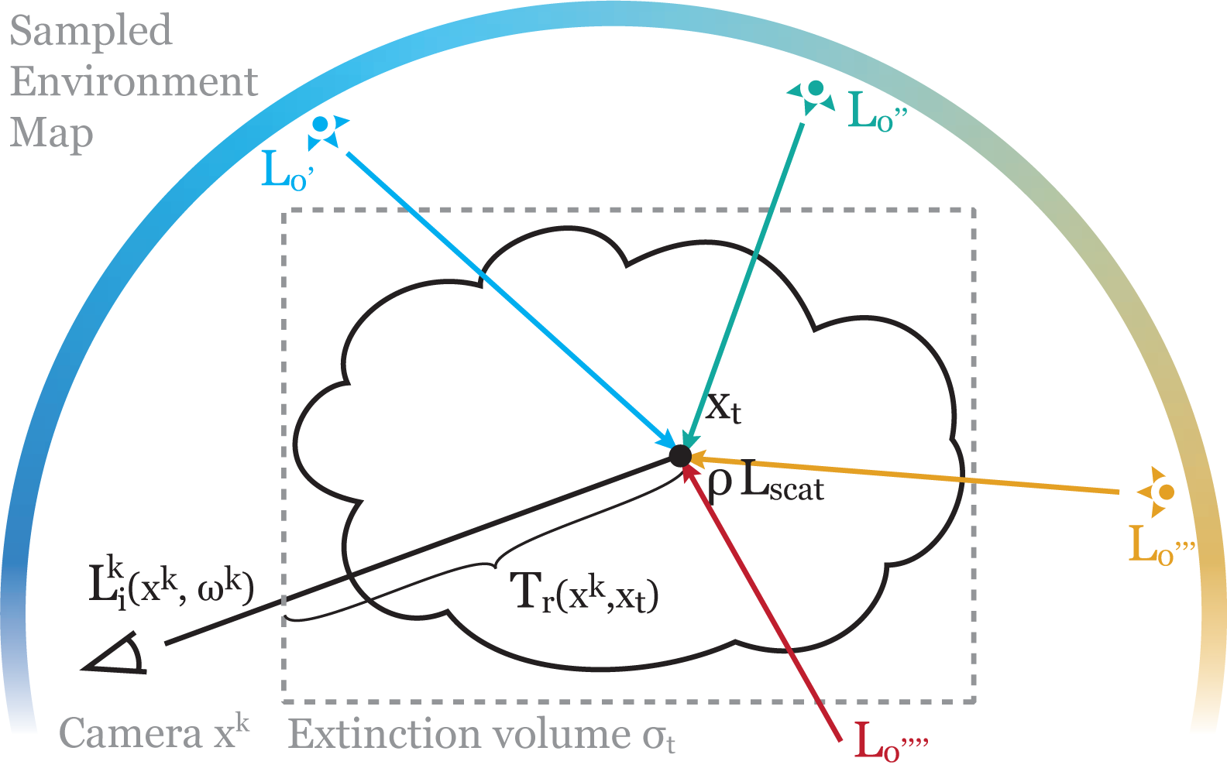
Volume Rendering
Notes:
Ok, a very quick walkthrough…
The first summand is the attenuated background radiance.
<CLICK>
The second summand
<CLICK>
is the radiance at each point towards the camera.
Here, we find emission
<CLICK>
and also albedo
<CLICK>
, that scales the in-scattered light.
I will now explain the optimization, but only for the light emission.
Albedo is basically the same and although extinction requires a few more pre-transformations and hence has more restrictions, the actual optimization is also the same.
For the optimization, we need to switch from the continues world to the discrete world.

Slide 12
Volume Reconstruction
Represent the target field (e.g. ) as linear combination of basis functions
Common for stored volumes (== voxels: box/triangle basis fct.)
Reconstruct coefficient vector
, such that
Includes target
Includes volume rendering
Notes:
We represent the emission values of the volume as a linear combination of basis function.
Thus the parameters that we want to optimize for are the coefficients of the basis functions.
Now, we need to reconstruct the coefficient, that can be written as a vector
<CLICK>
such that we fulfill this little equation.
<CLICK>
Now, the left hand side includes our target radiance
<CLICK>
And the matrix W includes volume rendering.
Now without going too much into the details let me show you how the integral of volume rendering and matrix W match up.

Slide 13
Emission Reconstruction
Notes:
This is volume rendering for pixel k.
Now if we separate the knowns from the unknowns,
<CLICK>
which is in this case L emit,
We get
<CLICK>
Here, we have a sum, because we want the coefficients for our basis functions v.
<CLICK>
The integral consists only of knows, can be computed and just becomes one row in the matrix W.
Ok, now the equations become shorter again, I promise.

Slide 14
Optimization
W is huge, ill-conditioned, …! => iterative conjugate gradient method
We need to compute:
Objective Function:
Derivative:
The trick: => this is rendering / back-projection!
=
Notes:
We said, we have inconsistent input and as such there is no solution to our equation.
Therefore we solved it in a least squares sense.
<CLICK>
The problem is, W is huge and ill-conditioned.
<CLICK>
To solve it, we use the iterative conjugate gradient method.
I am not going into the details of the conjugate gradient method, but it requires to compute two things:
<CLICK>
Obviously, the objective function that we optimize for.
But also the derivative, to give the best search direction in the optimization space
How to compute this, if W is huge and does not even fit into memory?
Well, we can compute both without storing the matrix W or its transpose, because we simply evaluate the entire expression every time.
The entries of W come from rendering
<CLICK>
Thus, multiplying with W is just rendering and multiplying by the transpose is a back-projection from an image into the volume.
Let’s look at more details how this is implemented

Slide 15
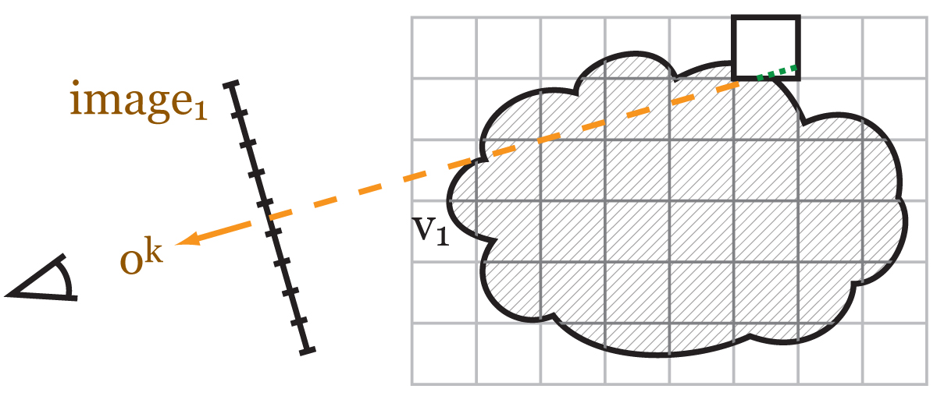
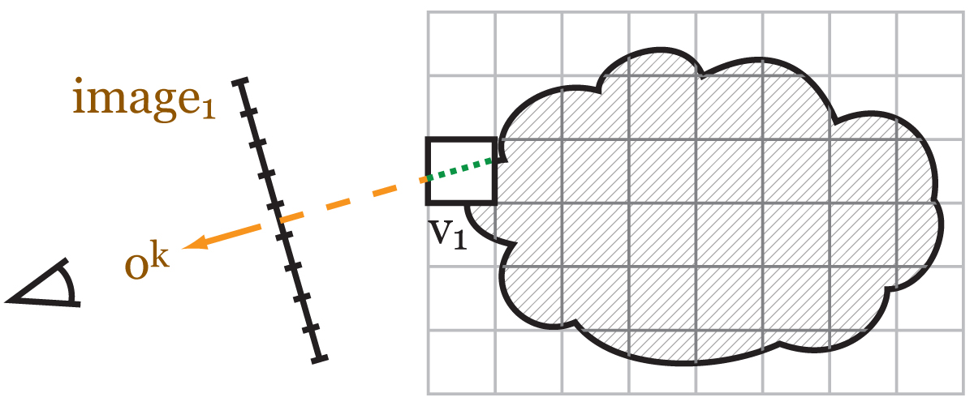
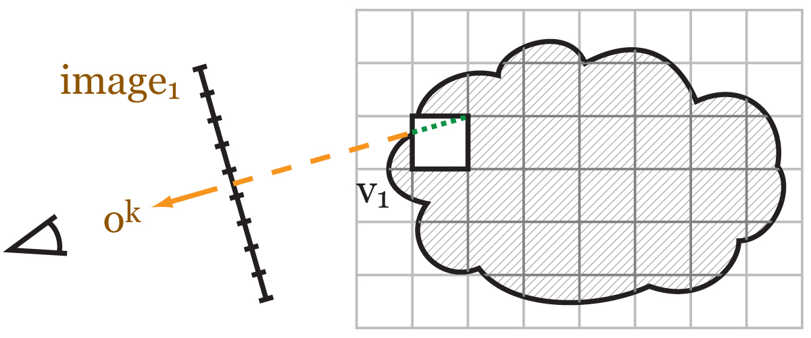
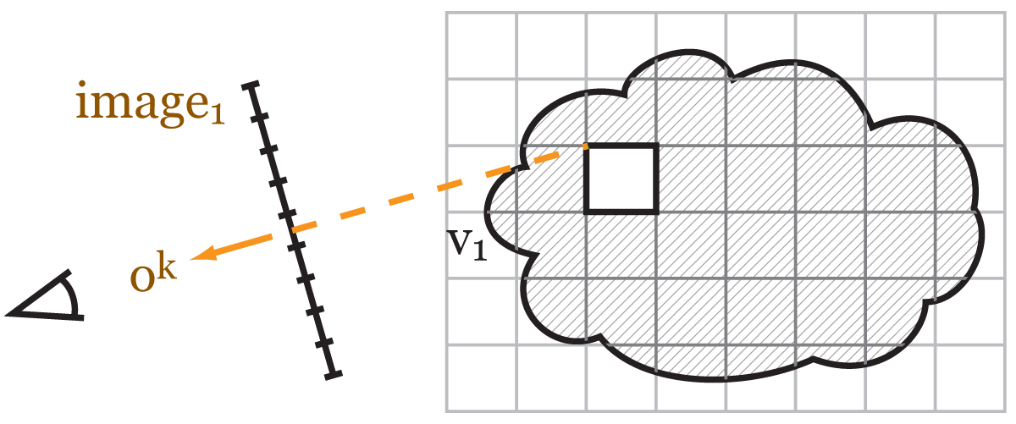
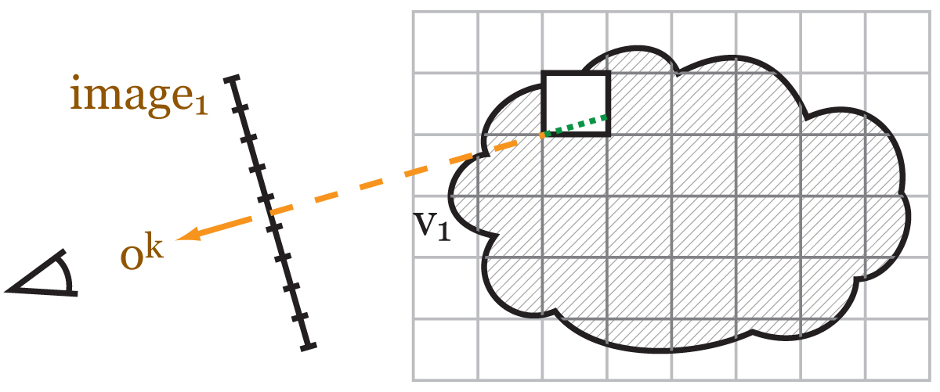
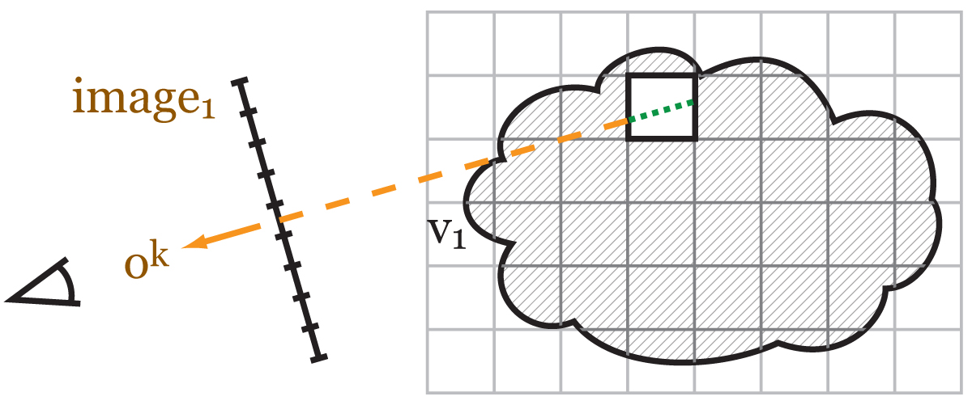
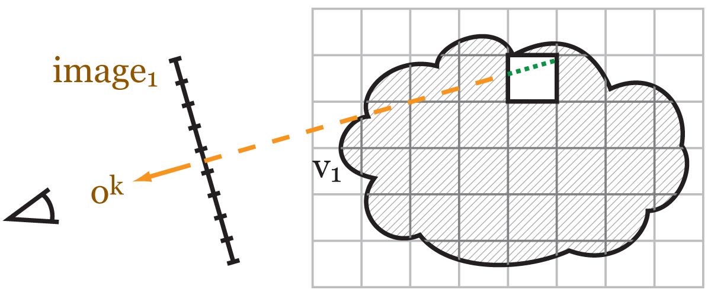
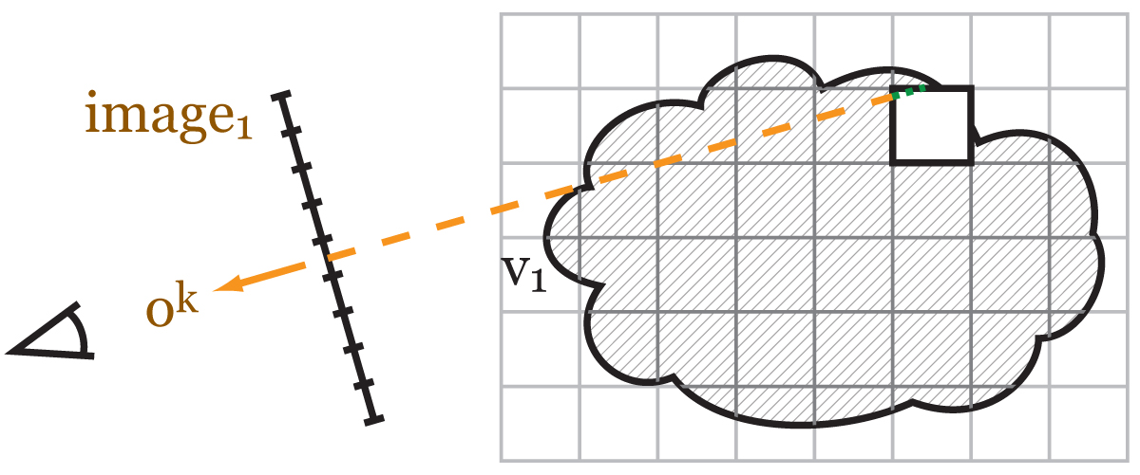
Implementation
Pre-computation
Cache incoming light in volume per voxel
Sub-sample environment map, deep shadow maps
Optimization
1. objective function evaluation
Voxel traversal, gathering pre-cached incoming light
Notes:
Before we actually start the optimization, we do a pre-computation to accelerate further steps
We compute the incoming light from all light sources, such as an sampled environment map for each voxel.
In the cases of emission and albedo reconstruction, we do not touch any of the parameters that we want to optimize for later.
For the actual optimization, we repeatedly require 2 things.
First, we need to evaluate the objective function.
This is as we saw, simply volume rendering.
As such, we perform a voxel traversal through the volume.
<CLICK>
In practice it is a ray-marching operation.
<CLICK>
While marching, we accumulate the light that goes to the camera using the cached incoming light.
<CLICK> <CLICK>
<CLICK><CLICK>
The necessary weights are determined by the local extinction of the volume.

Slide 16
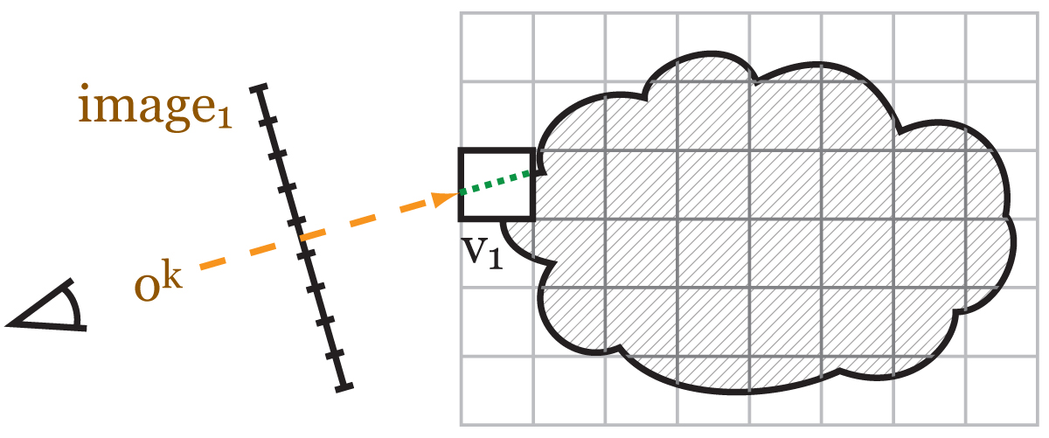
Implementation
Pre-computation
Cache incoming light in volume per voxel
Sub-sample environment map, deep shadow maps
Optimization
1. objective function evaluation
2. gradient of objective function
Notes:
The other thing that we need is the gradient of the function, which is the supposedly hard part.
However, in practice, it is quite easy to compute
Because we need to perform a back-projection from an image into the volume.
Thus, we perform a voxel-traversal again.
<CLICK>
Now, instead of accumulating any light, we add the value that we want to back-project to the voxel that we visit.

Slide 17
Implementation
Pre-computation
Cache incoming light in volume per voxel
Sub-sample environment map, deep shadow maps
Optimization
1. objective function evaluation
2. gradient of objective function
Additional vector arithmetic (addition, norm2, …)
Notes:
Last but not least to implement the conjugate gradient method, we also need some simple vector arithmetic.
We implemented all this in OpenGL.
Using image load/store the shaders for the volume rendering and back-projection look very similar.
The back-projection requires atomic operations, but with interleaved sampling and behaved inputs, we can even avoid this.
Now, it’s time for results.

Slide 18
Results - Video

Slide 19
Limitations / Future Work
How to handle inconsistent inputs?
How to define intermediate views?
How to generalize? – requires different optimization
Optimize for volume and lighting
Notes:
So, there are a couple of open questions remaining.
First, we solve for the least-squares difference, because we have inconsistent target views.
Can this be defined differently for certain applications.
Second, we optimize the volume such that it matches the desired appearance from certain viewpoints.
But what about intermediate views?
At lastly, it would be nice to drop some of the assumptions such as single-scattering or to allow for optimizing extinction with the other parameters.
The thing is, the problem becomes non-linear and also our matrix is not sparse anymore, but dense.
As these questions are quite hard to answer, we also see another possible future work.
<CLICK>
Where we want to combine the optimization of the volume with an optimization of the incoming light.
To conclude,
I

Slide 20
Conclusion
3D volume properties by 2D painting
Standard Rendering Model
Fast GPU Optimization for interactive sessions
Thank you
Notes:
To conclude,
I presented a method to derive volume parameters from painted images.
The parameters are taken from the standard rendering model, which enables the results to be used for any common volume rendering.
To perform the optimization of the parameters we provide a fast GPU conjugate-gradient optimization to enable interactive editing sessions.
<CLICK>

Slide 21
Fast Implementation
All OpenGL
Vectors are actually 3D Textures
Operations as shaders
Matrix multiplication is volume rendering
Arithmetic operations are “simple” shaders
=> Reconstruction in order of seconds
Notes:
Next: results

Slide 22
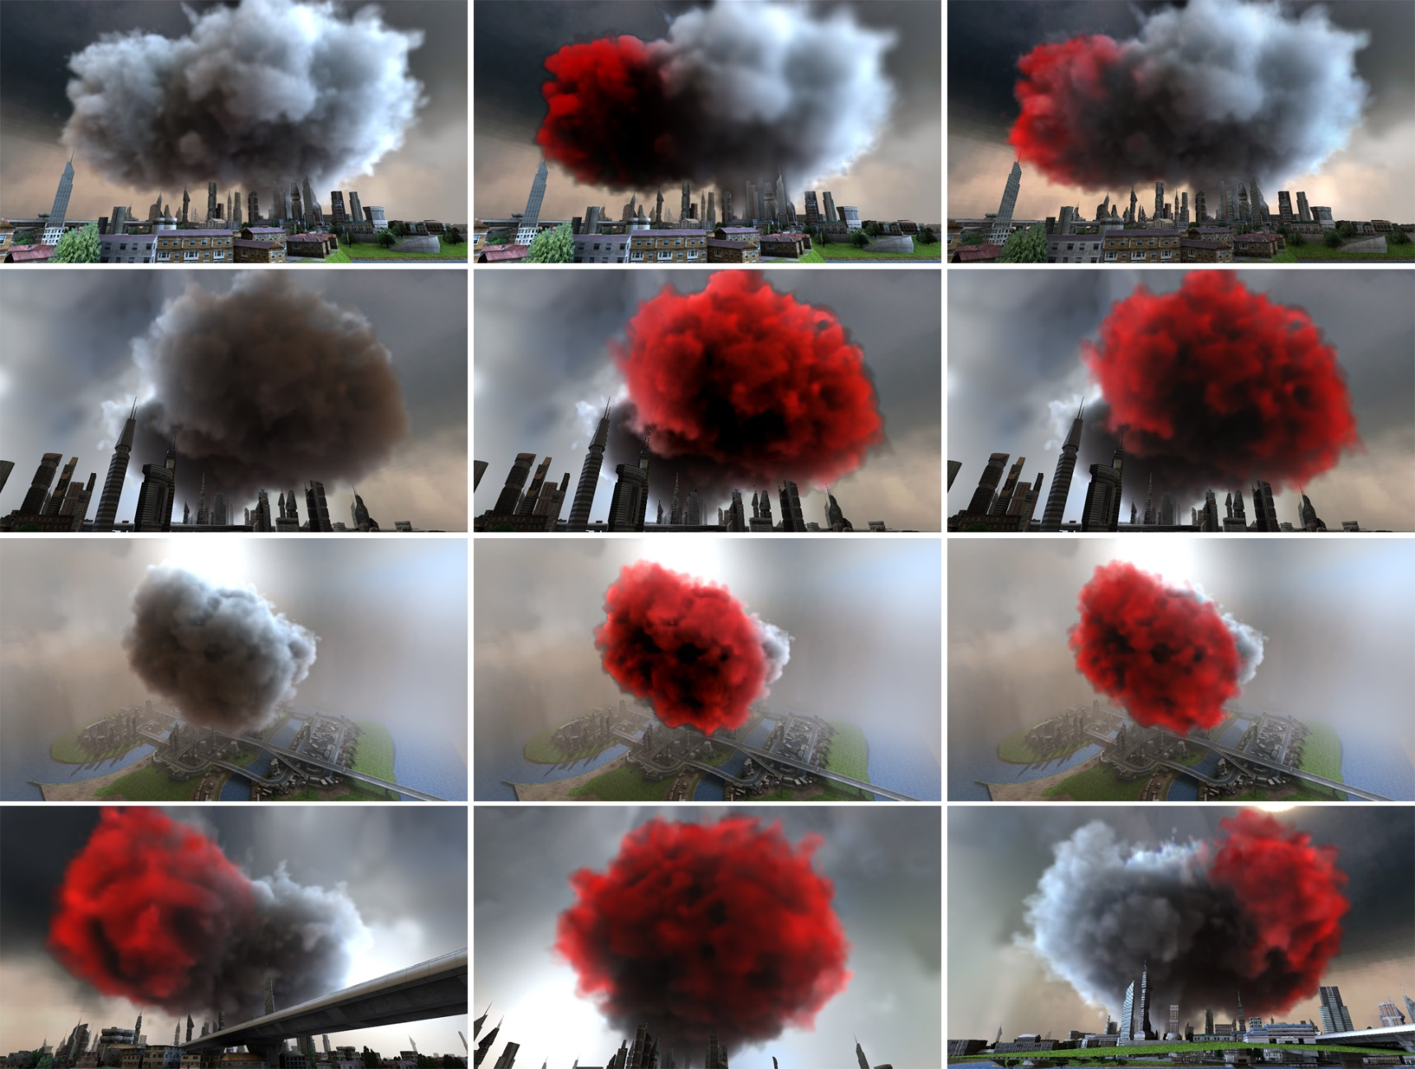
Results

Slide 23
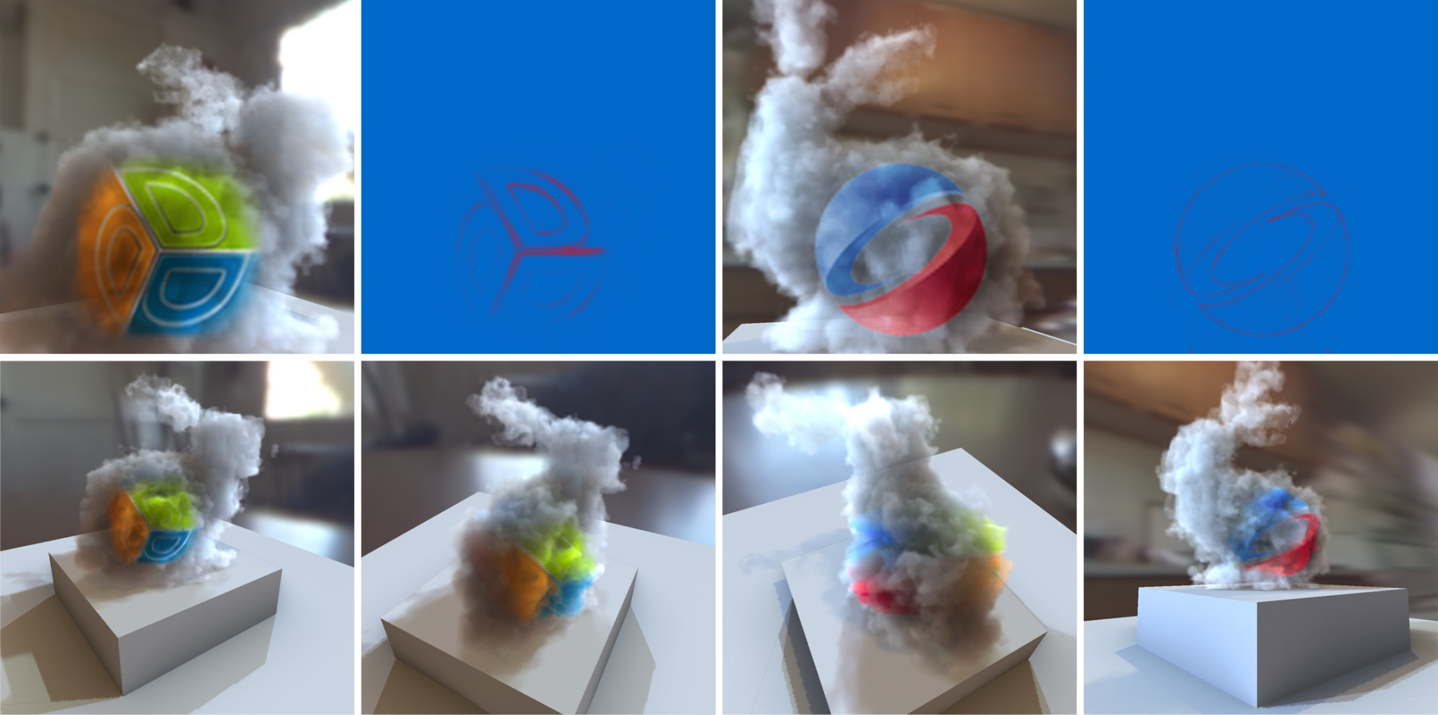
Results

Slide 24
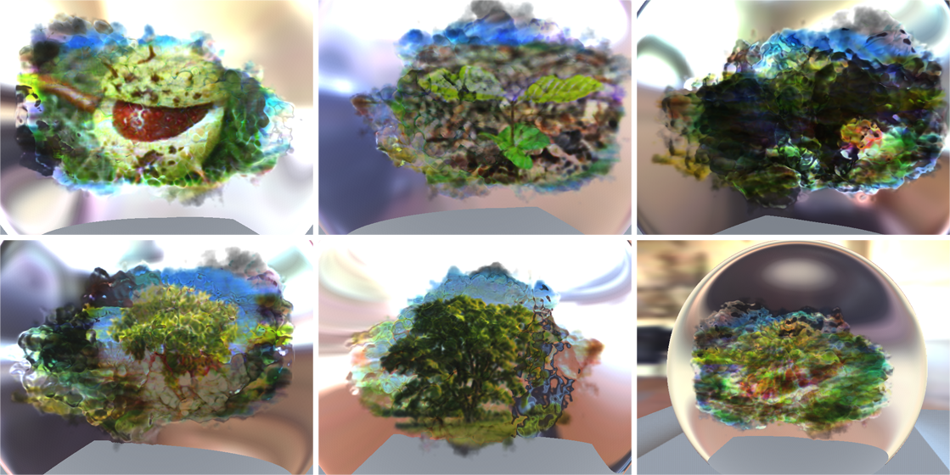
Results - Extinction

Slide 25
Related Work
Light Editing
Lighting with paint [Pellacini2007]
Non-linear light optimization
BendyLights [Kerr2010]
Editing of spot lights
Optimizing Environment Maps for Material Depiction [Bousseau2011]
Optimization with adhoc metrics
Volume editing
A Programmable System For Artistic Volumetric Lighting [Nowrouzezahrai2011]
Derivation of volume properties for single light beam only
Replacing physically-motivated parts of rendering with shaders
Homogeneous media only
Treat light beam as string of light (e.g. flow of particle)
Automatically Adjusting Parameters for Rendering Clouds using Photographs [Dobashi2012]
Notes:
Volumetric lighting by disney

Slide 26
Related Work
Tomography
Ihrke
Wetzstein
Lanmann
Fabrication
Shadow Art [Pauly2009]
Manufactoring Layered Attenuators for Multiple Prescribed Shadow Images [Baran2012]
Notes:
Volumetric lighting by disney

Slide 27
Volume Properties
Properties to reconstruct:
Extinction (overall density of volume)
Albedo (amount of scattering)
Emission (self glow)
Assumption: Single Scattering!
Light scatters ONCE in volume
Notes:
Next: problem definition

Slide 28
Emission reconstruction
Background / first surface, attenuated by volume
Integration along view ray
Attenuation by volume
Number of particles (extinction)
In-scattered light
Notes:
- start: have the target radiance
- We know all these parameters
Next: dot product

